Slide 1
Building the “BELOVED COMMUNITY”
The Vision
Reid Temple AME Church is a Bible Believing, Christ-centered, Family – Integrated, Multigenerational, Culturally aware church, spreading the gospel of Jesus Christ while “Building the Beloved Community”.
Rom.8:38 For I am persuaded, that neither death, nor life, nor angels, nor principalities, nor powers, nor things present, nor things to come, Nor height, nor depth, nor any other creature, shall be able to separate us from the love of God, which is in Christ Jesus our Lord.

Slide 2
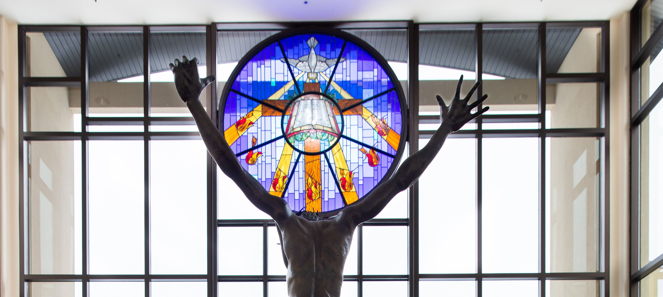
Reid Temple’s Mission and values
Our Mission:
The mission of Reid Temple AME Church is to increase and grow our ministry for the spiritual, social, and physical development of all people.
Our Core Values:
Faith in God
Integrity, Trust, and Ethical Behavior
Empowering People
Excellence and Innovation
Christ-centered Leadership

Slide 5
How to Enter God’s Presence
Dr. Mark E. Whitlock, Jr.
Pastor

Slide 6
Course objectives: How to Enter God’s presence!
Opening Prayer
The Word….
Reverence for God
Holiness and Integrity
The Kingdom of Priests
Ten Steps to Preparedness in Prayer
Let’s Pray at the Altar together….
Thank you….

Slide 7
The Word of God…
Prayer requires knowing how to enter God’s presence with a right spirit, approach, and preparation to have communion with God.
Leviticus 11:44 I am the Lord your God; consecrate yourselves and be holy, because I am holy. Do not make yourselves unclean by any creature that moves along the ground.
Leviticus 20:8 Keep my decrees and follow them. I am the Lord, who makes you holy.
Matthew 5:17 “Do not think that I have come to abolish the Law or the Prophets; I have not come to abolish them but to fulfill them.

Slide 8
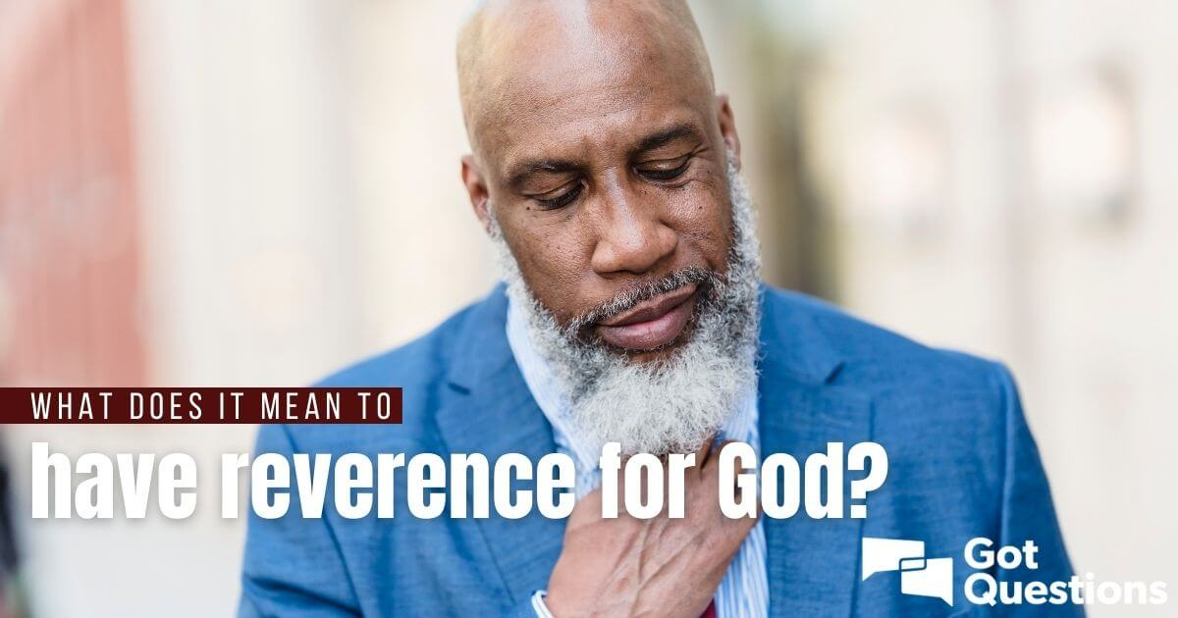
Reverence For God
Let’s not become addicted to cheap grace.
Matthew 22:37 Jesus said unto him, Thou shalt love the Lord thy God with all thy heart, and with all thy soul, and with all thy mind.
God is saying to the church, “don’t obey me because of the things you want from me, obey me because you love me.
John 14:15 If ye love me, keep my commandments.
If you love me, you won’t need a whipping and discipline to do what I ask…

Slide 9
Holiness and Integrity
When you don’t respect God’s commandments and are not honest with y0urself, you are unable to enter into his presence.
Hebrews 12:14 Follow peace with all men, and holiness, without which no man shall see the Lord:
Matthew 5:8 Blessed are the pure in heart: for they shall see God.
Beatitude ….The attitude to be pure….means living a holy life.
Leviticus 20:8 Keep my decrees and follow them. I am the Lord, who makes you holy.
Holiness only results from a right relationship with God by believing in Jesus Christ as Savior (accepting His gift of eternal life).

Slide 10
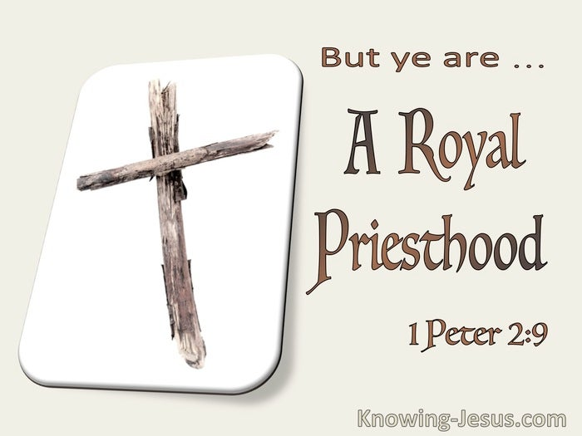
The Kingdom of Priest
1 Peter 2:9 But ye are a chosen generation, a royal priesthood, an holy nation, a peculiar people; that ye should shew forth the praises of him who hath called you out of darkness into his marvelous light.
The first Adam failed.
The National of Israel failed.
The Levitical Priest failed.
The Prophets failed or were killed.
Then God sent the second Adam….Jesus!!!
We are chosen priesthood of believers. As God’s priests, we are to intercede/pray for others so they will return to God and be coworkers in His presence.

Slide 11
Ten Steps to Preparedness in Prayer
Appropriate God’s grace – Turn from sin and to Holiness.
Put on righteousness – Live in the righteousness of God.
Put on truth and honesty – Speak truth and integrity.
Cleanse with the word – Saturate yourself in the word before coming to worship.
Worship and praise God - Honor God in spirit and in truth with authentic worship.
6. Separate yourself-Remove yourself from sinful people/relationships, and places.
7. Believe – Have faith in God’s power to fulfill promises.
8. Give glory to God – Confess it was God who delivered you from sin.
9. Wash in the word – Ask God to fulfill His purpose and promises for you.
10. Remain in the Anointing – Remain in a state of preparedness for prayer. You don’t have to get ready if you stay ready…..

Slide 12
Let’s pray at the altar together for Leadership…
Church
Family
Government
Pastor and First lady
Ministerial team
Music Department
Staff
Stewards
Trustees
Commissioners
Ministry leaders
Auxiliaries
Great/Grandparents
Parent(s)
Sisters and Brothers
Aunts and Uncles
Nephews and Nieces
Cousins
Adopted family
President and vice president
Senators
Congresswomen and men
Judicial Officers
Federal Staffers
Governors
State Representatives
Country executives
Country council people
Police and fire
Civic employees

Slide 13
Reid Temple Cares

