Slide 1
Building the “BELOVED COMMUNITY”
The Vision
Reid Temple AME Church is a Bible Believing, Christ-centered, Family – Integrated, Multigenerational, Culturally aware church, spreading the gospel of Jesus Christ while “Building the Beloved Community”.
Rom.8:38 For I am persuaded, that neither death, nor life, nor angels, nor principalities, nor powers, nor things present, nor things to come, Nor height, nor depth, nor any other creature, shall be able to separate us from the love of God, which is in Christ Jesus our Lord.

Slide 2
Spending Quality Time Together – November 16
Using Words of Affirmation for One Another – November 30
Planning Acts of Service Together – December 7
Giving and Receiving Gifts from One Another – December 14
The Paradox and Purpose of Physical Touching One Another – December 21

Slide 3
The Online Bookstore is Open! Reid Temple Bookstore is pleased to offer a curated list of must-have Christian books from Black and relevant authors and a collection of essential Black literature.

Slide 4
Narrative Approach means sharing biblical and personal stories.
Stories of the African American struggle for dignity and the pursuit of conscious sustaining connectedness.
Ritualistic rehearsals – Ritual that create meaning after discovering your spouses love language.
Sharing your stories together, vulnerable, transparent, integrous, and trustworthy.
The purpose of the story is share what we have in common.
Our story….Connecting love languages….

Slide 5
Love language 1# words of affirmation
Dr. Mark E. Whitlock
Pastor

Slide 6
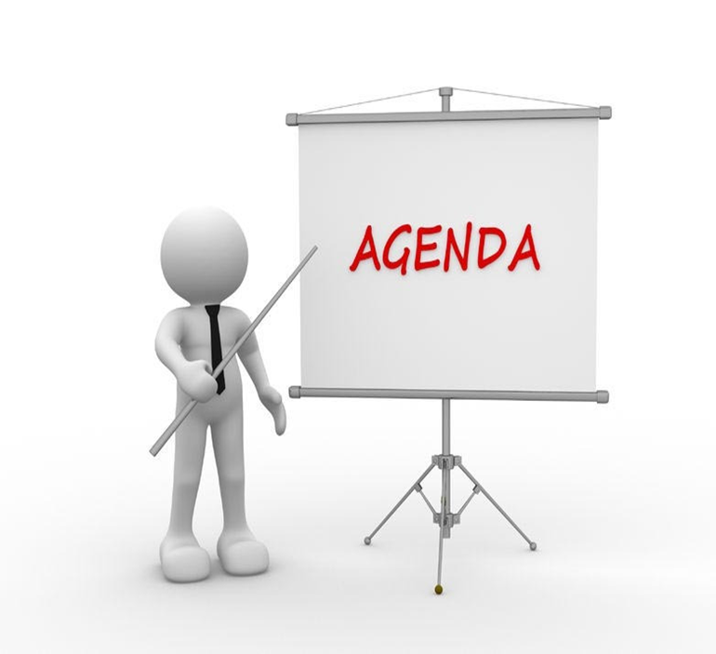
Course objectives: Words of affirmation!
Prayer
Introduction to the lesson – Ask the question!
The five love languages
Keeping the love tank full
Words of affirmation
Ritual Rehearsals
Examples of Words of Affirmation
Questions, comments, and answers
Thank you….

Slide 7
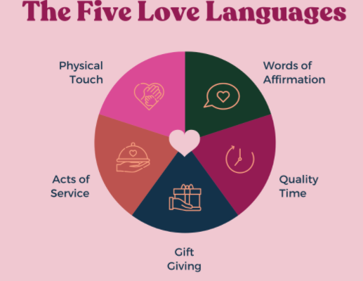

Slide 8
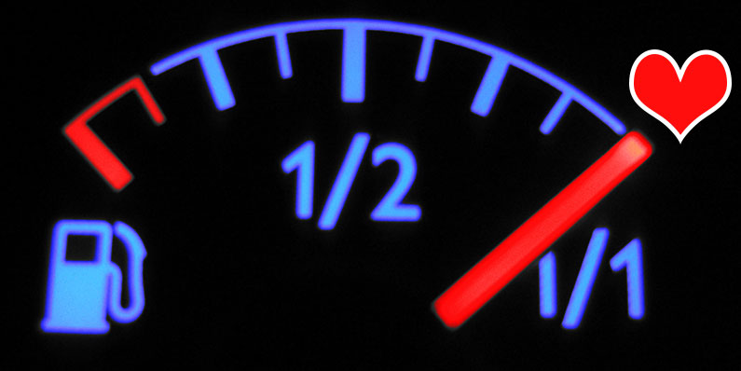
Keeping the love tank full
Ephesians 4:29, NLT Don’t use foul or abusive language. Let everything you say be good and helpful, so that your words will be an encouragement to those who hear them.
Psychologist William James said “that the possibly the deepest human need is the need to feel appreciated.”
JAMES 1:19 "Know this, my beloved brothers: let every person be quick to hear, slow to speak, slow to anger; for the anger of man does not produce the righteousness of God.“
This kind of love requires effort and discipline.
The purpose of this class is to focus on learning to hear the cry to be loved by using words of affirmation.

Slide 9
Words of affirmation
Encouraging (Inspire courage) Words - Affirm Their Strengths.
1 Thessalonians 5:11, NLT So encourage each other and build each other up, just as you are already doing.
Kind (proper Tone) words – Love is kind.
Ephesians 4:32, ESV Be kind to one another, tenderhearted, forgiving one another, as God in Christ forgave you.
Humble words - Affirm they matter To you.”
1 John 3:18, NLT Dear children, let’s not merely say that we love each other; let us show the truth by our actions.

Slide 10
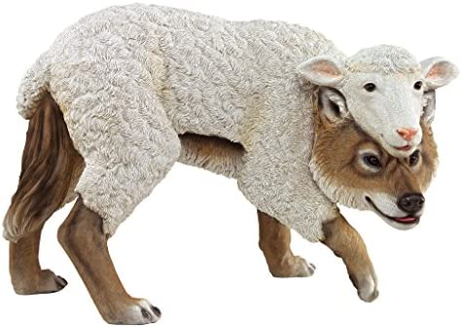
Ritualistic rehearsals
Ritualistic rehearsals are repetitive activities that forms a context for shaping a couples love narrative.
Proverbs 18:21 puts it this way: “The tongue has the power of life and death.”
Proverbs 26:28 A lying tongue hates those it hurts, and a flattering mouth works ruin.
Make it a Ritual to do the following:
Research words of affirmation online/google.
Study scriptures, articles, and books to learn words of affirmation.
Give verbal public compliments, or words of appreciation.
Keep a mental list of the activities, compliments, and positive responses of using words of Affirmation!

Slide 11
Examples of Words of Affirmation
Thank you for….
You look amazing!
I loved it when you…
It made me so happy when you…
That meal you made was delicious!
I’m so lucky to be with you.
You make my heart sing.
You make everything better.
I love that you always…
I trust you.
I believe in you.
I need you.
I know I can always count on you.
I couldn’t do this without you.
I’m so glad you’re in my life.
You’re so fun/exciting/hilarious.

Slide 12
Example of Words of Affirmation
You’re so fun to be with.
You’re so special to me.
I was so impressed when you….
I see how hard you’ve been working on….
I feel so grateful that I get to be with you.
I love our life together.
Thank you for listening.
I missed you.
You help me feel like I can do anything.
When I’m with you, I’m a better person.
You handled that like a pro.
I value your judgement.
I’m so proud of you.
Your support means the world to me.
Thank you for being a wonderful listener.
What is yours________________________

Slide 13
Questions and answers
This Photo by Unknown Author is licensed under CC BY-SA

Slide 14
Spending Quality Time Together – November 16
Using Words of Affirmation for One Another – November 23
Planning Acts of Service Together – November 30
Giving and Receiving Gifts from One Another – December 7
The Paradox and Purpose of Physical Touching One Another – December 14

