Slide 1
Building the “BELOVED COMMUNITY”
The Vision
Reid Temple AME Church is a Bible Believing, Christ-centered, Family – Integrated, Multigenerational, Culturally aware church, spreading the gospel of Jesus Christ while “Building the Beloved Community”.
Rom.8:38 For I am persuaded, that neither death, nor life, nor angels, nor principalities, nor powers, nor things present, nor things to come, Nor height, nor depth, nor any other creature, shall be able to separate us from the love of God, which is in Christ Jesus our Lord.

Slide 2
1. The Widow’s Wealth - 9/14
2. God's Will in Finances - 9-21
3. The Perils of Money- 9/28
4. Release from Financial Slavery - 10/5
5. Financial Planning - God's Way (Part 1)- 10/12
6. Financial Planning - God's Way (Part 2) - 10/19
7. God's Wants You to Prosper - 10/26
8. Sharing God's Plan with the Next Generation- 11/2

Slide 3
Release From Servitude
Dr. Mark E. Whitlock, Jr.
Reid Temple AME church

Slide 4
Course objectives: release from servitude!
Prayer
introduction to the lesson
Bible verses and Commentary
Andrea Jackson
Questions, comments, and answers
Thank you….

Slide 5
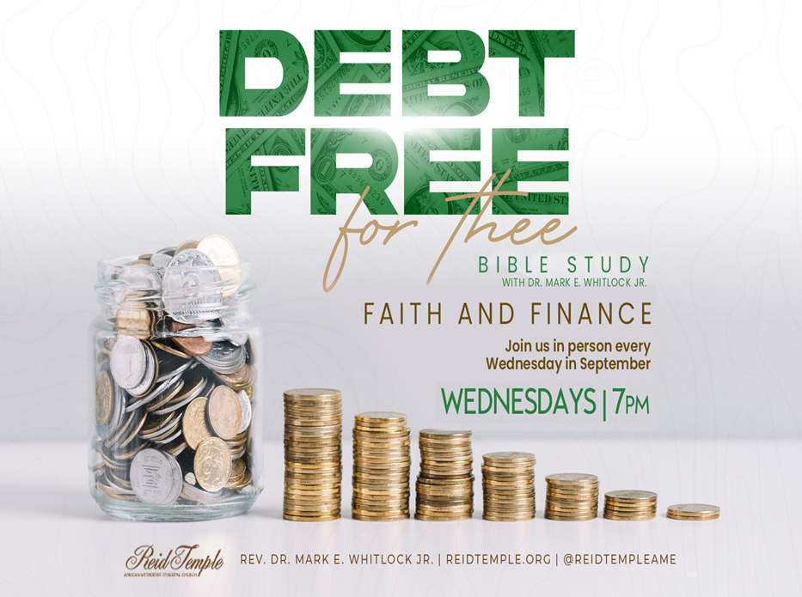
Introduction to the lesson!
Steps to Financial freedom
Misuse of money…
There are basic steps to achieving God’s plan
Seeking God’s bless
Video: Https://youtu.be/Twj6NioKvJU

Slide 6
Step One: transfer ownership to God….
Proverbs 3:19 The LORD by wisdom hath founded the earth; by understanding hath he established the heavens.
According to this verse, who is the real owner of everything?
Proverbs 8:18 Riches and honor are with me; yea, durable riches and righteousness.
What are the four blessings that come from trusting God.

Slide 7
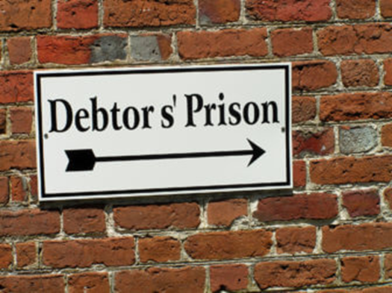
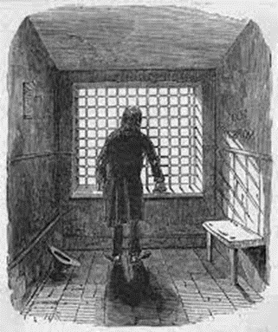
Step two: get out of debt
Proverbs 15:16 Better is little with the fear of the Lord than great treasure and trouble therewith.
You will not get out of debt overnight!
Proverbs 21:20 There is treasure to be desired and oil in the dwelling of the wise; but a foolish man spendeth it up.
The way to stay out of debt is to accumulate same saving.
So be___________ not _____________________

Slide 8
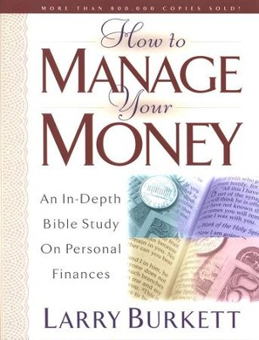
Step three: accept God’s provision
Matthew 6:31 Therefore take no thought, saying, What shall we eat? or, What shall we drink? or, Wherewithal shall we be clothed?
Peace comes from accepting god’s plan for your life and making the best of it. Accepting a bad situation that can be changed through diligence is called laziness.
Define anxiety_______________________________________
Define needs_________________________________________

Slide 9
Step four: refuse quick decisions
Proverbs 21:5 The plans of the diligent lead to profit as surely as haste leads to poverty..
Advantage (profit) comes from_______________________
Losses (poverty)______________________________________
Don’t let anyone or self make quick financial decisions based on incomplete information!!!

Slide 10
RELEASE FROM SERVITUDE
Andrea Jackson
Money coach

Slide 12
The problem: is Top down

Slide 13
Average American Debt by Age
The average American has $90,460 in debt, according to a 2021 CNBC report. That included all types of consumer debt products, from credit cards to personal loans, mortgages and student debt.

Slide 14
How do I see debt: Mindset is Everything Poor: consumer/it’s a part of life Middle Class: consumer/it’s manageable but one will always be in debt Wealthy: producer/temporary leverage
How Do I See Debt?

Slide 16
How do you see money: Mindset is Everything Poor: consumer/Focus on paying bills Middle Class: consumer/Focus on paying bills on time and their credit score Wealthy: producer/Focus on turning money into more money
How Do I See Money?

Slide 18
the largest debt for many is ...

Slide 19
EXTRA PAYMENT a year

Slide 20
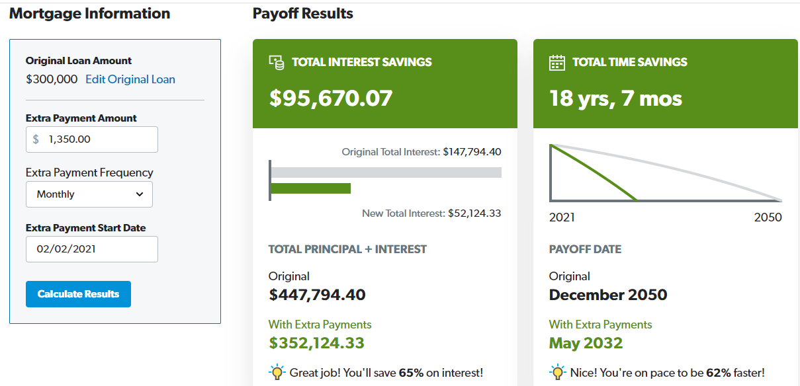
EXTRA PAYMENT a month

Slide 22
God only ask for 10% but ….
Store Credit Card | Interest
Macy’s | 26.99%
Target | 25.15%
Sears | 26.74%
JC Penny | 26.99%
Best Buy | 26.49%
PayPal | 25.99%
Amazon | 27.49%
Walmart | 22.90%

Slide 23
Six simple steps to get out of debt
Step 1
Set a Clear Attainable Goal
Step 2
Create a Spending Journal: Track your spending habits. Free up money
Step 3
Make a List of Current Debts: Balance, Interest Rate, Minimum Pymt, Actual Pymt
Step 4
Create Elimination Strategy: Debt Free for Thee Movement
Step 5
Accelerate pay off with discretionary money identified in Step 2
Step 6
Set Up Automatic Savings/Investment Plan with money identified in Step 2

Slide 25
Why get out of debt?
Less stress/better quality of life
Free up money
Start a business/invest more
Help others

Slide 26
Questions and answers
This Photo by Unknown Author is licensed under CC BY-SA

