Slide 1
Building the “BELOVED COMMUNITY”
The Vision
Reid Temple AME Church is a Bible Believing, Christ-centered, Family – Integrated, Multigenerational, Culturally aware church, spreading the gospel of Jesus Christ while “Building the Beloved Community”.
Rom.8:38 For I am persuaded, that neither death, nor life, nor angels, nor principalities, nor powers, nor things present, nor things to come, Nor height, nor depth, nor any other creature, shall be able to separate us from the love of God, which is in Christ Jesus our Lord.

Slide 2
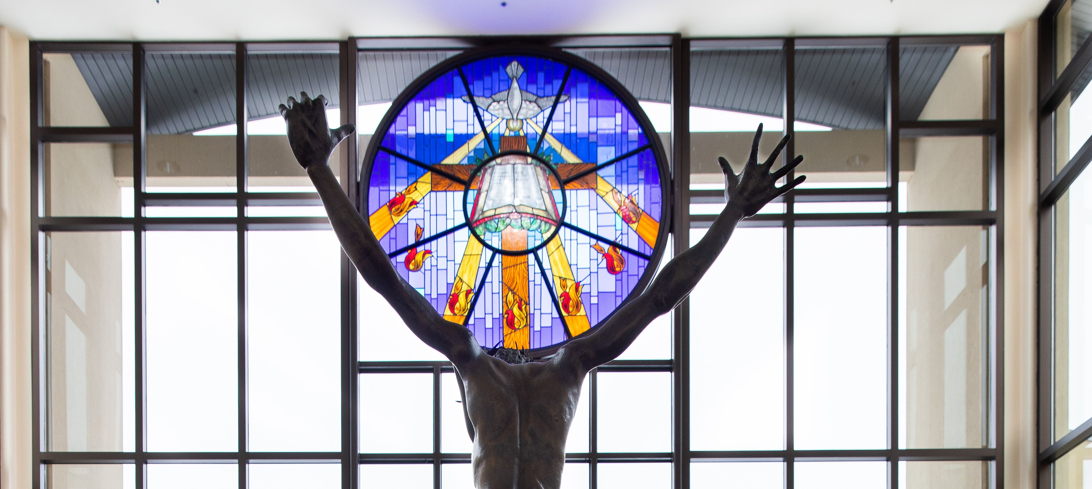
Reid Temple’s Mission and values
Our Mission:
The mission of Reid Temple AME Church is to increase and grow our ministry for the spiritual, social, and physical development of all people.
Our Core Values:
Faith in God
Integrity, Trust, and Ethical Behavior
Empowering People
Excellence and Innovation
Christ-centered Leadership

Slide 4
The Power of Jesus’ Name
Dr. Mark E. Whitlock, Jr.
Pastor

Slide 5
Course objectives: the power of Jesus’ name!
Opening Prayer
The Word….
Magic formula?
Call on his name!
Testimonial Service….
Altar call for the anointing…
Let’s Pray at the Altar together….
Thank you….

Slide 6
The Word of God…
God does not owe us anything. We have no claim on him outside Christ’s work of grace on our behalf. Christ redeemed us from our sins.
Eph. 1:7 In whom we have redemption through his blood, the forgiveness of sins, according to the riches of his grace;”
No one can claim power through Jesus’ name without having official -child of God status
John 1:12 But as many as received him, to them gave he power to become the sons of God, even to them that believe on his name:
The authority we have in His name through prayer is based on our covenant relationship with god in Christ.
Hebrews 8:6 But now hath he obtained a more excellent ministry, by how much also he is the mediator of a better covenant, which was established upon better promises.
The name of jesus is our legal authority to transact spiritual business with god!

Slide 7
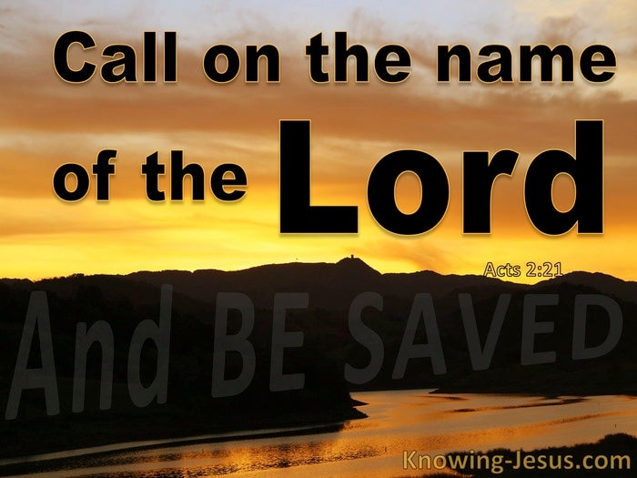
Call on the Name of Lord Jesus’ name is the key to heaven
John 3:35 The Father loveth the Son, and hath given all things into his hand.
John 5:20 For the Father loveth the Son, and sheweth him all things that himself doeth: and he will shew him greater works than these, that ye may marvel.
If you want to do business with the Father, don’t try to come without the name of Jesus, His name is the key to heaven.
Proverbs 18:10 The name of the Lord is a strong tower: the righteous runneth into it, and is safe.
Whatever you need, call on him to fulfill that need based on who He is.

Slide 8
Testimonial service

Slide 9
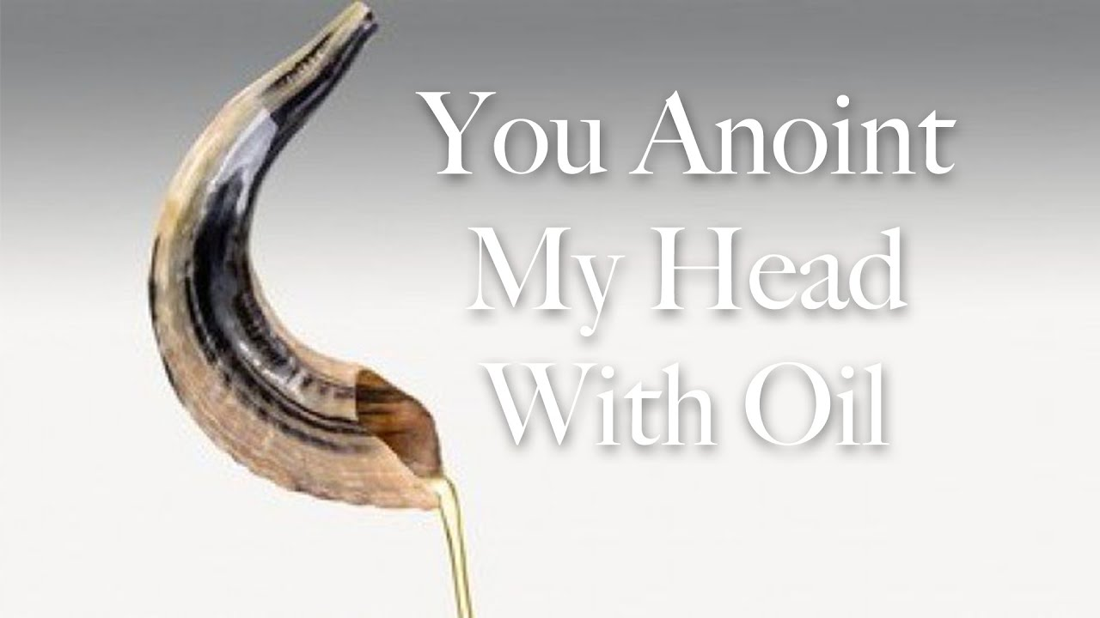
Let’s testify and pray at the Altar
Have I prayed in the name of Jesus without thinking about what that name really means?
When I pray in Jesus’ name, do I think about whether my life is a representation of his character and life?
Take time right now to worship the lord for all his marvelous attributes.
Ask him to forgive you for taking his name lightly.
Pray that God will meet your need “in the name of Jesus,” we must pray based on the divine name that is above every name…..

Slide 10
Reid Temple Care

