Slide 1
Building the “BELOVED COMMUNITY”
The Vision
Reid Temple AME Church is a Bible Believing, Christ-centered, Family – Integrated, Multigenerational, Culturally aware church, spreading the gospel of Jesus Christ while “Building the Beloved Community”.
Rom.8:38 For I am persuaded, that neither death, nor life, nor angels, nor principalities, nor powers, nor things present, nor things to come, Nor height, nor depth, nor any other creature, shall be able to separate us from the love of God, which is in Christ Jesus our Lord.

Slide 2
1. The Widow’s Wealth - 9/14
2. God's Will in Finances - 9-21
3. The Perils of Money- 9/28
4. Release from Financial Slavery - 10/5
5. Financial Planning - God's Way (Part 1)- 10/12
6. Financial Planning - God's Way (Part 2) - 10/19
7. God's Wants You to Prosper - 10/26
8. Sharing God's Plan with the Next Generation- 11/2

Slide 3
“The Widow’s wealth”
Dr. Mark E. Whitlock, Jr.
Andrea Jackson, Financial planner

Slide 4
Course objectives: Consecrate Yourself!
Prayer
introduction to the lesson and video
Scriptures – Mark 12:38-44
Biblical Commentary
What is Wealth?
Study Questions
Application of the text – Andrea Jackson
Questions, comments, and answers

Slide 5
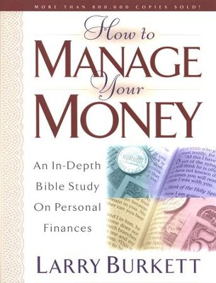
Introduction to the lesson and video!
This is not about a prosperity gospel
This is about trusting God with everything.
The widow’s Wealth!
Video: https://youtu.be/kLfpT0XZfcY

Slide 6
The Widow’s wealth
Mark 12: 38 As he taught, Jesus said, “Watch out for the teachers of the law. They like to walk around in flowing robes and be greeted with respect in the marketplaces, 39 and have the most important seats in the synagogues and the places of honor at banquets. 40 They devour widows’ houses and for a show make lengthy prayers. These men will be punished most severely.”
41 Then he sat down opposite the offering box, and watched the crowd putting coins into it. Many rich people were throwing in large amounts. 42 And a poor widow came and put in two small copper coins, worth less than a penny. 43 He called his disciples and said to them, “I tell you the truth, this poor widow has put more into the offering box than all the others. 44 For they all gave out of their wealth. But she, out of her poverty, put in what she had to live on, everything she had.”

Slide 7
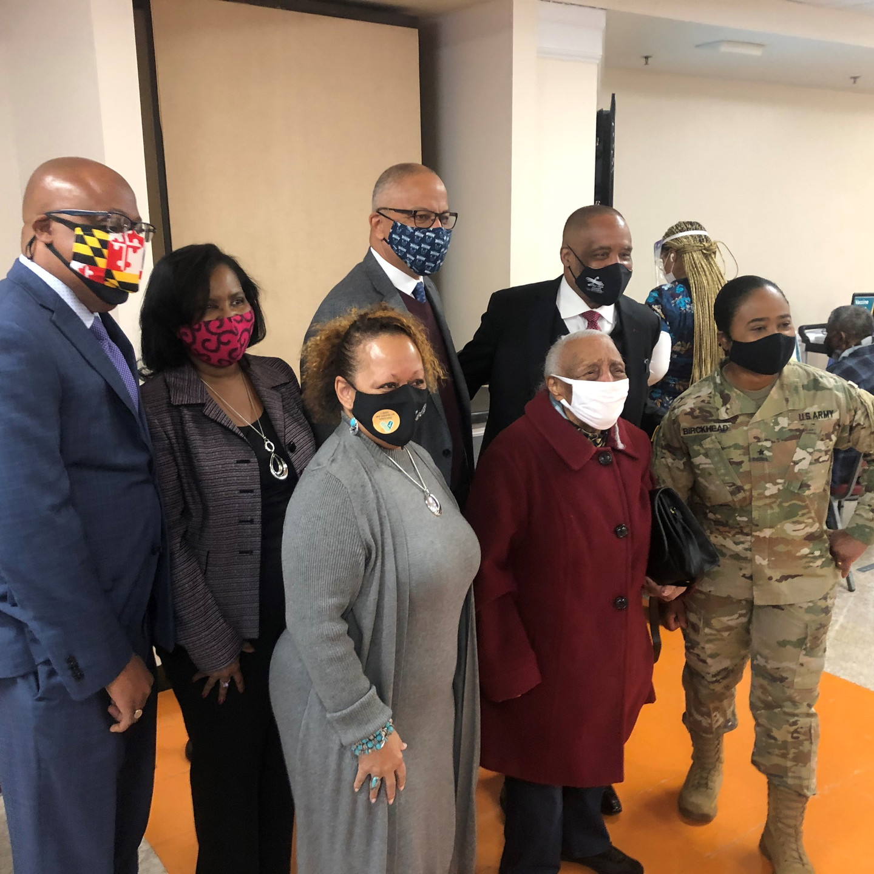
Biblical commentary on the widow’s wealth.
Mark 12:38-39 - Beware of prosperity preachers.
Mark 12:40 - Beware of prosperity messages promising financial blessing by faith alone.
Mark 12:41 - Beware of People who give out of abundance to be noticed by other people.
Mark 12:42 - The widow gave true wealth.
Mark 12: 43-44 - It’s not the amount we give, but what is left after giving!

Slide 8
Definition of Christian wealth
What Is Wealth?
Historically, Wealth measures the value of all the assets of worth owned by a person.
Alternatively, Wealth is expressed in intangible assets-based opinions.
Wealth is related to your creative ability.
Wealth represents power.
Wealth should mean more than the accumulation of money and possessions.
Prov. 10:22 “it is the blessings of the Lord that makes rich, and he adds no sorrow to it”.

Slide 9
Study questions:
What does god say about wealth?
1 Timothy 6:17 Command those who are rich in this present world not to be arrogant nor to put their hope in wealth, which is so uncertain, but to put their hope in God, who richly provides us with everything for our enjoyment.
What attitude does God expect from us about wealth?
Prov. 3:4 Then you will win favor and a good name in the sight of God and man. Psalm 37:21 “The wicked borrow and do not repay, but the righteous give generously.”

Slide 10
Study questions:
What is the real danger of wealth?
1 Timothy 6:10 For the love of money is a root of all kinds of evil. Some people, eager for money, have wandered from the faith and pierced themselves with many griefs.
Mark 12:43 He called his disciples and said to them, “I tell you the truth, this poor widow has put more into the offering box than all the others. 44 For they all gave out of their wealth. But she, out of her poverty, put in what she had to live on, everything she had.”

Slide 11
Application
Andrea Jackson

Slide 12
DEFINITION OF WEALTH
What Is Wealth?
Wealth measures the value of assets of worth owned by a person, community, company, or country. Wealth is determined by taking the value of all physical and intangible assets owned, then subtracting all debts.

Slide 13
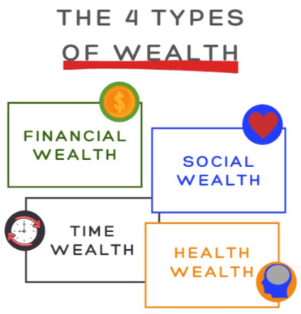

Slide 14
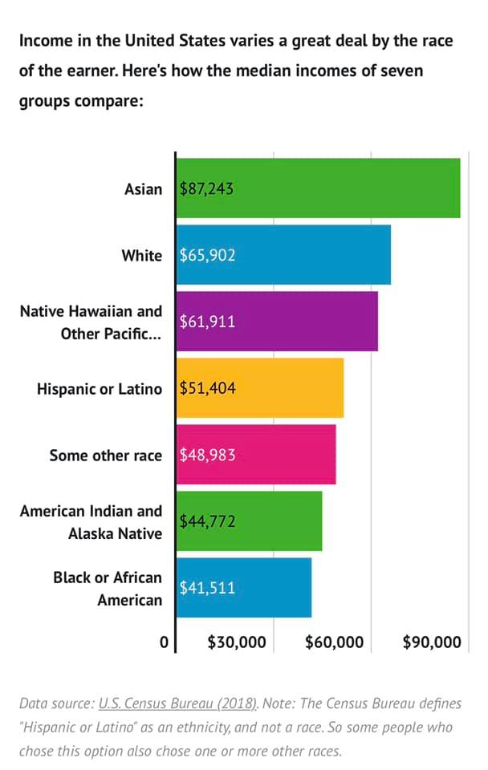

Slide 15
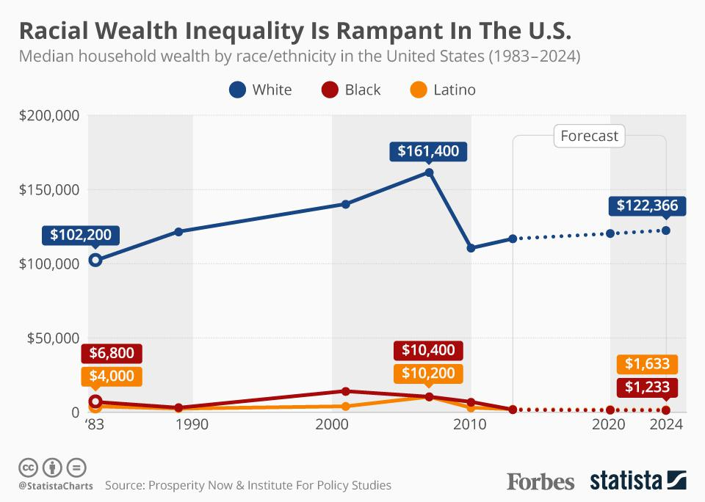

Slide 16
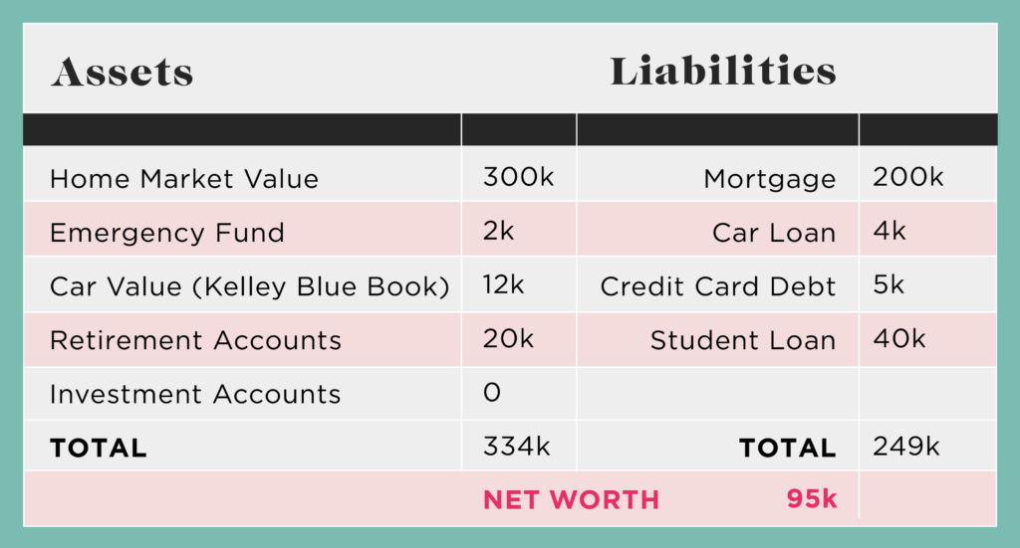
Assets-liabilities=net worth

Slide 17
7 best ways to increase your net worth
Boost your retirement contributions
Trim your expenses
Pay off debt ***
Save for emergencies
Renegotiate/consolidate loans
Keep your cars for as long as possible
Increase income

Slide 18
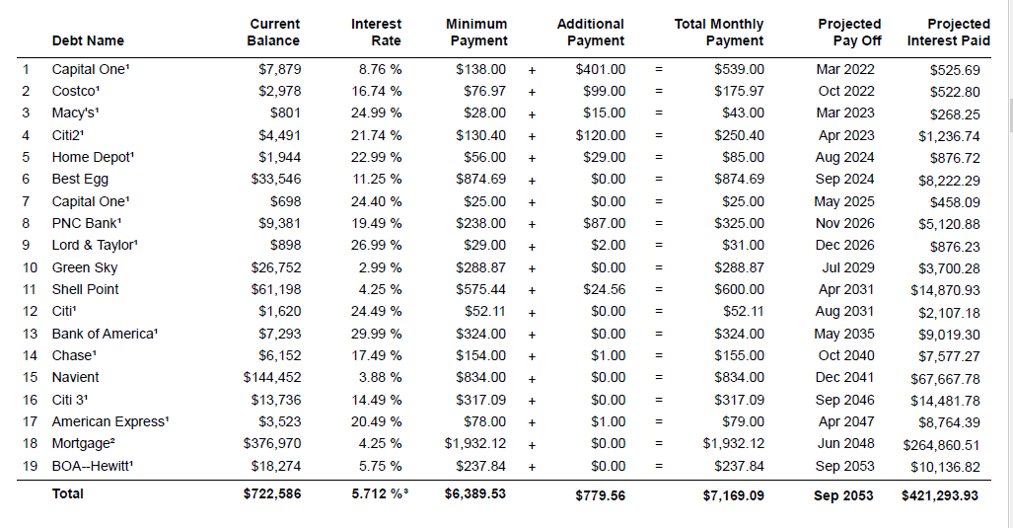
Actual debt elimination plan

Slide 19
