Slide 1
August Theme 2023 ”REFUELING to Go Higher in God”
Reid Temple A.M.E. Church
Reid Temple Wednesday Night Bible Study
August 9, 16, 23 and 30, 2023
Rev. Dr. Debyii L. Sababu-Thomas, Facilitator
Rev. Dr. Mark E. Whitlock, Pastor

Slide 2
First Things First: Reaffirming who we are as a Church
OUR VISION
Reid Temple AME Church is a
Bible Believing,
Christ-centered,
Family-Integrated,
Multigenerational,
Culturally aware church,
Spreading the Gospel of Jesus Christ while
“Building the Beloved Community”.
©Debyii L. Sababu-Thomas, Ph.D..

Slide 3
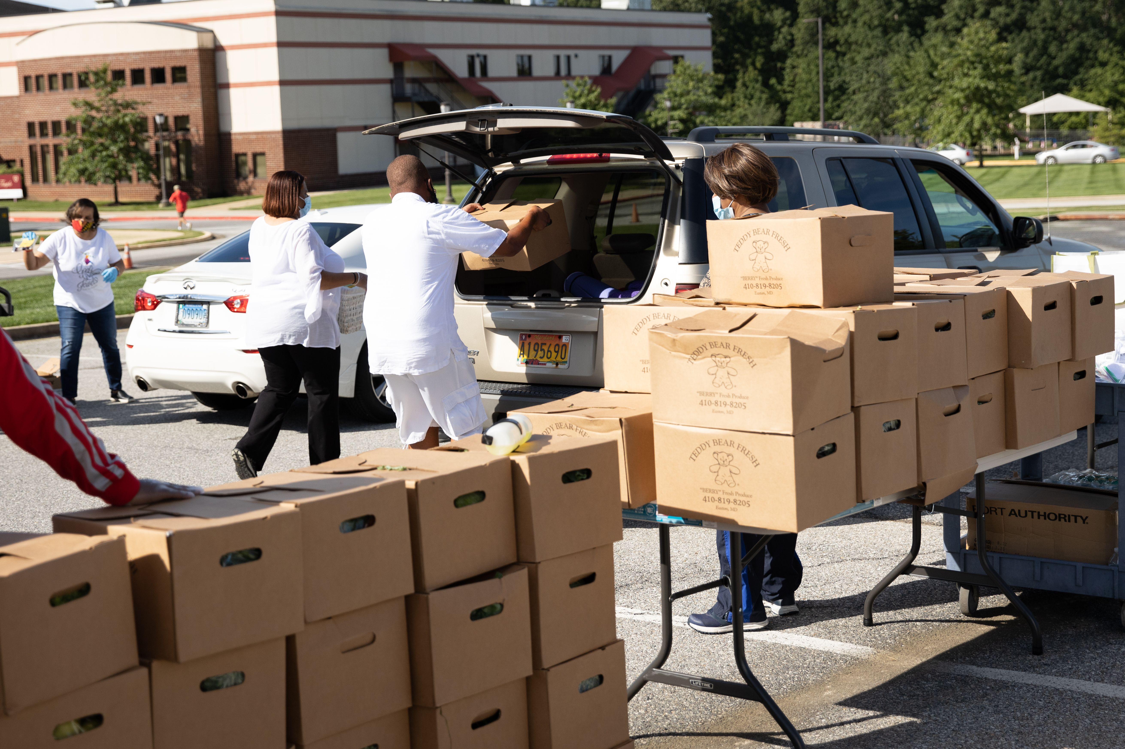
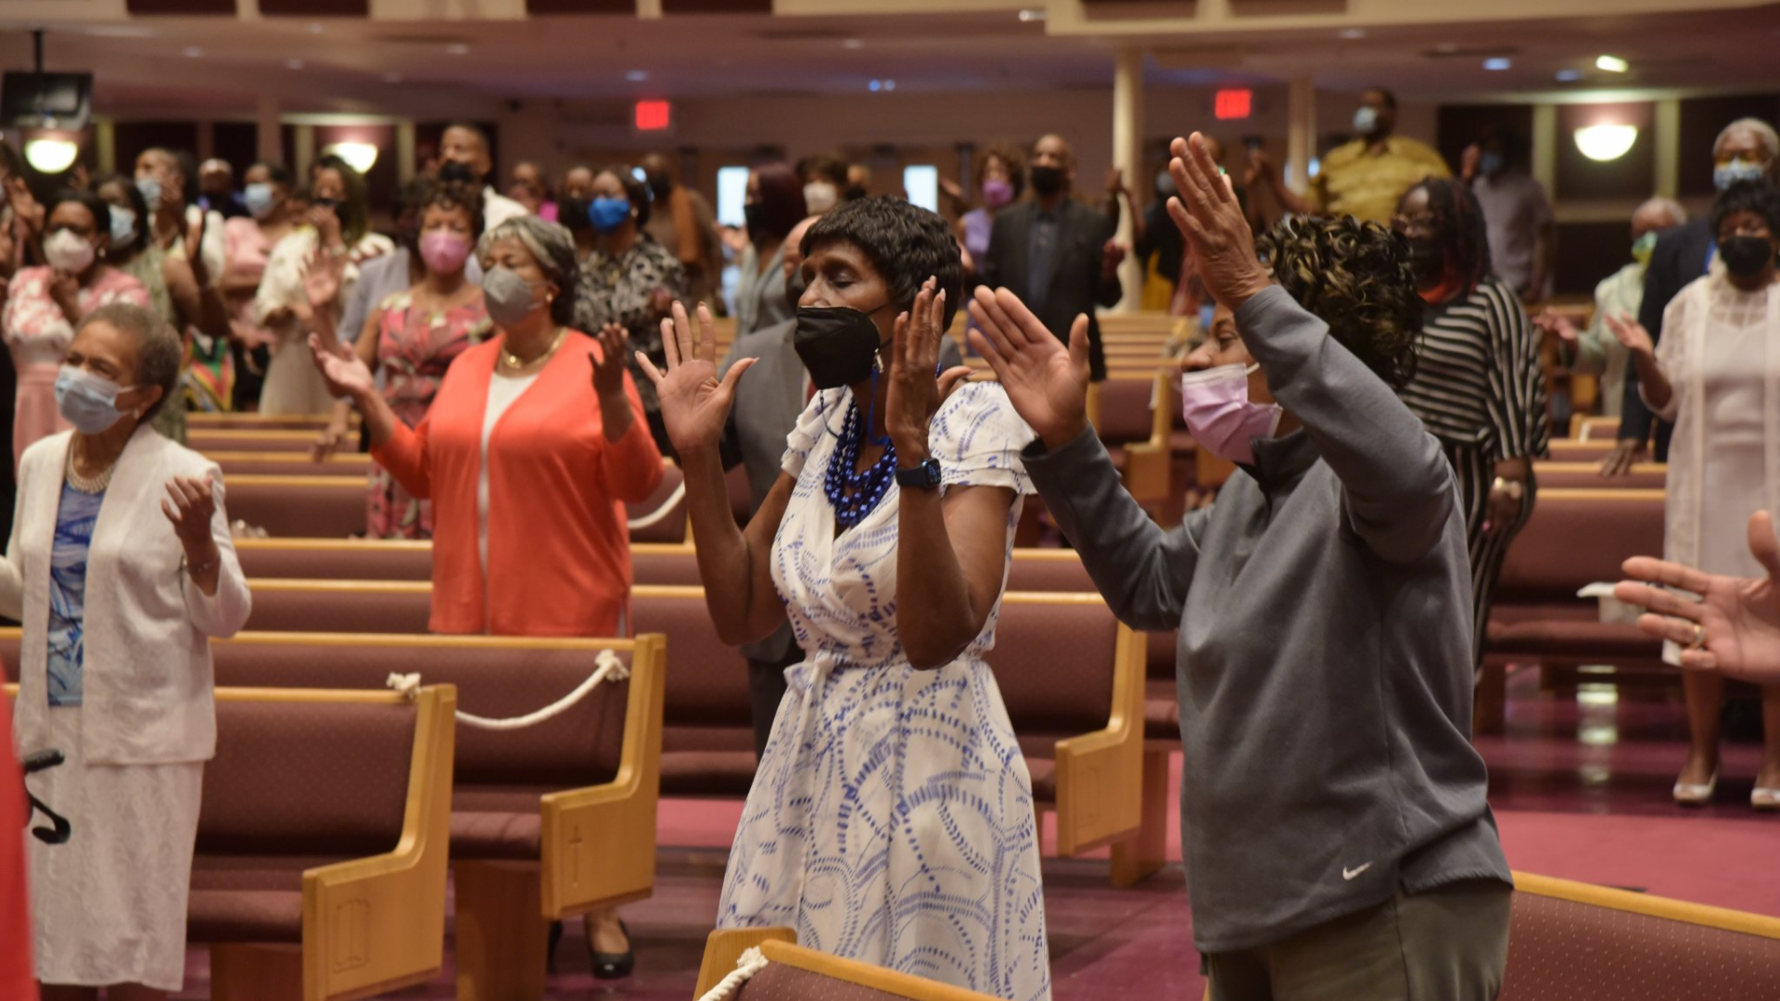
First Things First: Reaffirming who we are as a Church
OUR MISSION
The Mission of Reid Temple AME Church is
to increase and grow our ministry
for the spiritual, social, and physical development of all people.
©Debyii L. Sababu-Thomas, Ph.D..

Slide 4
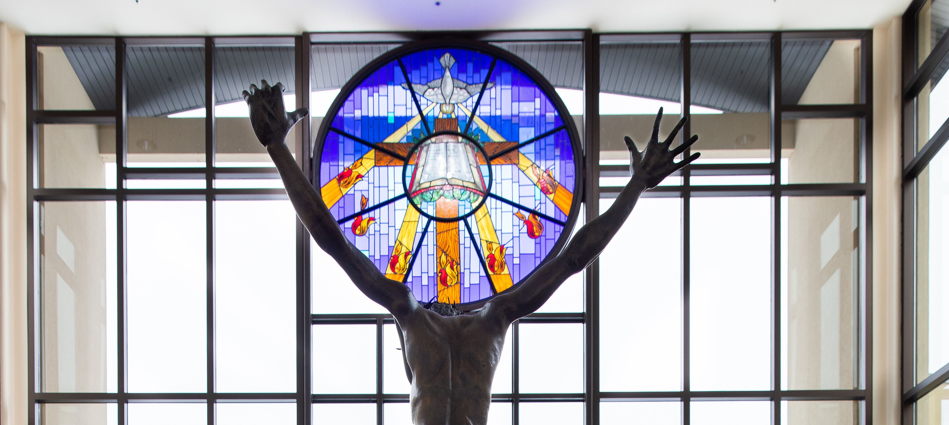
First Things First: Reaffirming who we are as a Church
OUR CORE VALUES
Faith in God
Integrity, Trust, and Ethical Behavior
Empowering People
Excellence and Innovation
Christ-centered Leadership
©Debyii L. Sababu-Thomas, Ph.D..

Slide 5
“REFUELING to Go Higher in God!!!
August 2023 – Church-wide Theme
Overview of Teaching – Week 1
The Context of Refueling
The Conditions for Refueling
The Causes for Refueling
THE CASE for REFUELING
Assignment and Q& A
* All topics are subject the leading of the Holy Spirit

Slide 6
“REFUELING to Go Higher in God!!!
Special Suggestions for a Meaningful Study
Access to Bible and Bible Study tools (Print and Online)
Notebook
Journal
An open, willing, committed and determined mindset to go Higher in the things of God,
A co-learner, prayer partner or someone to ride “shot gun” with you on your journey
* All topics are subject the leading of the Holy Spirit

Slide 7
The Context of ReFUELING
Fuel: Any substance burned/used as a source of heat or power,
To fill something, especially a plane, with fuel in order to continue a journey; to be filled with fuel
Finding life-giving ways to fill ourselves up.
(Sync counseling Center)
3. restoring the emotional energy to respond thoughtfully to life's bumps and obstacles instead of reacting without awareness
(Lifeworks Psychotherapy)

Slide 8
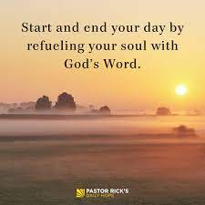
SYNONYMS
refill
replenish
restock
resupply
recharge
reset
refresh
reload
replace
restore
renew
recover

Slide 9
The Conditions for ReFUELING (Signs)
Physical
Headaches
Sleep/appetite problems
Pain w/o symptoms
Stomach problems
Fatigue
Increased alcohol/substance abuse
Emotional
Feeling worthless
Lethargic
Languishing
Helplessness
Depression
Defeated
Mental
Concentration issues
Indecisiveness
Quick tempered
Overly cynical (angry)
Excessive distrust of others
Isolated
No Motivation

Slide 10
The Conditions for ReFUELING (A Personal Testimony about Spiritual Exhaustion- Running on “E”)
.
.
1. Your Passion Fades.
2. You No Longer Feel the Highs or Lows.
3. Little Things Make You Disproportionately Emotional.
4. Everybody Drains You.
5. You’re Becoming Cynical.
6. Nothing Satisfies You.
7. You Can’t Think Straight.
8. Your Productivity Is Dropping.
9. You’re Self-Medicating.
10. You Don’t Laugh Anymore.
11. Sleep and Time Off No Longer Refuel You.
12. You don’t enjoy Church (DLST)

Slide 11
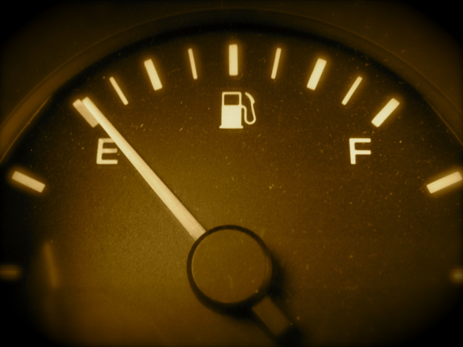
The Causes of Burnout/Burning-Out (Loss of Fuel)
Career Burnout
Absence of control
Absence of Rewards
Dysfunctional Work Environment
Lack of appropriate Support
Personal Causes
Childhood experiences.
"Helper" personality.
Social isolation.
Negative perfectionism.
Lifestyle Mismatches
Lack of sleep.
Lack of hobbies and social activities.
"Overachiever" mindset..

Slide 12
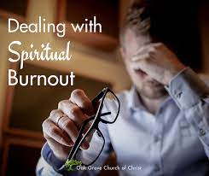
Thae Case/Cause for Refueling from Spiritual Burnout
.
.
Spiritual Burnout:
When you take on too much spiritual work without allowing your spirit to rest, process and grow. Often this looks like packing your schedule with workshops and webinars, gobbling up self-help books and spending much of your social life talking about spiritual ideas or experiences.
https://vantagepointrecovery.com/how-to-recognize-and-heal-spiritual-burnout/
When chronic busyness and exhaustion replaces our personal intimacy with God.
https://www.soulshepherding.org/spiritual-burnout/

Slide 13
The CASE for REFUELING? What can do it all?
Fuel: Any substance burned/used as a source of heat or power,
refill
replenish
restock
resupply
recharge
reset
refresh
reload
replace
restore
renew
recover

Slide 14
THE Ultimate REFUELING STATIONS BE FILLED with the FULLNESS of GOD
Ephesians 3: 14 -19
¹⁴ For this reason I bow my knees to the Father ^{[f]}of our Lord Jesus Christ, ¹⁵ from whom the whole family in heaven and earth is named, ¹⁶ that He would grant you, according to the riches of His glory, to be strengthened with might through His Spirit in the inner man, ¹⁷ that Christ may dwell in your hearts through faith; that you, being rooted and grounded in love, ¹⁸ may be able to comprehend with all the saints what is the width and length and depth and height— ¹⁹ to know the love of Christ which passes knowledge; that you may be filled with all the fullness of God.

Slide 15
THE Ultimate REFUELING STATIONS – FILLED with the HOLY SPIRIT
Acts 15:31
And the disciples were continually filled with joy and with the Holy Spirit.
3. Luke 1:41
When Elizabeth heard Mary’s greeting, the baby leaped in her womb; and Elizabeth was filled with the Holy Spirit.

Slide 16
THE Ultimate REFUELING STATIONS – ENJOY THE TIMES OF REFRESHING
4. Acts 3: 19-21
¹⁹ Repent therefore and be converted, that your sins may be blotted out, so that times of refreshing may come from the presence of the Lord, ²⁰ and that He may send ^{[c]}Jesus Christ, who was ^{[d]}preached to you before, ²¹ whom heaven must receive until the times of restoration of all things, which God has spoken by the mouth of all His holy prophets since ^{[e]}the world began.

Slide 17
ASSIGNMENT for NEXT WEEK:
NEXT WEEK:
SPIRITUAL FIUNDATIONS OF “REFUELING”
What have you learned about the Need to Refuel during this Session?
1. Create a Section or FILE in your Journal called “I SEE YOU, SELF!!!”
2. Write or record a message to your self entitled
“I need a refueling! I will be working on being stronger in (Your area). “
3. Also write an entry of how you have refueled other areas in your life that
were draining you of your energy!
4. Write one thing that you learned in this class so far!)

Slide 18
Rev Dr. Debyii L. Sababu-Thomas
Email: RevDebyii@reidtemple.org
Phone: #01 352-1746

Slide 19
