Slide 1
Activate dreams and see visions to go Higher in God!
Dr. Mark E. Whitlock, Jr.
Reid Temple A.M.E. church

Slide 2
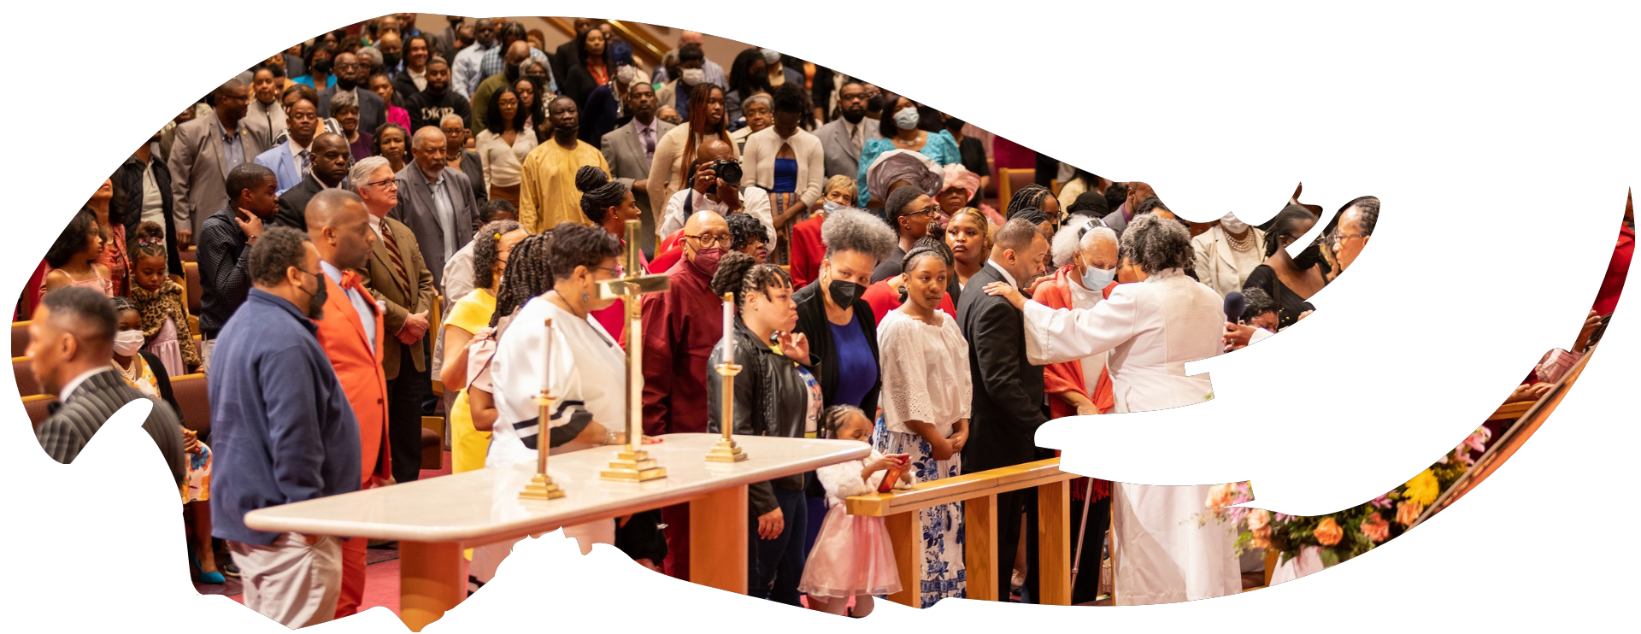
Our Core Values
Faith in GOD
Integrity, Trust and Ethical Behavior
Empowering people
Excellence and Innovation
Christ –centered Leadership

Slide 3
The Vision
Reid Temple AME Church is “Building the Beloved Community” by becoming a Bible Believing, Christ-centered, Family – Integrated, Multigenerational, Culturally aware church, spreading the gospel of Jesus Christ.

Slide 4
Our Strategic Goals
Membership Growth
Debt Free for Thee
Motivated and Skilled Staff & Volunteers
Community Commitment
New Demographic & Market Penetration

Slide 5
Overall Goals for 2023 -2024
Increase attendance to Bible Study
Increase baptisms
Increase the number of tithers
Increase the number of Disciples
Increase the number of servant leaders
Increase member and community engagement

Slide 6
Activate dreams and see visions to go Higher in God!
Dr. Mark E. Whitlock, Jr.
Reid Temple AME church

Slide 7
Course objectives: Activate Your Dreams and see Visions to go Higher in God!
Prayer
Holy Scriptures – Joel 2:28-30; acts 2:17
Who is Joel in the Old Testament?
The Difference in Dreams and visions.
Activate your dreams and visions!
Altar call
Salvation and Offering
Thank you….

Slide 8
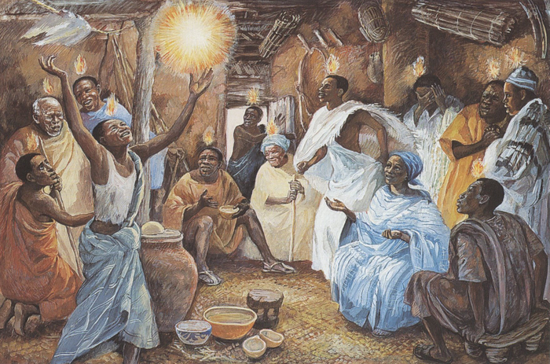
The Holy Scriptures
Joel 2: 28“And afterward, I will pour out my Spirit on all people. Your sons and daughters will prophesy, your old men will dream dreams, your young men will see visions. 29Even on my servants, both men and women, I will pour out my Spirit in those days. 30I will show wonders in the heavens and on the earth, blood and fire and billows of smoke.
Acts 2:17 “‘In the last days, God says, I will pour out my Spirit on all people. Your sons and daughters will prophesy, your young men will see visions, your old men will dream dreams.

Slide 9
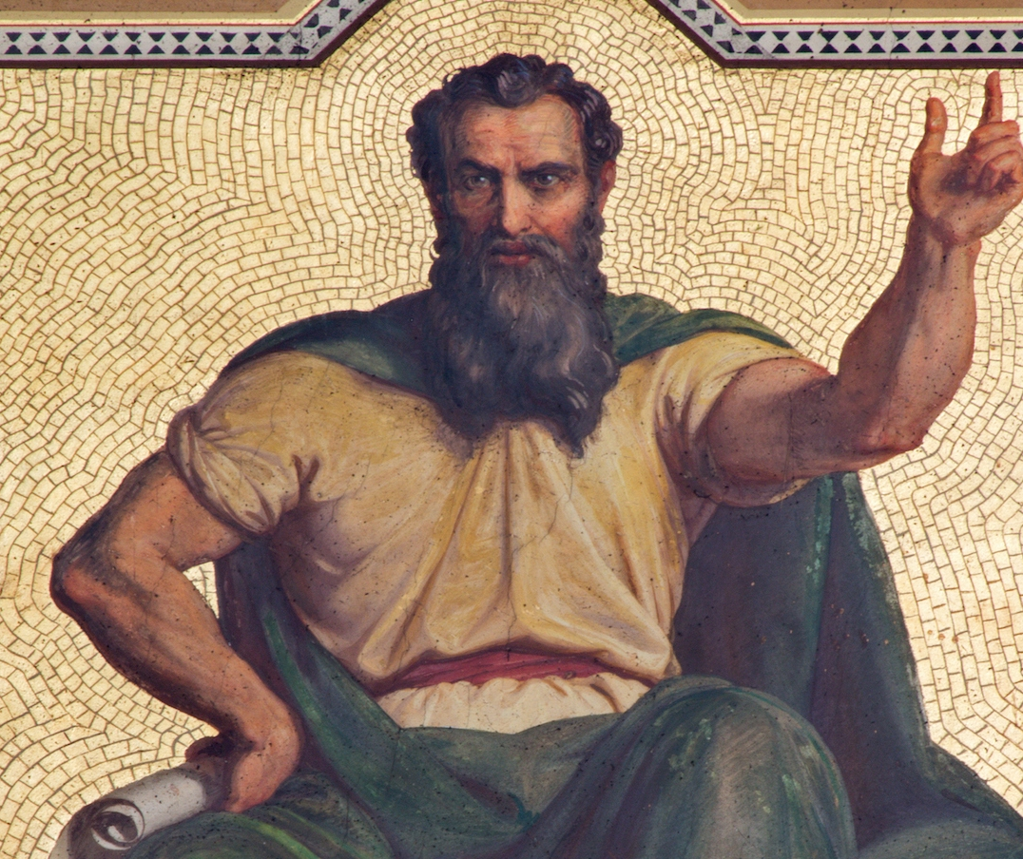
Who is Joel in the old Testament?
Joel is one of the Minor Prophets, a group of twelve prophets whose books are relatively short.
The book was written after Cyrus of Persia freed the Jewish exiles from their Babylonian captivity in 538 B.C.
The first part of the book Chapters 1:1 – 2:17 is a description of a devastating locust invasion that had ravaged the land of Judah.
Joel uses this natural disaster as a metaphor for God's impending judgment on the nation due to their sins. The locust plague serves as a wake-up call for the people to repent and to pray for Divine deliverance.
The second part of the book focuses on God’s prophecy and promises of deliverance:
Material restoration through the divine healing of the land (Joel 2:21-27)
Spiritual restoration through the divine outpouring of His Spirit (Joel 2:28-32)
National restoration through the divine judgment on the unrighteous (Joel 3:1-21)
Today, the promise of spiritual restoration through the outpouring of the Holy Spirit, as seen on the Day of Pentecost (Acts 2).

Slide 10
The difference in Dreams and Visions
Godly dreams happen while a person is asleep. Many biblical figures, such as Joseph (Genesis 37:5-10) and Daniel (Daniel 2:1-49), received important divine messages through dreams at night.
Godly visions take place when a person is awake and conscious. They involve seeing images, scenes, or events that are not part of the physical world but are shown to the individual in a spiritual or supernatural manner.
For example, the prophet Isaiah had a vision of God's throne (Isaiah 6:1-8), Paul had a vision to preach to the gentiles (Gal. 1:16), and the apostle Peter received a vision that guided him in matters of faith (Acts 10:9-16).
Pastor Whitlock had a vision about coming to Reid Temple….

Slide 11
Activate Dreams and Visions to go Higher in God!
Activating Dreams and visions from God can provide individuals with spiritual guidance and direction. They may reveal God's will, plan, or purpose for their lives. By activating and paying attention to these messages, individuals can align themselves more closely with God's intentions.
Activating Dreams and visions From God can confirm and reaffirmation of one's faith and calling.
Activating dreams and visions from God can lead to conviction, repentance, and a deeper commitment to living a righteous and obedient life.
Activating dreams and visions from God means sharing messages, warnings, or guidance from God to friends, Family and the broader community.
Activating dreams and visions from God can lead to the accomplishment of God's plans through obedient action.
Activating dreams and visions from God can lead to souls being saved.
Activating dreams and visions from God can serve as a means and methodology for going higher in communication with God.
We are the sum total of someone activating dreams and visions from God!!

Slide 12
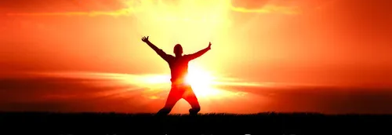
Let’s pray
Come to the altar to pray for pastor, staff, ministers, ministry leaders, officers and members.

Slide 13
Questions and answers
This Photo by Unknown Author is licensed under CC BY-SA

Slide 14
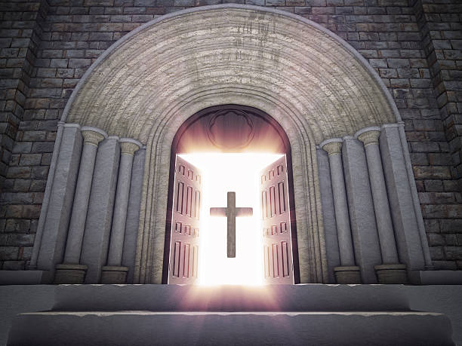
Doors of the church are open: “REID TEMPLE CARES”

