Slide 1
Activate the Power of Prayer Healing and Anointing Service…
Rev. Janet Renee Habersham, 2nd District Prayer Ministry
Dr. Mark e. Whitlock, Jr.
Pastor

Slide 2
The Vision: Building the “BELOVED COMMUNITY”
Reid Temple AME Church is a
Bible Believing,
Christ-Centered,
Family – Integrated,
Multigenerational,
Culturally Aware Church,
Spreading the Gospel of Jesus
Christ while
“Building the Beloved Community”.

Slide 3
REID TEMPLE’S MISSION AND VALUES
Our Mission:
The mission of Reid Temple AME Church is to increase and grow our ministry for the spiritual, social, and physical development of all people.
Our Core Values:
Faith in God
Integrity, Trust, and Ethical Behavior
Empowering People
Excellence and Innovation
Christ-centered Leadership

Slide 4
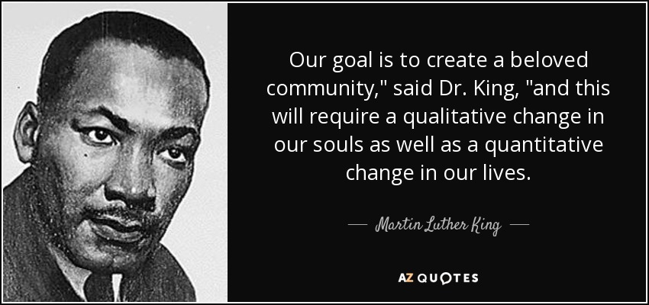
THE BELOVED COMMUNITY
THE BELOVED COMMUNITY IS THE DEMONSTRATION BY BELIEVERS ENGAGING IN ACTS OF SERVICE.
WE CREATE THE BELOVED COMMUNITY BY:
MAKING CHRISTIAN DISCIPLES – MATTHEW 28:19-20
SERVING THE POOR- MATTHEW 25:40
THE ELIMINATION OF HATE – 1 JOHN 4:20
JUSTICE FOR ALL PEOPLE – AMOS 5:18-24
ACTS OF KINDNESS – EPHESIANS 4:32
UNMERITED LOVED FOR OTHERS – MARK 12:31

Slide 5
Activate the Power of Prayer Healing and Anointing Service…
Rev. Janet Renee Habersham, 2nd District Prayer Ministry
Dr. Mark e. Whitlock, Jr.
Pastor

Slide 6
Course objectives: Activate the power of Prayer! Healing and Anointing Service…
Prayer
introduction to the lesson and video
Scriptures: James 5:14-15
Activate the power of prayer – Rev. Janet Renee Habersham
Altar Call for the Anointing and Healing
Salvation and Offering
Benediction

Slide 7
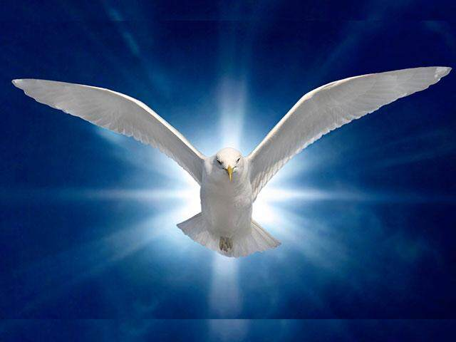
God’s holy word
James 5:13 Is any among you afflicted? let him pray. Is any merry? let him sing psalms. 14 Is any sick among you? let him call for the elders of the church; and let them pray over him, anointing him with oil in the name of the Lord: 15 And the prayer of faith shall save the sick, and the Lord shall raise him up; and if he have committed sins, they shall be forgiven him.
James emphasizes prayer, confession, and the value of redeeming those who have wandered from the truth.
The suffering of which this verse speaks could be physical, emotional, or circumstantial.
The antidote is prayer and the anointing of oil “in the name of the Lord.”

Slide 8
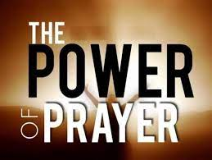
Rev. Janet Renee Habersham
James 5:15 And the prayer of faith shall save the sick, and the Lord shall raise him up; and if he have committed sins, they shall be forgiven him.
It isn’t simply the prayer that opens the door to healing, but “the Power of the prayer of faith.”
The sick person will be Heal
Spiritual healing is as important as physical healing.
Prayers of faith can accomplish both.
John 14: 8-14 NRSV
John 14: 15-17 NRSV
John 16: 13 NRSV
Acts 1: 8 NRSV
Acts 2: 1 – 3 NRSV
Luke 11: 9 – 13 NRSV

Slide 9
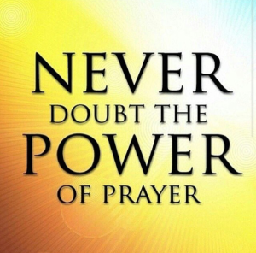
Let’s go to the Altar to Activate the power of Prayer but Leave Anointed and healed to give Higher for God! Giving Higher Means Giving Time to God. Giving Higher means Giving Talents to God. Giving Higher means Giving treasures to God

Slide 10
Open the doors and Offering

