Slide 1
Forgiveness Leads to God’s Favor: Going higher in forgiveness
Dr. Mark E. Whitlock, Jr.
Reid Temple AME church

Slide 2
The Vision
Reid Temple AME Church is “Building the Beloved Community” by becoming a Bible Believing, Christ-centered, Family – Integrated, Multigenerational, Culturally aware church, spreading the gospel of Jesus Christ.

Slide 3
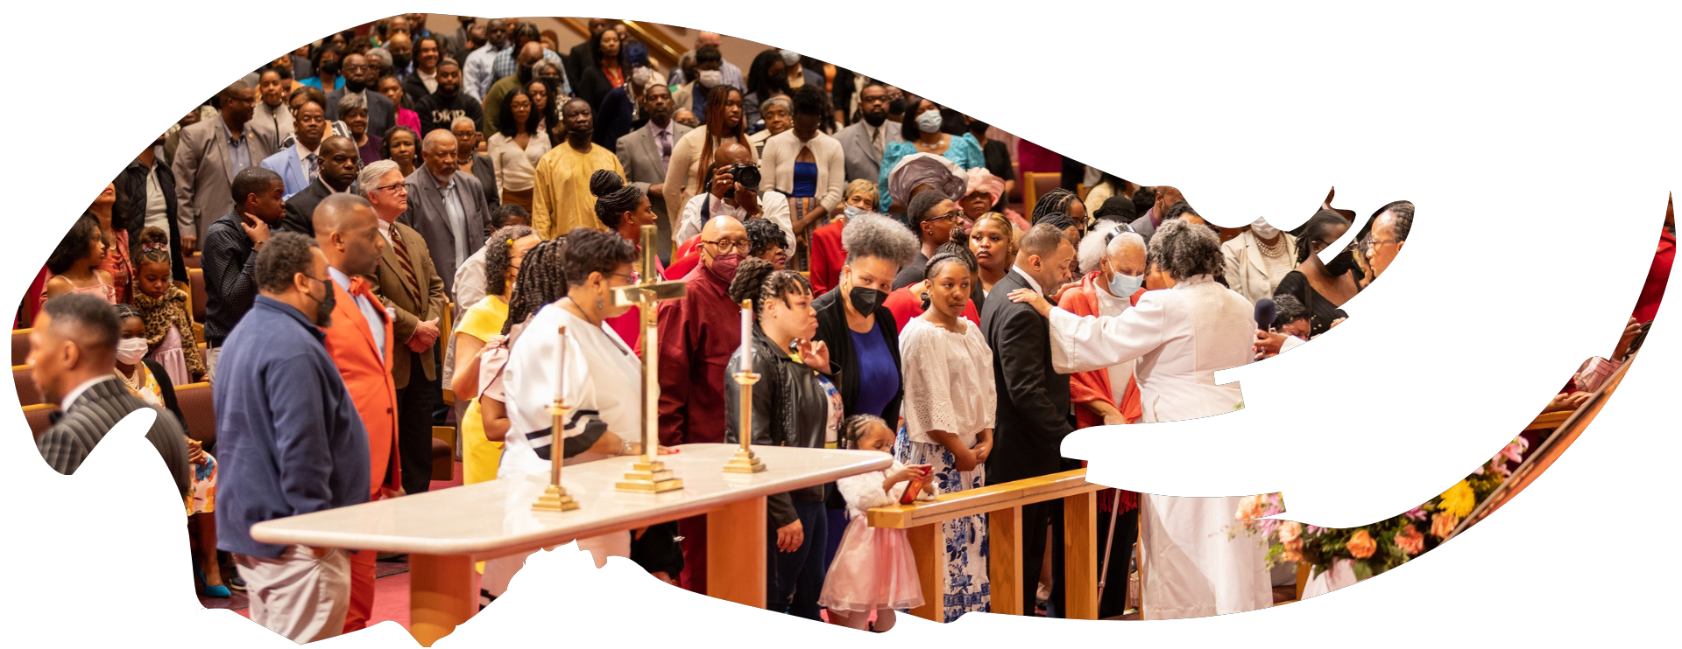
Our Core Values
Faith in GOD
Integrity, Trust and Ethical Behavior
Empowering people
Excellence and Innovation
Christ –centered Leadership

Slide 4
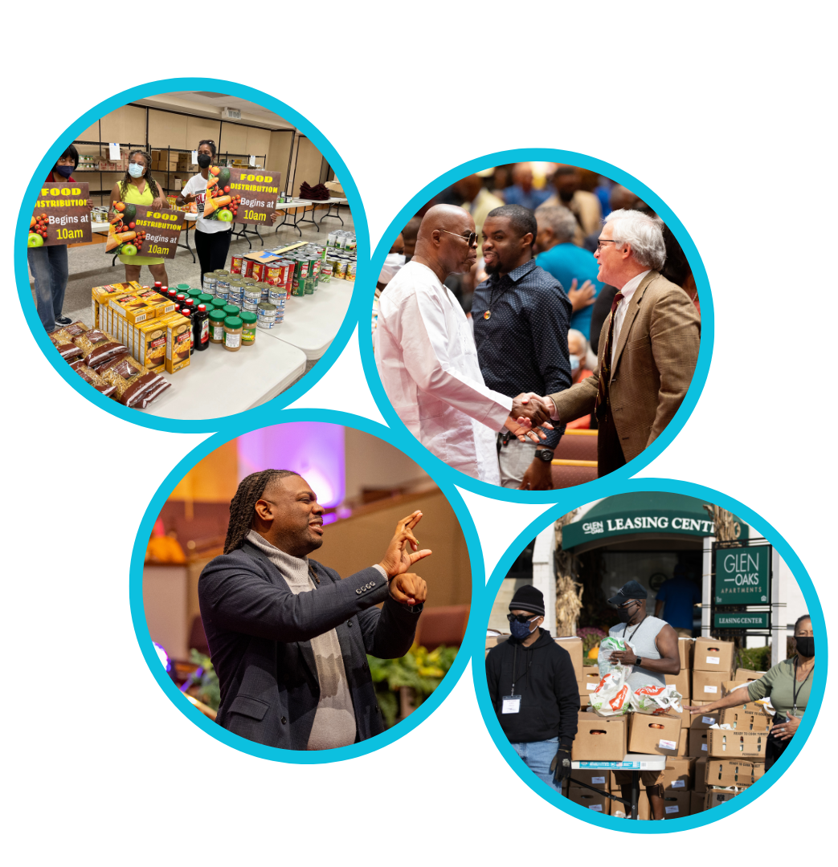
Our Strategic Goals
Membership Growth
Debt Free for Thee
Motivated and Skilled Staff & Volunteers
Community Commitment
New Demographic & Market Penetration

Slide 5
Overall Goals for 2023 -2024
Increase attendance to Bible Study
Increase baptisms
Increase the number of tithers
Increase the number of Disciples
Increase the number of servant leaders
Increase member and community engagement

Slide 6
Forgiveness Leads to God’s Favor: Going higher in forgiveness
Dr. Mark E. Whitlock, Jr.
Reid Temple AME church

Slide 7
Course objectives: Meditate on God’s word!
Prayer
God’s Word
Biblical forgiveness and conflicts
Repent to Reconcile
Jacob Receives God’s Favor
Come to Altar to Pray for Forgiveness
Salvation and Offering
Thank you….

Slide 8
God’s Word
Genesis 25:29 And Jacob sod pottage: and Esau came from the field, and he was faint: 30 And Esau said to Jacob, Feed me, I pray thee, with that same red pottage; for I am faint: therefore was his name called Edom. 31 And Jacob said, Sell me this day thy birthright. 32 And Esau said, Behold, I am at the point to die: and what profit shall this birthright do to me? 33 And Jacob said, Swear to me this day; and he sware unto him: and he sold his birthright unto Jacob. 34 Then Jacob gave Esau bread and pottage of lentiles; and he did eat and drink, and rose up, and went his way: thus Esau despised his birthright.
This Photo by Unknown Author is licensed under CC BY-NC

Slide 9
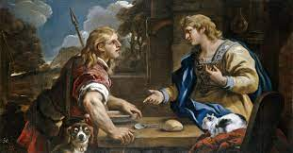
Biblical Forgiveness of sin and conflicts.
Forgiveness in the Bible is “Letting Go” or to “release it” or “dismissal” of a conflict.
(Jacob had not let go of the stealing Esau's birth right. There are two sides to forgiveness: decisional and emotional.)
Decisional forgiveness involves a conscious choice to replace ill will with good will.
For emotional forgiveness, you let go of negative feelings and no longer dwell on the wrongdoing.
"Emotional forgiveness is much harder and takes longer, as it's common for those feelings to return on a regular basis," says Dr. VanderWeele, co-director of the Initiative on Health, Religion, and Spirituality at the Harvard University.
Romans 5:1 Therefore, having been justified by faith, we have peace with God through our Lord Jesus Christ, through whom also we have access by faith into this grace in which we stand, and rejoice in hope of the glory of God.

Slide 10
Repent to Reconcile
Resentment is caused by a broken understanding of A relationship.
Persuasion – is the attempt to convince the other that your decision is the right!
Compelling – the forced Use of authority to make a decision.
Avoidance – when a person restrains from making a decision.
Participating – when parties work together to make a decision.
Negotiating – bargaining to get the best/most from the decision.
Supporting – you endorse/embrace the decision without responsibility.
repentance is a change of heart and life regarding sin.
Reconciliation is the restoration of a relationshipj, but change may cause disruptive conflicts.
Romans 12:18 If it be possible, as much as lieth in you, live peaceably with all men.

Slide 11
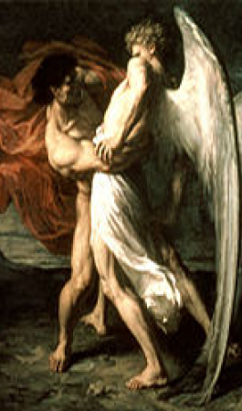
Jacob receives God’s favor!
Recognize. The first step; recognize the conflict in an objective way. The goal, not to think of the person in a negative light, nor to wallow in self-pity, but to come to a clear understanding of the wrong that was done. (prov. 28:13)
Empathize. Next, try to understand the other person's point of view regarding why he or she hurt you, without minimizing or downplaying the wrong that was done. (Col. 3:12-13)
Repentance. This step is about addressing your own shortcomings; Address the mistakes you have made. When we repent, we are acknowledging our need for God’s forgiveness and grace. ( 2 Chron. 7:14)
Commit. Commit to change; return to God. Without true repentance, there is no forgiveness. (Romans 12:1-3)
Press. Finally, Press on, hold on to your forgiveness. This step is tough because memories of the event will often recur. (Phil. 3:14)

Slide 12
Let’s pray for Forgiveness
Prayer is the vehicle by which you are meant to commune with God. It is the medium through which your spirit is intended to affect and be affected by the will and purpose of the divine creator.
Romans 11:29
For the gifts and calling of God are without repentance.

Slide 13
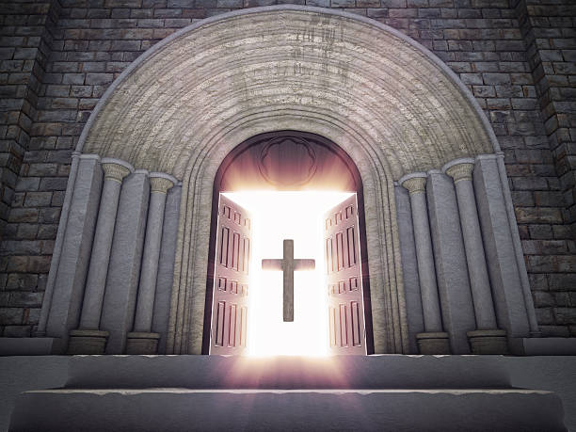
Doors of the church are open: “REID TEMPLE CARES”

