Slide 1
Forgiveness to Forge Forward: Going higher in forgiveness
Dr. Mark E. Whitlock, Jr.
Reid Temple AME church

Slide 2
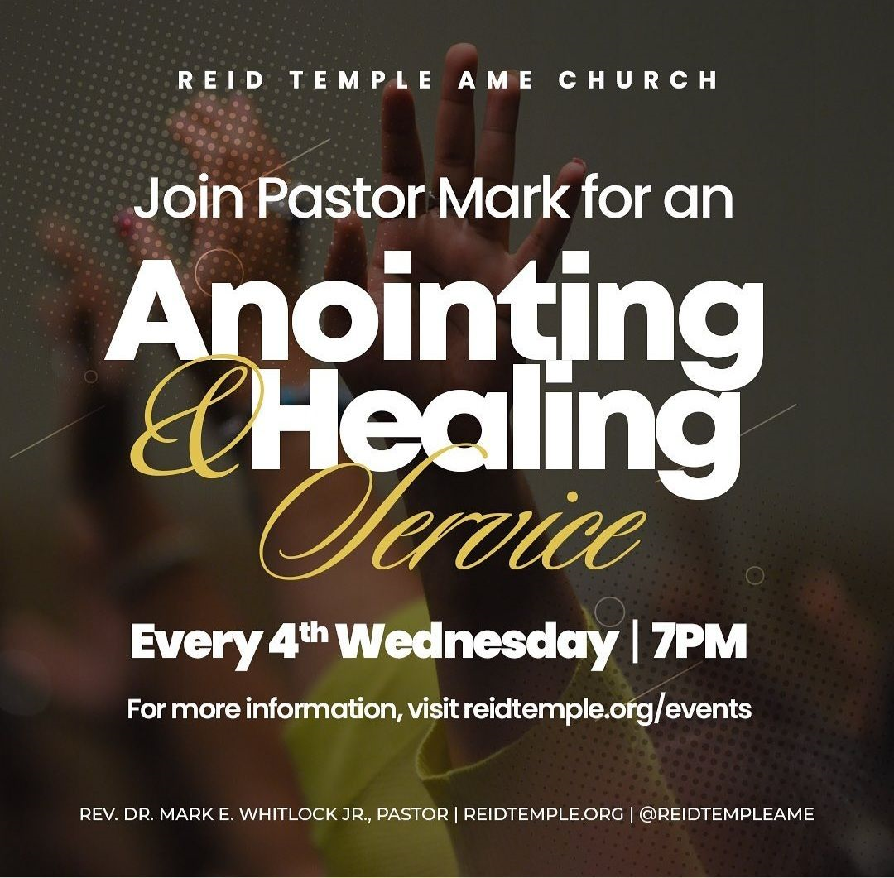
The healing and anointing service follows the teaching….

Slide 3
Forgiveness to Forge Forward: Going higher in forgiveness
Dr. Mark E. Whitlock, Jr.
Reid Temple AME church

Slide 4
Course objectives: Meditate on God’s word!
Prayer
God’s Word
Biblical forgiveness and conflicts
Repent to Reconcile
Jacob Receives God’s Favor
Come to Altar to Pray for Forgiveness
Salvation and Offering
Thank you….

Slide 5
God’s Word
Micah 7:18 Who is a God like you, who pardons sin and forgives the transgression of the remnant of his inheritance? You do not stay angry forever but delight to show mercy. 19 You will again have compassion on us; you will tread our sins underfoot and hurl all our iniquities into the depths of the sea. 20 You will be faithful to Jacob, and show love to Abraham, as you pledged on oath to our ancestors in days long ago.
This Photo by Unknown Author is licensed under CC BY-NC

Slide 6
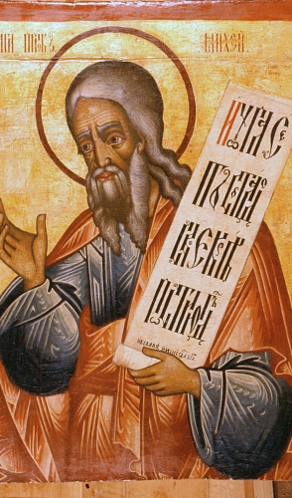
Israel sinned against God
This is the prayer of prophet Micah prayer for Israel. Micah is considered one of the Twelve Minor Prophets of the Hebrew Bible and was a contemporary of the prophets Isaiah, Amos and Hosea. He had announced God's judgment against Israel. Israel has exploited the poor and twisted the laws of the Torah, and God's justice means that he will deal with them severely. He prophesied the future destruction of Jerusalem and Samaria, the destruction and then future restoration of the Judean state, and he rebuked the people of Judah for dishonesty and idolatry.
But Micah's prayed for hope. The God of Israel is forgiving, faithful and full of mercy. Every sinful thought, word, deed, desire, motivation, etc. has been taken away from you and fully dealt with by God. The idea of casting your sins into the sea provides the comfort that they are never coming back to be reunited with you. They are gone… forevermore!

Slide 7
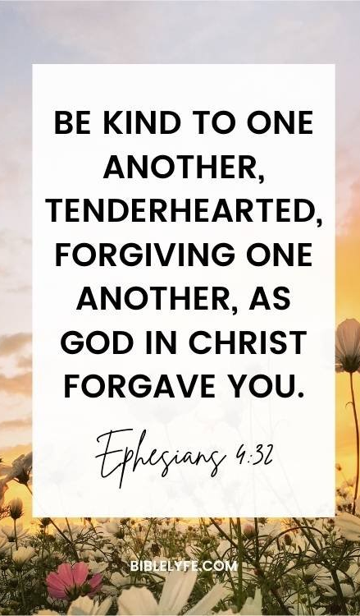
Biblical Forgiveness of sin and human conflicts.
Forgiveness in the Bible is “Letting Go’ or to “release it” or a “dismissal” of a conflict.
Micha prayed for Israel to forgive like God!
Decisional forgiveness involves a conscious choice to replace ill will with good will.
emotional forgiveness, you let go of negative feelings and no longer dwell on the wrongdoing.
Romans 5:1 Therefore, having been justified by faith, we have peace with God through our Lord Jesus Christ, through whom also we have access by faith into this grace in which we stand, and rejoice in hope of the glory of God.

Slide 8
Reconcile to forge forward
Resentment is caused by a broken understanding of the relationship.
People deal with Conflict differently……
Persuasive – does not win in the end!
Compelling – Authority is often power out of control!
Avoidance – We carry the pain for years.
Participating – when two parties work together to reconcile.
Negotiating – there is often a winner and loser.
Supporting – Empty agreements that leave a person exposed.
repentance is a change of heart and life regarding sin.
Reconciliation is the restoration of a relationship.
Romans 12:18 If it be possible, as much as lieth in you, live peaceably with all men.

Slide 9
Israel is called to repent!
Recognize. The first step is to recognize the conflict in an objective way. The goal is not to think of the person in a negative light nor to wallow in self-pity, but to come to a clear understanding of the wrong that was done. (prov. 28:13)
Repentance. This step is about addressing your own shortcomings. Address the mistakes you have made. When we repent, we are acknowledging our need for God’s forgiveness and grace. ( 2 Chron. 7:14)
Commit. Commit to change to turn back to God. Without true repentance there is no forgiveness. (Romans 12:1-3)
Press. Finally, Press on to hold on to your forgiveness. This step is tough because memories of the event will often recur. (Phil. 3:14)

Slide 10
Let’s pray for Forgiveness
Prayer is the vehicle by which you are meant to commune with God. It is the medium through which your spirit is intended to affect and be affected by the will and purpose of the divine creator.
Romans 11:29
For the gifts and calling of God are without repentance.

Slide 11
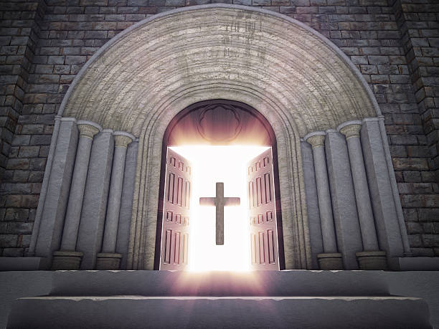
Doors of the church are open: “REID TEMPLE CARES”

