Slide 1
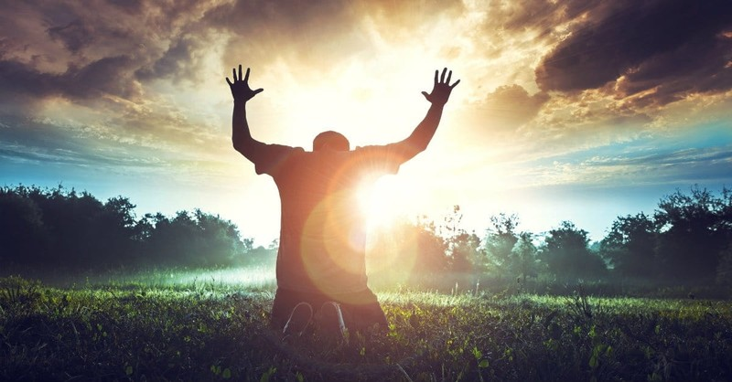
Going Higher in Praise for God!
Dr. Mark E. Whitlock, Jr.
Reid Temple AME church

Slide 2
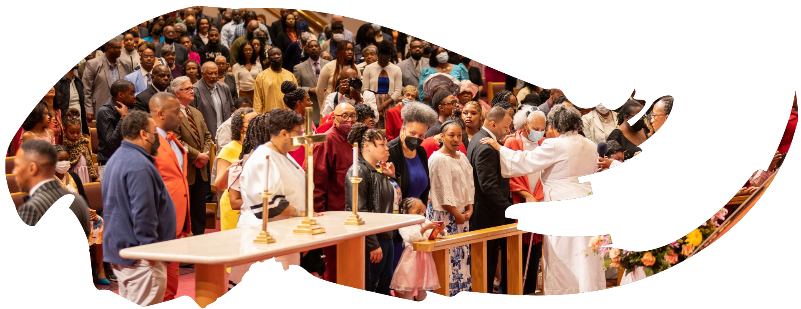
Our Core Values
Faith in GOD
Integrity, Trust and Ethical Behavior
Empowering people
Excellence and Innovation
Christ –centered Leadership

Slide 3
The Vision
Reid Temple AME Church is “Building the Beloved Community” by becoming a Bible Believing, Christ-centered, Family – Integrated, Multigenerational, Culturally aware church, spreading the gospel of Jesus Christ.

Slide 4
Our Strategic Goals
Membership Growth
Debt Free for Thee
Motivated and Skilled Staff & Volunteers
Community Commitment
New Demographic & Market Penetration

Slide 5
Overall Goals for 2023 -2024
Increase attendance to Bible Study
Increase baptisms
Increase the number of tithers
Increase the number of Disciples
Increase the number of servant leaders
Increase member and community engagement

Slide 6
Meditation 101 Class Schedule/Subjects/Books
Sept. 16 – The Purpose of Meditation.
Sept. 23 – The Practice of Meditation.
Sept. 30 – The Power of Meditation.
Oct. 7 – The Pursuit of Meditation.

Slide 7
Going Higher in Praise for God!
Dr. Mark E. Whitlock, Jr.
Reid Temple AME church

Slide 8
Course objectives: Going Higher in Praise For god!
Prayer
Scriptures – Joshua 6:20
What Walls are you fighting?
The Power of praise
Altar call
Salvation and Offering
Thank you….

Slide 9
Scripture
Joshua 6:20 So the people shouted when the priests blew with the trumpets: and it came to pass, when the people heard the sound of the trumpet, and the people shouted with a great shout, that the wall fell down flat, so that the people went up into the city, every man straight before him, and they took the city.

Slide 10
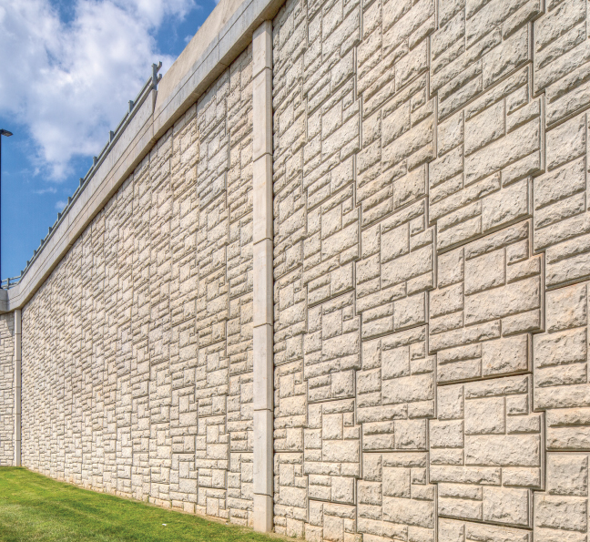
Walls you are fighting…
Walls are real:
Addiction
Health Crisis.
Workplace issues
Marital issues
Financial challenges
Career pressures
Emptiness/loneliness
Depression/anxiety
Inner peace

Slide 11
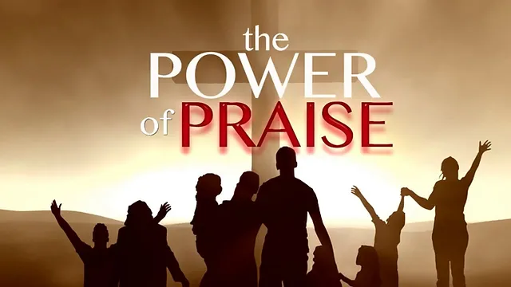
The power of praise
God commands Praise – ps. 150
Praise turns the focus to God - Ps. 100:4
Praise is being the presence of God – ps. 22:3
Praise Promotes Productivity – ps. 17:5-6
Praise changes the Atmosphere – Isa 61:3
Praise defeats Demons – Isa 14
God is worthy to be praise – Ps. 118:1

Slide 12
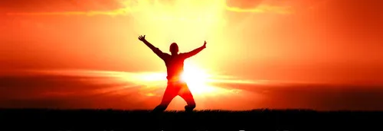
Let’s pray
Come to the altar to pray for pastor, staff, ministers, ministry leaders, officers and members.

Slide 13
Questions and answers
This Photo by Unknown Author is licensed under CC BY-SA

Slide 14
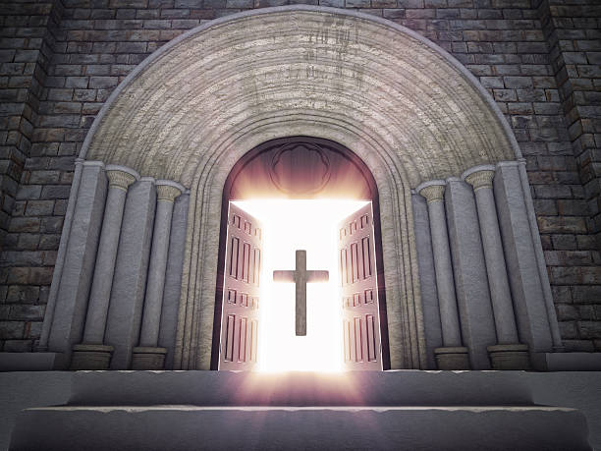
Doors of the church are open: “REID TEMPLE CARES”

