Slide 1
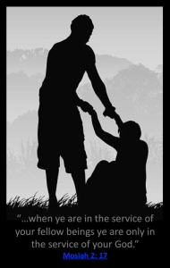
REID TEMPLE MID-WEEK BIBLE STUDY
Living HIGHER FOR GOD!
How To Keep the Main Thing the Main Thing!
April 19, 2023
DR. MARK E. WHITLOCK, PASTOR|REIDTEMPLE. ORG | @REIDTEMPLEAME

Slide 2
The Vision: Building the “BELOVED COMMUNITY”
Reid Temple AME Church is a
Bible Believing,
Christ-Centered,
Family – Integrated,
Multigenerational,
Culturally Aware Church,
Spreading the Gospel of Jesus
Christ while
“Building the Beloved Community”.

Slide 3
REID TEMPLE’S MISSION AND VALUES
Our Mission:
The mission of Reid Temple AME Church is to increase and grow our ministry for the spiritual, social, and physical development of all people.
Our Core Values:
Faith in God
Integrity, Trust, and Ethical Behavior
Empowering People
Excellence and Innovation
Christ-centered Leadership

Slide 4
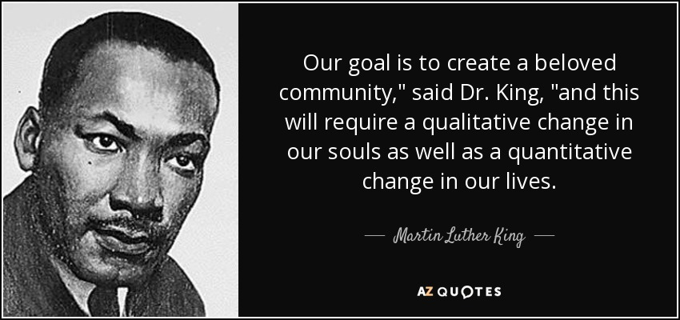
THE BELOVED COMMUNITY
THE BELOVED COMMUNITY IS THE DEMONSTRATION BY BELIEVERS ENGAGING IN ACTS OF SERVICE.
WE CREATE THE BELOVED COMMUNITY BY:
MAKING CHRISTIAN DISCIPLES – MATTHEW 28:19-20
SERVING THE POOR- MATTHEW 25:40
THE ELIMINATION OF HATE – 1 JOHN 4:20
JUSTICE FOR ALL PEOPLE – AMOS 5:18-24
ACTS OF KINDNESS – EPHESIANS 4:32
UNMERITED LOVED FOR OTHERS – MARK 12:31

Slide 5
Living Higher for God: How To Keep the Main Thing the Main Thing!
Rev. Dr. Mark E. Whitlock, Jr.
Pastor

Slide 6
COURSE OBJECTIVES: Living Higher for God: How To Keep the Main Thing the Main Thing!
Opening Prayer
Never Forget the Great Commission….
Never Forget the Great Commandment…
Never Forget We Are to Live by Great Faith….
Application of the Lesson
Let’s Pray at the Altar together….
Thank you….

Slide 7
Never Forget the Great Commission….
Matthew 28:19 Go ye therefore, and teach all nations, baptizing them in the name of the Father, and of the Son, and of the Holy Ghost: 20 Teaching them to observe all things whatsoever I have commanded you: and, lo, I am with you always, even unto the end of the world. Amen.
Living Higher means sharing the good news….
2 Corinthians 5:17 Therefore if any man be in Christ, he is a new creature: old things are passed away; behold, all things are become new. 18 And all things are of God, who hath reconciled us to himself by Jesus Christ, and hath given to us the ministry of reconciliation;
Living Higher means letting go of old things and bad behaviors.
Acts 1:8 But ye shall receive power, after that the Holy Ghost is come upon you: and ye shall be witnesses unto me both in Jerusalem, and in all Judaea, and in Samaria, and unto the uttermost part of the earth.
Living Higher means knowing you have the power to change the world.
1 Corinthians 9:19 For though I be free from all men, yet have I made myself servant unto all, that I might gain the more.
Living Higher means serving to gain the more…

Slide 8
Never Forget The Great Commandment
Matthew 22:36 Master, which is the great commandment in the law? 37 Jesus said unto him, Thou shalt love the Lord thy God with all thy heart, and with all thy soul, and with all thy mind. 38 This is the first and great commandment. 39 And the second is like unto it, Thou shalt love thy neighbour as thyself.
Living Higher means loving God, neighbors, and self…
1 Corinthians 13:1 Though I speak with the tongues of men and of angels, and have not charity, I am become as sounding brass, or a tinkling cymbal.
Living Higher means demonstrating love in action…
John 13:34 A new commandment I give unto you, That ye love one another; as I have loved you, that ye also love one another.
Living Higher means to love one another…
1 John 3:14 We know that we have passed from death unto life, because we love the brethren. He that loveth not his brother abideth in death.
Living higher means walking in love…

Slide 9
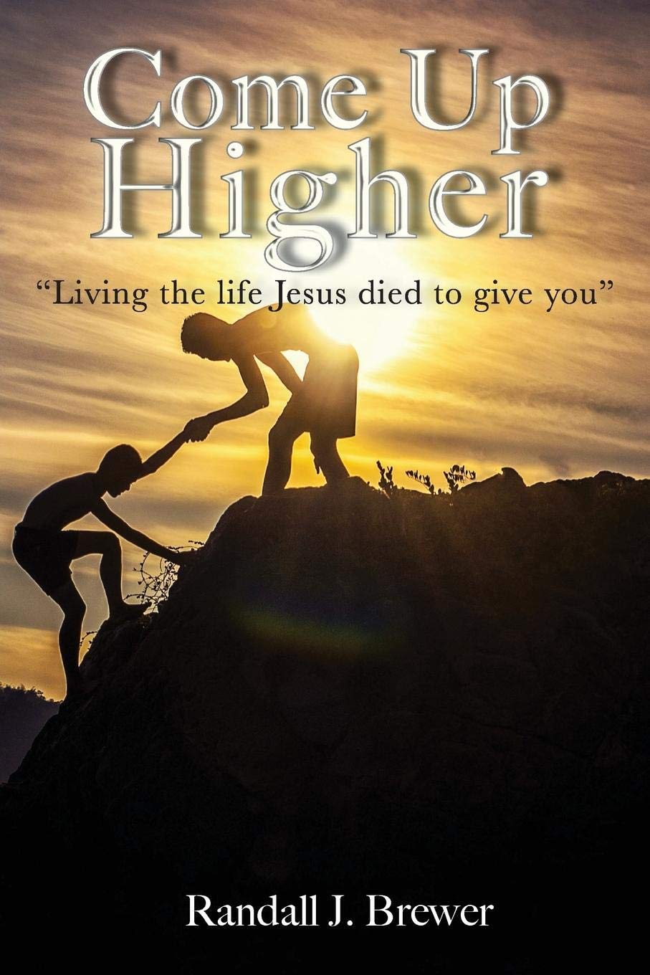
Never Forget We Are to Live by Great Faith….
Romans 1:17 For therein is the righteousness of God revealed from faith to faith: as it is written, The just shall live by faith.
Living Higher means living by faith.
2 Corinthians 5:7 (For we walk by faith, not by sight:)
Living Higher means walking by faith, not by sight….
2 Corinthians 4:13 We having the same spirit of faith, according as it is written, I believed, and therefore have I spoken; we also believe, and therefore speak;
Living Higher means speaking by faith…
Hebrews 11:6 But without faith it is impossible to please him: for he that cometh to God must believe that he is, and that he is a rewarder of them that diligently seek him.
Living Higher means seeking by faith…
Romans 10:17 So then faith cometh by hearing, and hearing by the word of God.
Living Higher means hearing the word of God

Slide 10
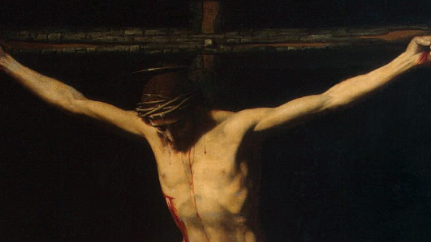
How to Keep the Main Thing the Main Thing….
Are you living higher in God by Fait? Living for the Great Commission and Great Commandment? Here are four way you can pray for to live higher for God.
Pray for God to open blind eyes to live higher
2 Cor. 4:4, Eph. 1:17-18, Acts 26:16
Pray for inner peace to live higher.
Hebrews 12:14, James 3:18, · ‎John 16:33
3. Pray for God’s Grace to live higher.
Eph. 2:8, Heb. 4:16, Ti. 2:11
4. Pray for Vulnerability and Transparency to liv.
Ps. 41:1, 2 Cor. 12: 9-10, Luke 6:27-36

Slide 11
Let’s go to the Altar to Pray but Leave to Live Higher for God! Living Higher means letting go of old things and bad behaviors. Living Higher means demonstrating love in action… Living Higher means serving to gain the more… Living Higher means knowing you have the power to change the world.

