Slide 1
Building the “BELOVED COMMUNITY”
The Vision
Reid Temple AME Church is a Bible Believing, Christ-centered, Family – Integrated, Multigenerational, Culturally aware church, spreading the gospel of Jesus Christ while “Building the Beloved Community”.
Rom.8:38 For I am persuaded, that neither death, nor life, nor angels, nor principalities, nor powers, nor things present, nor things to come, Nor height, nor depth, nor any other creature, shall be able to separate us from the love of God, which is in Christ Jesus our Lord.

Slide 2
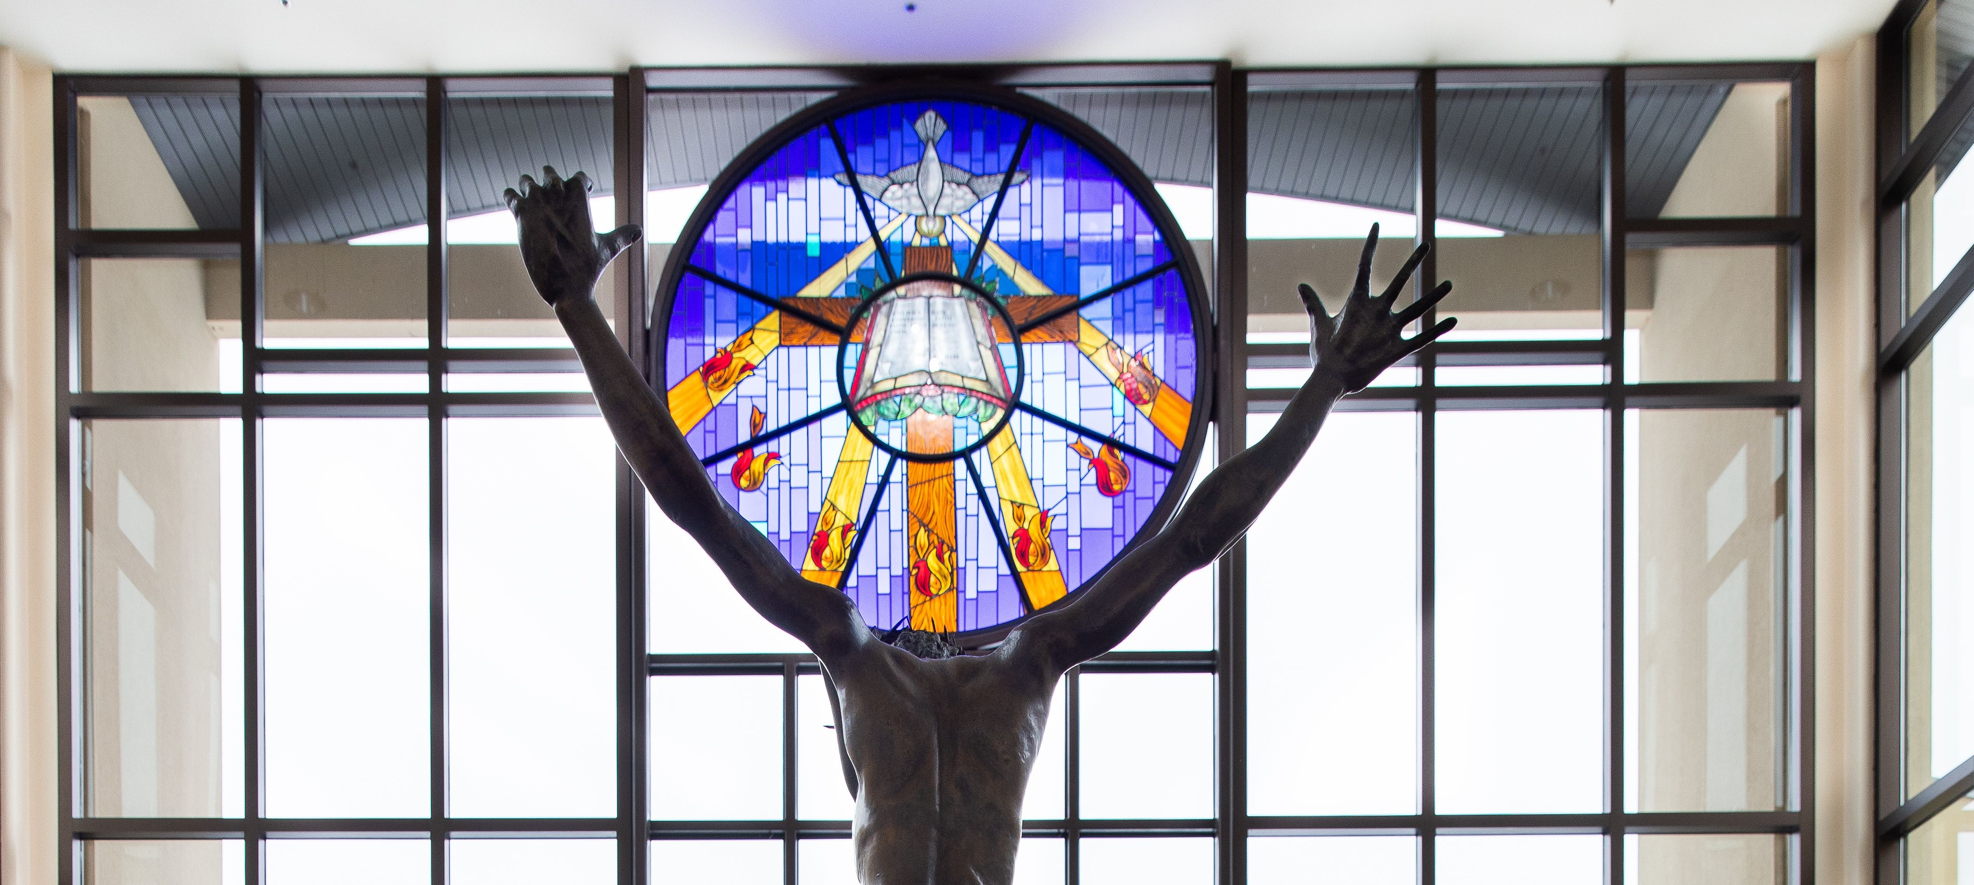
Reid Temple’s Mission and values
Our Mission:
The mission of Reid Temple AME Church is to increase and grow our ministry for the spiritual, social, and physical development of all people.
Our Core Values:
Faith in God
Integrity, Trust, and Ethical Behavior
Empowering People
Excellence and Innovation
Christ-centered Leadership

Slide 3
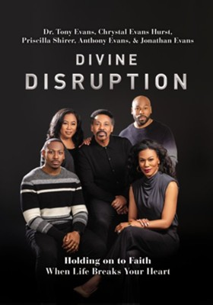

Slide 4
Going Higher in God: Love is action!
Dr. mark E. Whitlock, Jr.
Pastor

Slide 5
Course objectives: How to go higher is Love: Love is action!
Opening Prayer
The Word….
Love is an action
Love is not a feeling…
How to love….
Let’s Pray at the Altar together….
Thank you….

Slide 6
Love is The Word of God!
1 John 3:16 Hereby perceive we the love of God, because he laid down his life for us: and we ought to lay down our lives for the brethren. 17 But whoso hath this world's good, and seeth his brother have need, and shutteth up his bowels of compassion from him, how dwelleth the love of God in him? 18 My little children, let us not love in word, neither in tongue; but in deed and in truth.
Eros love is romantic love.
Storge love is family love.
Philia love is friendship love.
Agape love is unconditional love.

Slide 7
Love is action…
1 Corinthians 15:22 For as in Adam all die, even so in Christ shall all be made alive.
The first Adam gave into feelings.
The first Adam caused the fall of humanity….
Romans 5:8 But God commendeth his love toward us, in that, while we were yet sinners, Christ died for us.
God “sent” his love!!!
The second Adam loves by deeds and death.
.

Slide 9
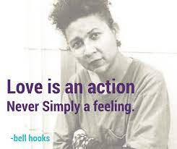
Love is not a feeling...
1 John 3:17 But whoso hath this world's good, and seeth his brother have need, and shutteth up his bowels of compassion from him, how dwelleth the love of God in him? 18 My little children, let us not love in word, neither in tongue; but in deed and in truth.
“To begin by always thinking of love as an action rather than a feeling is one way in which anyone using the word in this manner automatically assumes accountability and responsibility. hooks
“Love as 'the will to extend one's self for the purpose of nurturing one's own or another's spiritual growth.’
Love does.
love gives.
Love self-regulates
Love serves
Love creates

Slide 10
How to love?
Love is the Word…
Love is Asking
Love is action
Luke 6:31: Do to others as you would have them do to you.
John 15:12: My command is this: Love each other as I have loved you.
Corinthians 16:14: Do everything in love.
Acknowledge each other’s support
Ask what acts of service are most meaningful to them.
Encourage them to ask when they want something.
Communicate often and consistently.
Acts of service.
Offer an encouraging word.
Physical touch
Purchase a love gift.
Spend quality time.

Slide 11
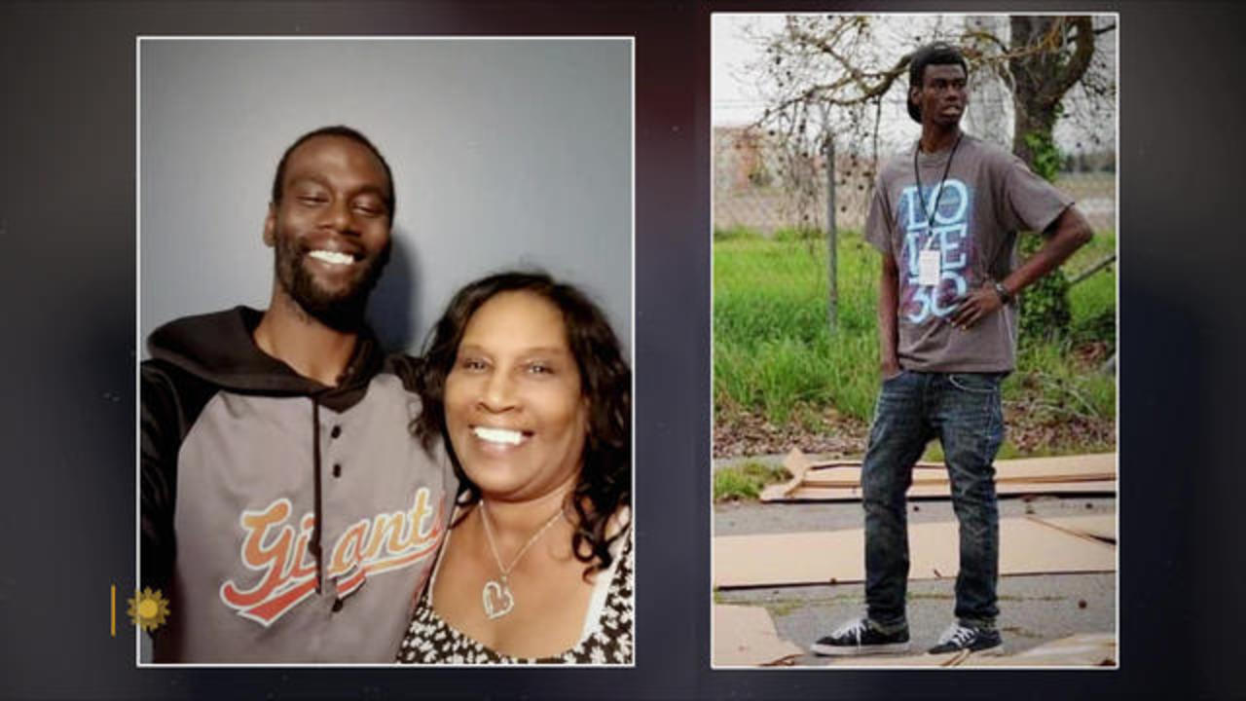
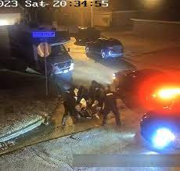
Let’s go to the altar to pray!
Tyre Nichols and RowVaughn Wells, mother

Slide 12
Reid Temple Care

