Slide 1
Meditation on God’s word: Going higher in faith
Dr. Mark E. Whitlock, Jr.
Reid Temple AME church

Slide 2
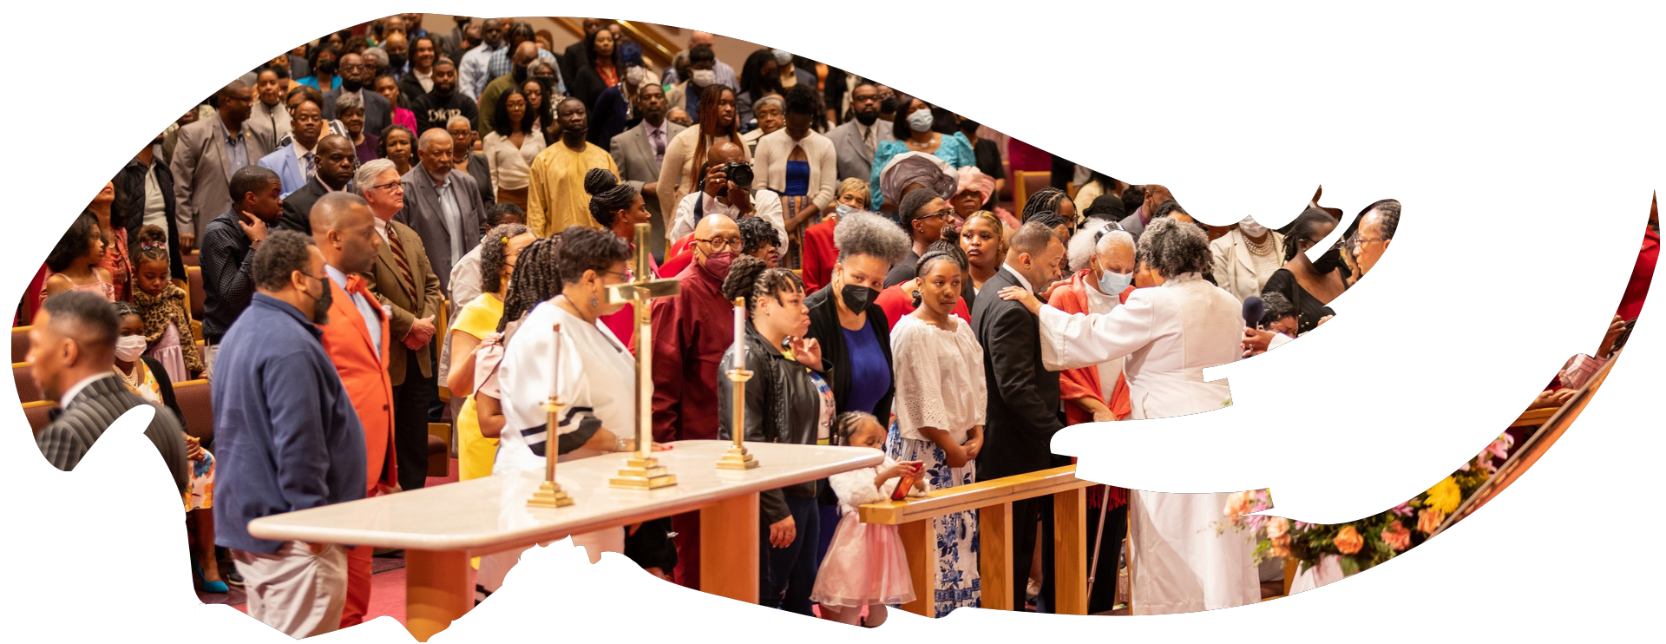
Our Core Values
Faith in GOD
Integrity, Trust and Ethical Behavior
Empowering people
Excellence and Innovation
Christ –centered Leadership

Slide 3
The Vision
Reid Temple AME Church is “Building the Beloved Community” by becoming a Bible Believing, Christ-centered, Family – Integrated, Multigenerational, Culturally aware church, spreading the gospel of Jesus Christ.

Slide 4
Our Strategic Goals
Membership Growth
Debt Free for Thee
Motivated and Skilled Staff & Volunteers
Community Commitment
New Demographic & Market Penetration

Slide 5
Overall Goals for 2023 -2024
Increase attendance to Bible Study
Increase baptisms
Increase the number of tithers
Increase the number of Disciples
Increase the number of servant leaders
Increase member and community engagement

Slide 6
Meditate On God’s Word: Going Higher in Faith
Dr. Mark E. Whitlock, Jr.
Reid Temple AME church

Slide 7
Course objectives: Meditate on God’s word!
Prayer
introduction to the lesson
The purpose of Christian meditation
How to meditate on God’s word
Let’s Meditate…
Questions, comments, and answers
Salvation and Offering
Thank you….

Slide 8
dysfunction
Unresolved emotional pain
Stress
Uncertainty
Addiction to pleasure
Fear of pain, failure, loss, bankruptcy, losing a job
Church escapism/bypassing
Church hurt

Slide 9
Introduction to the lesson!
Christian meditation is not transcendental meditation, which finds its roots in Hinduism and Buddhism.
The Bible uses meditation as deep contemplation, a method to go higher in faith by gaining greater understanding of the Word and be changed by God's truth.
Meditating on what God’s Word reveals about God:
His works (Psalm 143:5),
His deeds (Psalm 119:27),
His promises (Psalm 119:148), and
His unfailing love (Psalm 48:9).

Slide 10
The purpose of Christian meditation
The purpose of meditation is to eliminate common dysfunctional emotional patterns, the feeling of emotional deprivation and fear of abandonment.
Monkey brains, wild mind, troubling thoughts
To stop spiritual bypassing. The tendency to use church to avoid unhealed psychological wounds and overwhelming troubling emotions.
To stop hiding from psychological issues in church, as well as sensing the hidden power of our emotional patterns and relational wounding.
When Joshua was told to meditate constantly on God’s law, his meditation was to make him “careful to do everything written in it” (Joshua 1:8).
When Timothy is told to “meditate on” what Paul has written (1 Timothy 4:15, KJV)—the NASB has “be absorbed in.”
Meditation in Philippians 4:8 means to control their thoughts: “Finally, brothers and sisters, whatever is true, whatever is noble, whatever is right, whatever is pure, whatever is lovely, whatever is admirable—if anything is excellent or praiseworthy—think about such things.”

Slide 11
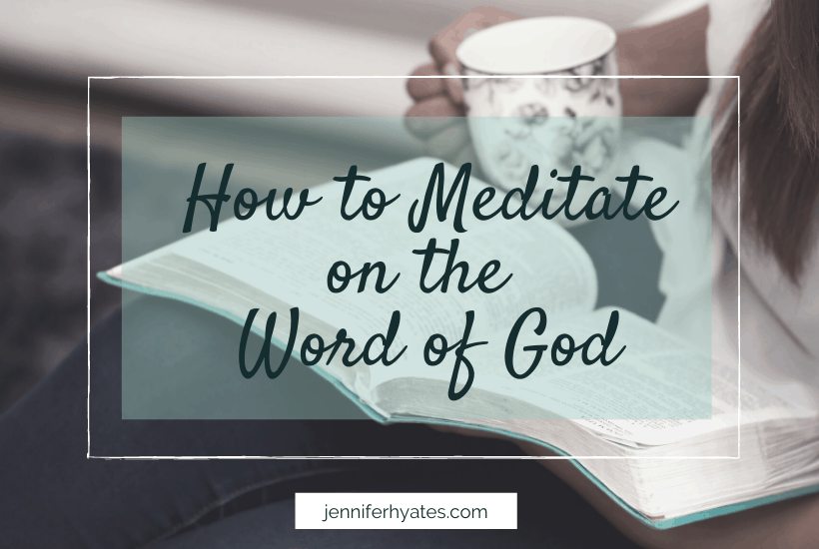
How to meditate on God’s word
1. Set a specific time and place each day to get alone and meditate on God’s Word.
2. Start with the Lord’s prayer and ask God to help you with your meditation.
3. Choose a scripture, research the meaning, memorize the text, and say it out loud during meditation.
4. apply the passage to your life and ask God to help you.

Slide 12
Let’s Meditate….
we can meditate on God’s Word by bringing to memory God’s truths.
The bible says in Ps. 63:6 “On my bed I remember you; I think of you through the watches of the night”.
The bibles says in Psalm 1:2, a blessed, fruitful, and righteous person delights in the Word of the Lord “and meditates on his law day and night.”
The bible says in Psalm 119:15, “I will study your commandments and reflect on your ways” (NLT). So biblical meditation involves deep reflection and study of God’s Word.
We meditate on God’s Word by filling our minds by studying god’s word.
Learn to relax and rest.
Raise your arms and then let your hands drop onto your thighs.
Exhale a loud, big breath.
Drop your awareness from thinking into what your body feels.

Slide 13
Questions and answers
This Photo by Unknown Author is licensed under CC BY-SA

Slide 14
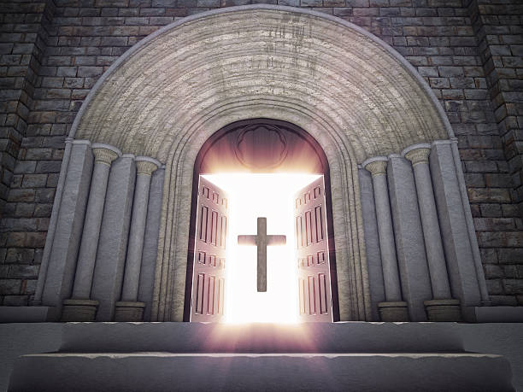
Doors of the church are open: “REID TEMPLE CARES”

