Slide 1
WORSHIPPING HIGHER IN GOD:
ARE YOU PREPARED TO WORSHIP?

Slide 2
COURSE OBJECTIVES:
Prayer
What is Preparation?
Holy Scriptures –Nehemiah 9:1-2
Fasting to Worship
Mourning to Worship
Separating to Worship
Confession of sin to Worship
Prayer at the Altar
Salvation and Offering
Thank you!

Slide 3
WHAT DOES PREPARATION MEAN IN THE BIBLE?
According to the strong Bible definition, the word “prepare” means “to be firm, be stable, be established, to be set up, to be ready, to make arrangement”. In other words, we need to stand firm in our faith in God, be stable in our walk with God, and be ready to meet God.
The biblical truth is this: God does the planning; we do the preparing. God is the one who says (Jeremiah 29:11-13), “For surely, I know the plans I have for you, says the Lord, plans for your welfare and not for harm, to give you a future with hope.
Prepare to meet God. Solomon wrote, "Guard your steps when you go to the house of God" (Eccl. 5:1).
One rendering of this verse is: "Watch your feet when you go to the house of God." The phrase guard your steps means to proceed with reverence, tip toeing into the presence of God.

Slide 4
THE BENEFITS OF PREPARATION FOR WORSHIP!
Invites The Presence of God: 2 Chronicles 5:11-14
Brings Victory: 2 Chronicles 20:15-20
Brings Deliverance From Enemies: Psalm 18:3
Satisfies The Soul: Psalm 63:1-5
Repels Depression: Isaiah 61:3
Brings Liberty: Acts 16:25-26
Brings Joy: Psalm 100:4
Draws Men To God: John 12:32

Slide 5
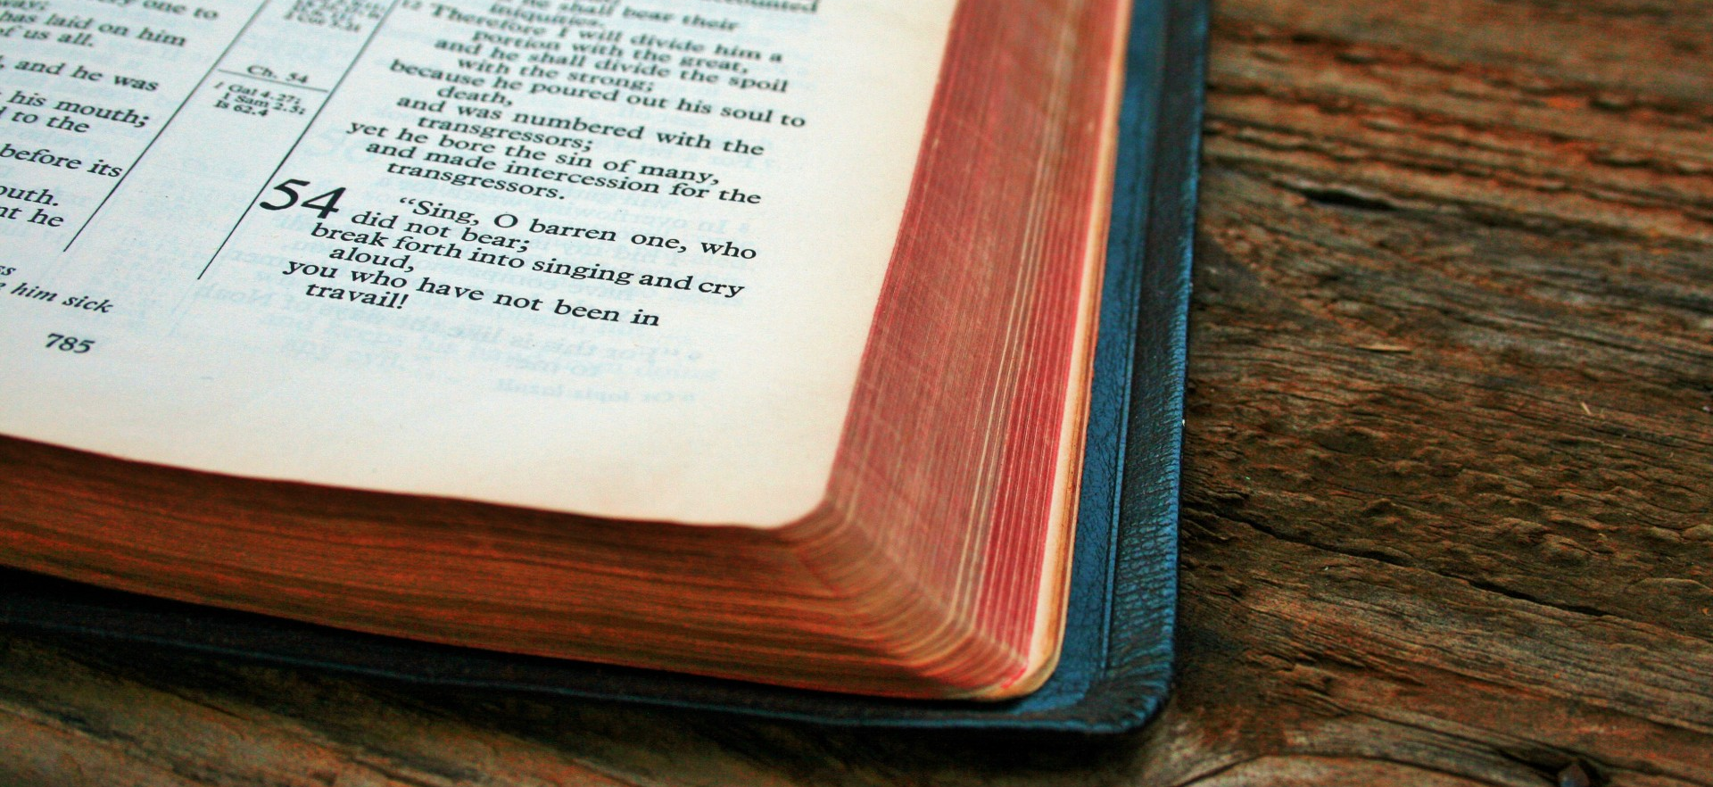
THE HOLY WORD: NEHEMIAH 9:1-2 KJV
Nehemiah 9:1 Now in the twenty and fourth day of this month the children of Israel were assembled with fasting, and with sackclothes, and earth upon them.
2 And the seed of Israel separated themselves from all strangers, and stood and confessed their sins, and the iniquities of their fathers.

Slide 6
TRUE WORSHIPPERS ARE PREPARED FOR WORSHIP!
In John 4:23, Jesus said this: “Yet a time is coming and has now come when the true worshipers will worship the Father in spirit and truth, for they are the kind of worshipers the Father seeks.”
The reality that God the Father is seeking worshipers who worship in spirit and truth, implies that there is both a wrong and right way to worship God.
Some people say, “I didn’t get anything out of the service”.
They say, “I was not fed the Word.”
Maybe, it’s because all you did was fall out of bed to come to church!!!
There was no preparation to receive the Word of God!
TRUE WORSHIP is coming before the most powerful being in the Universe!!!

Slide 7
PREPARE FOR WORSHIP
BY FASTING!

Slide 8
PREPARE FOR WORSHIP BY FASTING!
Nehemiah 9:1 Now in the twenty and fourth day of this month the children of Israel were assembled with fasting, and with sackclothes, and earth upon them.
Fasting is typically the sacrifice of abstaining from food for a period before coming to worship.
God expects each of us to fast in some form or another.
Fasting is not limited to food; it can be anything that demands a tremendous amount of our time, focus, or energy. (Internet, Facebook, TV, hobbies, etc.)

Slide 9
PREPARE FOR WORSHIP BY MOURNING
Nehemiah 9:1 and with sackclothes, and earth upon them.
The sackcloth and dust was meant to be a picture of their hearts before God.
This practice was associated with mourning and would typically be done at funerals. In this case, the Israelites were mourning over their sins and neglect of the law.

Slide 10
Mourning is not only preparation for worship, but God also expects us to mourn our sins committed.
Isaiah 6:5: “Woe to me!’ I cried. ‘I am ruined! For I am a man of unclean lips, and I live among a people of unclean lips, and my eyes have seen the King, the LORD Almighty.”
Matthew 5:4 “Blessed are those who mourn for they will be comforted”.
God blesses those who mourn over their own sin and the sin of the world.

Slide 11
PREPARE FOR WORSHIP
BY SEPARATING!
Nehemiah 9:2 And the seed of Israel separated themselves from all strangers,
God called the nation of Israel to separate from the Canaanites because of their sexual immorality, false worship, and lack of morals.
God calls the Church to be separate from the world.
2 Corinthians 6:17 Wherefore come out from among them, and be ye separate, saith the Lord, and touch not the unclean thing; and I will receive you.

Slide 12
STANDING TO CONFESS SIN TO WORSHIP
Neh. 9:2 stood and confessed their sins, and the iniquities of their fathers.
Many people have ineffective worship because they have not confessed and turned away from their sin.
James 5:16 “Confess your sins to one another and pray for one another, that you may be healed.”
God assures us that while our relationship with Him is personal, it's not private.
God expects us to confess sin before worshipping….

Slide 13
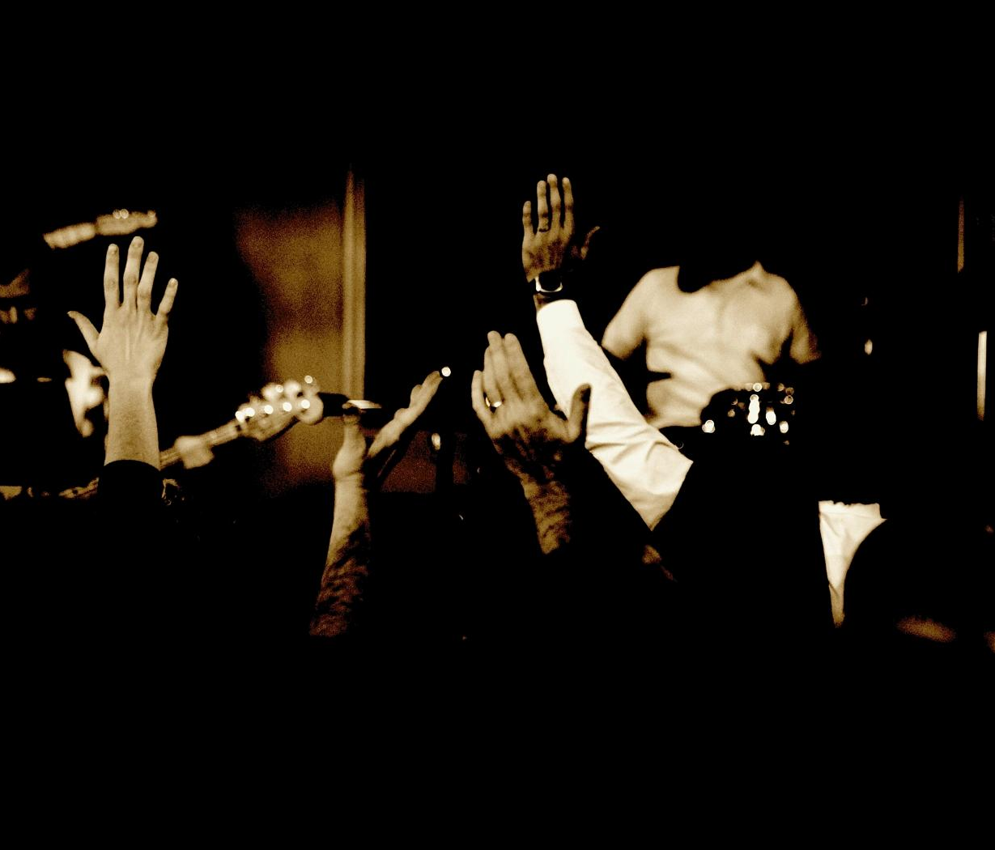
If we are going to worship God, we must prepare through fasting, mourning, separating, and confession.
An unprepared worship is an unacceptable worship!
UNPREPARED WORSHIP
IS
UNACCEPTABLE WORSHIP!!

Slide 14
God expects each of us to fast in some form or another.
God expects us to mourn for committing sin.
God expects us to separate from sinful people, sinful places, and sinful ways.
God expects us to confess our sins.

Slide 15
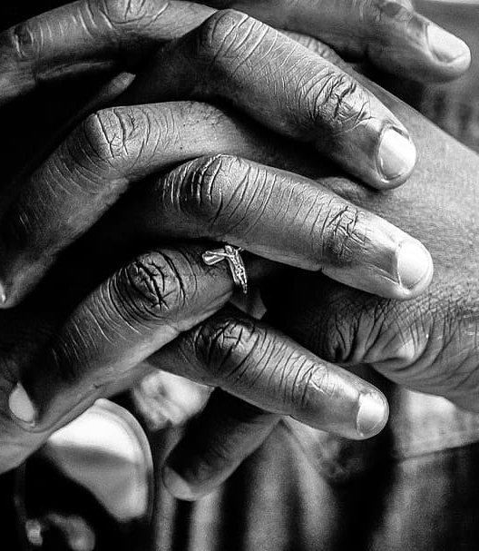
LET’S PRAY!!
Come to the altar to pray and confess your sins.

Slide 16
Doors of the church are open:
“REID TEMPLE CARES”

Slide 18
