Slide 1
FINISHING HIGHER IN GOD: SPIRITUAL PREPARATION FOR ADVENT PRODUCES HOPE!
Dr. Mark E. Whitlock, Jr.
Senior Pastor

Slide 2
COURSE OBJECTIVES:
Prayer
Holy Scriptures: Isaiah 9:6-7; John 14:1-3
History of Advent
Spiritual Preparation for Advent
Focus on Hope, Peace, Joy, and Love for Advent
Christian Mindfulness for Advent
Prayer at Alter
Salvation & Offering
THANK YOU!

Slide 3
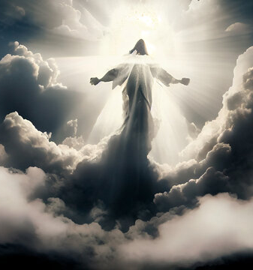
The Holy Word For Advent
Isaiah. 9:6- For to us a child is born, to us a son is given, and the government will be on his shoulders. And he will be called Wonderful Counselor, Mighty God, Everlasting Father, Prince of Peace.
7 Of the increase of his government and peace there shall be no end, upon the throne of David, and upon his kingdom, to order it, and to establish it with judgment and with justice from henceforth even for ever. The zeal of the Lord of hosts will perform this.
John 14:1- Let not your heart be troubled: ye believe in God, believe also in me. 2 In my Father's house are many mansions: if it were not so, I would have told you. I go to prepare a place for you.
3 And if I go and prepare a place for you, I will come again, and receive you unto myself; that where I am, there ye may be also.

Slide 4
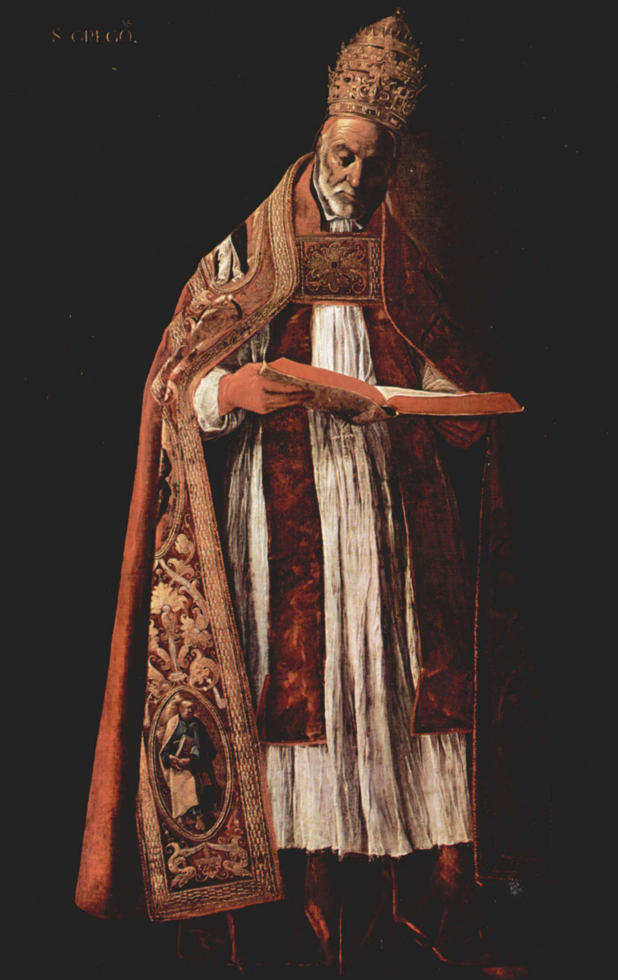
The History of Advent!
The earliest church centered its liturgical calendar around Easter. By the middle of the fourth century, celebrations of Jesus’s birth on December 25th in the West were increasingly common. ​
Advent is a period of four Sundays prior to the feast of the Nativity, took shape in the pontificate of Gregory I in the late sixth century. Pope Gregory I, developed the Advent liturgies by composing prayers, songs, readings, and responses for congregational worship. ​
.

Slide 5
The History of Advent!
Advent celebrations often concluded with baptisms and highlighted new life and union with the incarnate Christ.​
Advent looks forward to the final realization of all that Jesus’s incarnation at Christmas put into motion. For this reason, instead of the Gospels’ birth narratives, Advent sermons often centered on eschatological passages (Luke 21:25–36 and Matthew 24:37–44) or on the Triumphal Entry (Matthew 21:1–9) as a joyful anticipation of Jesus’s victorious second coming.

Slide 6
Spiritual Preparation for Advent
Advent is a season of spiritual preparation and is a time when Christians reflect on the significance of the birth of Jesus Christ and His Return. ​
Isaiah 9:2- The people walking in darkness have seen a great light; on those living in the land of deep darkness a light has dawned. ​
John 14:3- And if I go and prepare a place for you, I will come again, and receive you unto myself; that where I am, there ye may be also.​
Prepare to go Higher in God
Pivot Your Perspective
Pray to God​
Practice Silence and Solitude ​
Practice Patience

Slide 7
Focus on Hope, Peace, Joy,
and Love for Advent
The four candles on the wreath are three purple candles and one rose-colored candle. ​
Week 1: Represents the HOPE in Jesus. John 1:5​
Week 2: Represents the PEACE found in Jesus. John 14:27​
Week 3: Represents the JOY in Jesus. John 15:11​
Week 4: Represents the LOVE in Jesus. John 15:12-13

Slide 8
Christian Mindfulness for Advent
Advent promotes Christian mindfulness. Christian mindfulness is the calming of our minds and keeping a vertical focus on God who brought us out of darkness.​
Philippians 2:1-5​
Be in present moment.​
Be prepared mentally.​
Be of the same love as Jesus. ​
Be one in spirit and of one mind.​
Be humble like Jesus.​
Be of the same mindset as Jesus.

Slide 9
LET’S PRAY!! Come to the altar to pray and confess your sins.

Slide 10
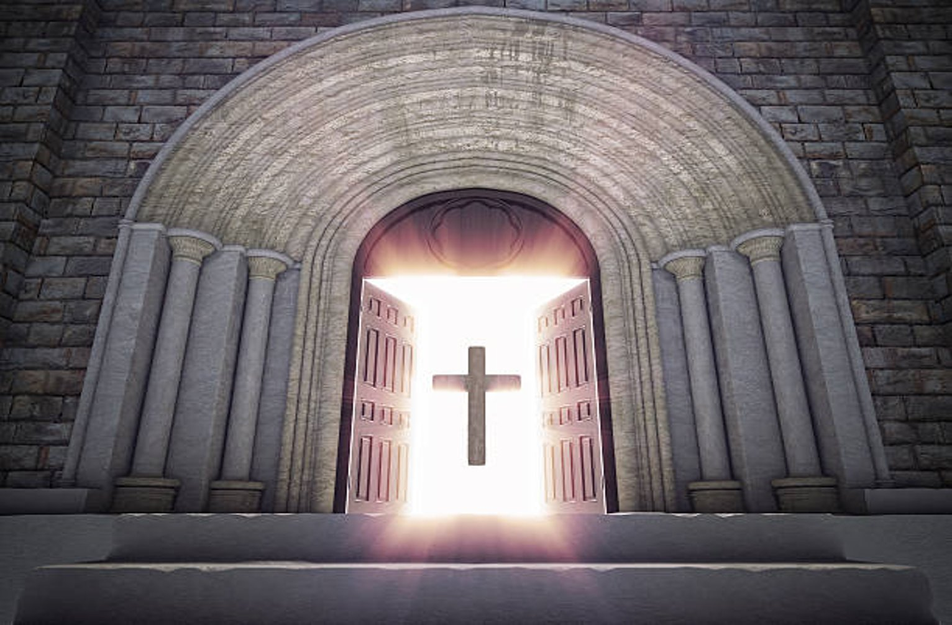
Doors of the church are open: “REID TEMPLE CARES”

