Slide 1
FINISHING HIGHER IN GOD:
BE STRONG WHILE FINISHING STRONG!

Slide 2
COURSE OBJECTIVES:
I. Prayer
II. Holy Scriptures: 2 Timothy 4:6-8
III. Advent and Christian Life
IV. Be Strong While Finishing Strong
V. Focus on Joy for Advent
VI. Prayer at the Altar
VII. Salvation and Offering
VIII. THANK YOU!

Slide 3
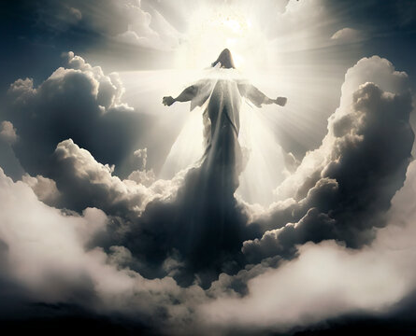
The Holy Word For Advent
2 Timothy 4:6 - For I am now ready to be offered, and the time of my departure is at hand.
7 I have fought a good fight, I have finished my course, I have kept the faith:
8 Henceforth there is laid up for me a crown of righteousness, which the Lord, the righteous judge, shall give me at that day: and not to me only, but unto all them also that love his appearing.

Slide 4
ADVENT AND CHRISTIAN LIFE
Advent symbolizes the church's present situation in these “last days” (Acts 2:17, Hebrews 1:2) as God’s people wait for the return of Christ in glory to consummate His eternal Kingdom.
The Church is in a similar situation to Israel at the end of the Old Testament: in exile, waiting and hoping in prayerful expectation for the coming of the Messiah. Israel looked back to God’s past gracious actions on their behalf in leading them out of Egypt in the Exodus, and on this basis, they called for God once again to act for them.
In the same way, the church, during Advent, looks back upon Christ’s coming in celebration while at the same time looking forward in eager anticipation to the coming of Christ’s kingdom when he returns for his people.

Slide 5
ADVENT AND CHRISTIAN LIFE
It is between the fulfilled promise of Christ’s first coming and the yet-to-be-fulfilled promise of his second coming that Karl Barth penned these words: “Unfulfilled and fulfilled promise are related to each other, as are dawn and sunrise. Both promise and in fact the same promise.
If anywhere at all, then it is precisely in the light of the coming of Christ that faith has become Advent faith, the expectation of future revelation. But faith knows for whom and for what it is waiting. It is fulfilled faith because it lays hold on the fulfilled promise.”
The promise for Israel and the church is Jesus Christ; The Lord has come to earth and will arrive again. This is the essence of Advent.

Slide 6
Be Strong While Finishing
Strong in Advent
Set Clear Goals: Habakkuk 2:2
Create a Timeline: Proverbs 16:3
Eliminate Distractions: 1 Peter 5:8
Stay Organized: Ecclesiastes 3
Communicate Often: Ephesians 4:29
Stay Positive and Resilient:
Philippians 4:6–7
Finish Strong: Galatians 6:9
Praise God For Finishing Strong: Hebrews 10:35

Slide 7
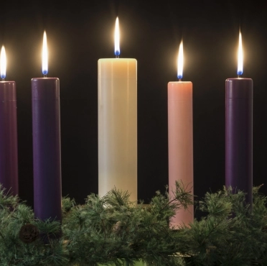
Focus on Hope, Peace, Joy, and Love for Advent
The four candles on the wreath are three purple candles and one rose-colored candle.
Week 1: Represents the HOPE in Jesus. John 1:5
Week 2: Represents the PEACE found in Jesus. John 14:27
Week 3: Represents the JOY in Jesus. John 15:11
Week 4: represents the LOVE in Jesus. John 15:12-13

Slide 8
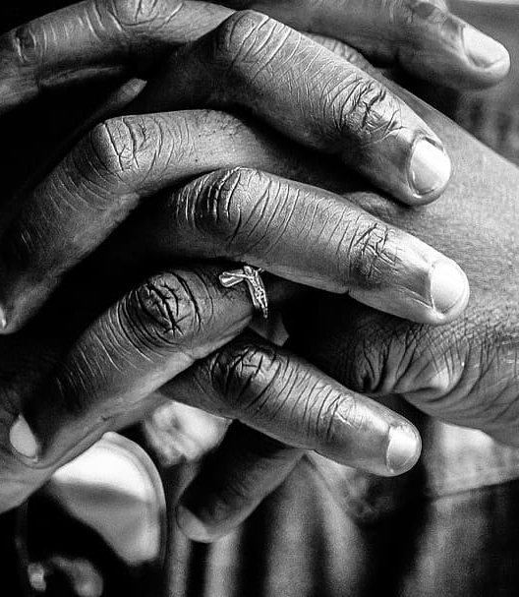
LET’S PRAY!!
Come to the altar to pray and confess your sins.

Slide 9
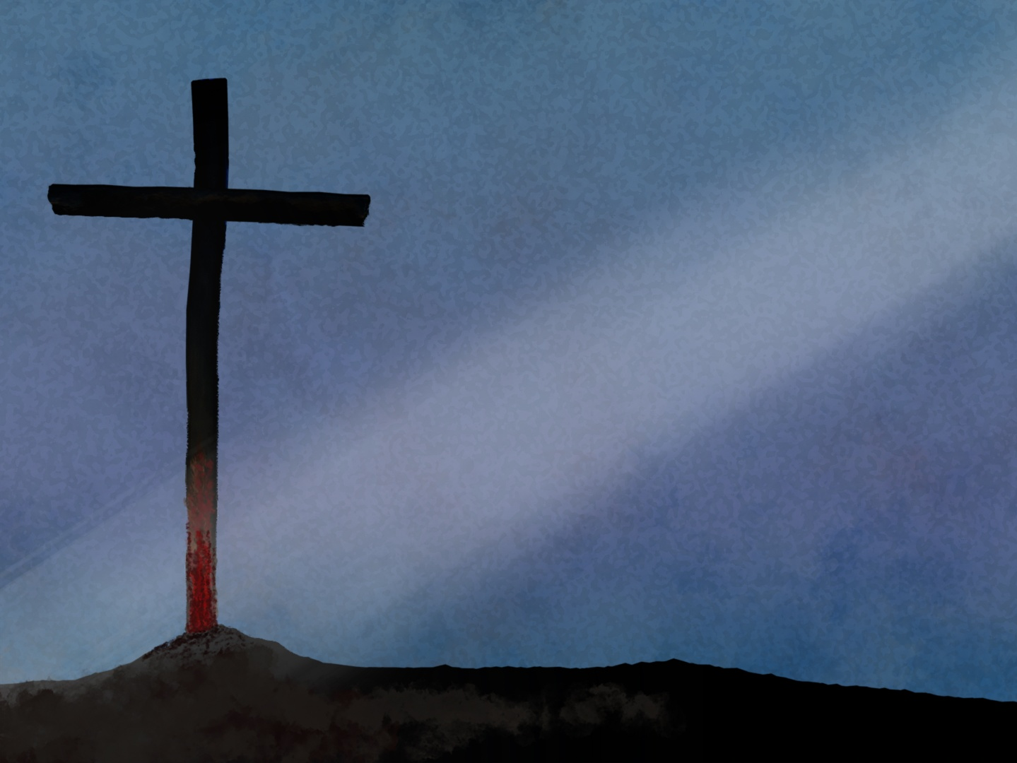
Doors of the church are open:
“REID TEMPLE CARES”

Slide 11
