Slide 1
WORSHIPPING HIGHER IN GOD:
The Anointing Leads to Healing

Slide 2
COURSE OBJECTIVES:
Prayer
Holy Scriptures – Ex. 23:25; 1 Peter 2:24
Worship Leads to Healing
True Worship Is To Encounter The Divine
Activate God’s Healing Power
Worshipping Leads to God’s Anointing and Healing
Prayer at the Altar
Salvation and Offering
Thank you!

Slide 3
WORSHIPPING LEADS TO HEALING !
Exodus 23:25: “Worship the Lord your God, and His blessing will be on your food and water. I will take away sickness from among you,”
If they did reject the gods of the Canaanites and continue in faithfulness to God, He promised to bring blessing through their whole life.
1 Peter 2:24: "He Himself bore our sins' in His body on the cross, so that we might die to sins and live for righteousness; 'by His wounds you have been healed. ”
Jesus took up his cross and died to give us life. For us, taking up our cross consists of dying to our old selfish, sinful ways of life and then following Jesus wherever He leads us.

Slide 4
TRUE WORSHIP IS TO ENCOUNTER THE DIVINE:
1 Peter 2:24: “He Himself bore our sins' in His body on the cross, so that we might die to sins and live for righteousness; by His wounds you have been healed. ”
This includes allusions to several suffering servant passages in Isaiah:
• “He has borne our sickness” (Isaiah 53:4).
• “By his wounds we are healed” (Isaiah 53:5).
• “He will bear their iniquities” (Isaiah 53:11).
• “He bore the sin of many” (Isaiah 53:12).
Peter’s point is that it is that, by virtue of Jesus’ death on the cross, it has become possible for us to die to sins and “live to righteousness.”

Slide 5
Activate God’s Healing Power!
James 5:16: Confess your faults one to another, and pray one for another, that ye may be healed. The effectual fervent prayer of a righteous man availeth much.
Jeremiah 30:17: For I will restore health unto thee, and I will heal thee of thy wounds, saith the Lord.
Jeremiah 17:14: Heal me, O Lord, and I shall be healed; save me, and I shall be saved: for thou art my praise.
Pray with authority to activate Gods power.
Pray for restoration even when they don’t instantly get healed.
Pray a prayer of praise in advance for healing, salvation, and the anointing and watch God do the miraculous.

Slide 6
Worshipping Higher in God Leads to an Anointing and Healing!
Brings the Anointing: Luke 4:18, Acts 4:27, Acts 10:38, and Hebrews 1:9
Brings Healing: Exodus 23:25
Brings Deliverance From Sin: 1 Peter 2:24
Repels Depression: Isaiah 61:3
Brings Liberty: Acts 16:25-26
Brings Unspeakable Joy: Psalm 100:4

Slide 7
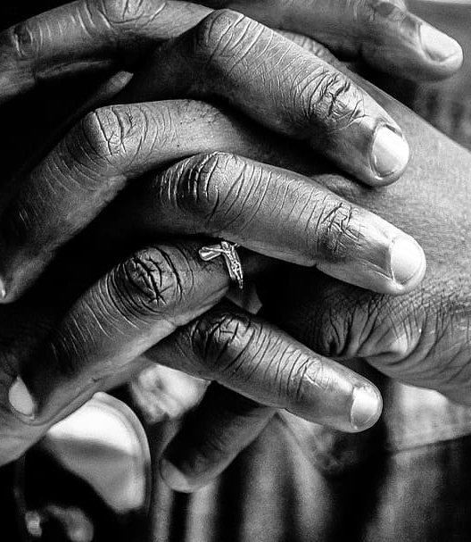
LET’S PRAY!!
Come to the altar to pray and confess your sins.

Slide 8
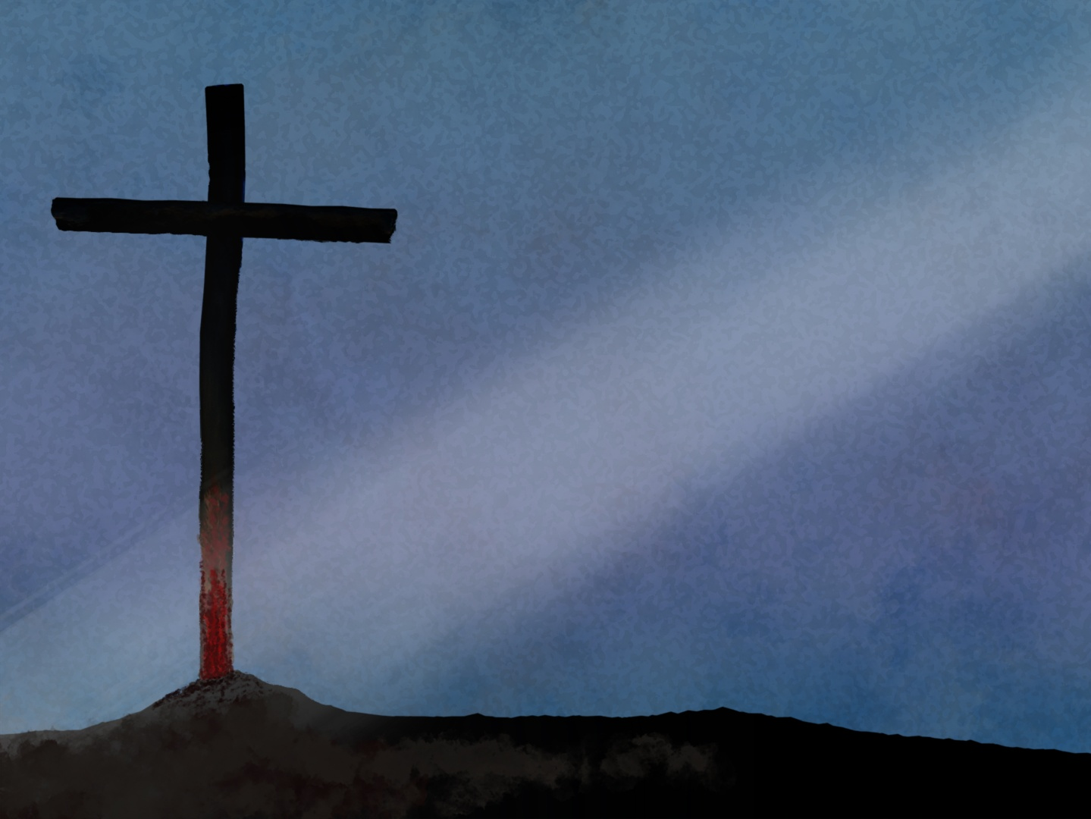
Doors of the church are open:
“REID TEMPLE CARES”

Slide 10
