Slide 1
August Theme 2023 ”REFUELING to Go Higher in God”
Reid Temple A.M.E. Church
Reid Temple Wednesday Night Bible Study
August 9, 16, 23 and 30, 2023
Rev. Dr. Debyii L. Sababu-Thomas, Facilitator
Rev. Dr. Mark E. Whitlock, Pastor
WEEK 2

Slide 2
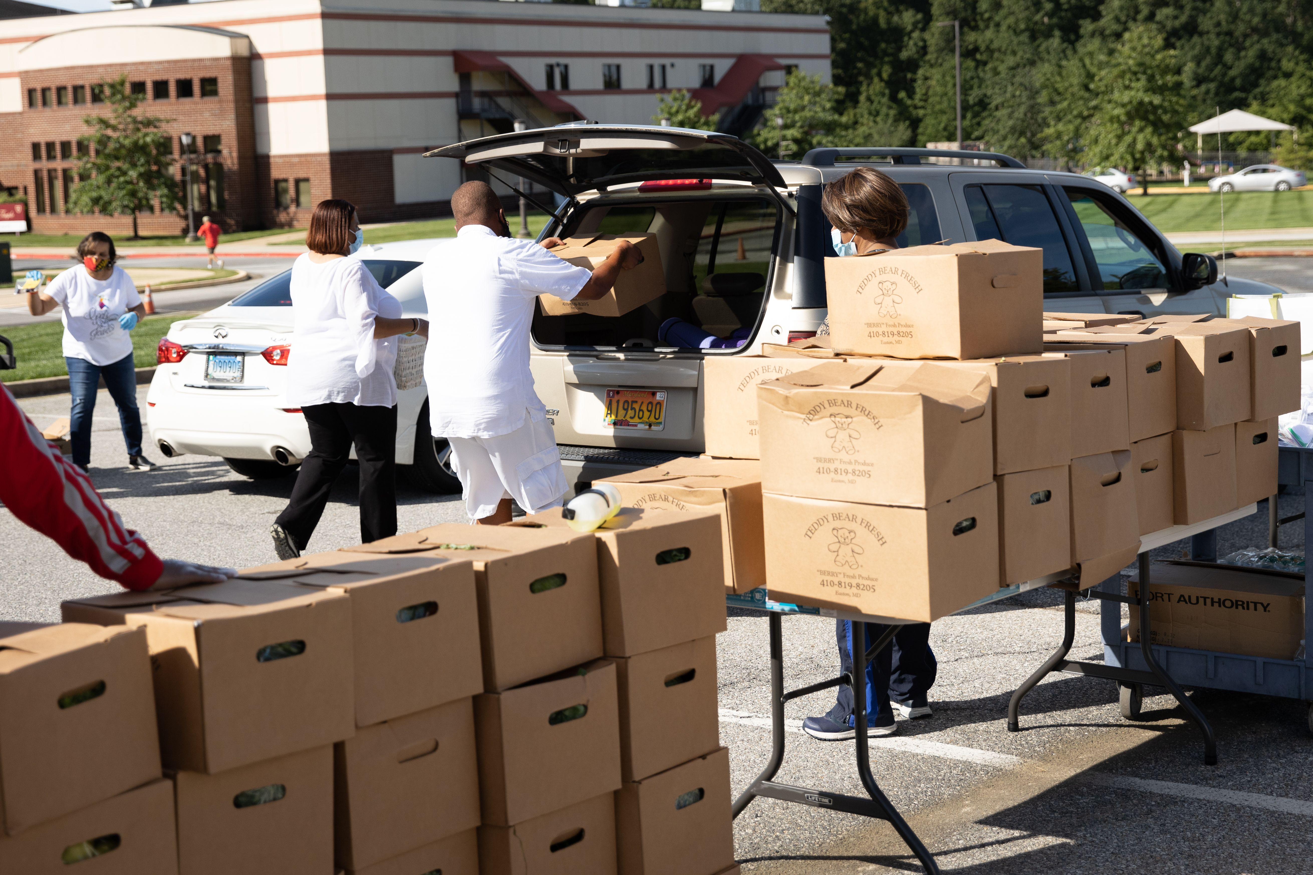
First Things First: Reaffirming who we are as a Church
OUR MISSION
OUR VISION
The Mission of Reid Temple AME Church is
to increase and grow our ministry
for the spiritual, social, and
physical development of all people.
Reid Temple AME Church is a
Bible Believing,
Christ-centered,
Family-Integrated,
Multigenerational,
Culturally aware church,
Spreading the Gospel of Jesus Christ while
“Building the Beloved Community”.
OUR CORE VALUES
Faith in God
Integrity, Trust, and Ethical Behavior
Empowering People
Excellence and Innovation
Christ-centered Leadership
©Debyii L. Sababu-Thomas, Ph.D..

Slide 3
“REFUELING to Go Higher in God!!! Spiritual Foundations
August 2023 – Church-wide Theme
Bible Study Goals
THE CASE for REFUELING: Key Texts
Challenges: External/Internal
FINDING the RIGHT FUEL
Assignment for Next Week
Q& A
* All topics are subject the leading of the Holy Spirit

Slide 4
“REFUELING to Go Higher in God!!!
Special Suggestions for a Meaningful Study
Access to Bible and Bible Study tools (Print and Online)
Notebook
Journal
An open, willing, committed and determined mindset to go Higher in the things of God,
A co-learner, prayer partner or someone to ride “shot gun” with you on your journey
ASSIGNMENT-Responses
* All topics are subject the leading of the Holy Spirit

Slide 5
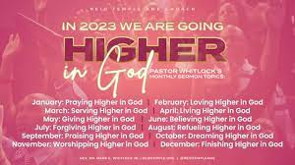
2023 THEME: GOING HIGHER IN GOD
To Go Higher in God
To Grow Stronger in God
To Get Closer to God

Slide 6
2023 THEME: GOING HIGHER IN GOD
To Grow Stronger in God - To Get Closer to God

Slide 7
The ENERGY/EXHAUSTION SPECTRUM
Satisfaction
>Contentment
>Manageable
>Tolerable
>Draining
>Overwhelming
>Unbearable
BURNOUT - COMPASSION FATIQUE

Slide 8
Challenges: The ENERGY/EXHAUSTION SPECTRUM
Satisfaction
>Contentment
>Manageable
>Tolerable
>Draining
>Overwhelming
>Unbearable
BURNOUT - COMPASSION FATIQUE

Slide 9
Burnout vs Compassion Fatigue
Burnout
Stems from deep exhaustion and a lack of motivation due to overexertion
describes the impact of a stressful workplace
Overload from external stimuli while functioning/achieving in an organizational/work goals/tasks
Ex. Excess assignments, limited resources, excessive overtime, etc.
Compassion fatigue
Comes from the fatigue caused by dealing with others’ trauma and sufferings, and it is common in any type of profession that focuses on helping others.
Describes the impact of helping others
Overwhelmed by external responsibilities related to helping others in need
Ex. Medical, Parental/Family
Notes:
1. https://semo.edu/faculty-senate/_pdfs/burnout-vs-compassion-fatigue-handout.pdf
2. https://www.griefworkcenter.com/compassion-fatigue-vs-burnout/

Slide 10
KEY SCRIPTURE BE FILLED with the FULLNESS of GOD
Ephesians 3: 14 -19
¹⁴ For this reason I bow my knees to the Father ^{[f]}of our Lord Jesus Christ, ¹⁵ from whom the whole family in heaven and earth is named, ¹⁶ that He would grant you, according to the riches of His glory, to be strengthened with might through His Spirit in the inner man, ¹⁷ that Christ may dwell in your hearts through faith; that you, being rooted and grounded in love, ¹⁸ may be able to comprehend with all the saints what is the width and length and depth and height— ¹⁹ to know the love of Christ which passes knowledge; that you may be filled with all the fullness of God.

Slide 11
WHAT DOES It Mean? TO BE FILLED WITH THE FULLNESS
The fullness of God is the totality of everything God is—His attributes, His character, His perfection, His holiness, His power, His love, et cetera. The fullness of God is His complete nature; it is who He is. God.
To walk with the Holy Spirit and demonstrate the FRUIT (Ephesians 5:22-23) and the Gifts of the Holy Spirit.
To fulfill the Ministry of Jesus Christ (Isaiah 61:1-4

Slide 12
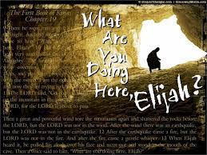
SIX Biblical Strategies for BEING REFUELED
ELIJAH’s Story (Compassion Fatigue) I Kings 19:1-14
I Kings 19:4 Acknowledge that you are in Need
I Kings 19:5 Find somewhere to Rest
I Kings 19:6 Nourish Yourself (Eat)
I Kings 19:8 Seek the Lord ---anyway you can!
I Kings 19:14 Take a Walk and
Spend time with God!
ISAIAH’s WISDOM:
Isaiah 40:28-31 Trust and WAIT

Slide 13
ASSIGNMENT for NEXT WEEK:
NEXT WEEK:
A TIME of REFRESHING Anointing Service!!!
Find Three (3 Scriptures) about being “refueled”
Reflect on how you have been refueled
Write in your journal if you feel led
Reflect on “The Times of Refreshing for next week

Slide 14
Rev Dr. Debyii L. Sababu-Thomas
Email: RevDebyii@reidtemple.org
Phone: #01 352-1746

