Slide 1
August Theme 2023 “REFUELING to Go Higher in God”
Reid Temple A.M.E. Church
Reid Temple Wednesday Night Bible Study
August 9, 16, 23 and 30, 2023
Rev. Dr. Debyii L. Sababu-Thomas, Facilitator
Rev. Dr. Mark E. Whitlock, Pastor
WEEK 3

Slide 2
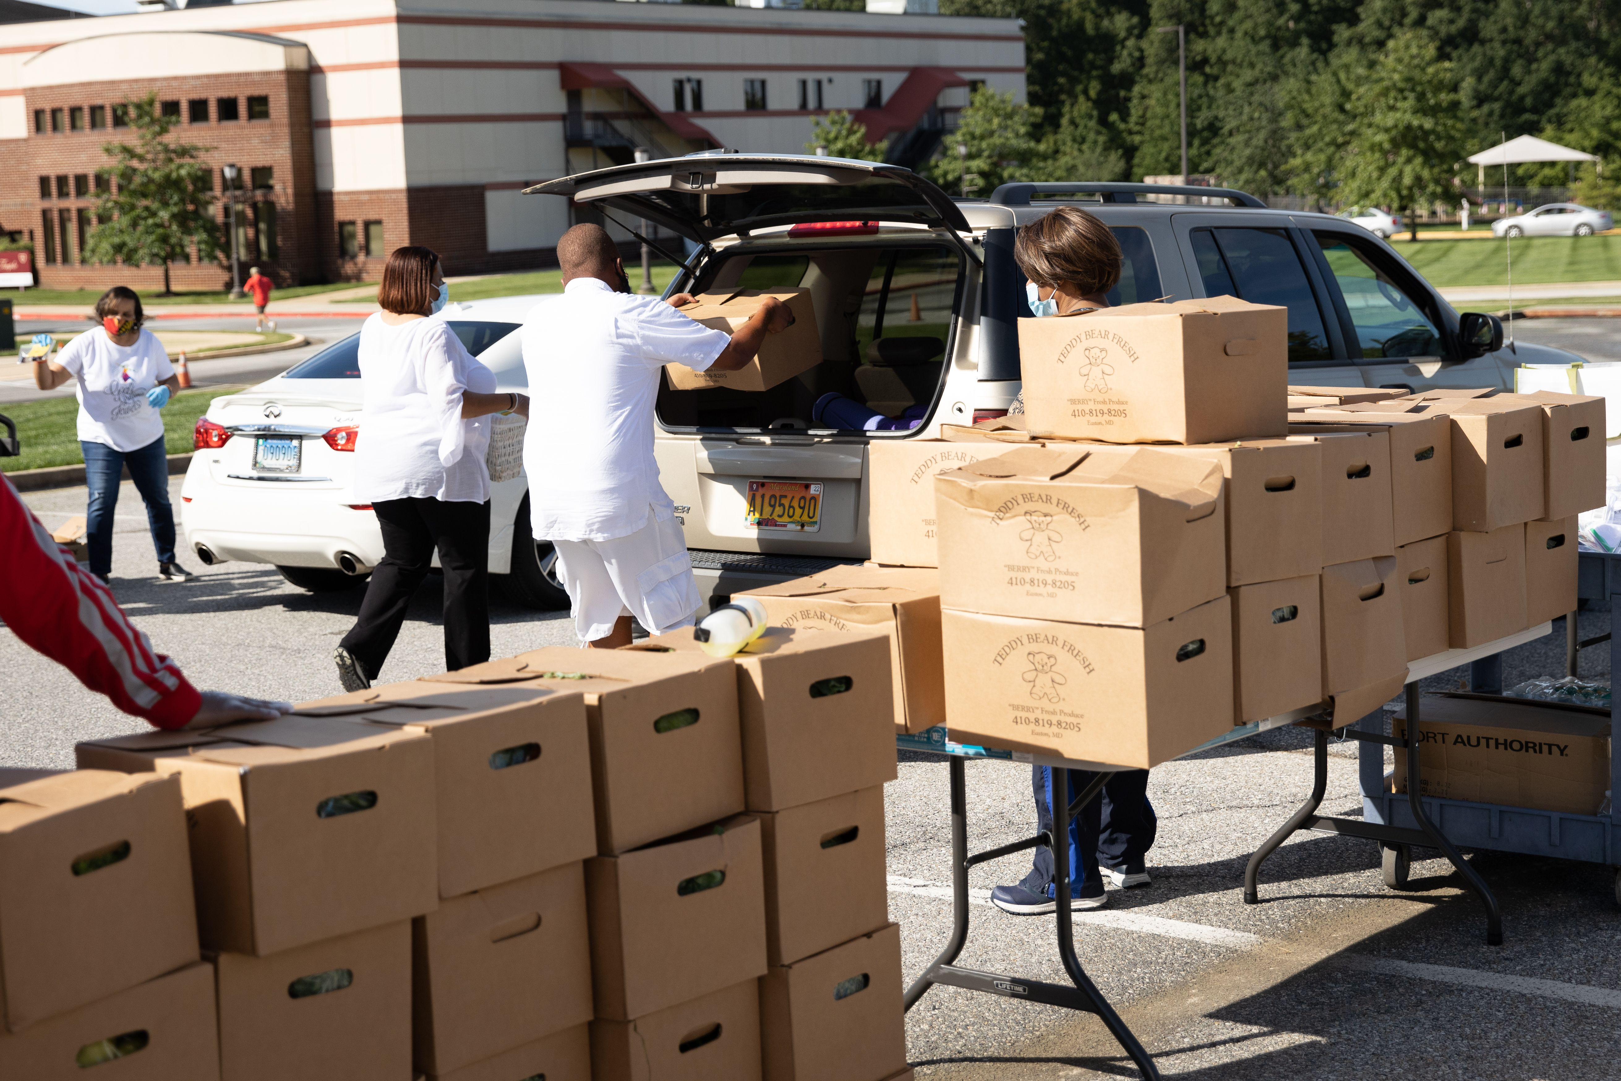
First Things First: Reaffirming who we are as a Church
OUR MISSION
OUR VISION
The Mission of Reid Temple AME Church is
to increase and grow our ministry
for the spiritual, social, and
physical development of all people.
Reid Temple AME Church is a
Bible Believing,
Christ-centered,
Family-Integrated,
Multigenerational,
Culturally aware church,
Spreading the Gospel of Jesus Christ while
“Building the Beloved Community”.
OUR CORE VALUES
Faith in God
Integrity, Trust, and Ethical Behavior
Empowering People
Excellence and Innovation
Christ-centered Leadership
©Debyii L. Sababu-Thomas, Ph.D..

Slide 3
2023 THEME: GOING HIGHER IN GOD
To Grow Stronger in God - To Get Closer to God

Slide 4
“REFUELING to Go Higher in God!!! Spiritual Foundations
August 2023 – Church-wide Theme
Bible Study Goals
The Case for Re-Fueling
A Cause for RE-fueling: Self-Sabotage
REFUELING and “The ANOINTING”
Q& A
* All topics are subject the leading of the Holy Spirit

Slide 5
ASSIGNMENT from Last Week:
Find Three (3 Scriptures) about being “refueled”
Reflect on how you have been refueled
Write in your journal if you feel led
Reflect on “The Times of Refreshing for next week

Slide 6
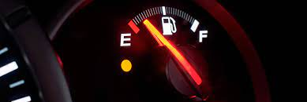
The ENERGY/EXHAUSTION SPECTRUM
Satisfaction
>Contentment
>Manageable
>Tolerable
>Draining
>Overwhelming
>Unbearable
BURNOUT COMPASSION FATIQUE

Slide 7
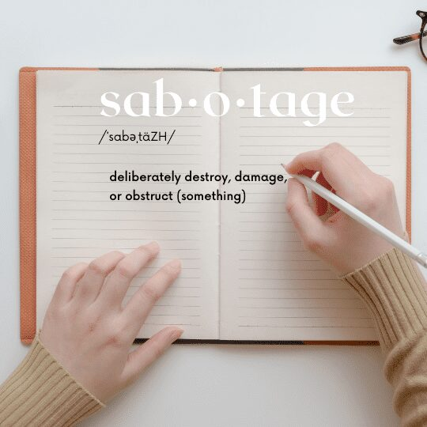
The ENERGY/EXHAUSTION SPECTRUM
Satisfaction
>Contentment
>Manageable
>Tolerable
>Draining
>Overwhelming
>Unbearable
BURNOUT - COMPASSION FATIQUE - SELF-SABOTAGE

Slide 8
Energy Loss > > SELF-SABOTAGE
Self –Sabotage
Refers to beliefs and behaviors that prevent us from achieving our goals, hopes, and dreams.
https://www.choosingtherapy.com/self-sabotaging/ (by Tanya Peterson)
2. Describes behaviors or thought patterns that hold you back and prevent you from doing what you want to do. (https://www.healthline.com/health/self-sabotage (By Crystal Raypole, 2021)
Can be defined as any behavior that goes against our self – our wider goals and values. https://www.thechelseapsychologyclinic.com/blog/why-do-we-self-sabotage/
Is a pattern of defeating behaviors a person consciously or subconsciously does. https://www.gosanangelo.com/story/life/faith/2021/02/05/psychology-and-jesus-self-sabotage/4361578001/ by Jean Stinett
Note: “self destructive behavior comes from an accumulation of distorted beliefs that lead people to underestimate capabilities, suppress feelings, or lash out at others in defense.
.
Notes:
1. https://semo.edu/faculty-senate/_pdfs/burnout-vs-compassion-fatigue-handout.pdf
2. https://www.griefworkcenter.com/compassion-fatigue-vs-burnout/

Slide 9
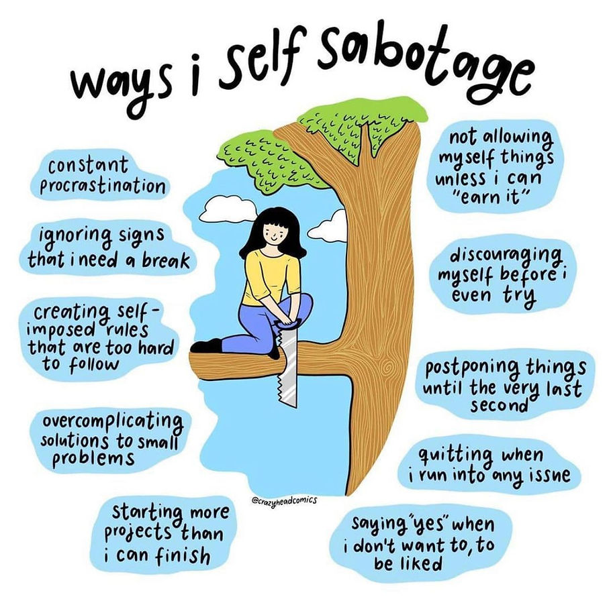
Symptoms and Signs
Reasons We Self Sabotage
Low Self-Esteem
Fear of Failure/Success
Fear of Rejection
Need to be Perfect
Unrealistic Expectations of Self
Lack of Hope
Limited Vision
Bad Habits
Other?
Source: Psychologistmahek.com/post/why-do-we-self-sabotage
Notes:
1. https://semo.edu/faculty-senate/_pdfs/burnout-vs-compassion-fatigue-handout.pdf
2. https://www.griefworkcenter.com/compassion-fatigue-vs-burnout/

Slide 10
REFUELING STRATEGIES
Acknowledge your Behaviors
Boost Your Self-Awareness (Declare yourself a Non-Judgement Zone)
Learn your Triggers and your Hiding Places
Know & Embrace Your Strengths
Love others, but Befriend Yourself (New Measuring Sticks)
Reinterpret Failure and Rejection
Reframe/Rename your Experiences
Redefine your goals, expectations (In sync with who, where, why you are)
Recognize the “Maximum Moment Me” (Mindfulness)
Work with a therapist
Do NOT Give UP!!!
FIND YOURSELF IN THE WORD OF GOD
Notes:
1. https://semo.edu/faculty-senate/_pdfs/burnout-vs-compassion-fatigue-handout.pdf
2. https://www.griefworkcenter.com/compassion-fatigue-vs-burnout/

Slide 11
KEY SCRIPTURE BE FILLED with the FULLNESS of GOD
Ephesians 3: 14 -19
¹⁴ For this reason I bow my knees to the Father ^{[f]}of our Lord Jesus Christ, ¹⁵ from whom the whole family in heaven and earth is named, ¹⁶ that He would grant you, according to the riches of His glory, to be strengthened with might through His Spirit in the inner man, ¹⁷ that Christ may dwell in your hearts through faith; that you, being rooted and grounded in love, ¹⁸ may be able to comprehend with all the saints what is the width and length and depth and height— ¹⁹ to know the love of Christ which passes knowledge; that you may be filled with all the fullness of God.

Slide 12
WHAT DOES It Mean? TO BE FILLED WITH THE FULLNESS
The fullness of God is the totality of everything God is—His attributes, His character, His perfection, His holiness, His power, His love, et cetera. The fullness of God is His complete nature; it is who He is…God.
To walk with the Holy Spirit and demonstrate the FRUIT (Ephesians 5:22-23) and the Gifts of the Holy Spirit.

Slide 13
The ANOINTING to be Refueled
Isaiah 61: 1 The Spirt of the Lord is upon me and anoints me
Psalm 23:5 He anoints my head with Oil
Isaiah 10:27 The Power of the Anointing
²⁷ And it shall come to pass in that day,
his burden shall be taken away from off thy shoulder,
his yoke from off thy neck, and
the yoke shall be destroyed
because of the Anointing!!!!
Let the ANOINTING of the Lord FALL ON US and REVIVE US, RESTORE US, REFUEL US!

Slide 14
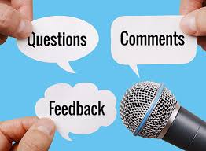
Rev Dr. Debyii L. Sababu-Thomas
Email: RevDebyii@reidtemple.org
Phone: 301 352-1746

