Slide 1
August Theme 2023 “REFUELING to Go Higher in God”
Reid Temple A.M.E. Church
Reid Temple Wednesday Night Bible Study
August 9, 16, 23 and 30, 2023
Rev. Dr. Debyii L. Sababu-Thomas, Facilitator
Rev. Dr. Mark E. Whitlock, Pastor
WEEK 4

Slide 2
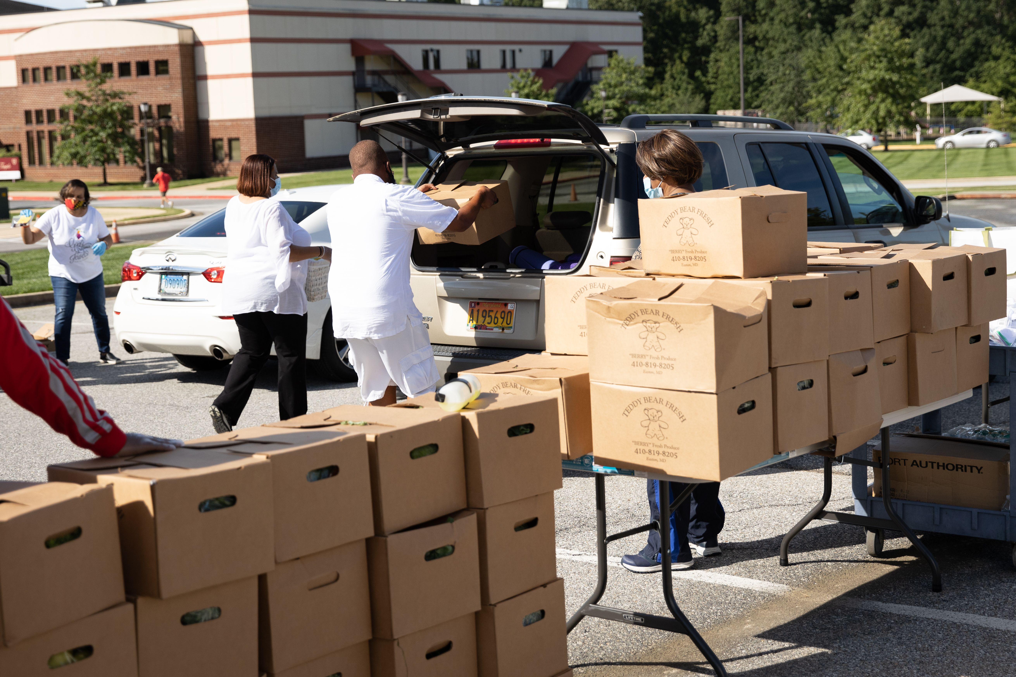
First Things First: Reaffirming who we are as a Church
OUR MISSION
OUR VISION
The Mission of Reid Temple AME Church is
to increase and grow our ministry
for the spiritual, social, and
physical development of all people.
Reid Temple AME Church is a
Bible Believing,
Christ-centered,
Family-Integrated,
Multigenerational,
Culturally aware church,
Spreading the Gospel of Jesus Christ while
“Building the Beloved Community”.
OUR CORE VALUES
Faith in God
Integrity, Trust, and Ethical Behavior
Empowering People
Excellence and Innovation
Christ-centered Leadership
©Debyii L. Sababu-Thomas, Ph.D..

Slide 3
2023 THEME: GOING HIGHER IN GOD
To Grow Stronger in God - To Get Closer to God

Slide 4
“REFUELING to Go Higher in God!!! Spiritual Foundations
August 2023 – Church-wide Theme
Bible Study Goals
The Case for Re-Fueling
A Cause for RE-fueling: SPIRITUAL Breach
REFUELING and the GREAT COMMANDMENT
Q& A
* All topics are subject the leading of the Holy Spirit

Slide 5
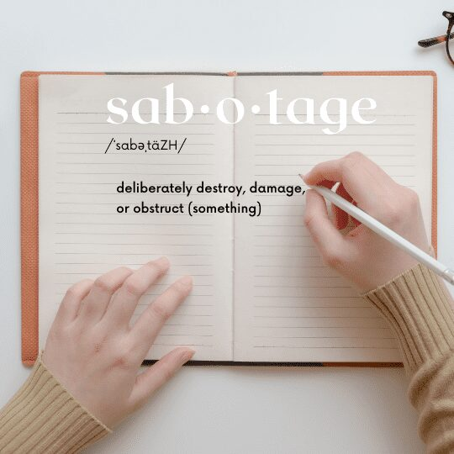
The ENERGY/EXHAUSTION SPECTRUM
Satisfaction
>Contentment
>Manageable
>Tolerable
>Draining
>Overwhelming
>Unbearable
BURNOUT - COMPASSION FATIQUE - SELF-SABOTAGE
SPIRITUAL BREACH

Slide 6
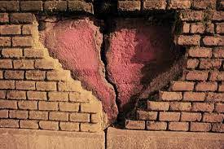
The ENERGY/EXHAUSTION SPECTRUM
Satisfaction
>Contentment
>Manageable
>Tolerable
>Draining
>Overwhelming
>Unbearable
BURNOUT - COMPASSION FATIQUE - SELF-SABOTAGE
SPIRITUAL WEARINESS

Slide 7
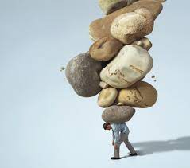
The Drain on Our Spirits (Daniel’s Prophecy of the Four Beasts) Focus 7:20-28
²⁴ And the ten horns out of this kingdom are ten kings that shall arise: and another shall rise after them; and he shall be diverse from the first, and he shall subdue three kings.
²⁵ And he shall speak great words against the most High, and shall wear out the saints of the most High, and think to change times and laws: and they shall be given into his hand until a time and times and the dividing of time.
²⁶ But the judgment shall sit, and they shall take away his dominion, to consume and to destroy it unto the end.
²⁷ And the kingdom and dominion, and the greatness of the kingdom under the whole heaven, shall be given to the people of the saints of the most High, whose kingdom is an everlasting kingdom, and all dominions shall serve and obey him.
²⁸ Hitherto is the end of the matter. As for me Daniel, my cogitations much troubled me, and my countenance changed in me: but I kept the matter in my heart

Slide 8
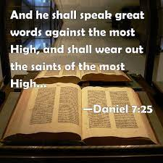
STRATEGY: Spiritual Weariness
He will speak against the Most High and oppress his holy people and try to change the set times and the laws. NIV
He shall speak pompous words against the Most High, Shall persecute the saints of the Most High, And shall intend to change times and law. Then the saints shall be given into his hand For a time and times and half a time. NKJV
"This king will speak evil of God Most High, and he will be cruel to God's chosen ones. He will try to change God's Law and the sacred seasons. And he will be able to do this for a time, two times, and half a time. CEB
He will speak against the Supreme God and oppress God's people. He will try to change their religious laws and festivals, and God's people will be under his power for three and a half years. GNB
Then he will blaspheme the High God, persecute the followers of the High God, and try to get rid of sacred worship and moral practice. God’s holy people will be persecuted by him for a time, two times, half a time. Message Bible
He will defy the Most High and oppress the holy people of the Most High. He will try to change their sacred festivals and laws, and they will be placed under his control for a time, times, and half a time. New Living Translation
Notes:
1. https://semo.edu/faculty-senate/_pdfs/burnout-vs-compassion-fatigue-handout.pdf
2. https://www.griefworkcenter.com/compassion-fatigue-vs-burnout/

Slide 9
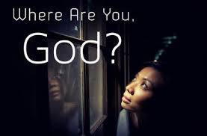
Target- Depleted Lives
Drain our Minds
Attacks when we are down mentally
Negative thoughts contrary to God’s Word
Overloaded with destructive thoughts, frustration, agitation
Can’t understand why things didn’t work out
Questions about God’s Promises .
Drain our Hearts
Crushes our hearts
Changes our Countenance joy to despair
Excess Worry, Overly sensitive,
Can’t feel God’s presence
Questions about God’s love
Drain our Spirits
Depletes our faith
Makes us immobile
Forget about God’s work in the past or present
Can’t get to the “praise
Can’t see God’s presence
Questions about God’s Nature

Slide 10
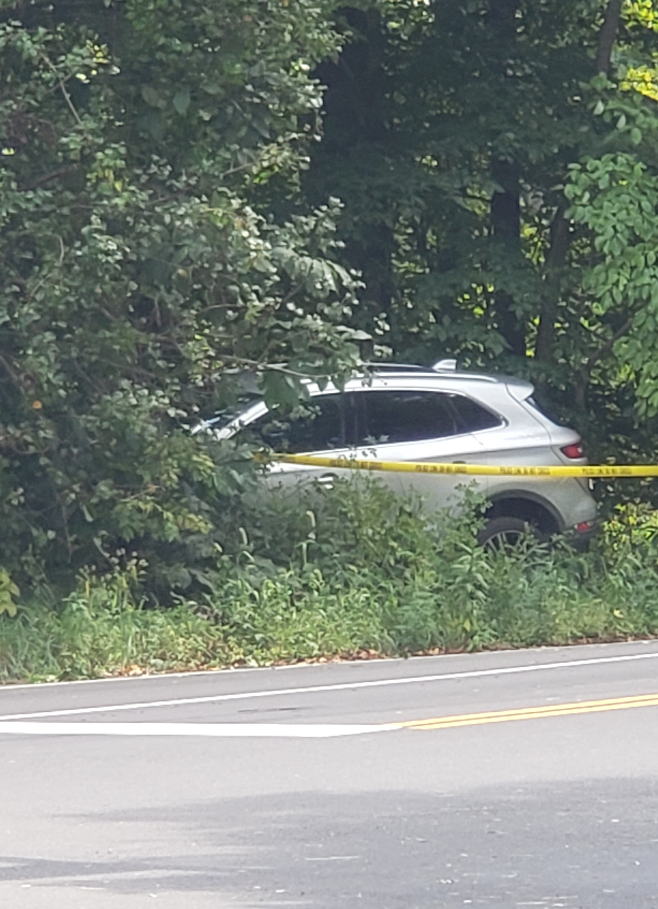
Case Study- “An Acute Case of Spiritual Weariness”
The TRIGGER - Starter
Date: Saturday August 26th 11:00 am
Location: Prince George’s County
Brown Station and White House Road
Upper Marlboro
Person: Son
Cause: Not certain but He Blacked out –
Was awakened from Vehicle by Paramedics and Police
Disposition: Car was towed to Collision Shop with various Insurance Drama
Son: Went to Chicago- could not do anything. Will be going to Doctor (Hopefully)
Mother: Recovering with Grace!!!
My Response….Next Page
Notes:
1. https://semo.edu/faculty-senate/_pdfs/burnout-vs-compassion-fatigue-handout.pdf
2. https://www.griefworkcenter.com/compassion-fatigue-vs-burnout/

Slide 11
My 5-Step REFUELING STRATEGY
1. REFUSE to accept what you see as the Final Version of everything.
The Just Live by FAITH; Without Faith it is impossible to please God, Hebrews 10:38 and 11:6
2. RELEASE IT: Renounce the works of the enemy; Plug in the hole in your thinking (Get your cry on, if needed)
Cast your cares on the LORD and He will sustain you; he will never let the righteous be shaken (Psalm 55:22)
3. RELINQUISH CONTROL: Turn the processes and post processes over to God
Now unto him that is able to do exceeding abundantly above all that we ask or think, according to the power that worketh in us, Ephesians 3:20
4. REMEMBER What God has done in the Past.
God is our refuge and strength, a very present help in trouble. Therefore will not we fear, though the earth be removed, and though the mountains be carried into the midst of the sea; Psalm 46: 1-2
5. REHEARSE and REJOICE for who God is and who you are to Him
Rejoice in the Lord always; again I will say, rejoice. Philippians 4:4
Notes:
1. https://semo.edu/faculty-senate/_pdfs/burnout-vs-compassion-fatigue-handout.pdf
2. https://www.griefworkcenter.com/compassion-fatigue-vs-burnout/

Slide 12
KEY SCRIPTURE BE FILLED with the FULLNESS of GOD
Ephesians 3: 14 -19
¹⁴ For this reason I bow my knees to the Father ^{[f]}of our Lord Jesus Christ, ¹⁵ from whom the whole family in heaven and earth is named, ¹⁶ that He would grant you, according to the riches of His glory, to be strengthened with might through His Spirit in the inner man, ¹⁷ that Christ may dwell in your hearts through faith; that you, being rooted and grounded in love, ¹⁸ may be able to comprehend with all the saints what is the width and length and depth and height— ¹⁹ to know the love of Christ which passes knowledge; that you may be filled with all the fullness of God.

Slide 13
WHAT DOES It Mean? TO BE FILLED WITH THE FULLNESS
Be filled with the Fruit of Righteous
(Philippians 1:11)
Be filed with Joy
II Timothy 1:4
Be Filled with the Wisdom and Knowledge of Jesus Christ
Colossians 1:9
Be Filled with Praise
Psalm 71:8
Be Filled with the SPIRIT
Ephesians 5:18

Slide 14
FiNAL WORDS to the BELOVED COMMUNITY The Great Commandment

Slide 15
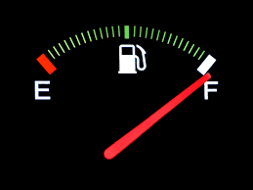
BE FILLED with the FULLNESS of GOD

Slide 16
Rev Dr. Debyii L. Sababu-Thomas
Email: RevDebyii@reidtemple.org
Phone: 301 352-1746

