Slide 2
DREAMING HIGHER IN GOD:
ANOINTING AND HEALING SERVICE!
DR. MARK E. WHITLOCK, JR.
REID TEMPLE AME CHURCH

Slide 3
Course Objectives: Dreaming Higher for Healing and Anointing!
I. Prayer
II. Scriptures – Jeremiah 1:17; 17:14; and 30:17
III. Dreaming Higher for Healing
IV. God’s Promise of Restoration
V. Healing Scriptures for Dreaming Higher
VI. Let’s Pray/Anoint Believers
VII. Salvation and Offering
VIII. Thank you!!

Slide 4
Dreaming of being healed signifies a necessary change that is required, but you may not be acknowledging it.
DREAMING HIGHER IN HEALING!
Jeremiah 1:12
“Then said the Lord unto me, thou hast well seen, for I will hasten my word to preform it.”
Jeremiah 17:14
“Heal me, o lord, and I shall be healed, save me, and I shall be saved, for thou art my praise.”
Jeremiah 30:17
“for I will restore health unto thee, and I will heal thee of thy wounds, saith the lord.”

Slide 5
GOD’S PROMISE OF RESTORATION
God promises to cure what is incurable and to heal what is beyond healing!
The promise of healing is a promise to make new flesh grow over an old wound. God is the great physician of His people!
God doesn’t want to leave His people alone in sin and wretchedness.

Slide 6
HEALING SCRIPTURES FOR DREAMING HIGHER…
EXODUS 23:25-26
PSALM 103:1-5
MATTHEW 8:2-23
“AND YE SHALL SERVE THE LORD YOUR GOD, AND HE SHALL BLESS THY BREAD, AND THY WATER; AND I WILL TAKE SICKNESS AWAY FROM THE MIDST OF THEE. THERE SHALL NOTHING CAST THEIR YOUNG, NOR BE BARREN, IN THY LAND: THE NUMBER OF THY DAYS I WILL FULFILL.” (HEALED BY HAVING FAITH IN GOD)​
BLESS THE LORD, O MY SOUL: AND ALL THAT IS WITHIN ME, BLESS HIS HOLY NAME. BLESS THE LORD, O MY SOUL, AND FORGET NOT ALL HIS BENEFITS: WHO FORGIVETH ALL THINE INIQUITIES; WHO HEALETH ALL THY DISEASES; WHO REDEEMETH THY LIFE FROM DESTRUCTION; WHO CROWNETH THEE WITH LOVINGKINDNESS AND TENDER MERCIES; WHO SATISFIETH THY MOUTH WITH GOOD THINGS; SO THAT THY YOUTH IS RENEWED LIKE THE EAGLE’S. (HEALED BY RELIGIOUS PRACTICE)​
“AND, BEHOLD, THERE CAME A LEPER AND WORSHIPPED HIM, SAYING, LORD, IF THOU WILT, THOU CANST MAKE ME CLEAN. AND JESUS PUT FORTH HIS HAND, AND TOUCHED HIM, SAYING, I WILL; BE THOU CLEAN. AND IMMEDIATELY HIS LEPROSY WAS CLEANSED.” (HEALED BY MIRACLES)​

Slide 7
HEALING SCRIPTURES FOR DREAMING HIGHER…
LUKE 6:19
“AND THE WHOLE MULTITUDE SOUGHT TO TOUCH HIM: FOR THERE WENT VIRTUE OUT OF HIM AND HEALED THEM ALL.” (HEALED BY DIVINE INTERVENTION)

Slide 8
LET’S PRAY AND RECEIVE THE ANOINTING OIL OF GOD!
James 5:14-15 (KJV)
“Is any sick among you? Let him call for the elders of the church; and let them pray over him, anointing him with oil in the name of the lord: And the prayer of faith shall save the sick, and the lord…”

Slide 9
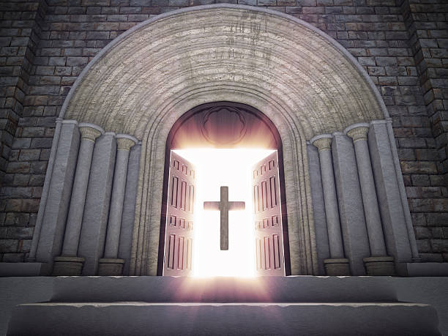
Doors of the church are open: “REID TEMPLE CARES”
Doors of the church are open: “REID TEMPLE CARES”

