Slide 1
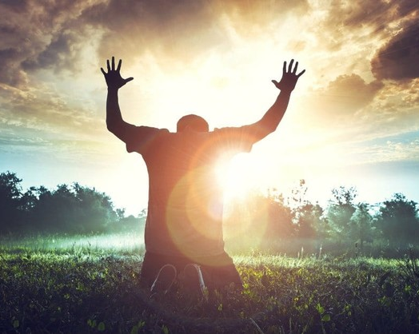
Praise heals!
Dr. Mark E. Whitlock, Jr.
Reid Temple AME church

Slide 2
Meditation 101 Class Schedule/Subjects/Books
Sept. 16 – The Purpose of Meditation.
Sept. 23 – The Practice of Meditation. (Canceled)
Sept. 30 – The practice and Power of Meditation.
Oct. 7 – The Pursuit of Meditation.

Slide 3
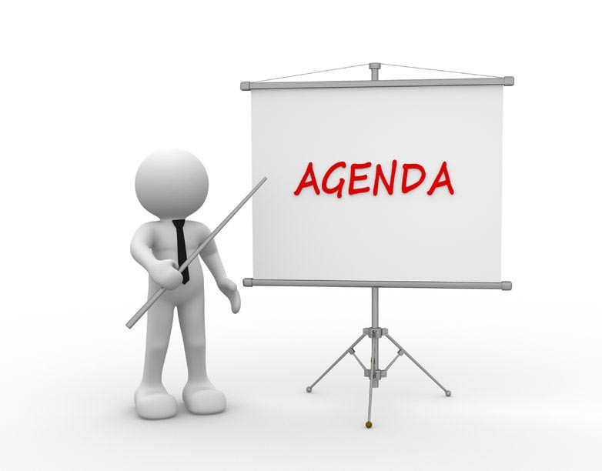
Course objectives: Praise Heals!
Prayer
Scriptures – 103:2-3
Heal thyself
Commit scriptures to memory - Praise heals
Altar call
Salvation and Offering
Thank you….

Slide 4
Scriptures
Psalm 103:2 Bless the Lord, O my soul, and forget not all his benefits:
3 Who forgiveth all thine iniquities; who healeth all thy diseases;

Slide 5
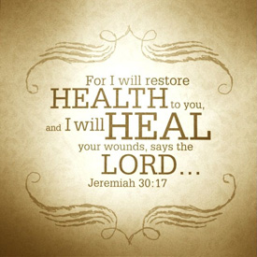
God forgives and heals – Heal thyself
Drinking Alcohol
Drinking soda
Ignoring Symptoms
Not Taking Vitamin D Supplements
Eating fried and fast foods
Food Tainted With This Chemical
Not Eating Enough Fiber
Adding Artificial Sweeteners
Bad Sleeping Positions
Not Hydrating Properly
Buying "Organic" Packaged Foods
Lack of exercise
No regular annual medical checkups
Not Getting Enough Sleep
Not Prioritizing Your Mental Health

Slide 6
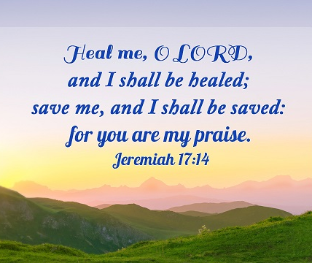
Commit praise Heals to memorize…
Jeremiah 17:14
Heal me, O Lord, and I shall be healed; save me, and I shall be saved, for you are my praise.
Revelation 21:4
He will wipe away every tear from their eyes, and death shall be no more, neither shall there be mourning, nor crying, nor pain anymore, for the former things have passed away.
Exodus 23:25
You shall serve the Lord your God, and he will bless your bread and your water, and I will take sickness away from among you.
Isaiah 53:5
But he was wounded for our transgressions; he was crushed for our iniquities; upon him was the chastisement that brought us peace, and with his stripes we are healed.

Slide 7
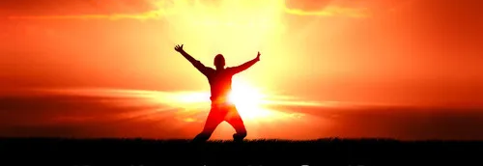
Let’s pray
Come to the altar to pray for pastor, staff, ministers, ministry leaders, officers and members.

Slide 8
Questions and answers
This Photo by Unknown Author is licensed under CC BY-SA

Slide 9
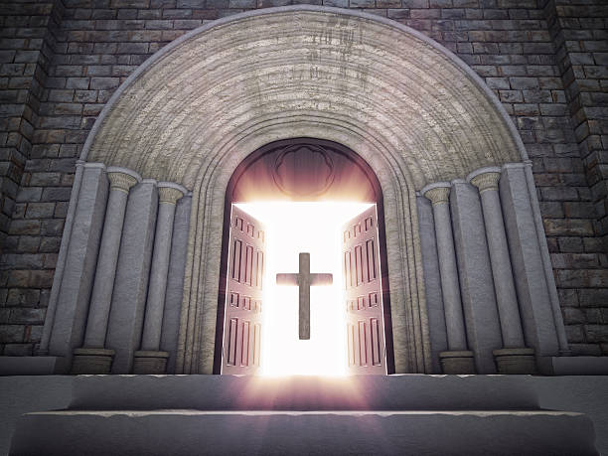
Doors of the church are open: “REID TEMPLE CARES”

