Slide 2
THE PURPOSE AND PRIORITY OF PRAYER:
THE AUTHORITY OF PRAYER!

Slide 3
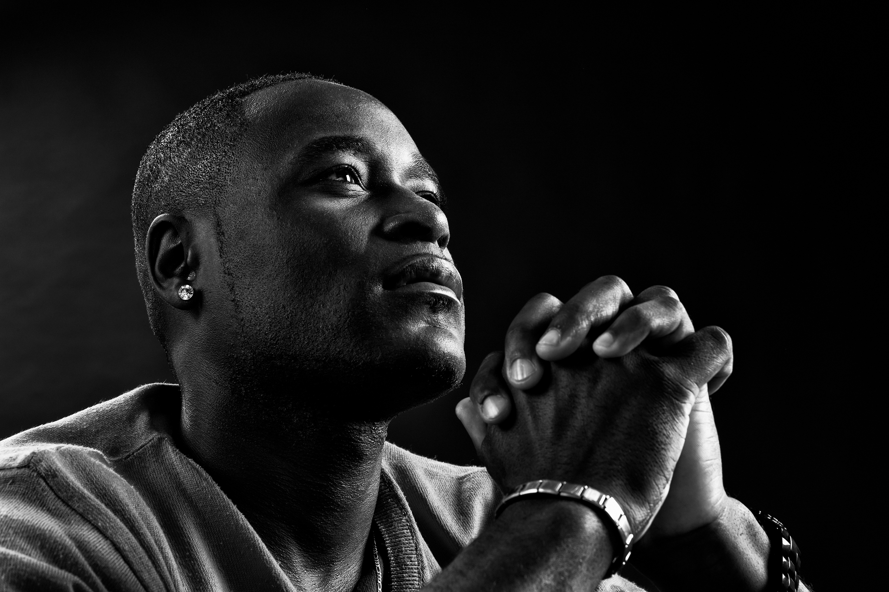
COURSE OBJECTIVES:
THE AUTHORITY OF PRAYER!
Prayer
The WORD: 2 Cor. 1:20; 4:4; John 14:12-14; 15:7, John 16:23-27
The Authority of Prayer
God’s Plan of Redemption
Christ Restored Dominion and Prayer
Man’s Redemption
Jesus is Our Model Dominion Authority
Let’s PRAY!
Open the Doors of the Church/Offering
THANK YOU!

Slide 4
THE WORD!
2 Corinthians 1:20 - For no matter how many promises God has made, they are “Yes” in Christ. And so through him the “Amen” is spoken by us to the glory of God.
2 Corinthians 4:4 - The god of this age has blinded the minds of unbelievers, so that they cannot see the light of the gospel that displays the glory of Christ, who is the image of God.
John 14:12 - Very truly I tell you, whoever believes in me will do the works I have been doing, and they will do even greater things than these, because I am going to the Father. 13 And I will do whatever you ask in my name, so that the Father may be glorified in the Son. 14 You may ask me for anything in my name, and I will do it.

Slide 5
THE WORD!
John 15:7 - If you remain in me and my words remain in you, ask whatever you wish, and it will be done for you.
John 16:23 - In that day you will no longer ask me anything. Very truly I tell you, my Father will give you whatever you ask in my name. 24 Until now you have not asked for anything in my name. Ask and you will receive, and your joy will be complete. 25 “Though I have been speaking figuratively, a time is coming when I will no longer use this kind of language but will tell you plainly about my Father. 26 In that day you will ask in my name. I am not saying that I will ask the Father on your behalf. 27 No, the Father himself loves you because you have loved me and have believed that I came from God.

Slide 6
THE AUTHORITY OF PRAYER
Why do we pray?
On what basis to we have the right to pray?
1. Principle – God’s plan of redemption is consistent with His character and purposes. He redeemed humanity while keeping humankind’s free will and earthly authority intact.
2. Principle – Through Christ we are restored to our purpose, through Him we have a right to pray and authority.
Yet our relationship with God was broken and authority was forfeited by Adam and Eve (2 Corinthians 4:4).
This left people estranged from God, so they:
Felt isolated from God
Lost their sense of purpose with God
Didn’t know what God wanted to do for and through them
Were unsure of where they stood with God

Slide 7
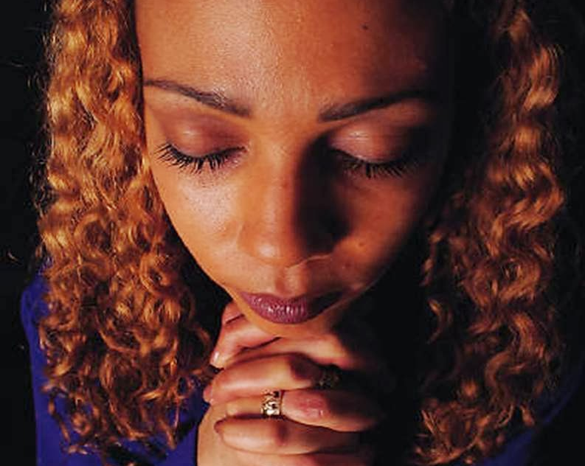
GOD’S PLAN FOR REDEMPTION!
When Adam and Eve rebelled against God and turned the world’s authority over to Satan, why didn’t God simply wrench control of earth back from the devil?
Describe the magnitude of humankind’s dilemma after the fall? (Romans 6:23)
3. Principle – as the second Adam, Christ is the image of God, exhibits a relationship of love with God, and reigns as king of the earth and judge of humankind.
God respected the authority of humanity when it lay dormant (Romans 11:29).
God sent Jesus to restore humankind (Matthew 19:26)
This Photo by Unknown Author is licensed under CC BY-NC-ND

Slide 8
Christ Restored Dominion and Prayer!
Jesus reigns with Authority (Matthew 11:5, Phil. 2:10-11; Rev. 19:16, 11:15).
Jesus has the right and the power to reign and to ask God to intervene since He was the perfect man and perfect sacrifice (Heb. 7:25; Romans 8:26; John 5:22).
Jesus reclaimed humankind’s earthly authority because, He was fully man and fully God, obedient and sinless, and rose victoriously. He was qualified to defeat sin and Satan (Colossians 1:19).
Jesus transferred authority to those who believe (John 3:5; Rev. 5:10, 20:4,6, 22:5).
Therefore, as we live and work in this fallen world today, in the future, and when we will live and reign with Jesus, the commission from is the same (Genesis 1:26).

Slide 9
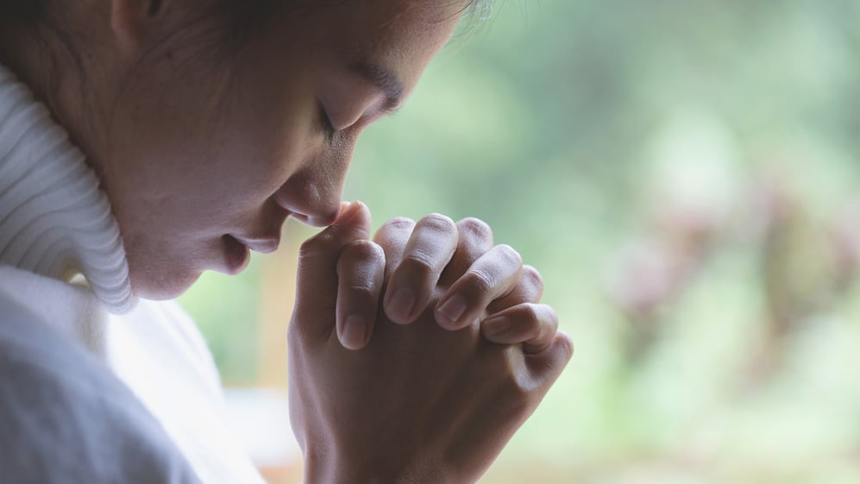
What is the only way in which Jesus could reestablish humankind’s relationship with God for effective prayers?
4. Principle – Christ reclaimed our earthly authority for prayer:
Jesus was qualified to be the son of God and to restore man’s relationship with the father by overcoming sin and death through His sacrifice on the cross to defeat sin and satan.
5. Principle – The authority that Jesus won has been transferred back to humankind through spiritual rebirth in Christ (John 6:35; 5:20; 10:17,30).
CHRIST RESTORED DOMINION
AND PRAYER!

Slide 10
MAN’S REDEMPTION!
6. Principle -When we do not live in our position of authority, it is because we do not recognize or accept our calling in Christ- we do not know our covenant rights!
7. Principle - Man’s redemption allows him to have dominion. This means that satan and sin have no authority over us. We have authority and access to the father and authority through the word to pray.
We have authority through Jesus' name to pray! ( John 14:12, 16:23-24).
We have access to the father through Jesus’ name. (Hebrews 4:16; John 16:26-27).
We have authority through the word to pray (John 15:7;1 peter 1:23).
We must pray in unity with God for His promises (2 Corinthians 1:20).

Slide 11
What is the backbone of prayer composed of?
What basis do you have the right to pray?
8. Principle – Jesus is our model of dominion authority. What He accomplished on earth, He accomplished in His humanity, even though He was also divine. Jesus is our model for an effective prayer life!
9. Principle – Our right to pray comes from both our calling in creation and our redemption in Christ.
Jesus relied on grace, the Holy spirit, and kept a close relationship with God through prayer (John 5:17, 19-20).
Jesus was obedient and lived to fulfill God’s purpose in prayer (John 10:17, 14:10-14).
God wants YOU to live confidently in the authority He has given you to pray!
(Matthew 18:18-19)
JESUS IS OUR MODEL
OF DOMINION AUTHORITY!

Slide 12
APPLYING GOD’S PRINCIPLES TO YOUR LIFE!
Think It Over…
Are your prayers based on emotions, feelings, or theories of men, rather than the word of God? If so, what will you do to change this pattern?
Pray About It…
TODAY begin to apply the redemption of Christ to your prayer life by acknowledging Jesus’ restoration of your relationship with the father and your purpose of dominion. Praise God for sending Jesus to earth so that you can have a restored relationship of love with Him and ask Him to fulfill His purposes in you.
Act on God’s Truth…
The backbone of prayer is our agreement with God’s word, our oneness with Christ, who is the living word, and our unity with God’s purpose and will.

Slide 13
LET’S PRAY!!

Slide 14
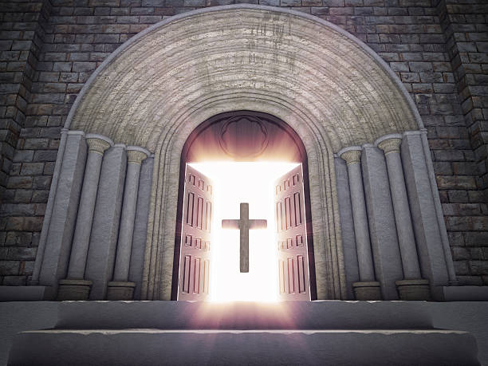
Doors of the church are OPEN: “REID TEMPLE CARES”

