Slide 1
PRAYER WORKS 2024 Reid Temple Bible Study February 7, 2024
“Praying Poweful Prayers”
Rev. Dr. Mark E. Whitlock Jr., Senior Pastor
Rev. Hermia Shegog Whitlock, Executive Minister
Rev. Dr. Debyii. L. Sababu-Thomas, Creator
Rev. Courtney Golden, Facilitator

Slide 2
First Things First: Reaffirming Who We Are as a Church
OUR VISION
Reid Temple AME Church is a
Bible Believing,
Christ-centered,
Family-Integrated,
Multigenerational,
Culturally aware church,
Spreading the Gospel of Jesus Christ while
“Building the Beloved Community”.
©Debyii L. Sababu-Thomas, Ph.D..

Slide 3
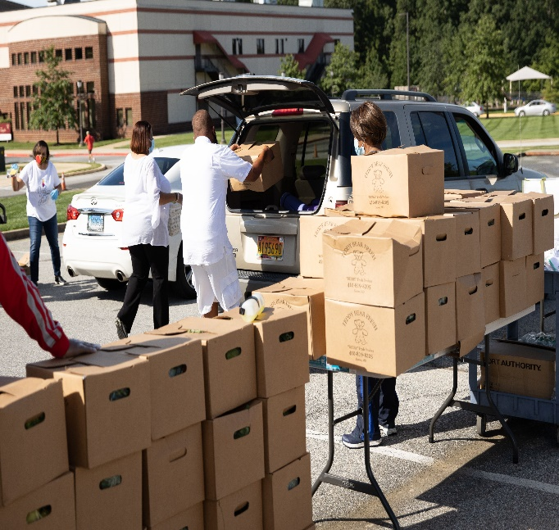
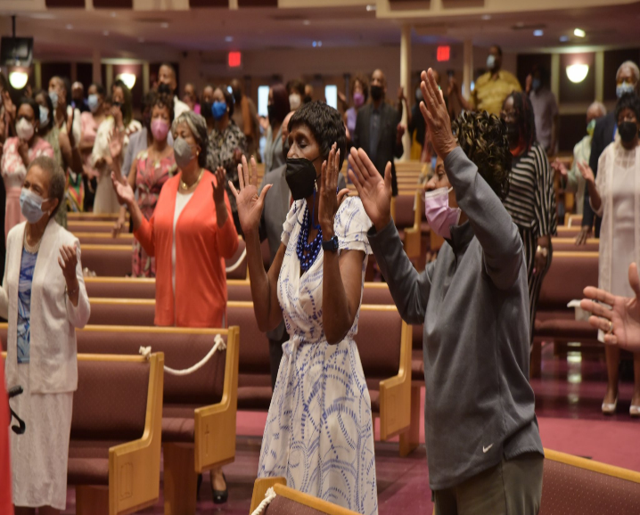
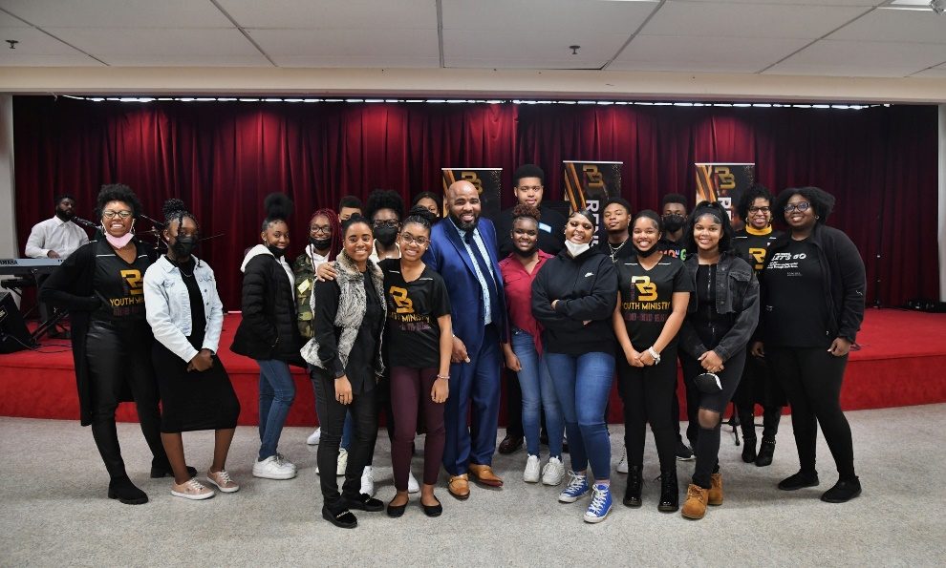
First Things First: Reaffirming who we are as a Church
OUR MISSION
The Mission of Reid Temple AME Church is
to increase and grow our ministry
for the spiritual, social, and physical development of all people.
©Debyii L. Sababu-Thomas, Ph.D..

Slide 4
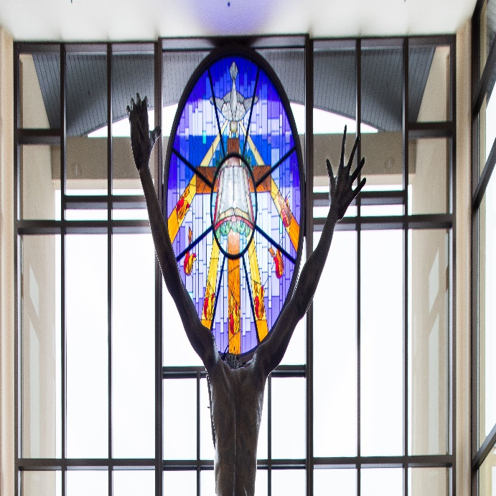
First Things First: Reaffirming who we are as a Church
OUR CORE VALUES
Faith in God
Integrity, Trust, and Ethical Behavior
Empowering People
Excellence and Innovation
Christ-centered Leadership
©Debyii L. Sababu-Thomas, Ph.D..

Slide 5
Overview oF Bible Study
The goal of this Bible Study it to gain more insight into the concepts of “Effectual Fervent Prayers” by
Identifying some core beliefs about about Prayer,
Examining Key Biblical requirements for prayers to be effective, and
Reinforcing what we have already learned through our sermons and Bible Studies, thus far.

Slide 6
Core Beliefs about PRAYER
Prayer is communicating and conversing with God
Prayer is a supernatural activity
Prayer is giving God legal access and permission to intervene in the affairs of earth and human beings (Myles Munroe)
Prayer is about relationship with God, the Holy Spirit
Prayer is a privilege of those called by God!
Prayer is an Expression of Love
Prayer is Lifestyle
Prayer changes things, but moreso it changes us!!
Prayer is a responsibility
©Debyii L. Sababu-Thomas, Ph.D..

Slide 7
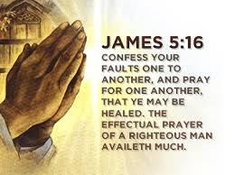
FOUNDATIONAL SCRIPTURE in KJV
James 5:16 KJV
¹⁶ Therefore confess your sins to each other and pray for each other so that you may be healed. The effective, fervent prayer of a righteous person avails much.

Slide 8
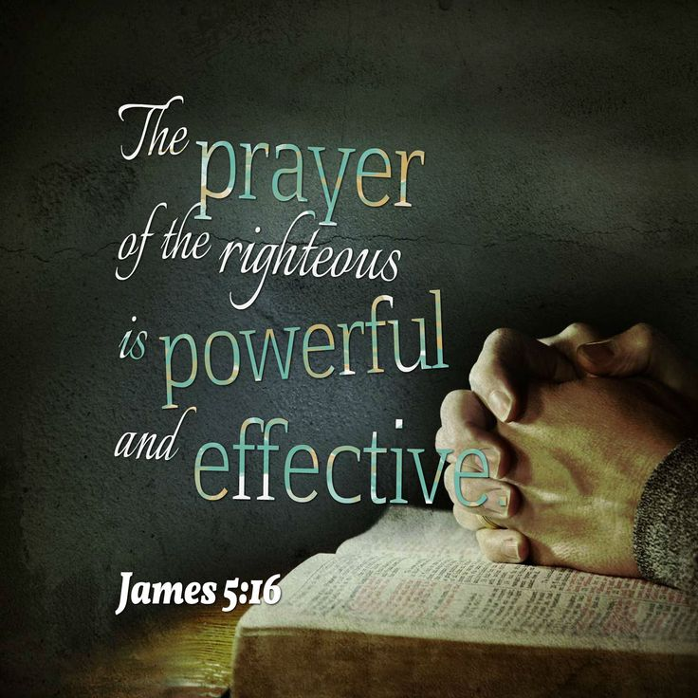
FOUNDATIONAL SCRIPTURE in NIV
James 5:16 NIV
¹⁶ Therefore confess your sins to each other and
pray for each other so that you may be healed.
The prayer of a righteous person is powerful and effective.

Slide 9
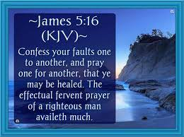
James 5:16 Requirements FOR PRAYING POWEFUL PRAYERS
¹⁶ Therefore
1. confess your sins
to each other and
2. pray for each other
so that you may be healed.
The prayer of a
3. righteous person
is powerful and effective.

Slide 10
HINDRANCES to EFFECTIVE POWERFUL PRAYERS
Unconfessed Sin
Unforgiveness
Doubt
Disobedience
Disregard for God’s WORD
Disregard for others
Un-Surrendered Will
Idols replacing God in your life
Lack of Transparency with God and others
Others?
Source:https://www.kevinhalloran.net/effective-prayer-life/

Slide 11
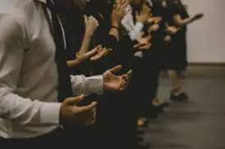
CRITERIA for PAYING EFFECTIVE POWERFUL PRAYERS
II Chronicles 7:14 - HUMBLY
I Thessalonians 5:17 - INCESSANTLY
Philippians 4:6 – In Everything
Matthew 18:18-20 - United
Ezekiel 3:17-19 - Focused
Matthew 17:21 - (Both/And) Fast & Pray
Matthew 26: 40-42 – (Both/And) Watch & Pray
Zechariah 4:6-7 – By HIS SPIRIT
Hebrews 11:6 - With FAITH

Slide 12
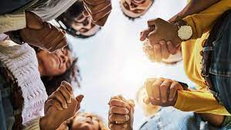
9 ATTITUDES for PRAYING EFFECTIVE, POWERFUL PRAYERS
II Chronicles 7:14 - HUMBLY
If my people, who are called by my name, will humble themselves and pray and seek my face and turn from their wicked ways, then I will hear from heaven, and I will forgive their sin and will heal their land.
2. I Thessalonians 5:17 - INCESSANTLY
Pray without ceasing.
3. I Thessalonians 5: 18 IN EVERYTHING
In every thing give thanks: for this is the will of God in Christ Jesus concerning you
4. Philippians 4:6 – WITH CONFIDENCE
Do not be anxious about anything, but in every situation, by prayer and
Hebrews 11:6 WITH FAITH
Without FAITH It is IMPOSSIBLE to please God.

Slide 13
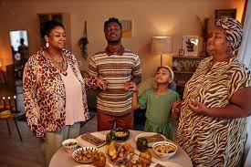
9 ATTITUDES for PRAYING EFFECTIVE, POWERFUL PRAYERS
6.. Matthew 17:21 - (Both/And) Fast & Pray
However, this kind does not go out except by prayer and fasting.”
Matthew 26: 40-42 – (Both/And) Watch & Pray
However, this kind (of power) does not go out except by prayer and fasting.”
8. Ephesians: 6:18 – PRAY IN THE SPIRIT
“Pray at all times in the Spirit with every prayer and request, and stay alert with all perseverance and intercession for all the saints”
Matthew 18:18-19 – PRAY IN AGREEMENT (Unity)
“Again, I tell you that if two of you on earth agree about anything you ask for, it will be done for you by my Father in heaven. For where two or three come together in my name, there am I with them.”

Slide 14
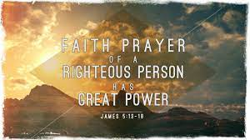
CLOSING THOUGHTS
DON’T STOP PRAYING!!!! It’s not in Vain

Slide 15
Thank you for your time and Attention
Questions? Comments?

