Slide 2
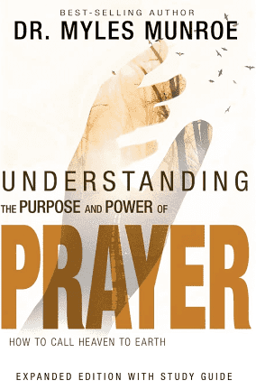
PREPARING FOR PRAYER:
TWELVE ACTION STEPS TO PRAYER!
PART I
Dr. Mark E. Whitlock, Jr.
Pastor

Slide 3
COURSE OBJECTIVES:
Prayer
The Word: James 5:16
Be SILENT
Give Adoration
Make Confession
Give Thanks
Make Supplication
Specify Petition And Requests
Putting Prayer Into Practice
Let’s Pray Together
Open The Doors of the Church/Offering
THANK YOU!

Slide 4
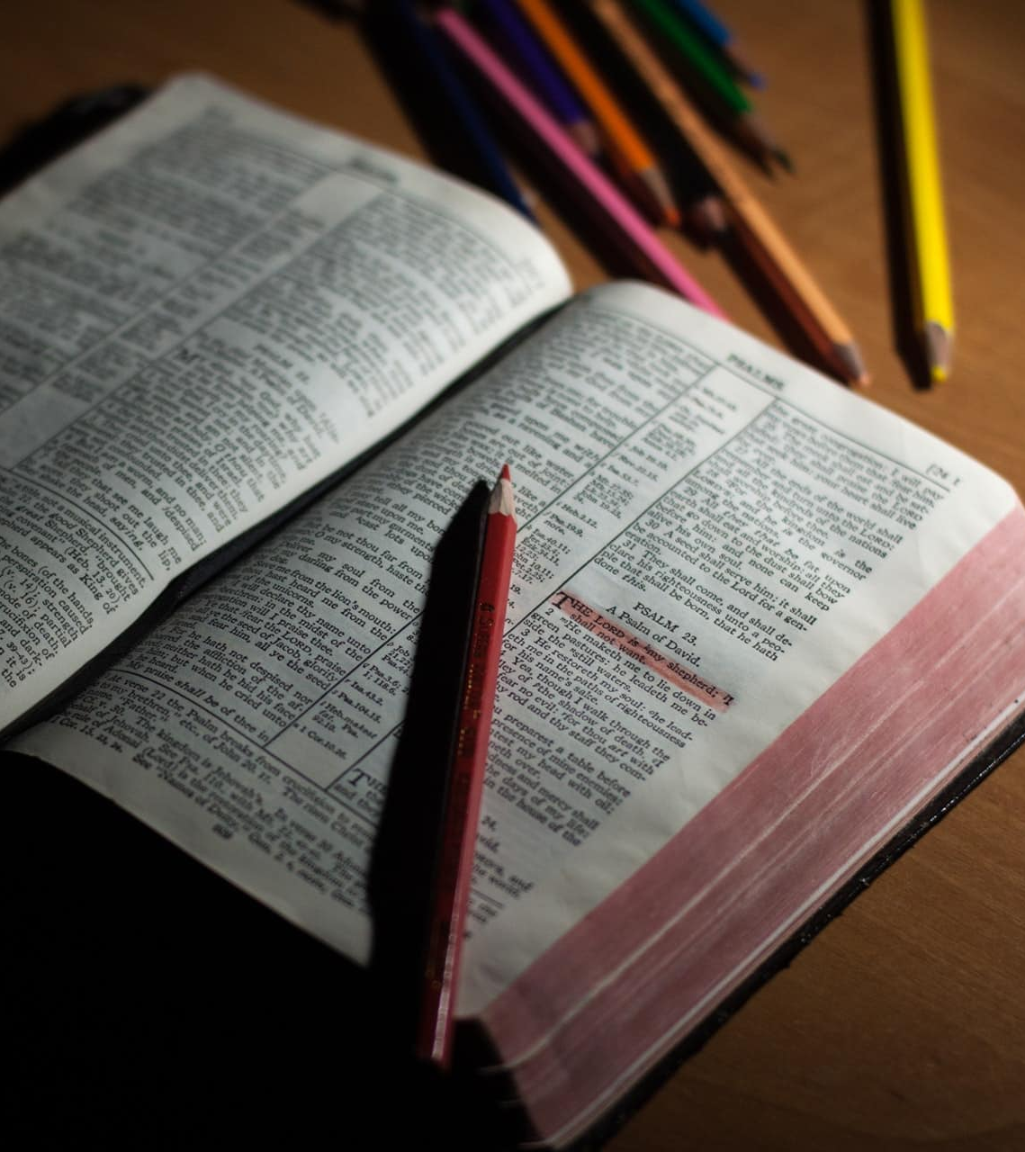
THE WORD!
James 5:16: “Therefore confess your sins to each other and pray for each other so that you may be healed. The prayer of a righteous person is powerful and effective.”
In this chapter, it shows the useful approach for organizing your steps to prayer.
The principles that follow were developed from evaluating the prayer lives of Jesus, Abraham, Joseph, Moses, David, Ezekiel, and others in the Bible. When you study these biblical figures, you will see that they all used a similar patterns in prayer.
Their prayers receive the attention of God and produced powerful results.

Slide 5
BECOME SILENT!
What is the first step to prayer, and how is it defined? How do we accomplish this step?
Principle - Become Silent: Be still and gather yourself. If your spirit, mind, body, and emotions are separated, then you will be unable to pray God’s will with singleness of purpose. Silence helps bring you into unity with God.
Matthew 6:6- “But when you pray, go into your room, close the door and pray to your Father, who is unseen. Then your Father, who sees what is done in secret, will reward you.”
Get quiet and eliminate distractions. Let the Lord calm your heart.
Isaiah 26:3- “You will keep in perfect peace (shalom) those whose minds are steadfast, because they trust in you.”
This steps may take ten minutes, and hour, or five hours, but it is the entrance to prayer.
Psalm 46:10- He says, “Be still, and know that I am God; I will be exalted among the nations, I will be exalted in the earth.”

Slide 6
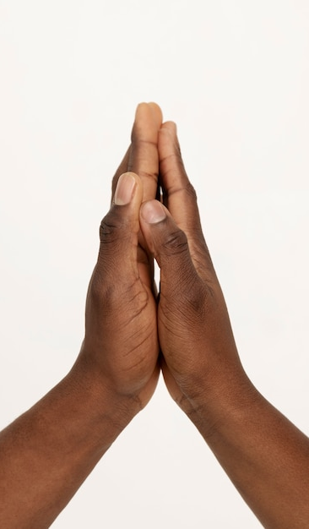
How do you give adoration to God?
2. Principle - Give Adoration: Worship God for who He is. King of all the earth, your creator, your savior, your all in all.
Luke 11:2 He said to them, “When you pray, say: ‘Father, hallowed be your name, your kingdom come.”
Psalm 95: 1- “ Come, let us sing for joy to the Lord; let us shout aloud to the Rock of our salvation. 2 Let us come before him with thanksgiving and extol him with music and song. 3 For the Lord is the great God, the great King above all gods.”
Adoration means leads to spending time in silent prayer dealing with yourself. We are to worship God for who he is: King of all the earth, our creator, our savior, our all and all. Start worshipping him. Start adoring him. Start blessing him. Start describing him.
Psalm 22:3 “But thou art holy, O thou that inhabitest the praises of Israel.”
GIVE ADORATION!

Slide 7
MAKE CONFESSION!
Rather than being an emotional response to our sins and failures, what is true meaning of confession? How does adoration prepare the way for confession? What can happen when we continue to play with sin and don’t agree with God about it?
3. Principle - Make confession: Confession means to agree with God about what He says to you and about you. Don’t dwell on past sins but obey God immediately when He show you that you are wrong.
Confession is trusting what God says to enable change. Whenever you explain, you are not sorry for the sin! Just say forgive me; I was wrong!
Galatians 5:16- “So I say, walk by the Spirit, and you will not gratify the desires of the flesh”.
1 John 1:9- “If we confess our sins, he is faithful and just (right) and will forgive us our sins and purify us from all unrighteousness (right standing)”.
King David committed adultery, conceived a child out of wedlock, and killed a man, but David confessed his sins…. Yet, he was a man after God’s heart!!! David confessed his sins….
Psalm 51:4- “Against you, you only, have I sinned and done what is evil in your sight; so you are right in your verdict and justified when you judge”.

Slide 8
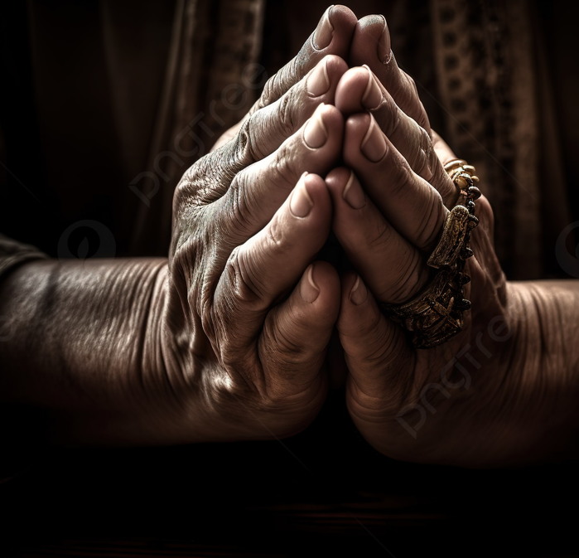
Why are we better able to offer thanks and praise to God after we have confessed?
4. Principle – Give Thanks: Offer sacrifices of praise to God with a free heart for all that He has done for you.
After you’ve confessed, start giving thanks. 1 Thessalonians 5:16-18 “Rejoice always, 17 pray continually, 18 give thanks in all circumstances; for this is God’s will for you in Christ Jesus”.
GIVE THANKS!

Slide 9
GIVE THANKS!
King David thank God as he confessed.
Psalm 51:14- “Deliver me from the guilt of bloodshed, O God, you who are God my Savior, and my tongue will sing of your righteousness. 15 Open my lips, Lord, and my mouth will declare your praise”.
King David’s confession ends in worship. Psalm 51:17 “My sacrifice, O God, is a broken spirit; a broken and contrite heart you, God, will not despise. 19 Then you will delight in the sacrifices of the righteous, in burnt offerings offered whole; then bulls will be offered on your altar”.
Offering sacrifices and burnt offerings were an old testament method of worship.
Hebrews 13:15- “Through Jesus, therefore, let us continually offer to God a sacrifice of praise—the fruit of lips that openly profess his name”.

Slide 10
MAKE SUPPLICATION!
What does it mean to offer supplication? Why is supplication usually a natural outgrowth of giving thanks?
5. Principle – Make a supplication: As God shows you what He desires, wholeheartedly agree with Him in prayer to fulfill His will.
Supplication is a word that implies three things. It means to intercede, to petition, and to brood.
Supplication is a form of prayer and considered as a humble petition to God.
Brooding means having a deep passion. When you offer supplication, it means you brood or feel the heart of God. You desire His will so much until it becomes an emotional experience.
Philippians 4:6- “Do not be anxious about anything, but in every situation, by prayer and petition, with thanksgiving, present your requests to God”.

Slide 11
Specify Petitions And Requests!
In what ways can we address God specifically and intentionally?
6. Principle-Specify petitions and requests: when you ask God to do something for you, bring evidence relevant to the case - in the form of God’s will and word – through specific, intentional communication.
Prayer is a very articulate, intentional, communication to God. When you come before God to petition for things that you want Him to do, you must be sure the evidence you bring is relevant to the case. Therefore, specify your petition by acknowledging God’s name and word. There is a name for every problem: IE…Jehovah-Jireh (the Lord our Provider) Jehovah-rapha (the Lord our Healer). This is why God had so many names!
Write down the things you want to pray for, and next to those items, write down the scriptures that you're going to use when you pray.
1 John 5:14- “This is the confidence we have in approaching God: that if we ask anything according to his will, he hears us. 15 And if we know that he hears us—whatever we ask—we know that we have what we asked of him”.

Slide 12
Action Steps:
This week, gradually begin incorporating the six steps into your prayers.
If you have been justifying wrongdoing in your life, agree with God that it is a sin and truly repent by turning from it and asking God to cleanse you from all unrighteousness.
Take one thing you are praying for, start living in expectation of it, and practice active belief. Anticipate that what you pray for according to God’s will, will happen and make arrangements for the answer.

Slide 13
LET’S PRAY!!

Slide 14
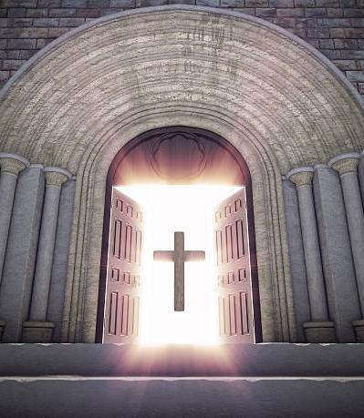
Doors of the Church are OPEN:
“REID TEMPLE CARES”

