Slide 2
HURDLES
and HINDRANCES
to ANSWERED PRAYERS:
Dr. Mark E. Whitlock, Jr.
Pastor
Rev. Debyii L. Sababu-Thomas, PhD.
Facilitator

Slide 3
COURSE OBJECTIVES!
PART I
To Identify 6 major HURDLES that affect our ability to receive answers to our prayers
To Identify any HURDLES we may have
To Identify ways we can OVERCOME the HURDLES
PART II
To Identify 11 HindranceS to our prayer lives
To Identify any HINDRANCES we’ve had to deal with
To Identify ways we can deal with these Hindrances
ALTAR CALL – PRAYER/SALVATION/JOIN
OFFERING
THANK YOU AND BENEDICTION

Slide 4
PART I
HURDLES to
ANSWERED PRAYER
Chapter 8

Slide 5
HURDLES to ANSWERED PRAYERS - Overview
“Recognizing and overcoming hurdles to answered prayer will protect your prayer potential and give you the right motivation and perspective for prayer. Prayer is the greatest opportunity and privilege offered to a person in Christ. Yet because of prayer, the adversary makes it his business to see that the prayers of individuals and churches are ineffective.
Satan knows that a church is only as powerful as its prayer life. Therefore, he will use misconceptions and misunderstandings about prayer to interrupt our prayer potential. These misconceptions are hurdles to overcome, as we address the problems that lead to unanswered prayer. Identifying some of these misconceptions and mistaken beliefs about prayer will help us see the difference and what God wants for us rising above these hurdles through God's grace will enable us to truly understand the purpose and power of prayer”
Miles Munroe

Slide 6
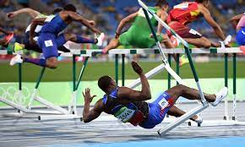
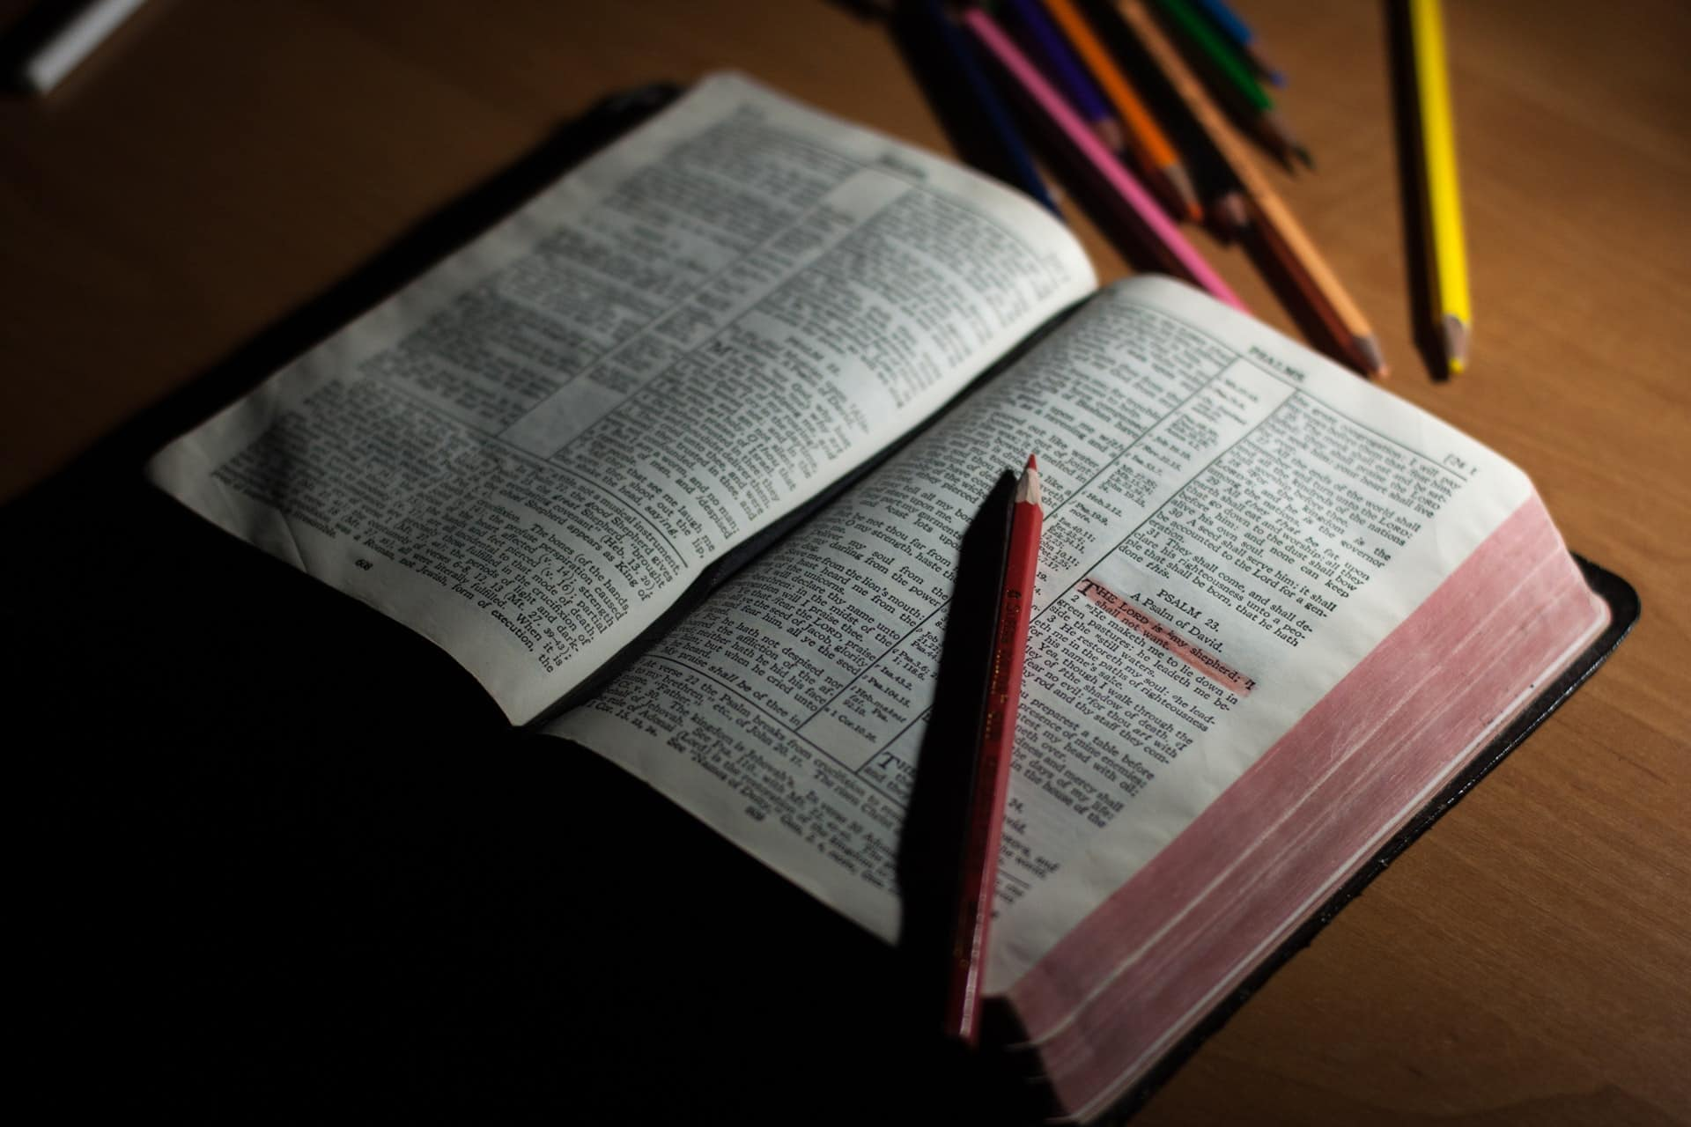
HURDLE 1.
Learning about Prayer,
But not Practicing it
The desire to read about prayer but not equip oneself for it.
Being an expert in the knowledge of prayer, but not actualizing it
Not making the decision to do it!

Slide 7
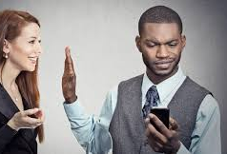
HURDLE 3.
Hearing the WORD and not Absorbing it
Not Paying attention to what is being said
Not focusing on the message
Not meditating or
With when anyone hears the message
about the Kingdom and does not
understand it, the evil one comes and
snatches away what was sown in his heart.
Matthew 13:19

Slide 8
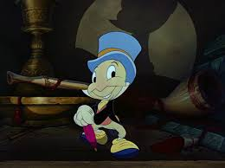
HURDLE 4.
Hoping Rather than Having Faith
Fixed on what is to come to pass.
Just plain “wishing” on something to happen, without understanding “how” things can happen
If one doubts in one’s heart, one is double minded and that one will not see anything Good from the Lord! James 1:7
Wishful thinking is a destructive
element in prayer because it does
not involve God!!!!
NOT OUR REALITY!

Slide 9
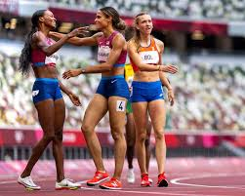
HURDLE 5.
PRAYING FOR FAITH
God never called us to Pray for Faith!
Faith is increased by listening to God’s Word
Listening to God’s WORD from others, from Music, from Art, from Yourself!!!
Faith comes by hearing …and Hearing the WORD of GOD (Romans 10:17
“I also tell you this: If two of you agree
( in what you hear) here on earth concerning anything you
ask, my Father in heaven will do it for
you. Matthew 18:19

Slide 10
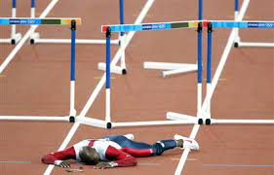
HURDLE 6.
Cares of the WORLD and LAZINESS
Neglect, busy-ness and laziness are the worst reasons for not praying!
It puts your interaction at the bottom of your priorities
Shallow Prayers
The one who received the seed that fell
among the thorns is the one who hears
the Word but the worries and cares of this
life and the deceitfulness of wealth
choke and it make it unfruitful.
Matthew 25:25

Slide 12
What hurdles have you had to overcome in your Prayer life?
What hurdles have Overcome since these Bible Studies?

Slide 13
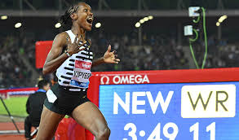
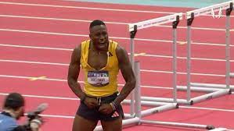
PART I. APPLICATION:
Overcoming Hurdles
PRACTICE Praying
IINTERNALIZE the need to pray
ABSORB the WORD
TRUST God and His Promises
WALK in Confidence in Faith
BE DILIGENT with your prayer Life

Slide 14
PART II
HINDRANCES to
ANSWERED PRAYER
Chapter 9

Slide 15
HINDRANCES to ANSWERED PRAYERS - Overview
“in addition to the hurdles we described in part one, there are spiritual and emotional hindrances to prayer that we need to address if we are to have true fellowship with God and receive answers to our prayers. Clearing out hindrances in our lives will enable us to live in harmony with God and with others and to have confidence in prayer included in Part 2 is a more systematic way to look at these hindrances so that we can recognize and understand the major obstacles that hinder our prayers and, therefore, we can deal with them more effectively.”
Miles Munroe

Slide 16
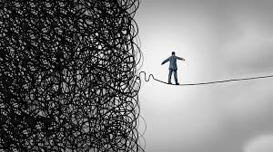
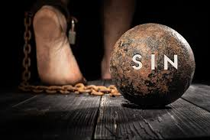
HINDRANCE #1
SIN
We must acknowledge the impact that sin has on our lives
Sin separates us from God
Unconfessed Sins shuts the doors to God’s heart
HINDRANCE #2
FEAR
Fear keeps us from believing that we can approach God.
Fear is Faith in what can go wrong rather Faith is in What could go RIGHT
Fear is Faith in the world (or the devil!)
Therefore, get rid of all moral filth & the evil that is so prevalent and humbly accept the word planted in you which can save you. Do not just listen to theword and so deceive yourselves …Do what it says! James 1:21-22
There is no fear in love, but perfect love casts out fear; for fear has torment, and he that fears has not been made perfect in love. John 4:18

Slide 17
HINDRANCE #3
GUILT
Guilt is related to the fear of being not being forgiven
It makes us believe that god has comdemned us
HINDRANCE #4
Feelings of Inferiority
A low opinion of ourselves is not of God
God Created us in His Image
We are so valuable to God that He sent His Only Son and He sacrificed Him for us
There is therefor no condemnation for those who are in Christ Jesus. Romans 8: 1
I praise you because I am fearfully and wonderfully made; your works are wonderful, I know that full well. Psalm 139:14

Slide 18
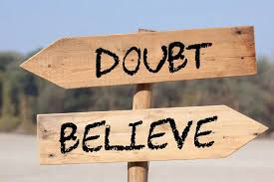
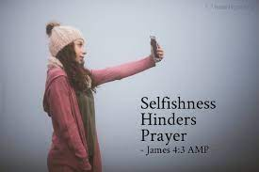
HINDRANCE #5
DOUBT
Doubt questions Who God is, Whether He is Able to do what He says he can Do and If we are important enough for God to do it for us.
Doubt says that empirical data is more credible than divine data (What is perceived through the sense
HINDRANCE #6
WRONG MOTIVES
If our motives are wrong, selfish vindictive, our prayers will be hindered.
God wants us to have clean and clean consciences about what we need to fulfil His Plan for us on Earth
When you ask, you do not receive, because you ask with wrong motives (Ask a miss), that you may spend what you get on your pleasures. James 4:3
A double-minded man (Doubting) is unstable (undependable in all his ways! James 1: 5-8

Slide 19
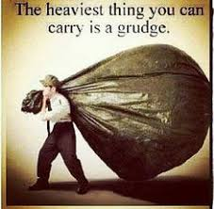
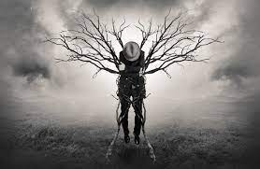
HINDRANCE #7
BITTERNESS
Bitterness indicates hidden hatred
It indicates that one is holding something against someone else and not forgiving them or releasing them.
Bitterness goes to the very source/root of life and dries it up!!!
HINDRANCE #8
UNFORGIVENESS
Unforgiveness hinders prayers in that it blocks relationships with God and other persons
Unforgiveness prevents healing from taking place in the “offended” life and possibly the offender.
See to it that no one misses the Grace of God and that no bitter root grows up to cause trouble and defile many. Hebrews 12:15
And when you stand Praying, if you hold anything against anyone, forgive him so that your Father in heaven may
forgive you your sins.
Mark 11:25

Slide 20
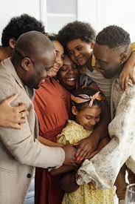
HINDRANCE #9
BROKEN FAMILY RELATIONSHIPS
Broken relationships in our families open the door to doubts, anger, bitterness, unforgiveness and other variables that will hinder prayer
Even though we can’t change others we must do our best to not be trapped in toxic emotions from trying events in the family
HINDRANCE #10
IDOLS
Be wary of lifting up people, events, or anything up above God!
Displacing God of His rightful position in our lives and place us in divine peril in our relationship with God
God must be #1
If it is possible, as
far as it depends on
you, live at peace
with everyone.
Romans 12:17-18
Love the Lord your God with all of your soul, , heart and with all your heart
Deuteronomy 6:5

Slide 21
HINDRANCE #9
BROKEN FAMILY RELATIONSHIPS
Broken relationships in our families open the door to doubts, anger, bitterness, unforgiveness and ither variables that will hinder prayer
Even though we can’t change others we must do our best to not be trapped in toxic emotions from trying events in the family
HINDRANCE #10
IDOLS
Be wary of lifting up people, events, or anything up above God!
Displacing God of His rightful position in our lives and place us in divine peril in our relationship with God
God must be #1
If it is possible, as
far as it depends on
you, live at peace
with everyone.
Romans 12:17-18
Love the Lord your God with all of your soul, , heart and with all your heart
Deuteronomy 6:5

Slide 22
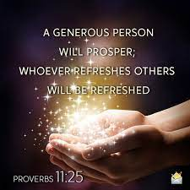
HINDRANCE# 11.
Stinginess
An ungenerous heart can hinder your prayers
Not helping others or contributing to the betterment of others can affect what happens to us
God, who is a Giver, Has called us to Give.
A generous man will prosper,
He who refreshes others will be refreshed!
A generous man will himself be bless,
for he shares his food with the poor!!!
Proverbs 11: 29 and 22:9

Slide 24
What hindrances have you had to overcome in your Prayer life?
What Hindrances have Overcome since these Bible Studies?

Slide 25
PART II. APPLICATION:
THROW OFF YOUR HINDRANCES
Repent of your sins Rebuke Fear Release Guilt Feelings Believe in Yourself Trust God and Don’t Doubt Have Godly Motives | 7. Deal with all Biterness Practice Forgiving Others Pray for Healing in family relationships Rebuke all Idols Be Generous to others

Slide 26
PRACTICE ACTIVE BELIEF
And
ACTIVE PRAYER!
Jesus Is telling us, “don’t stop believing after you pray. Don’t start doubting…double down on believing.
Get up and go look for what you ask for.
Live in Expectation.
Therefore, practice active belief and continue to live before God in holiness and truth. God will bless you as ask, seek, and knock.
This is the meaning of active prayer.

Slide 27
Dr. Mark E. Whitlock, Jr.
Pastor
Rev. Debyii L. Sababu-Thomas, PhD.
Facilitator

Slide 28
LET’S PRAY!!

Slide 29
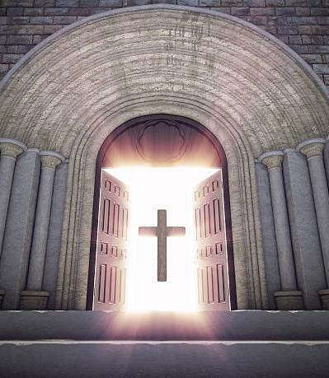
Doors of the Church are OPEN:
“REID TEMPLE CARES”

