Slide 2
THE POWER OF PRAYER:
THE POWER OF JESUS’ NAME!
Dr. Mark E. Whitlock, Jr.
Pastor

Slide 3
COURSE OBJECTIVES!
PRAYER
THE WORD: Acts 19:13-17
WHAT IS THE MAGIC FORMULA?
OUR COVENANTAL RIGHTS
WHAT’S IN A NAME?
THE NAME OF JESUS
POWER OF ATTORNEY
JESUS’ NAME IS THE KEY TO HEAVEN
LET’S PRAY TOGETHER
OPEN THE DOORS OF THE CHURCH/OFFERING
THANK YOU!

Slide 4
The power of the word
Whatever we ask God to do in our lives, in the lives of others, or in the world, must be based on His Word. God’s purpose is to be both the motivation and the content of our prayers.
Without God’s Word as our basis, our prayers have no foundation. They are based merely on our opinions, desires, and feelings. These prayers are powerless.
Prayer is speaking the Word to God exactly as He gave it to us.
There is no difference between what the people in the Bible were given by God as the basis for their effective prayers and what you and I are given to work with. Both relay on what God has given all mankind- His Word.
God wants to use His power in the world; however, for Him to do so, we must how to appropriate His Word. We must understand what it is and how to apply it.
God Himself is speaking in the Word.
God’s Word is the foundation of His power. His power is a reflection of His greatness.
The Word reveals God’s nature to us.
A cardinal principle of answered prayer is belief in the trustworthiness of the One to whom you’re praying. Belief is trust in action.

Slide 5
THE WORD!
One of the most important elements of effective prayer is using the name of Jesus. In conjunction with praying according to the word, praying in the name of Jesus gives our prayers tremendous POWER!
When you pray, do you pray “in Jesus’ name? what is the significance of praying in the is way? Have you seen results form the prayers you’ve prayed in the name of Jesus? Why or why not?
Acts 19:13: Then certain of the vagabond Jews, exorcists, took upon them to call over them which had evil spirits the name of the Lord Jesus, saying, We adjure you by Jesus whom Paul preacheth. 14 And there were seven sons of one Sceva, a Jew, and chief of the priests, which did so. 15 And the evil spirit answered and said, Jesus I know, and Paul I know; but who are ye? 16 And the man in whom the evil spirit was leaped on them, and overcame them, and prevailed against them, so that they fled out of that house naked and wounded. 17 And this was known to all the Jews and Greeks also dwelling at Ephesus; and fear fell on them all, and the name of the Lord Jesus was magnified.

Slide 6
What two things do we learn from the account of the sons of Sceva regarding how to “legally” use the authority behind the power of Jesus’ name?
Principle – Jesus’ name is not a magic formula that guarantees automatic acceptance of all our prayers.
Many prayers aren’t being answered because we misunderstand what it means to pray in the name of Jesus! It doesn’t work that way.
We must understand the significance of who Jesus really is and appropriating His power through faith in His name.
The story of Sceva in Acts 19:13-17 reveals that someone can use the name Jesus all they want, but he will still have no authority over the devil if (1) he isn’t in proper relationship with Christ, and (2) he doesn’t understand how to use Jesus’ name.
WHAT IS THE MAGIC FORMULA?

Slide 7
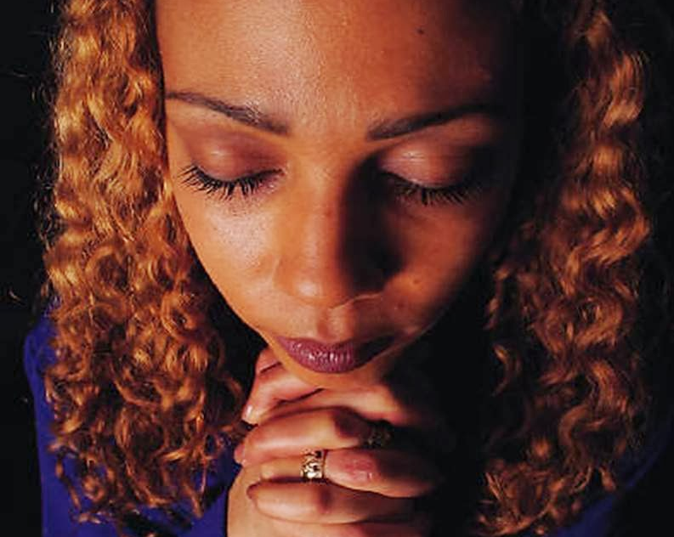
OUR COVENANTAL RIGHTS!
On what basis do we have authority in prayer in Jesus’ name?
2. Principle – We must be able to legally use the authority behind the power of Jesus’ name in order to obtain results in prayer.
3. Principle - The authority we have in His name through prayer is a covenantal authority; it is based on our covenant relationship with God through Christ (Hebrews 11:6).
We can pray to God directly in Jesus’ name because He has given us authority to do so based on the new covenant (John 16:23-27).
Therefore, the strength of prayers prayed in the name of Jesus is covenantal authority based on our relationship with Christ (Philippians 2:10).
In essence, Jesus’ name is our legal authority to transact spiritual business with God ( 1Timothy 2:5-6)
This Photo by Unknown Author is licensed under CC BY-NC-ND

Slide 8
WHAT’S IN A NAME?
What is the significance of God’s saying that His name is “I am” (Exodus. 3:14)?
What is the significance of God’s calling Himself “the God of Abraham, the God of Isaac and the God of Jacob” (Exodus 3:15)
4. Principle – In the scriptures, the name of someone (or something) symbolized the essence of his nature. It represented the person’s collective attributes and characteristics – His nature, power, and glory.
5. Principle – God’s overarching name, I am, encompasses all His nature and attributes.
There is total consistency between who God is and what He says and does. The main reason we are commanded to use the name of God in vain (Exodus. 20:7) is that His name does not just represent who He is, but also it is who He is. God reveal truth to Moses in Exodus 3:13-15.
God was saying , I am My name. Whatever I am, that’s what I’m called. In English, “my name is whatever I am at the time I am it.” This is because God is our all-sufficiency, and His name differs depending on what our need is at the time! God is a Provider, healer, peace, etc.
He desires to be your God and to meet your needs, no matter what they are.

Slide 9
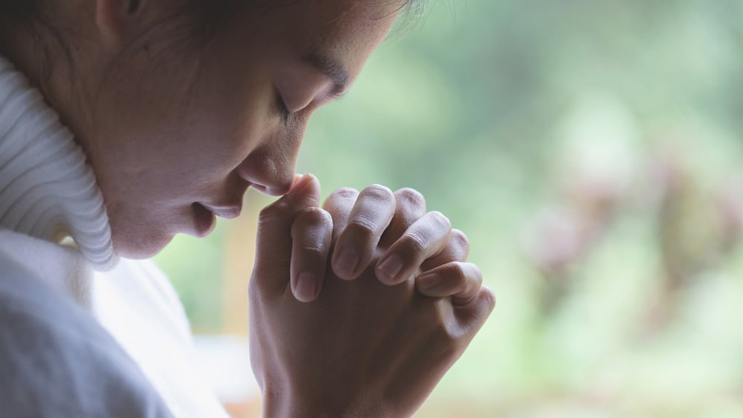
If we want God to meet our needs when we pray “in the name of Jesus,” how must we pray?
6. Principle –The names of the second person of the Trinity refer to all that He is, both as the Son of God and as the son of man-all His nature, power, and glory.
7. Principle – Jesus is the name of Christ in His humanity-as the son of man. I am is the name of Christ in His divinity – as the Son of God as the son…John 8:58 “I tell you the truth, Jesus answered, before Abraham was born, I am!”
8. Principle – If we want God to meet our needs when we pray in the name of Jesus,” we must pray based on the divine name that meets our particular needs.
THE NAME OF JESUS!

Slide 10
Like God the Father, the Son has a variety of names that describe who He is. In the Old testament, some of His names are the “seed” (Genesis 3:15) , “the Branch” (Zech. 6:12) and “Immanuel” [“God with us”] (Isaiah 7:14). In the New testament, Jesus (Luke 1:31; Matthew 1:21).
The name Jesus means “Savior”. His name reflects who He is. He came to earth to save the world!
Therefore, Jesus is the name of Christ in His humanity-as the Son of man. However, we must call on His nature and attributes! He’s calling on us to understand His nature and appropriate faith it in faith.
The story of Lazarus…John 11:23-27 “I am the resurrection and the life.”
THE NAME OF JESUS!

Slide 11
POWER OF ATTORNEY!
Praying in the name of Jesus like giving Him “Power of Attorney”. From what position is Jesus representing our interest to God?
9. Principle – To pray in the name of Jesus is to give Him power of attorney on our behalf when we make requests of the father.
10. Principle – The Holy Spirit continues Jesus’ ministry on earth. He assists in exercising power of attorney by enabling us to pray when we don’t know how to pray.

Slide 12
POWER OF ATTORNEY!
Praying in the name of Jesus is giving Him power of attorney to intercede on your behalf when you make request of the Father (John 16:23). Jesus is actively working on our behalf. (Rom. 8:34; Heb. 7:25; John 14:12-14).
After Jesus spoke to the disciples about praying in His name, He talked to the Holy Spirit, because the Holy Spirit continues Jesus’ ministry on earth. (John 14-15-17).
When we don’t know what we should pray for, the Holy Spirit helps us! (Rom. 8:26-27; Eph. 6:18)

Slide 13
JESUS’ NAME IS THE KEY TO HEAVEN!
Why does the spirit tell us that Jesus is the only one who can speak for us to the Father?
What is the significance in terms of prayer and fulfilling God’s purpose that Jesus’ name is the “name that is above every name” and that “at the name of Jesus every knee should bow, in heaven and on earth and under the earth” (Phil. 2:9-10).
11. Principle – Jesus’ name is the only name that can activate power in heaven.
12. Principle- The authority of Jesus’ name is the basis on which we are to fulfill the great commission.

Slide 14
JESUS’ NAME IS THE KEY TO HEAVEN!
This is a crucial truth in relation to prayer, because, if the father loves the son, then the father will do anything the son wants. If the father loves the son and does whatever the son asks, and if the son is representing you, then you don’t have to worry about your case being heard. That is why it is essential that you call up Jesus’ power of attorney.
Jesus said if we want to do business with the Father, we must come in His name alone (Acts 4:13).
According to God’s word, Jesus is the only one who can speak for you (1Tim. 2:5; Phil. 2:9-10;).
It is the name of Jesus that brings others to salvation (Matt. 28:18-19).

Slide 15
Putting Prayer into Practice
Focus this week on abiding in Christ and having His word abide in you, so that the Word can be inside you to work powerfully in your life.
Take time this week to worship the Lord for all His marvelous attributes. Ask Him to forgive you for taking His name lightly or misusing His name, and then purpose in your heart always to honor His name.
The name of the Lord is a strong tower, the righteous run to it and are safe. Proverbs 18:10. Whenever you are in a different situation, instead of becoming fearful, run to the name of the Lord in prayer and call him as your Salvation and Righteousness and as your Protector and Defender.

Slide 16
LET’S PRAY!!

Slide 17
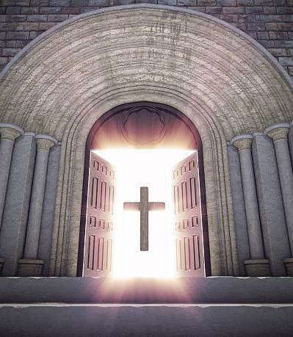
Doors of the Church are OPEN:
“REID TEMPLE CARES”

