Slide 2
THE “REAL” LORD’S Prayer:
John 17
Dr. Mark E. Whitlock, Jr.
Pastor
Rev. Debyii L. Sababu-Thomas, PhD.
Facilitator

Slide 3
COURSE OBJECTIVES!
To introduce the nature of the “High Priestly Prayer” of Jesus Christ
To understand why is is considered the “Real Lord’s Prayer”
To demonstrate the Love that Jesus showed for His Disciples , then , and those to come
ALTAR CALL – PRAYER/SALVATION/JOIN
OFFERING
THANK YOU AND BENEDICTION

Slide 4
The High Priestly Prayer of Jesus- Overview
In John chapter 17, is called the High Priestly Prayer because, just as High Priests would pray before they offered the sacrifice for forgiveness of sins, Jesus is on the cusp of offering himself on the cross. In fact, the cross is only hours away, which is of course, why Jesus lifts up his eyes and says that “the hour has come.” The cross was imminent and so he prayed.
This particular prayer is densely theological and incredibly comforting. Because so much of what Jesus is doing in the upper room is comforting his disciples.
Prior to this Jesus really centers around teaching them about the work of the Holy Spirit and how he will guide and comfort them after Jesus is gone. He alsond also engaged in footwashing and serving communion. And so it’s on the heels of that, Jesus continues to comfort his disciples by offering one of the most glorious prayers in all of Scripture. The “High Priestly Praye:r as a whole breaks down very simply: Jesus begins by praying for himself,, then he prays for his immediate disciples, and he ends his prayer by praying for all Christians.
Rev. Jake Hooker, Providence Presbyterian Church- www.provroanoke.org

Slide 5
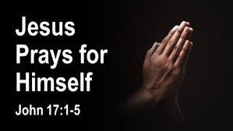
PART 1
John 17:1-5

Slide 6
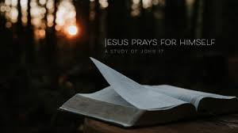
Jesus spoke these words, lifted up His eyes to heaven, and said
1. “Father, the hour has come.
Glorify Your Son, that Your Son also may glorify You, ² as
You have given Him authority over all flesh, that He ^{[a]}should give eternal life to as many as You have given Him. ³
And this is eternal life, that they may know You, the only true God, and Jesus Christ whom You have sent. ⁴ I have glorified You on the earth.
I have finished the work which You have given Me to do.
⁵ And now, O Father, glorify Me together ^{[b]}with Yourself, with the glory which I had with You before the world was.

Slide 7
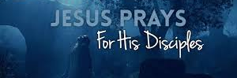
PART 2
John 17:6-19

Slide 8
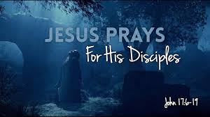
⁶ “I have ^{[c]}manifested (revealed) Your name
to the men whom You have given Me out of the world. They were Yours,
You gave them to Me, and
they have kept Your word.
⁷ Now they have known that all things
which You have given Me are from You.
f.) ⁸ For I have given to them the words which You have given Me;
g) and they have received them, and
h.) have known surely that I came forth from You; and
i.) they have believed that You sent Me
THEY WERE CHOSEN BY GOD!

Slide 9
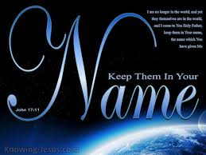
⁹ “I pray for them. I do not pray for the world
but I pray for those whom You have given Me,
for they are Yours.
¹⁰ And all Mine are Yours, and Yours are Mine, and I am glorified in them.
and none of them is ^{[g]}lost except the son of ^{[h]}perdition, that the Scripture might be fulfilled.
¹¹ Now I am no longer in the world, but these are in the world, and I come to You. Holy Father,
keep^{[d]} through Your name those whom You have given Me, that they may be one as We are. ¹
¹² While I was with them ^{[e]}in the world, I kept them in ^{[f]}Your name.
Those whom You gave Me I have kept;
HE PRAYED FOR GOD TO
KEEP THEM THROUGH HIS NAME!

Slide 10
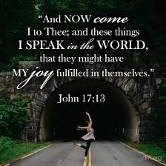
¹³ But now I come to You, and these things I speak in the world,
that they may have
My joy fulfilled in themselves.
HE PRAYED FOR US TO HAVE JOY
…HIS JOY!!

Slide 11
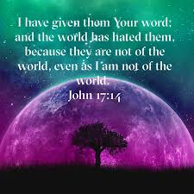
¹⁴ I have given them Your word;
and the world has hated them
because they are not of the world,
just as I am not of the world.
¹⁵ I do not pray that You should take them out of the world,
but that You should keep them from the evil one.
¹⁶ They are not of the world, just as I am not of the world.
WE ARE DIFFERENT- WE ARE SPECIAL (PECULIAR II PETER 2:9)
LIKE JESUS

Slide 12
¹⁷ Sanctify^{[i]} them by Your truth.
Your word is truth.
¹⁸ As You sent Me into the world,
I also have sent them into the world.
¹⁹ And for their sakes I sanctify Myself, that
they also may be sanctified by the truth.
HE PRAYED THAT GOD WOULD GIVE US HIS WORD
SO WE COULD BE COMPLETELY DEDICATED TO GOD

Slide 13
¹³ But now I come to You, and these things I speak in the world,
that they may have
My joy fulfilled in themselves.
HE PRAYED FOR US TO HAVE JOY
…HIS JOY!!

Slide 14
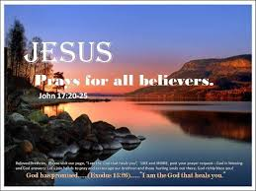
PART 3
John 17:20-26

Slide 15
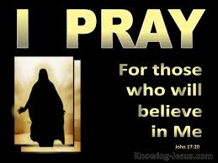
²⁰ “I do not pray for these alone,
but also for those who ^{[j]}will believe in Me through their word;
²¹ that they all may be one,
as You, Father, are in Me,
and I in You;
that they also may be one in Us,
that the world may believe that You sent Me.
JESUS PRAYS FOR ALL BELIEVERS TO BE UNITED

Slide 16
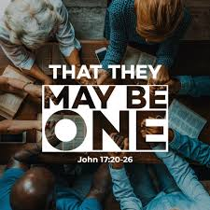
²² And the glory which You gave Me
I have given them,
that they may be one just as We are one:
²³ I in them, and You in Me;
that they may be made perfect in one, and
that the world may know that You have sent Me,
and have loved them as You have loved Me.
JESUS PRAYED THE WORLD WILL KNOW THAT WE ARE ONE AND
ARE LOVED BY HIM AND THE FATHER

Slide 17
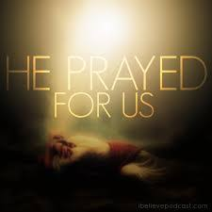
²⁴ “Father, I desire that they also whom You gave Me
may be with Me where I am,
that they may behold My glory which You have given Me;
for You loved Me before the foundation of the world.
²⁵ O righteous Father!
The world has not known You, but I have known You; and these have known that You sent Me.
²⁶ And I have declared to them Your name, and will declare it,
that the love with which You loved Me may be in them, and I in them.”
Oh, how he loves you and me!!!

Slide 19
WHAT HAVE YOU LEARNED ABOUT JESUS?
DO YOU THINK THIS QUALIFIES AS “THE LORD’S PRAYER”

Slide 20
Dr. Mark E. Whitlock, Jr.
Pastor
Rev. Debyii L. Sababu-Thomas, PhD.
Facilitator

Slide 21
LET’S PRAY!!

Slide 22
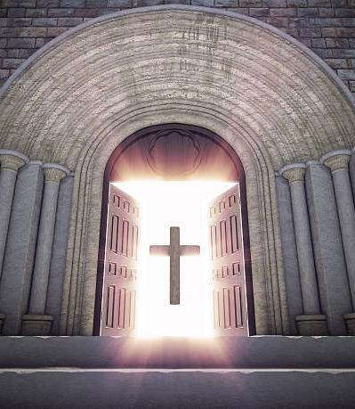
Doors of the Church are OPEN:
“REID TEMPLE CARES”

