Slide 2
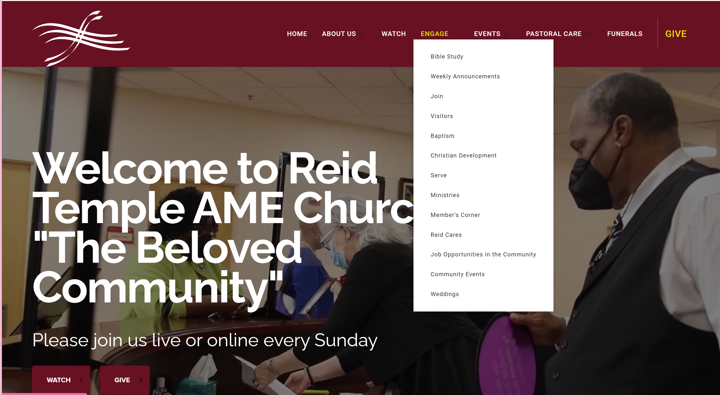

Slide 3
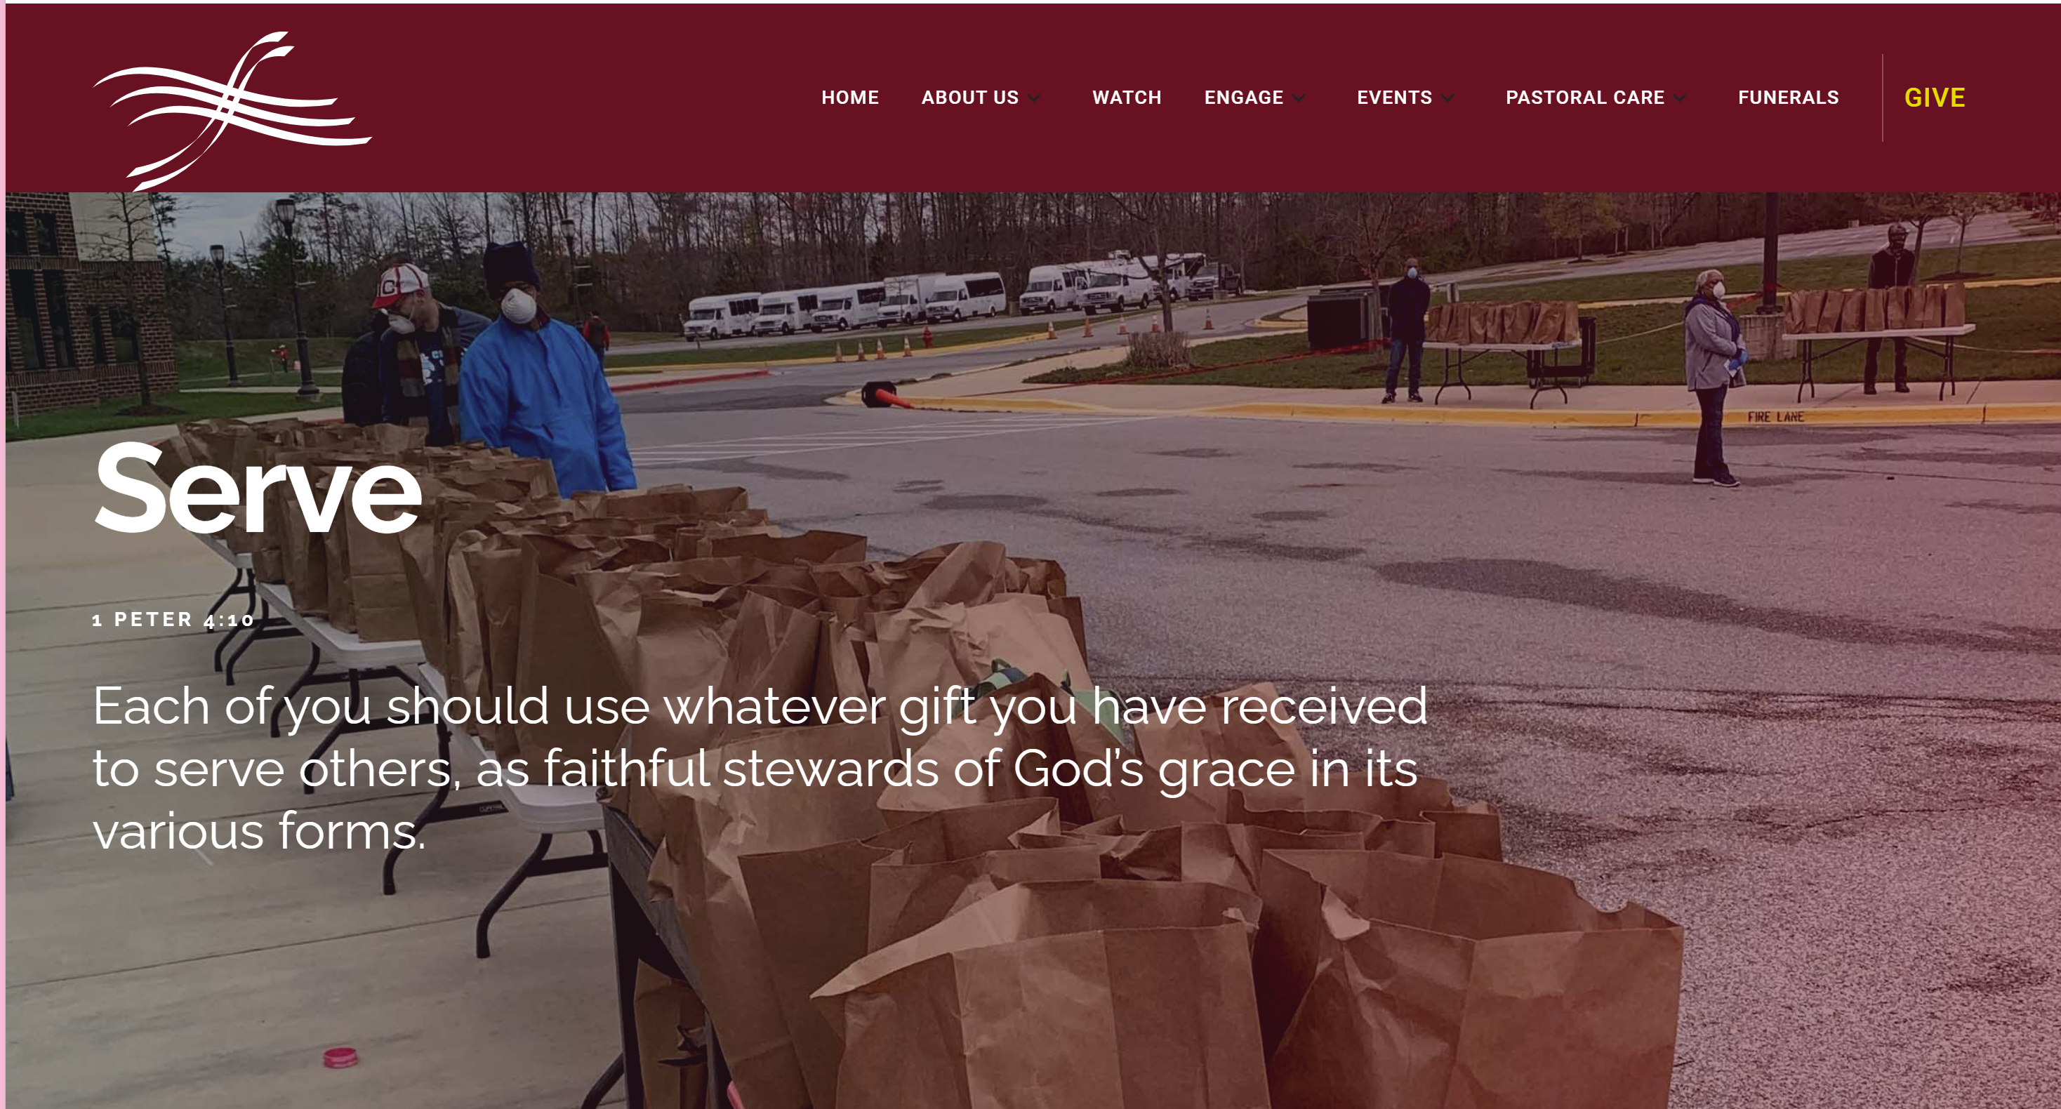

Slide 4
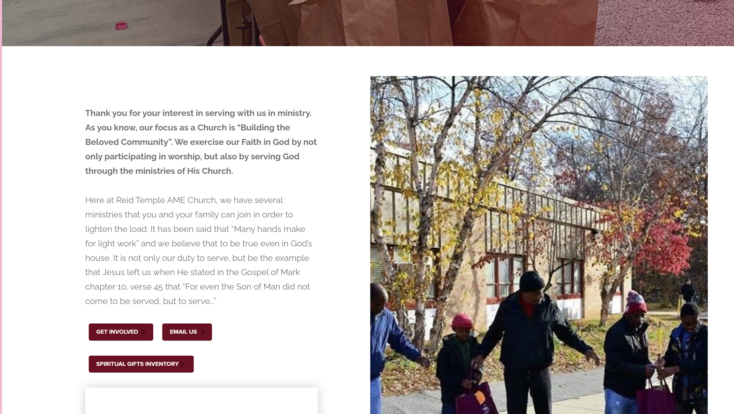

Slide 5
TEAM EVANGELISM:
“UNDERSTANING THE TASK”

Slide 6
COURSE OBJECTIVES
PRAYER
RECAP: UNDERSTANDING THE PURPOSE AND POWER OF PRAYER
THE WORD: MATTHEW 29:19-20
THE PURPOSE OF THE EVANGELISM COMMISSION
OBEY HIS COMMANDMENTS
UNDERSTADNING THE TASK
HOMEWORK!
LET’S PRAY TOGETHER
OPEN THE DOORS OF THE CHURCH/OFFERING
THANK YOU!

Slide 7
UNDERSTANDING THE PURPOSE AND POWER OF PRAYER
When prayers aren’t answered, the Word of God provides an indication of why, giving insight into the kind of prayers God responds to, and what can inhibit our prayers. (LUKE 18:1)
God is faithful to answer prayer. Jesus gives the assurance that God does hear and answer our prayers. (MARK 11:24)
God’s will and word do work when they are understood and put into practice. Prayer is speaking the Word to God exactly as He gave it to us.
Praying without understanding and applying the truth and principles of prayer is INEFFECTIVE. God knows we have limited understanding of Him and His ways, and that we struggle with our fallen nature.
We can pray to God directly in Jesus’ name because He has given us authority to do so based on the new covenant (JOHN 16:23-27).
Jesus is our model of dominion authority. What He accomplished on earth and in His humanity, even though He was also divine. Jesus is our model for an effective prayer life!
There is no difference between what the people in the Bible were given by God as the basis for their effective prayers and what you and I are given to work with. Both relay on what God has given all mankind- His Word.
God wants to use His power in the world; however, for Him to do so, we must know how to appropriate His Word, while understanding what it is and how to apply it.
God’s Word is the foundation of His power. His power is a reflection of His greatness.

Slide 8
THE WORD
According to Thom Rainer's book, The Unchurched Next Door, 82% of our friends and family that don't attend church are at least somewhat likely to attend church if invited.
Do you know anyone suffering:
A neighbor that is complaining about how much stress they are under?
A single mom that is being crushed under the weight of trying to be both parents for her kids?
A co-worker that is just moving through life in zombie-like fashion?
A friend suffering with an addiction?
A young adult going in the wrong direction?
Or how about that friend who does go to church, but he has not experienced freedom?

Slide 9
THE WORD
Matthew 28:19 “Therefore go and make disciples of all nations, baptizing them in the name of the Father and of the Son and of the Holy Spirit, 20 and teaching them to obey everything I have commanded you. And surely, I am with you always, to the very end of the age.”
We are to go into all the world, but often we fail to go to our own neighbor. Inviting others to church is one way we can fulfill our responsibility to obey Jesus and introduce Him to a lost world.

Slide 10
THE PURPOSE OF THE EVANGELISM COMMISION

Slide 11
THE PURPOSE OF THE EVANGELISM COMMISSION
In the Greek, “make disciples” is the only imperative verb. Going, baptizing, and teaching them to obey everything I have commanded you. And surely, I am with you always, to the very end of the age.”
Are participles—subordinate to “make disciples.”
The MISSION is to “make disciples.” To accomplish that mission, the disciples must go, baptize, and teach, so there is an imperative quality to each of those—but the only imperative verb (and the primary mission) is “make disciples.”
A disciple is a learner—a student—a follower : A person committed to learning what a teacher must teach. The disciple is expected not only to learn what the pastor teaches, but also to practice what the pastor preaches. In other words, the idea is not simply learning, but also living. Hence “teaching them to observe all things that I commanded you” (v. 20) is a natural component of Jesus’ Great Commission.
Baptizing them in the name of the Father and of the Son and of the Holy Spirit. Being baptized in the name of indicates a new relationship, a rebirth, an adoption. Being baptized indicates that the new relationship involves all three faces of the Trinity.

Slide 12
THE PURPOSE OF THE EVANGELISM COMMISSION
Teaching them to obey everything I have commanded you. Our responsibility does not end with leading people to make an initial decision to follow Christ. We must not miss the importance of the word obey His commandments.
Jesus gave approximately fifty commandments on how to live. We must also persuade the ethne (nations or Gentiles) to obey Jesus. Here the line blurs between teaching (where the emphasis is transmitting information) and preaching (where the emphasis is to persuasion). We must find the balance between preaching and teaching!!!
Surely, I am with you always, to the very end of the age.” Jesus’ promise to be with us always. From beginning to end, therefore, the promise is that we will live under the umbrella of the presence of God/Jesus.
He is promising to be with us now—and in the future—and into that time where the whole idea of time has become meaningless—into eternity.

Slide 13
OBEY HIS COMMANDMENTS

Slide 14
OBEY HIS COMMANDMENTS!
Matthew 7:12 "So in everything, do to others what you would have them do to you, for this sums up the Law and the Prophets."
Matthew 4:17 “From that time on Jesus began to preach, “Repent, for the kingdom of heaven has come near.”
Matthew 4:19 “Come, follow me,” Jesus said, “and I will send you out to fish for people.”
Matthew 5:16 “In the same way, let your light shine before others, that they may see your good deeds and glorify your Father in heaven.”
Matthew 5:23 “Therefore, if you are offering your gift at the altar and there remember that your brother or sister has something against you, leave your gift there in front of the altar. First go and be reconciled to them; then come and offer your gift.”

Slide 15
OBEY HIS COMMANDMENTS!
Matthew 5:37 “All you need to say is simply ‘Yes’ or ‘No’; anything beyond this comes from the evil one.”
Matthew 5:39 “But I tell you, do not resist an evil person. If anyone slaps you on the right cheek, turn to them the other cheek also.”
Matthew 6:33 “But seek first his kingdom and his righteousness, and all these things will be given to you as well.”
Matthew 7:12 “So in everything, do to others what you would have them do to you, for this sums up the Law and the Prophets.”
Matthew 18:21 “Then Peter came to Jesus and asked, “Lord, how many times shall I forgive my brother or sister who sins against me? Up to seven times?”
Matthew 22:37 “Love the Lord your God with all your heart and with all your soul and with all your mind.’ This is the first and greatest commandment.” and the second is like it: “Love your neighbor as yourself.”

Slide 16
UNDERTANDING
THE TASK
Matthew 28:19 “Therefore go and make disciples of all nations, baptizing them in the name of the Father and of the Son and of the Holy Spirit, 20 and teaching them to obey everything I have commanded you. And surely, I am with you always, to the very end of the age.”
Fill in the blank
Therefore, go and___________ Mathetevo (Gk.) =______________________
____________them in the name of the father and of the son and of the Holy spirit.
___________ them to obey everything I have commanded you. Didasko (Gk.) =_____
The great commission is a_______________________
Objective of the great commission is to make people __________________
The great commission is given to the __________________________
The great commission tell us __ to do _____ and ___ is to do it, not _____ to do it.

Slide 17
HOMEWORK!
Go to the reidtemple.org!
Engage
Serve
Spiritual Gifts
Take the test and let’s talk about it next week!

Slide 18
LET’S PRAY!

Slide 19
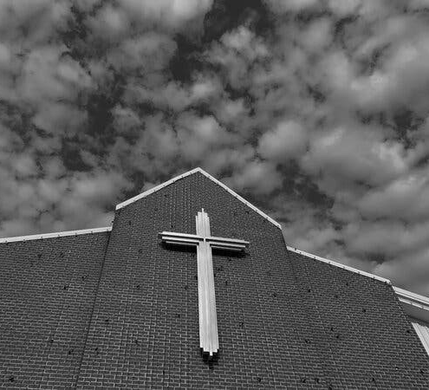
THE DOORS OF THE
CHURCH ARE OPEN!

