Slide 3
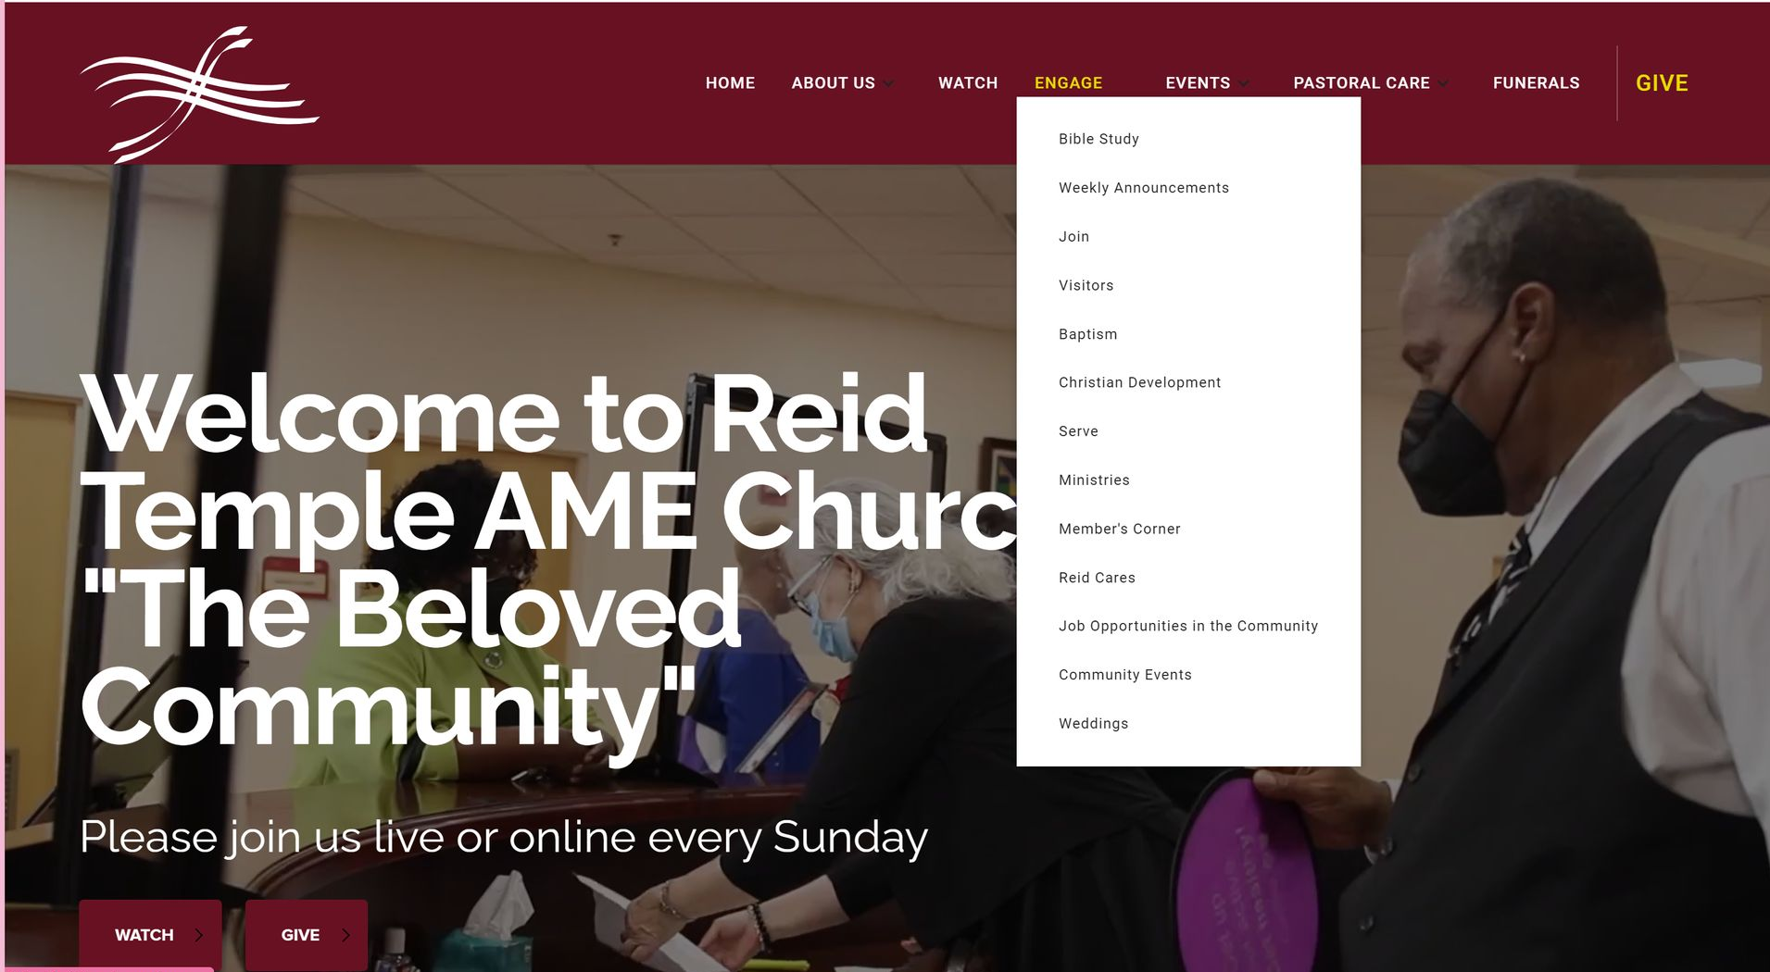

Slide 4
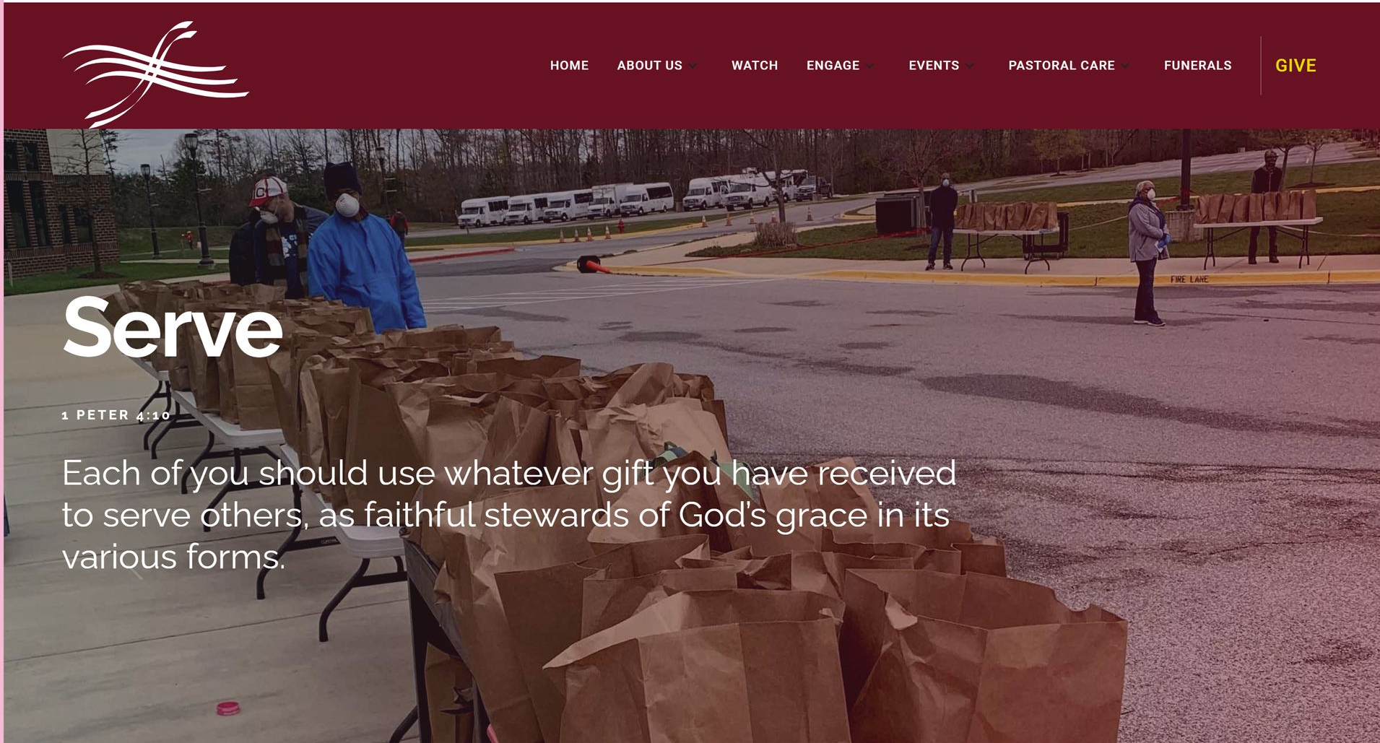

Slide 5
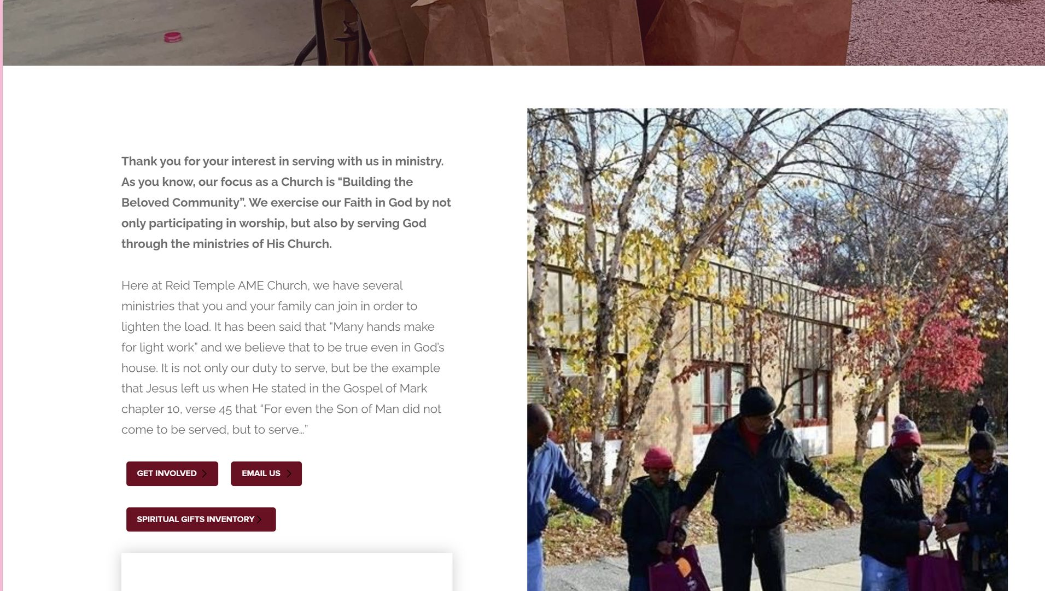

Slide 6
TEAM EVANGELISM:
“UNDERSTANING THE METHOD BY USING SPIRITUAL GIFTS”

Slide 7
COURSE OBJECTIVES
PRAYER
THE WORD: MATTHEW 28:19-20
THE PURPOSE OF THE EVANGELISM COMMISSION
SPIRITUAL GIFTS
UNDERSTADING THE TASK
HOMEWORK
LET’S PRAY TOGETHER
OPEN THE DOORS OF THE CHURCH/OFFERING
THANK YOU!

Slide 8
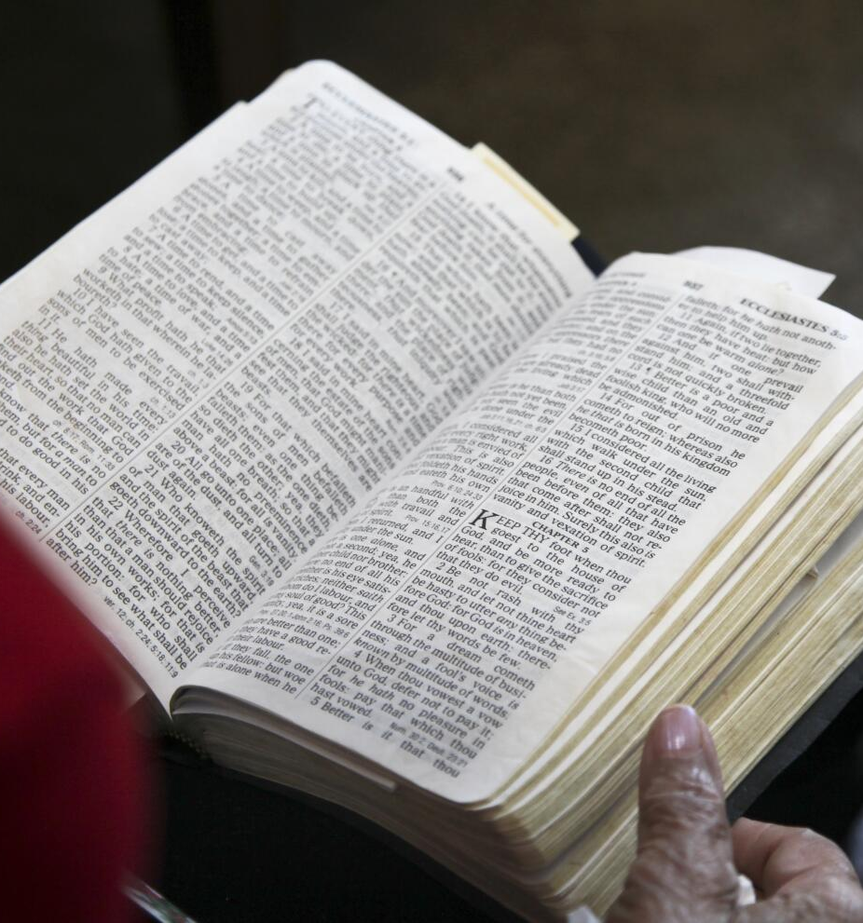
Matthew 28:19 “Therefore go and make disciples of all nations, baptizing them in the name of the Father and of the Son and of the Holy Spirit, and teaching them to obey everything I have commanded you. And surely, I am with you always, to the very end of the age.”
The Gospel contains messages of love, forgiveness, and redemption. Sharing these teachings can bring about positive change in people's lives, leading to personal transformation, healing, and reconciliation.

Slide 9
THE PURPOSE OF THE EVANGELISM COMMISSION!

Slide 10
In the Greek, “make disciples” is the only imperative verb. Going, baptizing, and teaching them to obey everything I have commanded you. And surely, I am with you always, to the very end of the age.”
The MISSION is to “make disciples.” To accomplish that mission, the disciples must go, baptize, and teach, so there is an imperative quality to each of those—but the only imperative verb (and the primary mission) is “make disciples.”
A disciple is a learner—a student—a follower : A person committed to learning what a teacher must teach. The disciple is expected not only to learn what the pastor teaches, but also to practice what the pastor preaches. In other words, the idea is not simply learning, but also living.
Baptizing them in the name of the Father and of the Son and of the Holy Spirit. Being baptized in the name of indicates a new relationship, a rebirth, an adoption. Being baptized indicates that the new relationship involves all three faces of the Trinity.

Slide 11
THE PURPOSE OF THE EVANGELISM COMMISSION
Teaching them to obey everything I have commanded you. Our responsibility does not end with leading people to make an initial decision to follow Christ. We must not miss the importance of the word obey His commandments.
Jesus gave approximately fifty commandments on how to live. We must also persuade the ethne (nations or Gentiles) to obey Jesus. Here the line blurs between teaching (where the emphasis is transmitting information) and preaching (where the emphasis is to persuasion). We must find the balance between preaching and teaching!!!
Surely, I am with you always, to the very end of the age.” Jesus’ promise to be with us always. From beginning to end, therefore, the promise is that we will live under the umbrella of the presence of God/Jesus.
He is promising to be with us now—and in the future—and into that time where the whole idea of time has become meaningless—into eternity.

Slide 13
GOD GIVES SPIRITUAL GIFTS TO EVERY BELIEVER TO SUPPORT AND SUBSTAIN THE BODY OF CHRIST.
THERE ARE THREE BIBLICAL LISTS OF THE “GIFTS OF THE SPIRIT”, ALSO KNOWN AS SPIRITUAL GIFTS!
THE THREE MAIN PASSAGES DESCRIBING THE SPIRITUAL GIFTS ARE:
ROMANS 12: 6-8
1 CORINTHIANS 12: 4-11
1 CORINTHIANS 12:28

Slide 15
PROPHECY:
The Greek word translated “prophecy” in both passages properly means “a speaking forth.” To prophesy is to declare the divine will, to interpret the purposes of God, or to make known in any way the truth of God.

Slide 16
SERVING:
This gift involves providing service of any kind; it is the broad application of practical help to those in need. “Serving“ is a translation of the Greek word diakonian, from which we get the English deacon.

Slide 17
TEACHING:
This gift involves the analysis and proclamation of the Word of God, explaining the meaning, context and application to the hearer’s life.

Slide 18
EVANGELISM:
The gift of evangelism is found in Ephesians 4:11-12 where Paul says that Jesus “gave the apostles, the prophets, the evangelists, the shepherds and teachers, to equip the saints for the work of ministry, for building up the body of Christ.”

Slide 19
ENCOURAGING:
Also called “exhortation,” this gift is evident in those who consistently call upon others to heed and follow God’s truth, which may involve correction or building others up by strengthening weak faith or comforting in trials.

Slide 20
GIVING:
Gifted givers are those who joyfully share what they have with others, whether it is financial, material, or the giving of personal time and attention.

Slide 21
LEADERSHIP:
The gifted leader is one who rules, presides over, or has the management of other people in the church.

Slide 22
MERCY:
The gift of mercy is obvious in those who are compassionate toward others who are in distress, showing sympathy and sensitivity coupled with a desire and the resources to lessen their suffering in a kind and cheerful manner.

Slide 23
WISDOM:
The fact that this gift is described as the “word” of wisdom indicates that it is one of the speaking/preaching gifts.

Slide 24
KNOWLEDGE:
This is another speaking gift that involves understanding truth with an insight that only comes by revelation from God.

Slide 25
FAITH:
All believers possess faith in some measure because it is one of the gifts of the Spirit bestowed on all who come to Christ in faith.
(Galatians 5:22-23).

Slide 26
HEALING:
Although God does still heal today, and while there is no biblical reason that God can not empower an individual with the spiritual gift of healing today.
(2 Corinthians 2:12; Hebrews 2:4)

Slide 27
MIRACULOUS POWERS:
Also known as the working of miracles, this is another temporary sign gift that involved performing supernatural events that could only be attributed to the power of God. (Acts 2:22)

Slide 28
DISCERNMENT:
Certain individuals possess the unique ability to determine the true message of God from that of the deceiver, Satan, whose methods include purveying deceptive and erroneous doctrine.
(Matthew 24:4-5)

Slide 29
TONGUES:
The gift of tongues is one of the temporary sign gifts given to the early church to enable the gospel to be preached throughout the world to all nations and in all known languages.

Slide 30
INTERPREATION OF TONGUES:
A person with the gift of interpreting tongues could understand what a tongues-speaker was saying.

Slide 31
HELPING:
Closely related to the gift of mercy is the gift of helps. Those with the gift of helping are those who can aid or render assistance to others in the church with compassion and grace.

Slide 32
UNDERSTANDING THE METHOD!

Slide 33
UNDERSTANDING THE METHOD!
Understanding the philosophy #1_______________
Every Christian has the responsibility to witness to every unsaved person. Furthermore, witnessing goes beyond a personal testimony, requiring you to present the plan of salvation and pursue a decision.
Strength
Structured – High organized system with controls
Provides how to training
Verbalization
Weaknesses
People won’t commit to training
Assume all will fit
Decision without getting people in church
Philosophy #2________
Evangelism – a process of networking people into receptive relationships living your life that others may see Christ in you.
Strengths
Removes guilt freedom to be yourself
Utilizes strengths of the relationship
Promotes holy living
Weaknesses
Sin nature of man
Does not involve the church application
Nonverbal (people are not going to ask

Slide 34
PHILOSOPHY #3!
Evangelism- Recognizes that approximately 10% of Christians have the spiritual gift of evangelism while 90% do not. This allows the individual to adopt a method suitable to his or her own giftedness.
Minimizes Weaknesses:
No training required
Recognizes the gift of evangelism
Put emphasis on people joining church
Uses people where they are, imperfect sinners
Organizes systems of putting the heart into helping people
Promotes sharing through natural communication without a planning presentation
Strengths:
User friendly designed for laity
Uses all principles of effective evangelism
Low Pressure
No Remaking- Just be yourself
Uses everyone’s gift as a team, assemble the body.

Slide 35
LET’S PRAY!

Slide 36
THE DOORS OF THE
CHURCH ARE OPEN!

