Slide 2
TOTAL TRUST:
“UNSHAKABLE TRUST IN GOD”
DR. MARK E. WHITLOCK, JR.
PASTOR

Slide 4
PRAYER
SCRIPTURE: PROVERBS 29:25
WHAT IS TRUST?
THE CHARACTER OF GOD
CONFIDENCE IN CHRIST
LET’S PRAY TOGETHER
THE DOORS OF THE CHURCH ARE OPEN/OFFERING
THANK YOU!

Slide 5
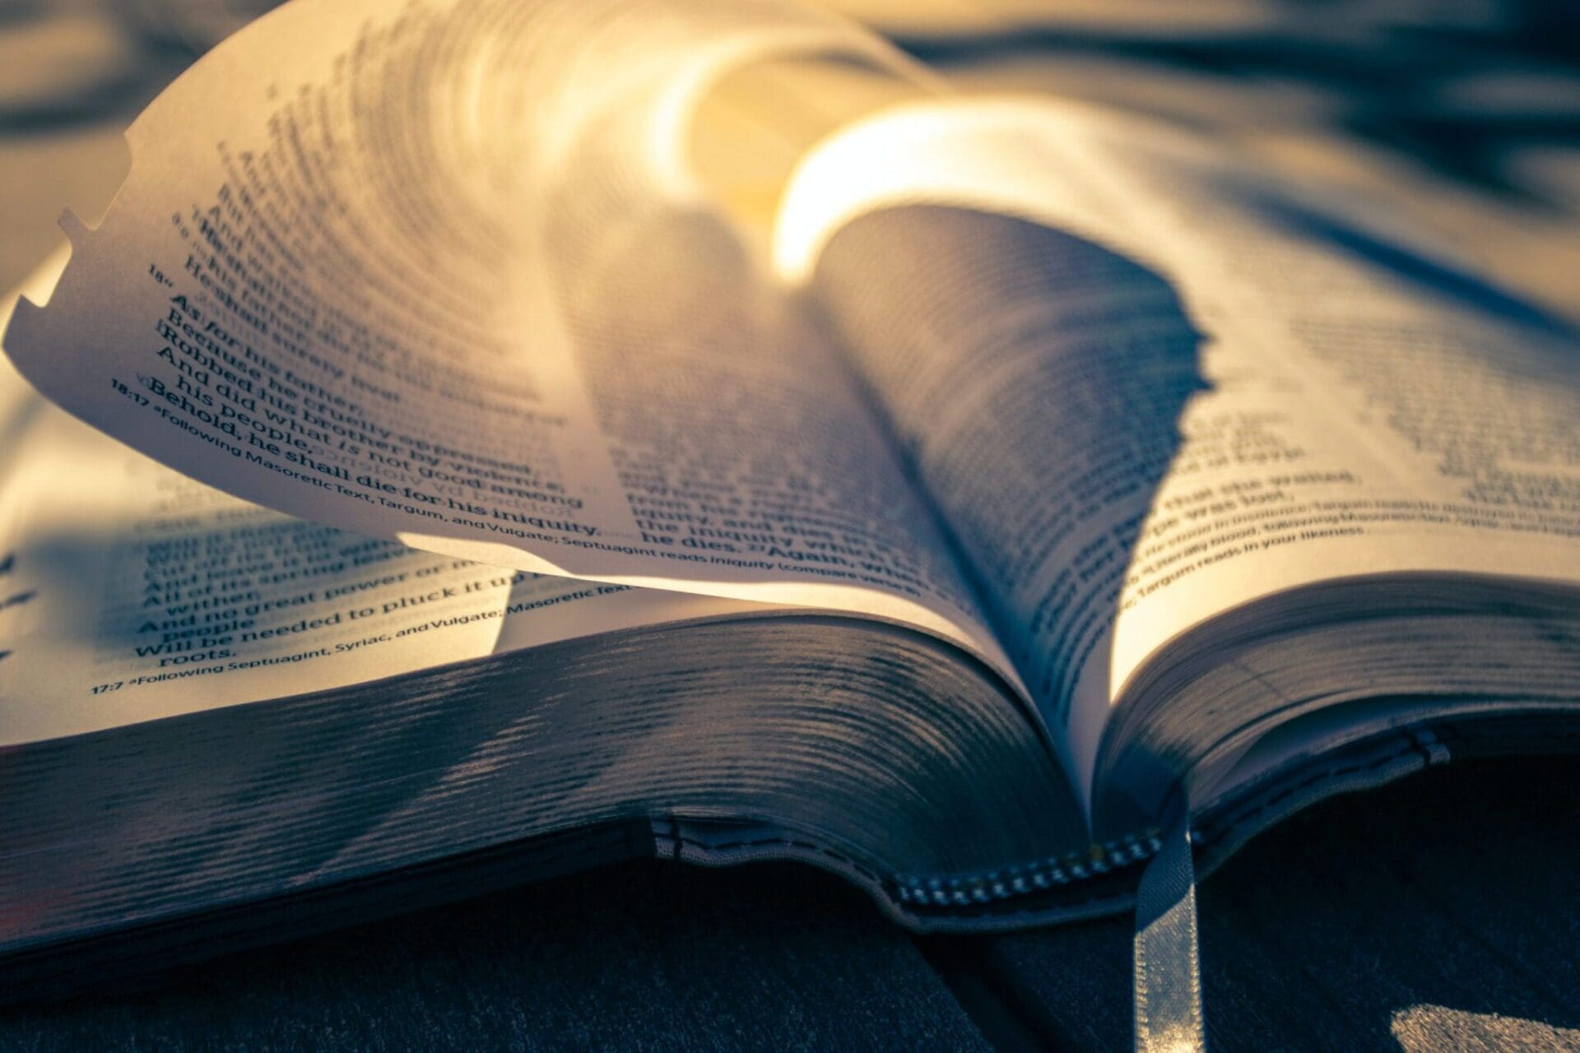
THE WORD OF GOD
Proverbs 29:25
The fear of man bringeth a snare: But whoso putteth his trust in the LORD shall be safe.

Slide 6
The Hebrew word here for “snare” refers to traps hunters used to catch animals or birds. Snares are dangerous. If we get caught, we must do whatever it takes to free ourselves. Satan uses snares to trap human beings (Jeremiah 5:26). One of those snares is the fear of man.
The fear of man can be both physical and psychological. Jesus said to His followers, “I tell you, my friends, do not be afraid of those who kill the body and after that can do no more. But I will show you whom you should fear: Fear him who, after your body has been killed, has authority to throw you into hell. Yes, I tell you, fear him” (Luke 12:4–5).

Slide 7
The fear of man manifests as people-pleasing, compromised values, peer pressure, and not sharing our faith.
The fear of man can be a snare when we allow it to influence our decisions. Rather than obeying the voice of the Holy Spirit (John 10:27), we opt for avoiding unpleasant interactions.
The fear of man stifles our growth in God.

Slide 8
WHAT IS TRUST?
TRUST: Is confidence; a reliance or resting of the mind on the integrity, veracity, justice, and friendships are sound principles of another person.

Slide 9
The fear of man has replaced trust in God. Public opinion has overridden the clear teaching of Scripture on many social issues. The need to be liked and accepted has become more important than the Word of God to many professing to be believers, thus proving the truth of Proverbs 29:25.
Trust enables us to live without fear, weights, burdens, or cares because of the confidence we have that another will handle those things for us.
The psalmist David spoke frequently about putting his trust in God. (Colossians 3:14; Ephesians 4:24; 6:15; Proverbs 3:5)
David refused to put on Saul's armor to defeat Goliath. He put his trust in God! (1 Sam. 17:34-36)

Slide 10
THE CHARACTER OF GOD!

Slide 11
Trust is dependent on what we know about the character of the one being trusted. If we do not believe the person is good, just, kind, loving, and trustworthy, then we cannot put our confidence in them.

Slide 12
THE CHARACTER OF GOD
One aspect of God's character is that He gives us comfort though He is just. That means that He will always make wrong things right.
Trusting in God to bring justice relieves us of the job of doing it ourselves. God clearly states in His word that vengeance is His and that He repays the enemies of His people.
Hebrews 10:30 “For we know him who said, “It is mine to avenge; I will repay,” and again, “The Lord will judge his people.”
To express the justice of God, we must be willing to turn the situation over to Him and refuse to try and take care of it ourselves.

Slide 13
CONFIDENCE IN CHRIST!
Trust is said to be confident. As believers in Jesus, our confidence needs to be in Him. The apostle Paul was very clear when he stated that he put no confidence in the flesh.

Slide 14
Trust is confidence in the one who is trusted, and confidence in Christ makes us comfortable! It allows us to work with ease because we believe we can do what needs to be done. Confident trust removes stress, pressure, worry, and the fear of failure.

Slide 15
Satan doesn't want us to be confident because he knows that without it, we will not accomplish much in life.
However, if your confidence is in God, you can trust God to give you favor.
People who are very talented, intelligent, educated, and capable still need confidence.

Slide 16
Confidence for us, is what fuel is to a plane or car. An airplane has the capability to fly, a car has the capability to drive, yet an airplane or car will not move without fuel.
Psalm 20:7 “Some trust in chariots, and some in horses: but we will remember the name of the Lord our God.”

Slide 17
WILL YOU TRUST GOD?

Slide 18
LET’S PRAY TOGETHER!

Slide 19
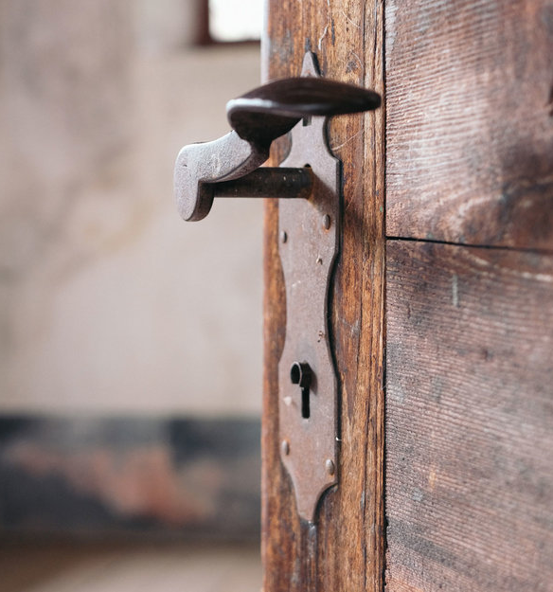
THE DOORS OF THE CHURCH ARE OPEN!
“REID TEMPLE CARES”

