Slide 2
TOTAL TRUST:
“Who Can I Trust”
DR. MARK E. WHITLOCK, JR.
PASTOR

Slide 3
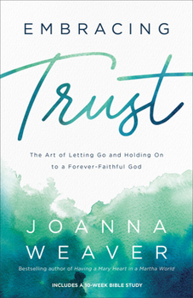
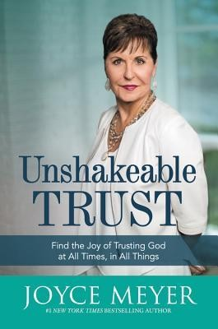

Slide 4
COURSE OBJECTIVES:
PRAYER
SCRIPTURE: JEREMIAH 17:5-6
WHO CAN I TRUST?
TRUST WITH EYES WIDE OPEN
FAULTY EXPECTATIONS
DISCREANMENT: 1 CORINTHIANS 12:4-11
TRUST GOD- PROVERBS 3:5-6
LET’S PRAY TOGETHER
OPEN THE DOORS OF THE CHURCH/OFFERING
THANK YOU!

Slide 5
“Cursed is the one who trusts in man, who draws strength from mere flesh and whose heart turns away from the Lord. That person will be like a bush in the wastelands; they will not see prosperity when it comes. They will dwell in the parched places of the desert, in a salt land where no one lives. “But blessed is the one who trusts in the Lord, whose confidence is in him. They will be like a tree planted by the water that sends out its roots by the stream. It does not fear when heat comes; its leaves are always green. It has no worries in a year of drought and never fails to bear fruit.”
The Word
-Jeremiah 17:5-8

Slide 6
These verses outline two ways of living—only two—there is no middle ground. Those who trust in mere mortals are accursed (verves 5-6), but those who trust in the Lord are blessed (verves 7-8).
These verses are like Psalm 1, which pronounces blessings on those whose “delight is in Yahweh’s law” (v. 2). Such people “will be like a tree planted by the streams of water, that brings forth its fruit in its season, whose leaf also does not wither. Whatever he does shall prosper” (v. 3). “The wicked are not so but are like the chaff which the wind drives away” (v. 4). “Therefore, the wicked shall not stand in the judgment, nor sinners in the congregation of the righteous. For Yahweh knows the way of the righteous, but the way of the wicked shall perish” (vv. 5-6).

Slide 7
WHO CAN I TRUST?

Slide 8
It's not surprising that we all come into life with some sort of trust issue. After all birth itself is quite traumatic.
One moment we are safe and warm, cradled close inside our mother's womb; with every need met without our asking.
We trust everything and everybody but then suddenly, we're ejected into in the world. Life experiences often gives birth to distrust. Trust may be broken by parents, friends, teachers, police, pastors, work associates, and sometimes we can't trust ourselves.

Slide 9
From the beginning of time, God has longed for people to trust and call His own. Like Adam and Eve, we were intended to live as cherished children enjoying the sweet communion with our father.
Yet, we still suffer from the original sin of Adam and Eve.

Slide 10
Trust With Eyes Wide Open

Slide 11
The bible says, John 2:24 “But Jesus would not entrust himself to them, for he knew all people”.
This scripture does not say that Jesus didn't trust anyone. Instead, it says that He did not trust himself to them. What does that mean? He didn't give himself over to the idea that man would never disappoint Him.
The birth of distrust started with the original sin committed by Adam and Eve in the garden of Eden.
Their distrust of God's goodness led them to crave something more than they had. Satan tempted them with the forbidden fruit. God had given several trees but told them not to eat of the tree of good and evil.
They bit from the forbidden tree and their eyes we're wide open.

Slide 12
John 2:25 “He did not need any testimony about mankind, for he knew what was in each person”.
Jesus was well informed about human nature and the weaknesses it contained. He came to strengthen humanity in their weakness and forgive their failures and sin.
Distrust leaves us powerless, tormented by fear, enslaved to temptation, disappointed, and susceptible to suffering.
However, God will never disappoint us! There is a difference between being disappointed by God and God disappointing us. God always knows what is best for us, even when we don’t.
Romans 5:5 “And hope does not put us to shame, because God’s love has been poured out into our hearts through the Holy Spirit, who has been given to us”.

Slide 13
FAULTY EXPECTATIONS!

Slide 14
God never disappoints. Sometimes we are disappointed because we want things that God doesn’t wants for us!
How much of our disappointment is someone else's fault, and how much is our own?
To expect a person to never hurt or disappoint you is a faulty expectation, simply because human nature is incapable of perfection.
Jesus was prepared when His disciples disappointed Him and was not devastated by their actions.
Judas betrayed Him, Peter denied Him, they all slept during His most critical hour of need instead of praying with Him.
Yet He continued loving them completely.

Slide 15
Hebrews 13:5 “Keep your lives free from the love of money and be content with what you have, because God has said, “Never will I leave you; never will I forsake you”.
The word “contentment” derives from two Latin words, con and tenere, meaning “to hold together.” When you have faith in God, your mind will “hold together” so efficiently that you can recover from disappointment.

Slide 16
“There are different kinds of gifts, But the same spirit distributes them.
- 1 Corinthians 12:4
Discernment
There are different gifts God gives us! These supernatural gifts allow us at times to know who is evil and who is good. That is the same God at work!

Slide 17
The brain is wonderfully made to discern danger. Trust that God is in you!
The amygdala is key in detecting and responding to threats. When it perceives danger, it can trigger the "fight or flight" response, activating the body's stress response system.
The hippocampus, also located in the temporal lobe, is involved in forming and retrieving memories. It works with the amygdala to compare current sensory information with past experiences to help determine if a situation is dangerous.

Slide 18
The hypothalamus plays a role in the physiological response to danger by activating the autonomic nervous system and the endocrine system, which control the release of stress hormones like adrenaline and cortisol.
The insular cortex, or insula, processes sensory information and emotional experiences, contributing to the perception of bodily states and feelings of unease or fear.
Don't doubt the gift of discernment. Pray for discernment. It will keep you from being deceived and perhaps hurt.

Slide 19
TRUST GOD!

Slide 20
The Bible says in Proverbs 3:5-6 “Trust in the Lord with all your heart and lean not on your own understanding; in all your ways submit to him, and he will make your paths straight”.
“Trust in the Lord with all your heart.” – Half hearted trust won't cut it. We must bring everything to the table, including all that we have. We cannot trust God with our whole being if we're making backup plans in case God doesn't come through.

Slide 21
“And lean not on your own understanding.” - We think we should be able to figure out life on our own. But our thoughts are not God’s. The Bible says in James 1:5 if any of you lacks wisdom, you should ask God, who gives graciously to all.
“In all your ways submit to him.” -God is always with us. God is our father. God will never mislead or leave us. He promised never to leave us or forsake us, so that God's will for us is accomplished instead of our own.
We must call on Him for help and trust God to answer!

Slide 22
“And he will make your path straight.” -God will make a straight path for you. Isaiah 45:2 says, “I will go before you and will level the mountains”. He specializes in making crooked places straight. The steps of a good person are ordered by God.
Rather than giving in to distrust choose to trust God.
Declare your faith in Jesus out loud: “Lord, I trust you with all that I am and all that I face. I acknowledge that you are with me in this situation, I am not alone. Thank you for going before me and showing me the way to go. I trust You!”

Slide 23
“Some trust in chariots and some in horses, but we trust in the name of the Lord our God”. -Psalms 20:7

Slide 24
LET’S PRAY TOGETHER!

Slide 25
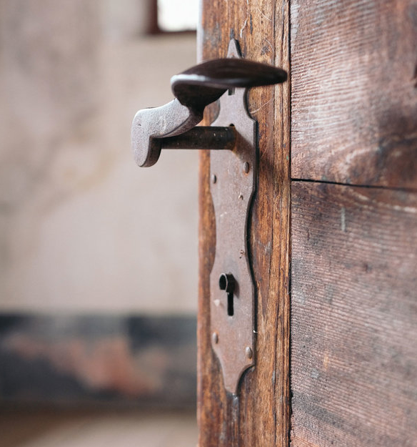
THE DOORS OF THE CHURCH ARE OPEN!
“REID TEMPLE CARES”

