Slide 1


Slide 2

TOTAL TRUST:
Faith over finance
DR. MARK E. WHITLOCK, JR.
PASTOR
ANDREA L. JACKSON
MONEY COACH

Slide 3

Prayer
Scriptures
Faith over finances: biblical principles--
Trusting God with our finances
The Story vs what is really happening
Let’s pray together
Open the doors of the church/offering
Thank you!

Slide 4

What is Faith?
  Hebrews 11:1
  Now faith is the substance of things hoped for, the evidence of things not seen.
  James 2:26
  For just as the [human] body without the spirit is dead, so faith without works [of obedience] is also dead.

Slide 5



Please download and install the Slido app on all computers you use
What area of your finances concerns you the most
ⓘ Start presenting to display the poll results on this slide.

Slide 6
Provision:
God did it Before, God Will Do it Again
1st Kings 17:2-6
² Then the word of the Lord came to Elijah: ³ “Leave here, turn eastward and hide in the Kerith Ravine, east of the Jordan. ⁴ You will drink from the brook, and I have directed the ravens to supply you with food there.”
⁵ So he did what the Lord had told him. He went to the Kerith Ravine, east of the Jordan, and stayed there. ⁶ The ravens brought him bread and meat in the morning and bread and meat in the evening, and he drank from the brook.

Slide 7
Promises of God
Matthew 6:25-27
²⁵ “Therefore I tell you, do not worry about your life, what you will eat or drink; or about your body, what you will wear. Is not life more than food, and the body more than clothes? ²⁶ Look at the birds of the air; they do not sow or reap or store away in barns, and yet your heavenly Father feeds them. Are you not much more valuable than they? ²⁷ Can any one of you by worrying add a single hour to your life?
Romans 8:28
²⁸ And we know that all things work together for good to those who love God, to those who are the called according to His purpose

Slide 8

5 KEY BIBLICAL FINANCIAL PRINCIPLES
God is not a respecter of persons (Acts 10:34),
but a respecter of principles

Slide 9

The 10-10-80 RULE

Slide 10
STEP 1: GIVING (10%)
Seed, Time, Harvest
Time
talents
treasure

Slide 11
John 3:16
For God So Loved the world he “GAVE” His only begotten son …
God doesn’t ask us to do something he was not willing to do himself
Heavenly Mandate to Give

Slide 12
The Principle of First
1st Corinthians 16:2
On the first day of every week, each one of you should set aside a sum of money in keeping with your income, saving it up, so that when I come no collections will have to be made.

Slide 13
God only ask for 10% but ….
Store Credit Card | Interest
Macy’s | 34.49%
Ross | 32.24%
Burlington | 33.34%
Wayfair Visa | 32.24%
Amazon Prime Visa | 20.49-29.24%
Walmart | 26.99%

Slide 14
STEP 2: Controlling the Uncontrollable
If anyone fails to provide for his relatives, and especially for those of his own family, he has disowned the faith [by failing to accompany it with fruits] and is worse than an unbeliever [who performs his obligation in these matters]. 1st Timothy 5:8
Proper amount of Term Life Insurance
You only need life insurance while you have people depending on your income. Buy a 10–20-year term policy worth 10–12 times your annual income—Dave Ramsey

Slide 15
The Theory of Decreasing Responsibility
How Life Works
Today
Young children
High debt
House mortgage Loss of income would be devastating
At Retirement
Grown children
Lower debt
Mortgage paid Retirement income needed

Slide 16
STEP 3: SAVE/INVEST (10%)
Seed, Time, Harvest
Matthew 25:14-30
Parable of the talents

Slide 17
SAVING vs INVESTING
Higher rate of return
Higher risk
Short term/long term
Low rate of return
Low risk
Short term purpose

Slide 18

Account ONE:
Three Fundamental Accounts
1. Emergency Account
Goal: Up to three months of income
Emergencies
Uncovered medical expenses
Major car repairs
Purchases within 0-2 years

Slide 19

Account TWO:
Three Fundamental Accounts
2. Short-Term Account
Goal: Up to six months of income
Reserve for unforeseen events
Loss of job
Disabilities
Short-term purchases
Car
Down payment for a house
Purchases within 3-5 years

Slide 20

Account THREE:
Three Fundamental Accounts
3. Wealth-Building Accounts
Goal: Retirement Funds
Roth or Traditional IRA*
401(k), deferred comp,
tax-sheltered annuity, etc.*
Tax-deferred accounts*

Slide 21
Based on your total investment amount, allocate:
50% to your emergency account
25% to your short-term account
25% to your wealth-building account
Once emergency and short-term goals
are satisfied, add those investment
amounts to the wealth-building
account.
$1,000
Total
$ 250
Short-Term
25%
$ 500
Emergency Fund
50%
$ 250
Wealth-Building
25%

Slide 22



Become an Owner, Not a Loaner
TRADITIONAL
FINANCIAL
INSTITUTIONS
YOUR
MONEY
GLOBAL
ECONOMY
Savings Accounts, CDs, Cash Value Life Insurance = Historically Low Rates of Return
Notes:
Become an Owner, Not a Loaner
Objective: To show that the traditional methods of savings may not allow the client to reach their long-term goals
Points to Cover:
“How is it that being a ‘loaner’ to the bank could keep you from reaching your financial goals? The answer is that traditional financial institutions typically pay an interest rate to you, and those rates have been historically low. Banks can do this because they typically invest your money to achieve higher returns than what they pay you.”
“You have a greater potential opportunity to grow your money if you bypass traditional institutions and invest directly in the economy. Let’s look at an important principle that reinforces the idea of getting greater returns on the money you invest.”
Go to next slide.

Slide 23
Are You Earning a Guaranteed Loss?
You invest $10,000 at a 4% rate of return in your local bank …
You earn interest for the year:
But you pay $100 in taxes on that interest at 25%
So, your net earnings are:
Your resulting balance would be:
… but if inflation is 3%, your buying power would be reduced to:
$400
-$100
$300
$10,300
$10,000
You would have actually earned no gain!
Notes:
23

Slide 24
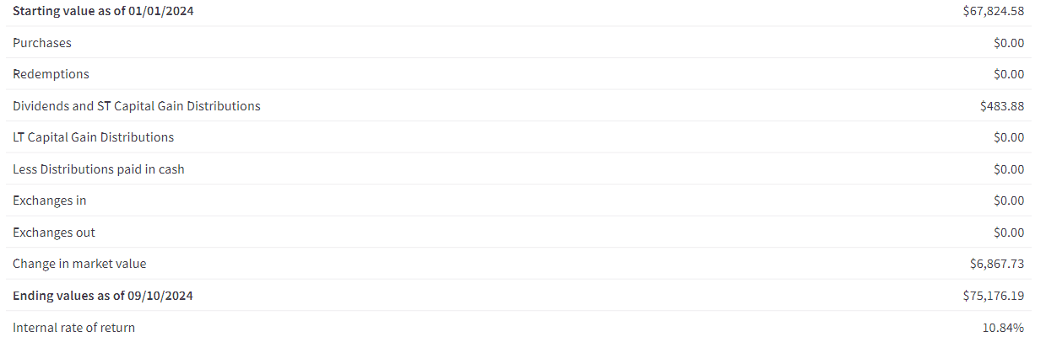
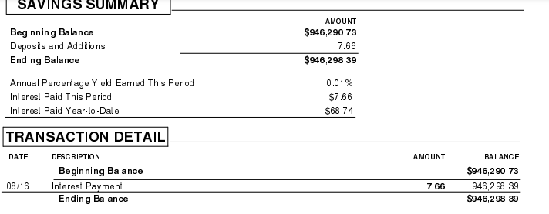
SAVING vs INVESTING

Slide 25
The Rule of 72…
Sometimes called the Bankers Rule
Divide your interest rate into 72 to find the
approximate number of years it takes for money to double!
Years 3% 6% 12%
3%
6%
12%
0
$10,000
$10,000
$10,000
6
12
18
24
30
36
42
48
$20,000
$20,000
$40,000
$80,000
$20,000
$40,000
$160,000
$320,000
$80,000
$640,000
$1,280,000
$40,000
$160,000
$2,560,000

Slide 26
The 80%
Luke 16:10
He who is faithful in a very little thing is also faithful in much; and he who is dishonest in a very little thing is also dishonest in much.
Step 4: Debt Elimination

Slide 27
Debt Elimination
ACKNOWLEDGE: Is there a problem? (justifying with cash back or travel miles)
IDENTIFY: What is the problem? Credit cards, student loans, personal loans, IRS etc….
SOLUTION: Debt Stacking (Eliminates Debt using same monies)

Slide 28
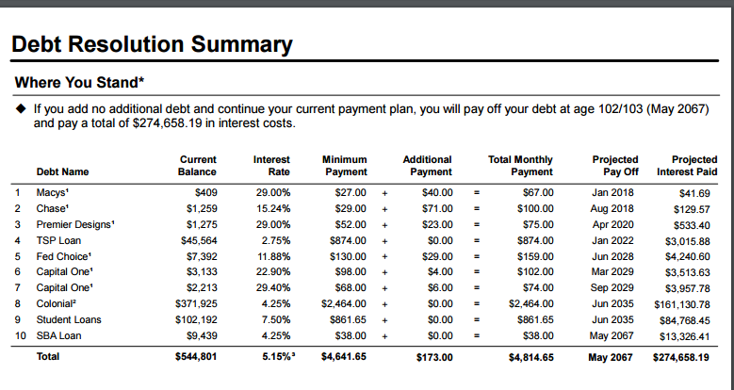

Slide 29
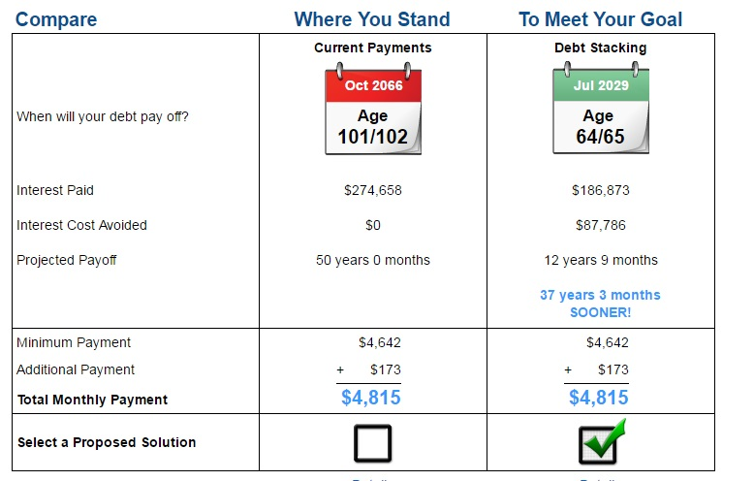

Slide 30
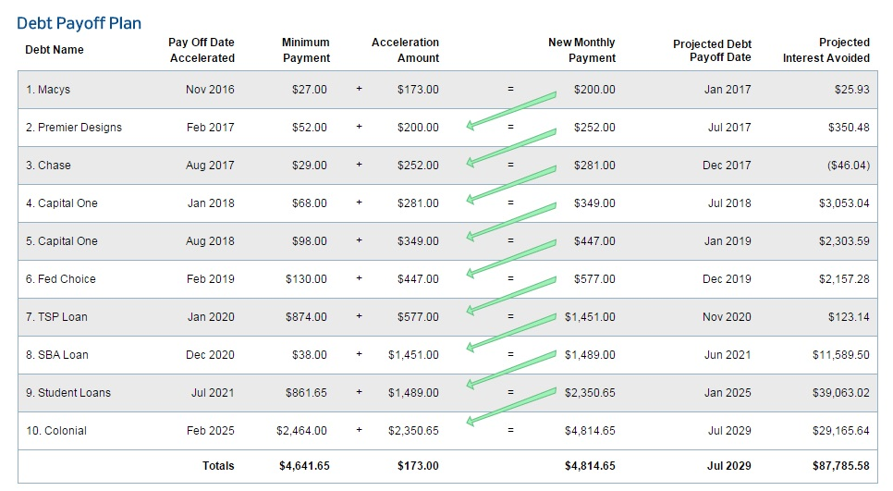

Slide 31
The 80%
Luke 16:10
He who is faithful in a very little thing is also faithful in much; and he who is dishonest in a very little thing is also dishonest in much.
Step 5: budgeting/spending plan

Slide 32
Prioritize Wants vs Needs
Iphone
Cheescake Factory
Ballenciaga’s
Gucci Bag
Ulta Beauty
PS3, PS4, PS5
Apple Earbuds
A Cellphone
Chipotle
Sneakers
A Hand Bag
Target, Walmart, Beauty Supply
A video gaming system
Earbuds

Slide 33
BUDGETING
Do you know the difference between expenses & debts
EXPENSES | DEBTS
RENT CELL PHONE FOOD GAS ELECTRIC INTERNET MOVIES HOBBIES | MORTGAGE CAR LOAN PERSONAL LOAN STUDENT LOAN CREDIT CARDS
10%

Slide 34
60% must do
Giving, Housing, utilities, transportation, groceries, basic needs, savings
30% want to do
dining out, entertainment, hair/nails,
10% nice to do
Travel, house improvement, new car
A Spending
Plan

Slide 35
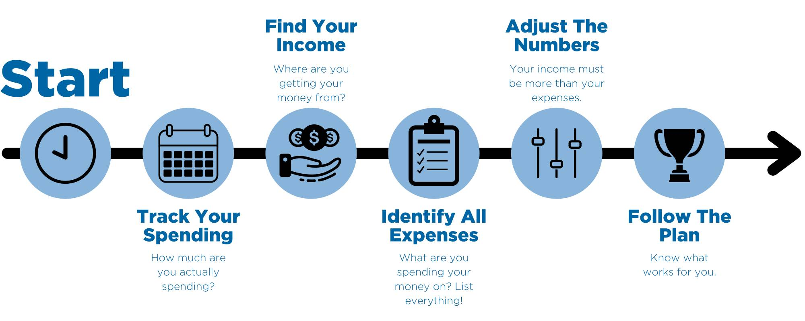

Slide 36
The Story
vs
What is really happening

Slide 37
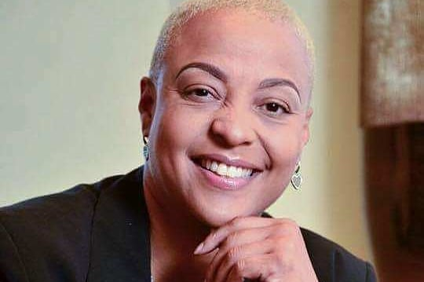

Contact Me:
Complimentary Consultation
Andrea L. Jackson
reidfaithandfinance@gmail.com
www.andrealewan.com
Stewardship: The Other 90% class will start end of October 2024

Slide 38
LET’S PRAY TOGETHER!

Slide 39
The Doors Of The Church Are Open!

Slide 40
Thank You!

Slide 41


Slide 42


