Slide 2
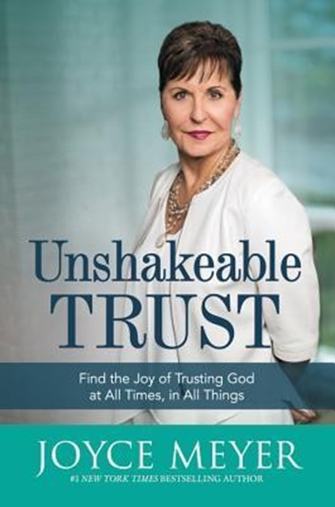
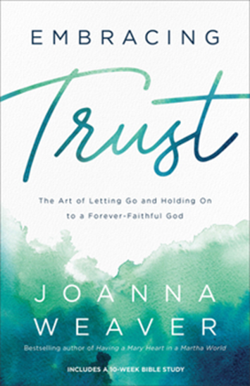

Slide 3
TOTAL TRUST:
“Establishing A Trustworthy Relationship”
DR. MARK E. WHITLOCK, JR.
PASTOR

Slide 4
Prayer
Scripture: Proverbs 31: 10-12
Trust Requires Transparency
Trust Means Keeping Promises
Trust Is Communicating Mistakes To Sustain Accountability
Trust God
Let’s Pray Together
Open The Doors Of The Church/Offering
Thank You!

Slide 5
“WHO CAN FIND A VIRTUOUS WOMAN? FOR HER PRICE IS FAR ABOVE RUBIES. THE HEART OF HER HUSBAND DOTH SAFELY TRUST IN HER SO THAT HE SHALL HAVE NO NEED OF SPOIL. SHE WILL DO HIM GOOD AND NOT EVIL ALL THE DAYS OF HER LIFE.”​
-Proverbs 31:10-12
The Word

Slide 6
HAVING A LOVING SPOUSE IS FAR ABOVE MONEY, MATERIAL POSSESSIONS AND WEALTH. IT IS THE BEST GIFT THAT COMES FROM GOD. IF THEY TRUST EACH OTHER WITH ALL THEIR HEART, THEY'LL HAVE A HAPPY, SATISFYING LIFE.​
HAVING A LOVING SPOUSE REQUIRES TRANSPARENCY, KEEPING PROMISES, EFFECTIVE COMMUNICATION, AND BEING GROUNDED IN GOD’S WORD! ​
THE BIBLE TEACHES us THAT LOVE IS THE FOUNDATION OF ALL RELATIONSHIPS, and that LOVE SHOULD BE CHARACTERIZED BY SELFLESSNESS, KINDNESS, AND TRUSTWORTHINESS.​
JOHN 15:12 “THIS IS MY COMMANDMENT, THAT YE LOVE ONE ANOTHER, AS I HAVE LOVED YOU.​”

Slide 7
Trust
Requires
Transparency

Slide 8
JOHN 3:19-21 “This is the verdict: Light has come into the world, but people loved darkness instead of light because their deeds were evil. Everyone who does evil hates the light, and will not come into the light for fear that their deeds will be exposed. But whoever lives by the truth comes into the light, so that it may be seen plainly that what they have done has been done in the sight of God.​”
TRANSPARENCY IS A FORM OF HUMILITY THAT INVOLVES INVITING OTHERS TO KNOW YOU AS YOU TRULY ARE. ​

Slide 9
TRANSPARENCY INVOLVES SHARING YOUR INTENTIONS, FEELINGS, AND THOUGHTS OPENLY. THIS FOSTERS A SENSE OF OPENNESS AND REDUCES MISUNDERSTANDINGS.​
TRANSPARENCY MEANS BEING VULNERABLE, SHARING YOUR FEARS, INSECURITIES, and CONCERNS. THIS OPENNESS OFTEN LEADS TO DEEPER EMOTIONAL CONNECTIONS AND TRUST.​
TRANSPARENCY REQUIRES TAKING A RISK, IT SIGNALS TO THE OTHER PERSON THAT YOU TRUST THEM ENOUGH TO SHARE YOUR AUTHENTIC SELF.​

Slide 10
Trust Means Keeping Promises
NUMBERS 30:2 “When a man (WOMAN) makes a vow to the Lord or takes an oath to obligate himself by a pledge, he must not break his word but must do everything he said.​”

Slide 11
AS CHRISTIANS, THE HOLY SPIRIT LIVES INSIDE US. God’s POWER IS READY TO TEACH US TO CAREFULLY CONSIDER PROMISES BEFORE WE MAKE THEM. (John 14:26)​
TRUST GROWS WHEN YOU KEEP your PROMISES.
TRUST HAPPENS WHEN YOUR SPOUSE CAN COUNT ON YOU WHEN THEY NEED HELP OR SUPPORT.​
TRUST REQUIRES EMOTIONAL CONSISTENCY! ​
TRUST IS RESPECTING THE OTHER PERSON’S BOUNDARIES, OPINIONS, AND FEELINGS. ​
TRUST MEANS Treating people WITH KINDNESS, PATIENCE, and FAIRNESS.

Slide 12
Trust THROUGH
CommunicatION!

Slide 13
JAMES 1:19: "KNOW THIS, MY BELOVED BROTHERS: LET EVERY PERSON BE QUICK TO HEAR, SLOW TO SPEAK, SLOW TO ANGER.“​
OPEN AND HONEST COMMUNICATION HELPS ADDRESS ISSUES AND PREVENTS MISUNDERSTANDINGS. LISTENING IS AS IMPORTANT AS SPEAKING.​
COLOSSIANS 3:13: "BEARING WITH ONE ANOTHER AND, IF ONE HAS A COMPLAINT AGAINST ANOTHER, FORGIVING EACH OTHER; AS THE LORD HAS FORGIVEN YOU, SO YOU ALSO MUST FORGIVE.“​

Slide 14
ESTABLISHING TRUST REQUIRES FORGIVENESS.​
ESTABLISHING TRUST REQUIRES CLEAR COMMUNICATION WHICH PREVENTS MISUNDERSTANDINGS. EXPRESS YOUR NEEDS, THOUGHTS, AND CONCERNS DIRECTLY, AND LISTEN ATTENTIVELY TO THE OTHER PERSON'S PERSPECTIVE.​
ESTABLISHING TRUST REQUIRES ACTIVE LISTENING WHICH SHOWS RESPECT AND MAKES THE OTHER PERSON FEEL VALUED. AVOID INTERRUPTING AND TRY TO UNDERSTAND THEIR POINT OF VIEW.​

Slide 15
Trust God!

Slide 16
TRUSTING GOD MEANS THAT WE CAST OUR CARE ON GOD WHEN CHOOSING A SPOUSE, BUT IT DOES NOT MEAN THAT WE CAST OUR RESPONSIBILITY AWAY! WE MUST DO OUR PART!!!
EPHESIANS 5:25-29 “HUSBANDS, LOVE YOUR WIVES, EVEN AS CHRIST ALSO LOVED THE CHURCH, AND GAVE HIMSELF FOR IT; THAT HE MIGHT SANCTIFY AND CLEANSE IT WITH THE WASHING OF WATER BY THE WORD, THAT HE MIGHT PRESENT IT TO HIMSELF A GLORIOUS CHURCH, NOT HAVING SPOT, OR WRINKLE, OR ANY SUCH THING; BUT THAT IT SHOULD BE HOLY AND WITHOUT BLEMISH. SO OUGHT MEN TO LOVE THEIR WIVES AS THEIR OWN BODIES. HE THAT LOVETH HIS WIFE LOVETH HIMSELF. FOR NO MAN EVER YET HATED HIS OWN FLESH; BUT NOURISHETH AND CHERISHETH IT, EVEN AS THE LORD THE CHURCH.”

Slide 17
TRUST GOD TO FIND A TRUSTWORTHY RELATIONSHIP. PROVERBS 18:22 "HE WHO FINDS A WIFE FINDS WHAT IS GOOD AND RECEIVES FAVOR FROM THE LORD."​
TRUST GOD TO COMMIT YOUR WAY TO THE LORD. PSALM 37:5 “COMMIT THY WAY UNTO THE LORD; TRUST ALSO IN HIM; AND HE SHALL BRING IT TO PASS.”​
TRUST GOD TO BE STILL BEFORE THE LORD AND WAIT PATIENTLY FOR HIM. PSALM 37:7 “REST IN THE LORD, AND WAIT PATIENTLY FOR HIM: FRET NOT THYSELF BECAUSE OF HIM WHO PROSPERETH IN HIS WAY, BECAUSE OF THE MAN WHO BRINGETH WICKED DEVICES TO PASS.​”
​

Slide 18
LET’S PRAY TOGETHER!

Slide 19
The Doors Of The Church Are Open!

Slide 21
Thank You!

