Slide 2
THE PURPOSE AND PRIORITY OF PRAYER:
THE GENESIS OF PRAYER!

Slide 3
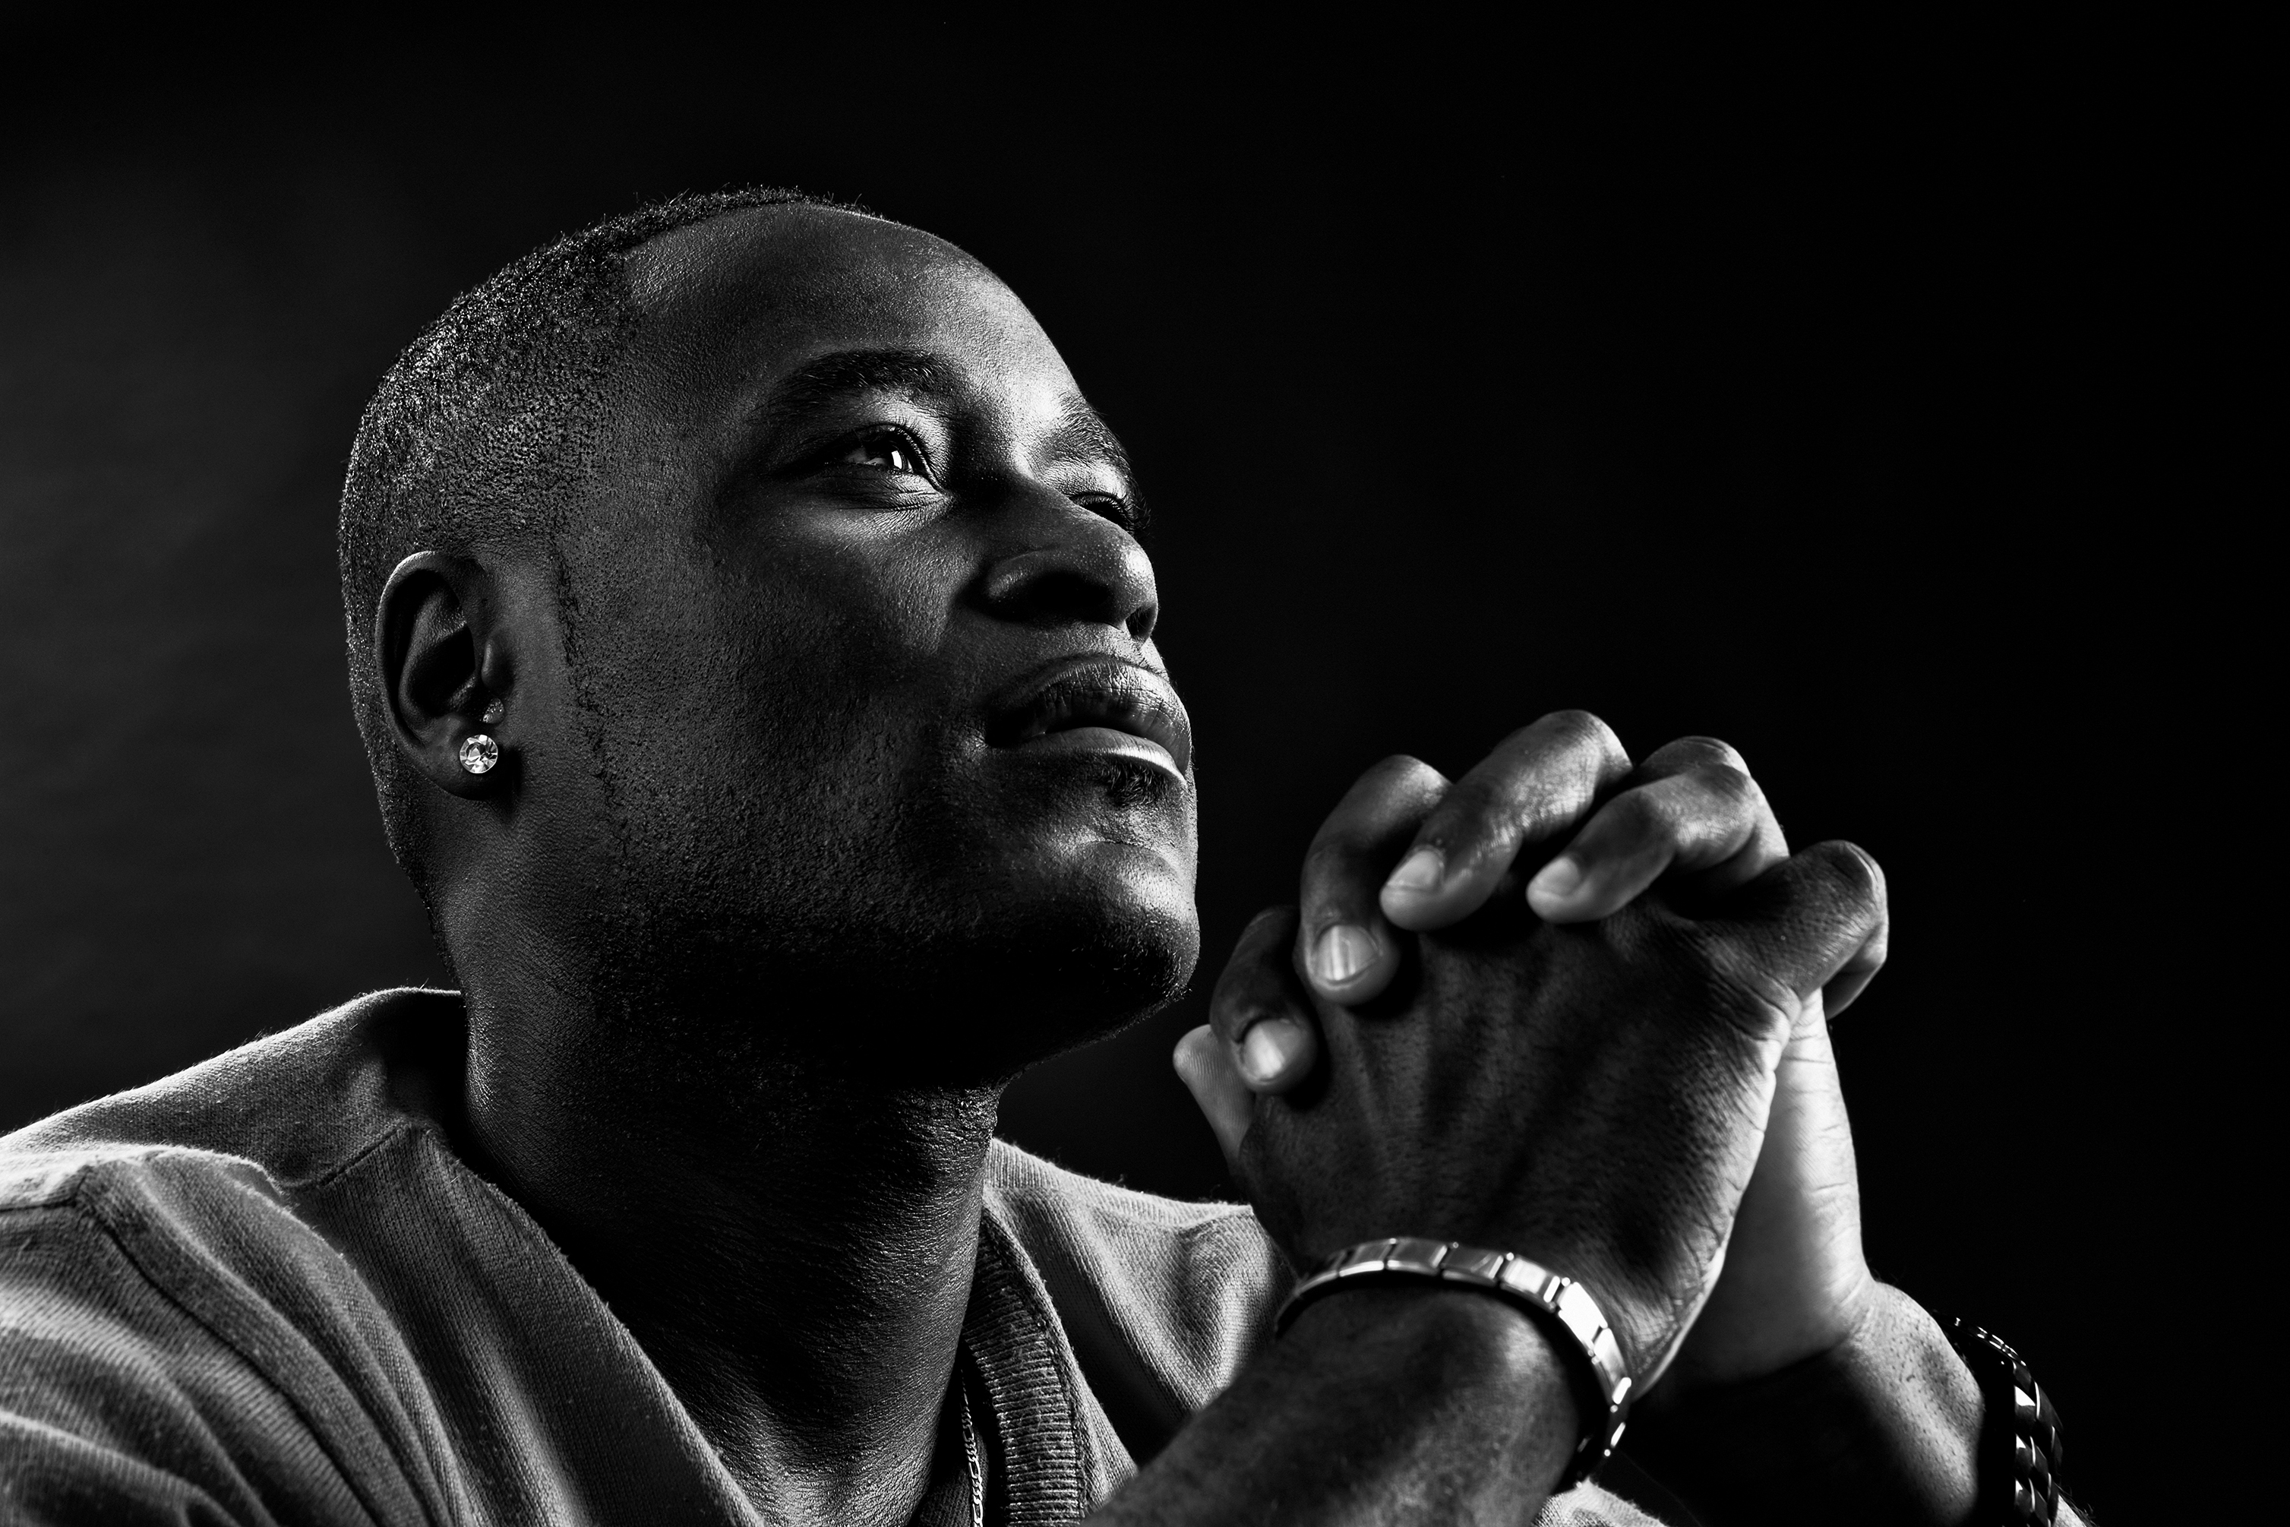
COURSE OBJECTIVES:
THE GENESIS OF PRAYER!
Prayer
The WORD: Isaiah 14:24; Psalm 33:11; Proverbs 19:21; and Genesis 1:26
The Genesis of Prayer
Humanity to Reflect God’s Nature
Humanity to Have Dominion
The Nature of Prayer
God’s Will: The Confidence of Our Prayers
Prayer Exercising the Authority of Dominion
Effectiveness in Prayer with God
Putting Prayer Into Practice
Let’s Pray Together
Open the Doors of the Church/Offering
Thank you!

Slide 4
THE GENESIS OF PRAYER
SCRIPTURAL REFERENCES
Isaiah 14:24 The Lord Almighty has sworn, “Surely, as I have planned, so it will be, and as I have purposed, so it will happen.
Psalm 33:11 But the plans of the Lord stand firm forever, the purposes of his heart through all generations.
Proverbs 19:21 Many are the plans in a person’s heart, but it is the Lord’s purpose that prevails.
Genesis 1:26 Then God said, “Let us make mankind in our image, in our likeness, so that they may rule over the fish in the sea and the birds in the sky, over the livestock and all the wild animals, and over all the creatures that move along the ground.”

Slide 5
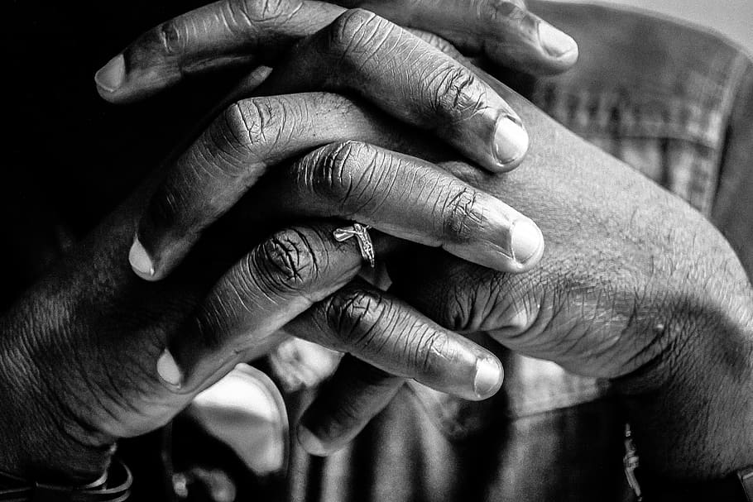
THE GENESIS OF PRAYER!
Prayer is humankind exercising dominion on the earth by giving God the freedom to intervene in earth’s affairs.
When we pray but don’t receive answers to our prayers, we may wonder: “What is the purpose of prayer? Does God do whatever He wants to do, anyway?”

Slide 6
THE GENESIS OF PRAYER!
When we know God’s will, are obedient to it, and ask God to fulfill it, God will grant what we ask of Him.
God does everything for a reason, because He is a God of PURPOSE (Isaiah 14:24; Psalm 33:11; Proverbs 19:21).
God is a God of purpose, and everything He has created in this world has been created to fulfill His purpose (Genesis 1:26)

Slide 7
HUMANITY TO REFLECT GOD’S NATURE!
First, God created humanity to reflect His character and personality (Genesis1:26). This means we were created to have His nature and moral character.
2. God created humanity to establish a relationship of mutual love with God and each other. The only reason we may have fellowship with God is that God made man out of His own essence (John 4:24).
3. God is our creator and father. God wants us to approach Him as a child would a loving father (Deut. 32:6; Pslam103:13).
4. We are dependent on God as our source of strength. We are not self-sufficient. We are intended to reflect on God’s nature in the context of being connected to Him in fellowship (John 4:16).

Slide 8
HUMANITY CREATED TO HAVE DOMINION!
Secondly, God created humanity to carry out His purposes on earth.
He gave humanity free will to plan and make decision, and then to take action to fulfill those plans, just as God did in creating the world. (Genesis 1:26)
Humanity was created not only to have a relationship with God, but also to SHARE in God’s authority. (Psalm 8:6; 115:6)

Slide 9
HUMANITY CREATED TO HAVE DOMINION!
God never intended to rule the earth alone. (1John 4:8)
God created humankind out of His essence, which is spirit. God gave humanity physical bodies manifested in two genders (Genesis 1:27). The purpose of dominion was given to both men and women!

Slide 10
THE NATURE OF PRAYER!
1. Prayer is the expression of humanity’s relationship with God and participation in His purpose.
2. Prayer is an expression of the beloved community and relationship of love with God.
3. Prayer is humanity’s vehicle of the soul and spirit by which humanity communes with the invisible God.
4. Prayer is not optional – When God gave man dominion, He gave him the freedom to legally function as the authority on this planet (Psalm 33:11).
5. Prayer is essential for God’s will to be done in the earth. Prayer is mandatory for spiritual progress and victory in our individual lives and the world at large.

Slide 11
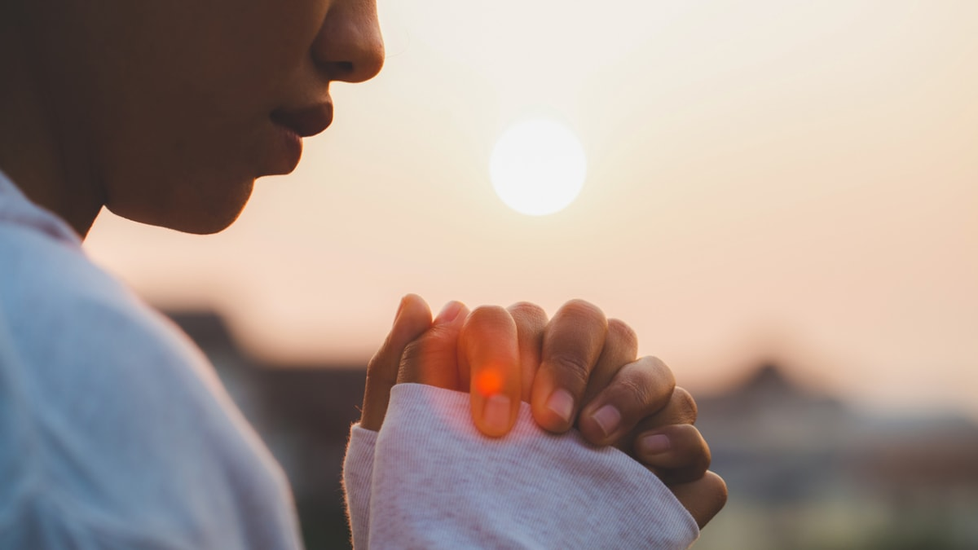
PURPOSE:
THE RAW MATERIAL OF PRAYER

Slide 12
PURPOSE: THE RAW MATERIAL OF PRAYER
God’s desire is for you to WILL HIS WILL! His will is meant to be the backbone and center of your prayers, the source of confidence in supplication, the strength of your fervent and effectual prayers.
Praying does not mean convincing God to do your will BUT DOING HIS WILL THROUGH YOUR WILL!!
Prayer is essential for God’s purpose for your life, His reason for your existence-as a human being in general and as an individual specifically.
Your purpose is the “raw material,” the foundational matter, for your prayer life.
Prayer is calling forth what God has already purposed and predestined-continuing His work of creation and the establishment of His plan for the earth.

Slide 13
GOD’S WILL: THE CONFIDENCE OF OUR PRAYERS
We are not to ask God to do anything outside of what we have been given to do based on our purpose.
We keep praying amiss because we continue to ask for the wrong things. (James 4:3)
If we were to ask for things based on God’s purpose, then we will not become frustrated.

Slide 14
GOD’S WILL: THE CONFIDENCE OF OUR PRAYERS
Jesus always prayed for God’s will to be done, and then worked to accomplish it.
Jesus knew God’s purpose for his life, and he desired to do the will of God and acted on it. (John 17:6, 9-19, 4:34)
Jesus’ assurance in prayer was based on his knowing and doing God’s will (1 John 5:14-15).

Slide 15
PRAYER IS EXERCISING THE AUTHORITY OF DOMINION
When we know God’s will, when we are obedient to it, and when we ask God to fulfill it, God will grant what we ask of Him.
When we pray, we carry out our responsibility to demonstrate what our relationship with the Lord means in terms of living and ruling in the world.
He has given humanity authority over the earth; He REQUIRES prayer from humanity to act on the earth. (Luke 18:1, Matthew 16:19)
We need to pray for God to intervene in human affairs.
Prayer is not an option for the believer! (James 4:2)

Slide 16
EFFECTIVENESS IN PRAYER WITH GOD!
God gave humanity a vast amount of freedom and authority on earth. We must not use this power for anything other than God’s will and purpose.
The rebellion of the first man and woman brought about this distortion of God’s image in humankind and thus attacked God’s plans for the earth.
Humanity used it’s will for self-serving purposes, whereas God’s will is based on love!
True prayer is maintained through oneness of heart and purpose with God. When we pray, we represent God’s interest on earth, and representation requires relationship.

Slide 17
Effective prayer has everything to do with being united with God in a relationship of love, having a heart and mind in union with God’s will, gaining a discerning mind to His purpose, and exercising faith in His word.

Slide 18
PUTTING PRAYER INTO PRACTICE!
ASK YOURSELF:
1. Have I ever neglected to pray because I felt God would do whatever He wanted to do anyway?
2. If the real purpose of prayer is to fulfill God’s purposes on earth, how much do I know about those purposes? How can I learn more about what God’s purposes are?
3. Have I been resisting God’s will in any area of my life?
4. What can I do today to build a deeper relationship of love with God?
5. What is one of God’s purposes that I can begin to agree with Him about prayer today?

Slide 19
LET’S PRAY!!

Slide 20
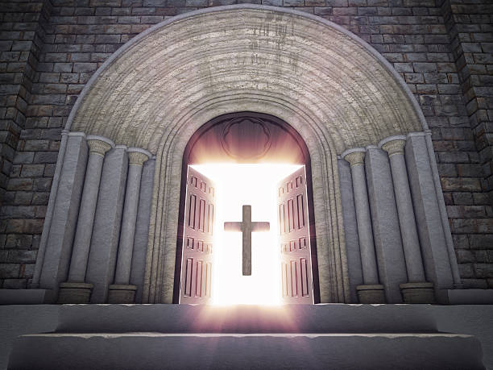
Doors of the church are OPEN: “REID TEMPLE CARES”

