Slide 2
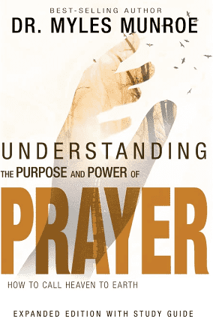
PREPARING FOR PRAYER:
HOW TO ENTER GOD’S PRESENCE!
Dr. Mark E. Whitlock, Jr.
Pastor

Slide 3
COURSE OBJECTIVES!
PRAYER
THE WORD: Matthew 5:17; Hebrews 8:5-5; 9:23
HOW TO ENTER GOD’S PRESENCE
REVERENCE FOR GOD
HOLINESS AND INTEGRITY
THE KINGDOM OF PRIEST
TEN STEPS TO PREPAREDNESS IN PRAYER
PUTTING PRAYER INTO PRACTICE
LET’S PRAY TOGETHER!
OPEN THE DOOR OF THE CHURCH/OFFERING
THANK YOU!

Slide 4
THE WORD!
Matthew 5:17: Think not that I am come to destroy the law, or the prophets: I am not come to destroy, but to fulfil.
Hebrews 8:5: Who serve unto the example and shadow of heavenly things, as Moses was admonished of God when he was about to make the tabernacle: for, See, saith he, that thou make all things according to the pattern shewed to thee in the mount. 6 But now hath he obtained a more excellent ministry, by how much also he is the mediator of a better covenant, which was established upon better promises.
Hebrews 9:23: It was therefore necessary that the patterns of things in the heavens should be purified with these; but the heavenly things themselves with better sacrifices than these.

Slide 5
HOW DO WE ENTER GOD’S PRESENCE AND BEGIN TO PRAY?
HOW TO ENTER
GOD’S PRESENCE!
1. PRINCIPLE – AS BELIEVERS, WE ARE “A CHOSEN PEOPLE, A ROYAL PRIESTHOOD, A HOLY NATION, A PEOPLE BELONGING TO GOD (1 PETER 2:9)​
WE MUST LEARN TO ENTER GOD’S PRESENCE WITH THE RIGHT SPIRIT, APPROACH, AND PREPARATION SO WE CAN COMMUNE WITH HIM AND OFFER EFFECTIVE PRAYERS AS GOD’S PRIESTS.​
THERE IS A DEEPER SPIRITUAL MEANING OF THE OLD TESTAMENT PRACTICES AND RITUALS, WHICH WERE FULFILLED IN JESUS CHRIST (HEBREWS 8:5-6; 9:23). ​
WE MUST UNDERSTAND THE OLD TESTAMENT PRACTICES TO APPRECIATE WHAT THE FULFILLMENT OF THE NEW TESTAMENT MEANS FOR OUR RELATIONSHIP WITH GOD.

Slide 6
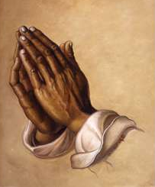
REVERENCE FOR GOD
The term “entering into God’s presence” is often used in the church in reference to worship and prayer.
Most Christians don’t understand what this concept really means. This blocks many prayers.
We have lost reverence from God, the church, ministers, and ministries.
We say, “grace cancels law!” and that two clean sheets don’t make sin. WRONG! But then we pray for God’s immediate forgiveness!!! Praying for grace is not a temporary covering for sinful mess to sin again.
God’s Grace supersedes God’s Law in the sense that only the grace we receive in Christ enables us to fulfill the law. If we don’t value the shed blood of Jesus, then grace will never abound.
God wants a holy relationship, not a transactional religious experience!
Prayer is method of communing with God.
Communion means intimacy with our heavenly father to find out His will, and then do it.

Slide 7
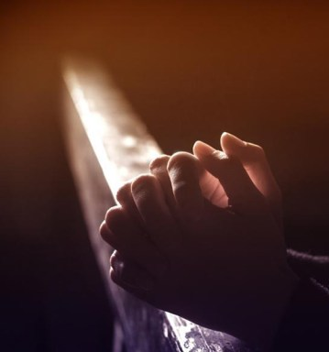
HOLINESS AND
INTEGRITY!
Holiness is critical to prayer – the beatitudes teach holiness
(Hebrews 12:14; Matthew 5:1-8).
Jesus is teaching the attitude to remain in unity with God.
The word holy means to sanctify, set a part, or to be set free from sin. (Leviticus 11:44; 20:8; 26).
What does it mean to see God in relation to prayer? (Exodus. 14:13; 2 Chron. 20:17) God says if you are holy, then I will manifest Myself to you (James 1:5-8).
Sinful behavior is unholy. Unholiness cannot remain in His presence (Leviticus 10:2).
When we go to God in prayer, we must have the same integrity between what we say, and do that God does, because holiness is telling the truth and then living the truth (Jer. 29:13; Gen. 32:24-30). We must believe God answers pray, and not doubt!
Double-mindedness is the opposite of holiness and integrity (James 1:7).

Slide 8
A KINGDOM OF PRIESTS
2. Principle – As God’s priests, we are to intercede for others so they will return to God and be coworkers in His purpose.
God sent prophets to become the kingdom priests, but Israel killed or ignored the prophets.
God raised up a kingdom priest from the line of Abraham and from His own house - Jesus, the third person of the trinity, the son of God, our high priest: (Hebrews 5:4-6).
God and Jesus created a new nation of kingdom priests to heal the world (1 Peter 2:5,9).
We are the new nation of kingdom priest(s), men and women will fulfill God’s original purpose: (Galatians 3:28; Joel 2:28-29).

Slide 9
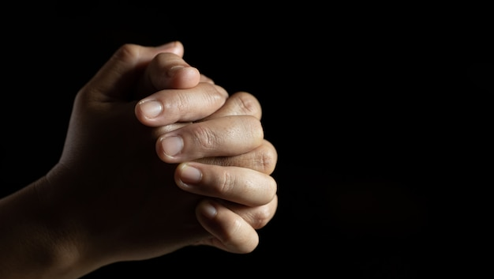
TEN STEPS TO PREPARDNESS IN PRAYER!

Slide 10
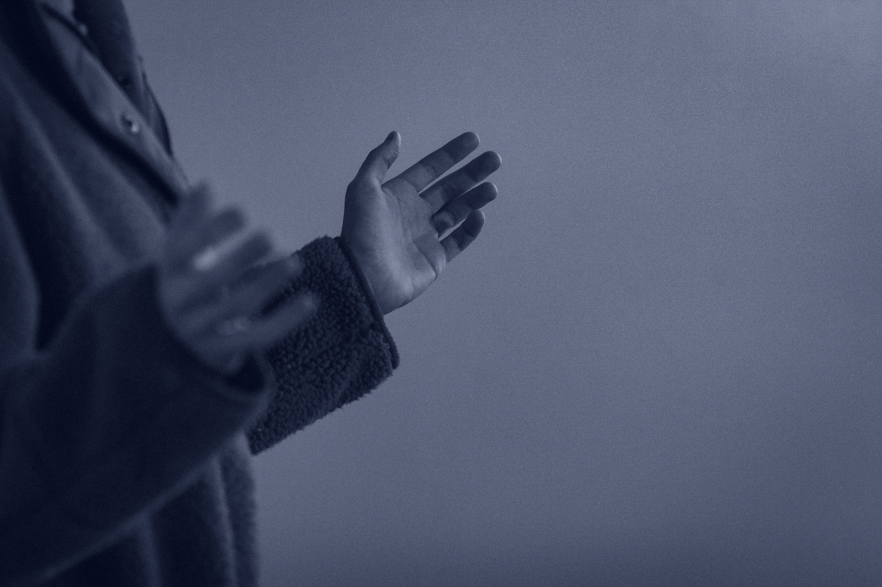
TEN STEPS TO PREPAREDNESS IN PRAYER!
We can learn from Aaron, the first high priest of Israel. Aaron was a model of the spiritual nation of priests who would serve God.
Appropriate God’s grace – Pray for forgiveness of sin (Isaiah 59:2; Psalm 19:3;1 John 1:7-9; Hebrews 9:22, 7:27).
Put on righteousness – Pray for the armor of God (Genesis 3: 17-19; Ephesians 6:11-20; 2 Corinthians 5:21; Galatians 5:25; Isaiah 61:10).
Put on truth and honesty – Pray to remove all secrets ( Leviticus 16:4; Psalm 51:6; Ephesians 6:14; Psalm 24:3-4; Romans 8:3-4).
Cleanse with the Word – Pray for spiritual cleansing by the word (John 15:13; 17:17; Ephesians 5:25-26; Colossians 3:9).
Worship and praise God – Prepare your heart to pray (Leviticus 16:12; John 4:19-24).

Slide 11
TEN STEPS TO PREPAREDNESS IN PRAYER!
6. Separate Yourself – Pray and fast to eliminate distractions (Leviticus 16:17; 9:23-24; 10:1-2; Jeremiah 29:13; Isaiah 58:8).
7. Believe – God answers prayers (Leviticus 16:18-19; Hebrews 7:27; Romans 3:25; 1 Peter 1:18; Hebrews 9:11-14; 1 John 2:2; 1:29; Hebrews 4:16).
8. Give God the glory – Give God the credit and the excess of granted prayers (Leviticus 16:25; Isaiah 42:8; 48:11).
9. Wash in the Word – Washing of God’s appropriate promises (Leviticus 16:26; Philippians 4:6).
10. Remain in the anointing – Remain prepared for prayer ( Leviticus 16:32-34; Hebrews 10:12;
Romans 8;15).

Slide 12
PUTTING PRAYER INTO PRACTICE!
ASK YOURSELF:
In what attitude or manner do I approach God in prayer?
Am I being casual about the sin in my life, without regard for God’s holiness?
Do I think I can get God to hear my prayers by doing good deeds – or do I come to Him through Christ alone?
What does it mean that I am a member of the priesthood of believers?
ACTION STEPS:
Before you pray, review the ten steps of preparedness for entering God’s presence. See what steps you are omitting and which areas you need to set right before God.
Consider your role as a priest, or intercessor, before God on behalf of the world. Let that knowledge guide how you pray.

Slide 13
LET’S PRAY!!

Slide 14
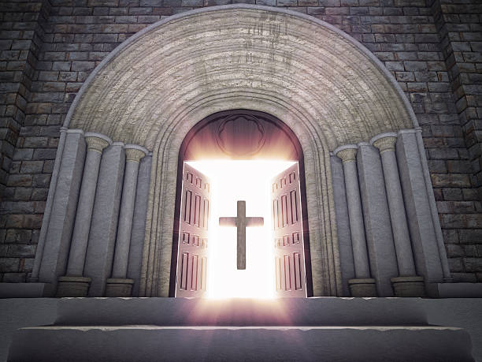
Doors of the church are OPEN: “REID TEMPLE CARES”

