Slide 3
WHAT DOES IT MEAN?
TODAY marks the beginning of Lent, a 40-day period of reflection and prayer in preparation for Easter. It serves as a reminder of human mortality, while also referencing the resurrection of Jesus and the possibility of eternal life.
Ashes are blessed in the church on Ash Wednesday. These ashes are obtained by burning the blessed palms of the previous year. They are used to remind us of our humble origin and of how the body of Adam, was formed out of the clay of the earth; also, to remind us of death, when our bodies will return to dust, and of the necessity of repentance. The tradition of tracing a cross with the ashes on our forehead is meant to identify those who are faithful to Jesus.
“In the sweat of thy face shalt thou eat bread, till thou return unto the ground; for out of it wast thou taken for dust thou art, and unto dust shalt thou return.”
Genesis 3:19 (KJV)

Slide 4
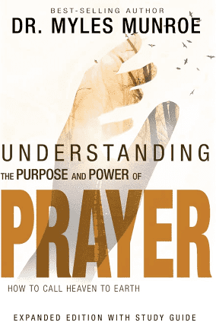
PREPARING FOR PRAYER:
CULTIVATING THE GOD KIND OF FAITH!
Dr. Mark E. Whitlock, Jr.
Pastor

Slide 5
COURSE OBJECTIVES:
Prayer
The Word: Romans 1:17; Galations 3:11; Hebrews 11:6
What is Faith?
The word of Faith
Have the God kind of Faith
God’s faith comes from His word
Putting prayer into practice
Let’s pray together !
Open the doors of the Church/Offering
THANK YOU!

Slide 6
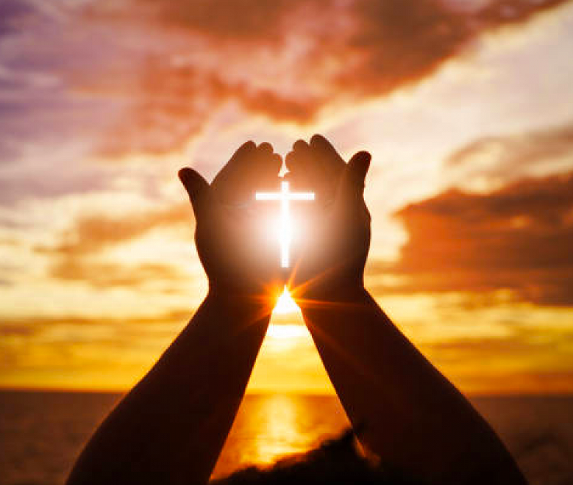
THE WORD!
Romans 1:17: “For therein is the righteousness of God revealed from faith to faith: as it is written, The just shall live by faith”.
Galatians 3:11: “But that no man is justified by the law in the sight of God, it is evident: for, The just shall live by faith”.
Hebrews 11:6: “But without faith it is impossible to please him: for he that cometh to God must believe that he is, and that he is a rewarder of them that diligently seek him”.

Slide 7
Why must we be able to function in the faith the bible speaks of?
Principle – Unanswered prayer has more to do with our having the wrong kind of faith than a lack of faith. (Romans 1:17; Galatians 3:11). Understanding the different kinds of faith, and how faith functions, are key preparations for prayer. Faith is belief.
How does God Himself operate?
2. Principle - Men and women were created in God’s image to pray in the same way He does-through words of faith. (Psalm 33:9; Hebrews 11:3). Having faith means believing and having confidence in the words that you hear.
The word of faith!

Slide 8
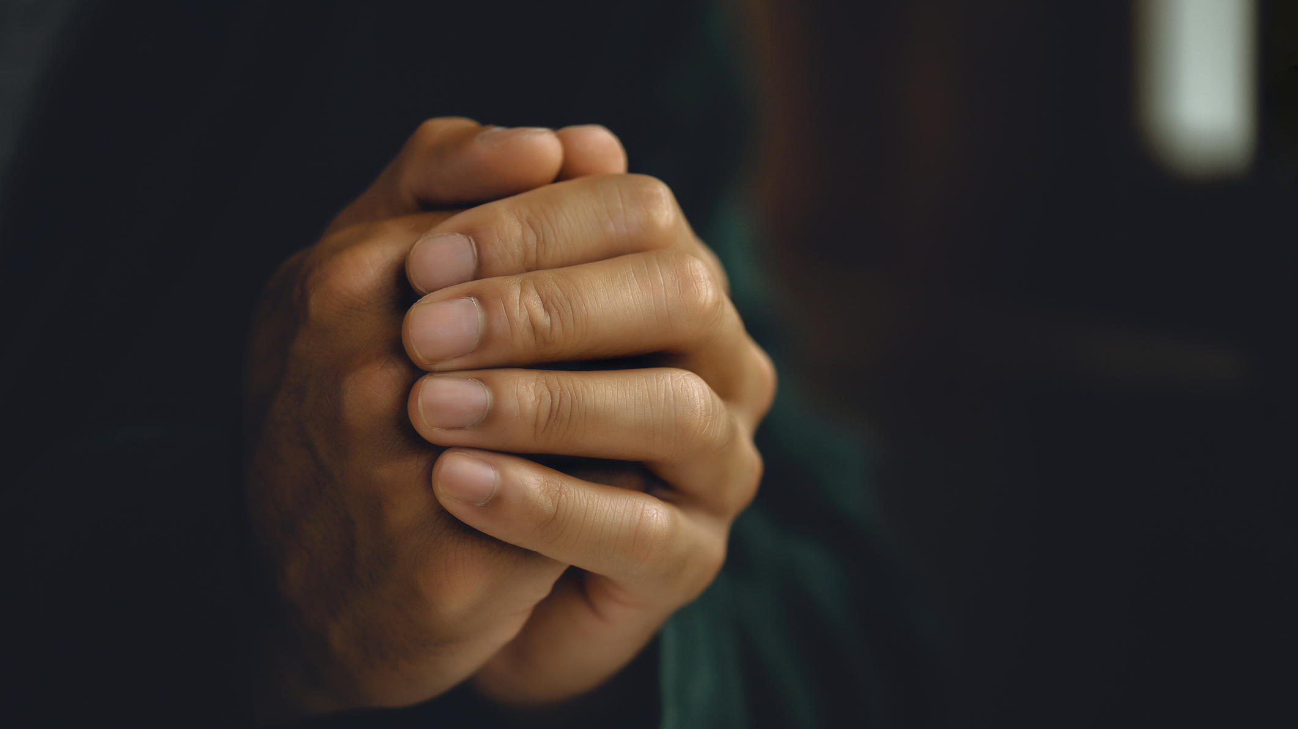
THE WORD OF FAITH!
3. Principle – Faith is active belief. It is a point of action or belief combined with expectation. (Romans 10:6; Matthew 12:34). Be careful who you listen to you because your ears are the gate way to the heart.
4. Principle – Romans 10:8 “The word is near you; it is in your mouth and in your heart.” There is positive faith and there is negative faith, and both come by the same means. They come by what we listen to and believe (James. 1:19). Prayer is nullified negative faith.
What is the one reason God sometimes doesn’t answer our prayers?
5. Principle - Sometimes god doesn’t answer prayers because he understands how powerful the principle of faith is and knows that what we’re asking for wouldn’t be good for us.
Since we were created to operate in the same way God does, what does God’s method of creating the world teach us about the way we are to pray?

Slide 9
HAVE THE GOD KIND OF FAITH!
What is one reason God sometimes doesn’t answer our prayers?
6. Principle – What you pray reflects what is in your heart – of what you believe. What you keep saying the most is what you will receive.
7. Principle – Paul said that the word of faith He wanted to plant in the believers’ hearts was the one he was preaching- the one given by God (Romans 10:8). This is the faith we are to have.
What is the literal translation of Jesus’ statement “have faith in God”?
8. Principle – The literal translation of Jesus' statement, “have faith in God” (Mark 11:22) is, “Have the God kind of faith.”
If you have filled your heart and mind with the word of God, what will this do for you in the times of trouble and adversity?
9. Principle – The God kind of faith comes from hearing the word!

Slide 10
You can be (positively) or (negatively) affected by what you say and believe!
10. Principle - A constant diet of the word of god will nourish your heart. When you experience troubles, it will be the word that comes out of your mouth, and you will create what the word says.
When you pray about something, what are the conditions under which you won’t be “ashamed” concerning it?
11. Principle – The prayer for salvation is “if you confess and hold on to God’s truth, you will not be made ashamed. He will answer.” (Romans 10:10-11.) When we pray and stay connected to the word of god, you will bear fruit in season. (Psalm 1:1-3.)
Why is it important to spend time with other people of faith?
12. Principle – To keep believing, you have to be planted. Plant yourself in a place where the word is prevalent and the people around you are continually speaking and living it.
GOD’S FAITH COMES BY HIS WORD!

Slide 11
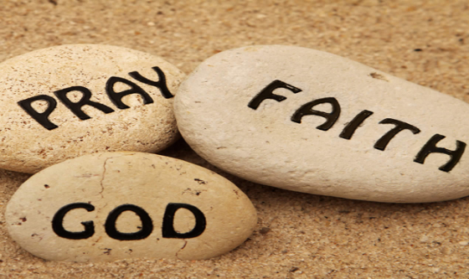
PUTTING PRAYER INTO PRACTICE!

Slide 12
ACTION STEPS!
List any negative thoughts you think or that others say to you during the day. In the evening, review them, and counteract them with what God says in His word.
Start developing the God kind of faith by taking one situation in your life and finding out what God’s word say about it. State your finding, pray about the situation considering them, and hold fast to the Word whenever you are tempted to doubt.
Decrease the amount of time you spend with negative people and increase the time you spend with those who are reading and living out the word. If your souse and children are negative, live in a way that expresses your own faith and speak the word of God on them as you have opportunity.
Challenge: Spend at least as much time in the word this week as you spend doing something else.

Slide 13
LET’S PRAY!!

Slide 14
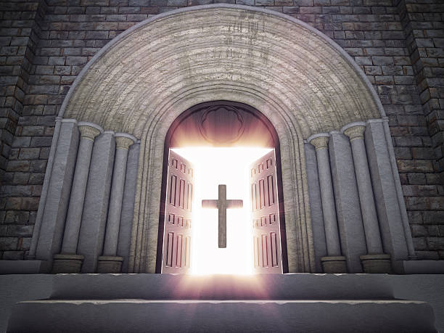
Doors of the church are OPEN: “REID TEMPLE CARES”

