Slide 2
PREPARING FOR PRAYER:
JESUS’ MODEL PRAYER!
Dr. Mark E. Whitlock, Jr.
Pastor

Slide 3
COURSE OBJECTIVES!
PRAYER
THE WORD: Luke 11:1; Mark 1:35, Matthew 18:18
WHAT THE DISCIPLES OBSERVED
THE RESULTS OF INTIMACY WITH THE FATHER
PRAYER DOES NOT COME AUTOMATICALLY
A PATTERN FOR PRAYER
APPLYING GOD’S PRINCIPLES TO YOUR LIFE
LET’S PRAY TOGETHER!
OPEN THE DOORS OF THE CHURCH/OFFERING
THANK YOU!

Slide 4
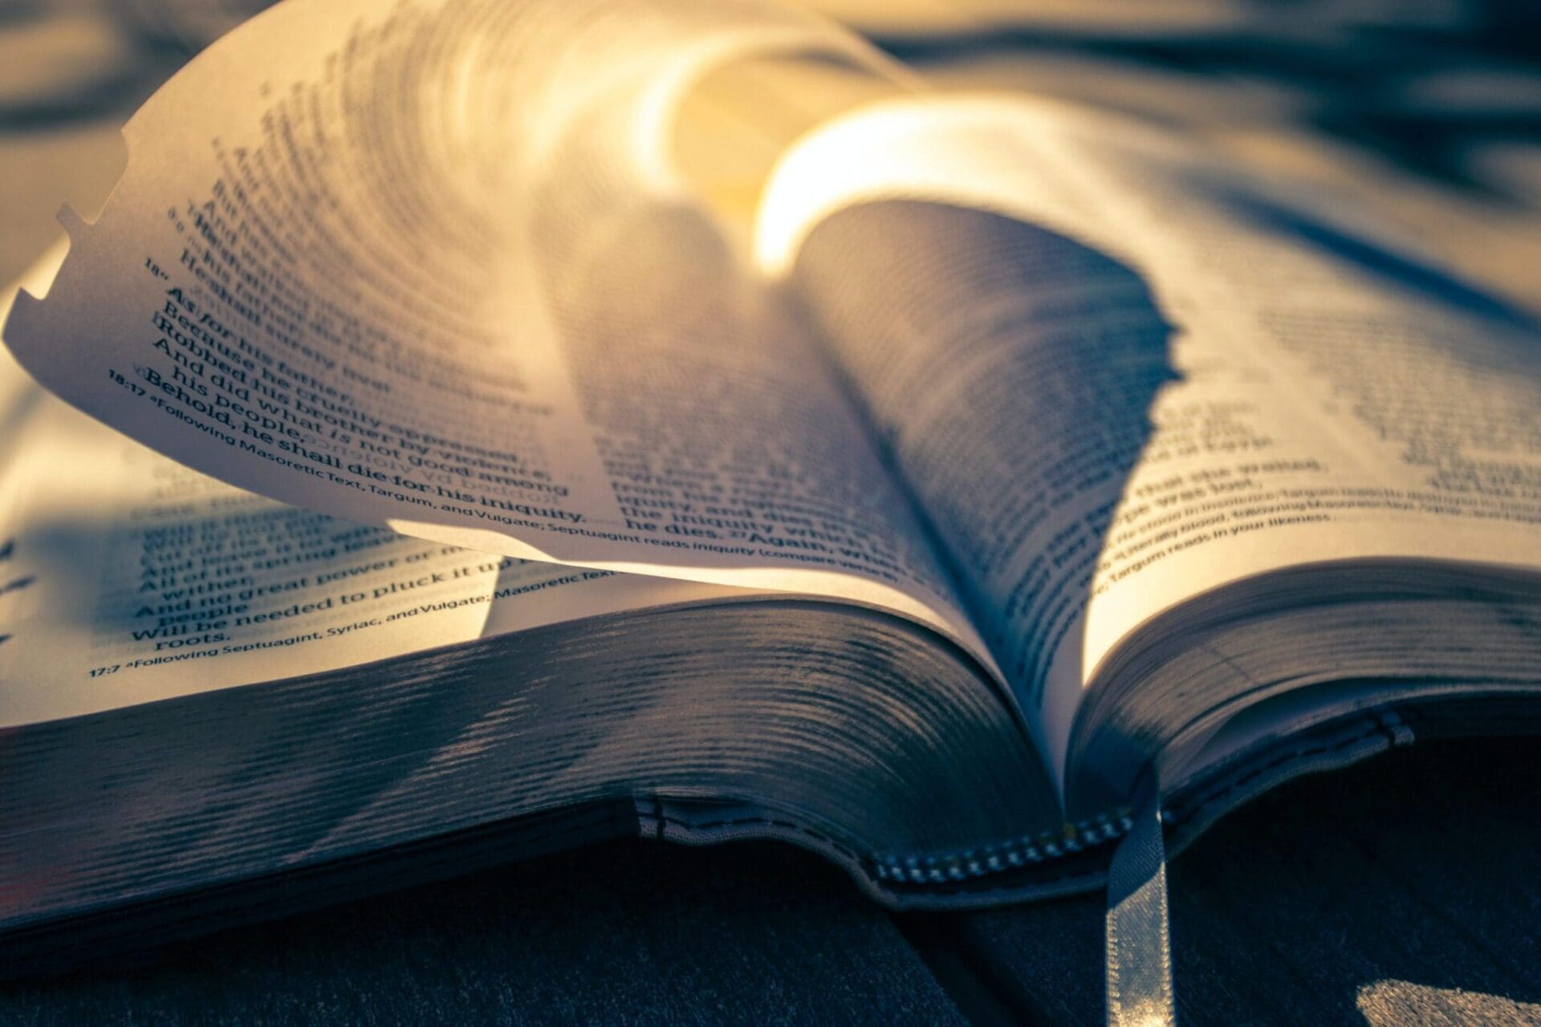
THE WORD!

Slide 5
Luke 11:1 And it came to pass, that, as he was praying in a certain place, when he ceased, one of his disciples said unto him, Lord, teach us to pray, as John also taught his disciples. 2 And he said unto them, When ye pray, say, Our Father which art in heaven, Hallowed be thy name. Thy kingdom come. Thy will be done, as in heaven, so in earth. 3 Give us day by day our daily bread. 4 And forgive us our sins; for we also forgive every one that is indebted to us. And lead us not into temptation; but deliver us from evil.
Mark 1:35 And in the morning, rising up a great while before day, he went out, and departed into a solitary place, and there prayed.
Matthew 18:18 Verily I say unto you, Whatsoever ye shall bind on earth shall be bound in heaven: and whatsoever ye shall loose on earth shall be loosed in heaven.

Slide 6
WHAT THE DISCIPLES OBSERVED!
Principle – Prayer is more important than all the other activities of the day. Through prayer, god gives guidance, wisdom, and discernment for fulfilling his will and purpose.
Mark 1:35 And in the morning, rising up a great while before day, he went out, and departed into a solitary place, and there prayed.
Jesus would spend four to five hours a day in prayer, but only two minutes casting out demons.
The church does the opposite, we spend a few minutes in prayer, but massive hours helping people.
We can never be too busy to pray!
Why did Jesus’ disciples conclude that the prayers that Jesus prayed were even more important than the miraculous things He did during the day?

Slide 7
THE RESULTS OF INTIMACY!
How do we know this pattern should be followed according to God’s purpose for prayer?
Principle - Through His intimacy with the Father, Jesus knew the thoughts and heart of God and manifested in His ministry of what God was doing in the world.
Why did Jesus spend hours in prayer? Hours with God makes minutes with men effective!
We often spend hours discussing national problems with others without producing any solutions. Yet what happens when we spend time in prayer about these problems?
3. Principle - God wants the same communion with us that He had with Jesus, so that we will naturally manifest his works.

Slide 8
PRAYER DOES NOT COME AUTOMATICALLY!

Slide 9
HOW DO YOU LEARN TO PRAY?
They observed Jesus praying- ( the disciples saw him praying)
Ask for Instructions – (the disciples requested to learn how to pray)
Jesus taught them how to pray – (the disciples receive instructions on prayer).
4. Principle - Prayer does not come automatically. It must be learned.
New Christians often don’t know how to pray.
Seasoned Christians often pray incorrectly!
God calls us to equip the saints!
Luke 11:1 One day Jesus was praying in a certain place. When he finished, one of his disciples said to him, “Lord, teach us to pray, just as John taught his disciples.” 2 He said to them, “When you pray, say:

Slide 10
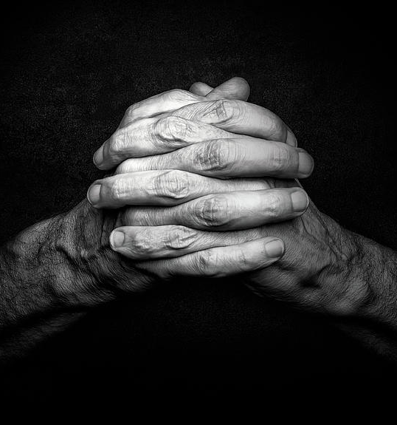
A PATTERN OF PRAYER
Christ taught us to pray to enable us to
fulfill what purpose? GOD’S PURPOSE!
6. Principle - The elements of Jesus’ model prayer are the following:
“Our Father (the Source)”; We bring to God the concerns of others as well as ourselves, acknowledging God as our source. Develop a relationship with others through Christ. The first person of the holy trinity.
“in Heaven”: We admit we need help from outside our earthly realm-that we need God’s help. We depend on Jesus and the spirit as our intermediaries with God. We as humans can’t comprehend heaven. We depend on the Holy Spirit to be our intermediaries with God.
Why did Jesus teach us to pray, “hallowed be Your name?”
“Hallowed be your name”: We worship the Father as the holy one, glorifying all His attributes. We honor Him in our lives and dealings with others. Exodus 20:7 is the greatest name in the universe.
ACKNOWLEDGE GOD IS YOUR ALL IN ALL AND WORSHIP HIM!

Slide 11
A PATTERN OF PRAYER!
“Give us day by day our daily bread”: We ask God to supply the daily needs of others as well as our own and to provide for the process that makes the sustenance possible. We are praying for healthy bodies and a healthy environment, soil, beaches, air and water.
Why did Jesus pray, “And forgive us our sins, for we also forgive everyone who is indebted to us”?
“And forgive us our sins, for we also forgive everyone who is indebted to us”: we forgive others as that god will also forgive us and will hear and answer our prayers.
Jesus is talking about relationships. God forgives those who forgive others. Matt. 6:14-15; 5:23-34; 18:21-22; Heb. 11:6. forgiveness will free your prayers to that they can work. Ps. 66:18 forgive others for God to forgive us.
What is the significance of our praying this concept: “your kingdom come. Your will be done on earth as it is in heaven”?
“Your kingdom come. Your will be done on earth as it is in heaven” we express interest in god’s kingdom and what he wants accomplished before our own interests.
When we pray for daily needs, why are we to pray using the plural, “give us day by day our daily bread”?

Slide 12
A PATTERN OF PRAYER!
“And do not lead us into temptation but deliver us from the evil one”:
We are alert to temptation and weaknesses that satan will exploit to harm our relationship with God. We pray that God will protect us from succumbing to them. Don’t put yourself in harms way. Peter did not remain alert and awake. ( Matt. 26:40-41) put on the armor of God (Eph. 6:11).
What is the significance of completing our prayers with this thought: “for your is the kingdom and power and the glory forever. Amen”?
“For Yours is the kingdom and the power and the glory forever. AMEN”: We worship the Father again, giving Him all the glory in advance for answered prayer.
When we ask God not to “lead us into temptation, but deliver us from the evil one,” does this statement imply that God might deliberately steer us toward temptation? (no…)

Slide 13
APPLYING GOD’S PRICIPLES TO YOUR LIFE!
Did the disciples truly learn Jesus’ secret? YESSSS!!!
Acts 1:14 they all joined together constantly in prayer, along with the women and Mary the mother of Jesus, and with his brothers.
Luke 24:49 I am going to send you what my Father has promised; but stay in the city until you have been clothed with power from on high.”
Acts 2:43 Everyone was filled with awe at the many wonders and signs performed by the apostles.

Slide 14
ACTION STEPS! WHAT’S NEXT?
Use Jesus' model prayer as a guideline for your daily prayer. Take each step and personalize it so that is a heartfelt expression of our growing relationship with God.
Over the next few weeks, increase the time you spend with God in prayer each day to build and maintain a relationship of intimacy with Him.

Slide 15
LET’S PRAY!!

Slide 16
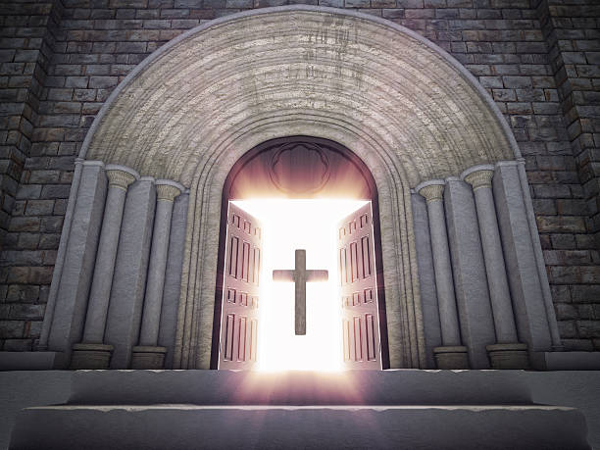
Doors of the church are OPEN: “REID TEMPLE CARES”

