Slide 2
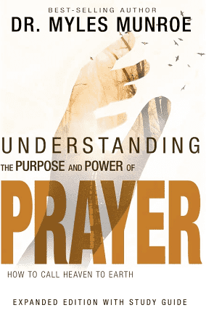
THE PURPOSE AND PRIORITY OF PRAYER:
DOES PRAYER REALLY WORK?

Slide 3
COURSE OBJECTIVES: THE PURPOSE AND PRIORITY OF PRAYER: DOES PRAYER REALLY WORK?
I. PRAYER
II. DISCUSSION ON “IF YOU PRAY, WHY WORRY?”
III. THE WORD: LUKE 18:1; MARK 11:24, MATTHEW 6:7; JOHN 10:10; JOHN 11:41
VI. DOES PRAYER REALLY WORK?
V. CONSEQUENCES OF UNANSWERED PRAYERS
VI. THE MISUNDERSTOOD ART OF PRAYER
VII. THE PATHWAY TO PRAYER
VIII. PUTTING PRAYER TO PRACTICE
XI. LET’S PRAY TOGETHER
X. THE DOORS ARE OPEN!/OFFERING
XI. THANK YOU!!

Slide 4
SCRIPTUAL PATHWAY TO PRAYER!

Slide 5
SCRIPTUAL PATHWAY TO PRAYER!
LUKE: 18:1– “ And He Spake a parable unto them to this end, that men ought always to pray, and not to faint;”
MARK 11:24– “Therefore I say unto you, what things soever ye desire, when ye pray, believe that ye receive them, and ye shall have them.”
MATTHEW 6:7– “But when ye pray, use not vain repetitions, as the heathen do: for they think that they shall be heard for their much speaking.”
JOHN 10:10– “The thief cometh not, but for to steal, and to kill, and to destroy: I come that they might have life, and that they might have it more abundantly.”

Slide 6
SCRIPTUAL PATHWAY TO PRAYER!
JOHN 11:41– “ Then they took away the stone from the place where the dead was laid. And Jesus lifted up his eyes, and said, Father, I thank thee that thou hast heard me. 42. And I knew that thou hearest me always: but because of the people which stand by I said it, that they may believe that thou hast sent me.”

Slide 7
DOES PRAYER REALLY WORK?
Prayer is one of the MOST misunderstood arts of the human experience.
Prayer is a lonely experience for many of us because of unanswered prayers.
Unanswered prayers are a major obstacle that stands in the way of a life of true faith!
For some, the practice of prayer is merely a religious exercise, one that isn’t concerned with obtaining results from prayer.
Our disappointing experiences with prayer have caused some to question: “Will God’s word do what it says it will do?”

Slide 8
CONSEQUENCES OF UNANSWERED PRAYERS
Some of us have lost our FAITH because of unanswered prayers.
We feel ABANDONED and ISOLATED from God, imagining that he doesn’t care about our problems and doubting his love.
We question God’s character and integrity and begin to DISTRUST God.
We feel as if our lives are very unsettled and unstable; therefore, we begin to rely on ourselves, or others INSTEAD of God.
We come to PREMATURE conclusions about ourselves, our prayers, and we don’t learn the principles and truths concerning prayer.
We DOUBT our callings as God’s intercessors, so that we ABANDON a major purpose of God for our lives.
JOHN 21:15 says, “ What is the Almighty, that we should serve him? And what profit should we have, if we pray unto him?”

Slide 9
THE MISUNDERSTOOD
ART OF PRAYER!

Slide 10
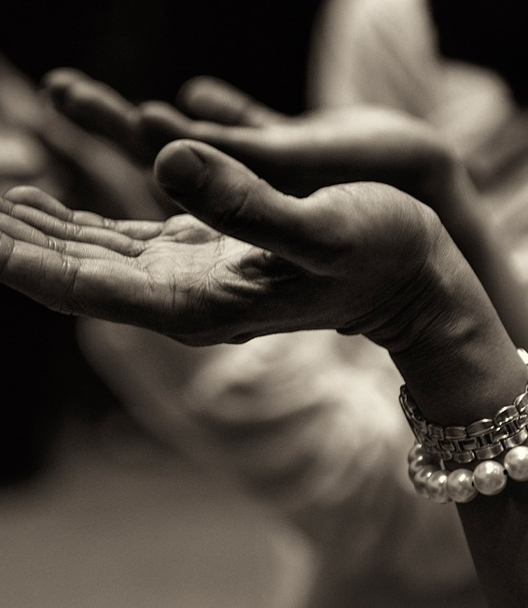
THE PATHWAY TO PRAYER
First, we must realize that when prayer does not bring results, it is an indication that something is wrong. When prayers aren’t answered, the word of God provides an indication of why it was not answered, giving insight into the kind of prayers God responds to, and points out what can inhibit our prayers. (LUKE 18:1)
Secondly, God is faithful to answer prayer. Jesus gives the assurance that God does hear and answer our prayers. (MARK 11:24)

Slide 11
THE PATHWAY TO PRAYER
Third, God’s will and word do work when they are understood and put into practice. Trust prayer to do the following:
Build intimacy with God
Honor his nature and character
Cause respect for his integrity
Enable belief in his word
Bring trust in his love
Affirm his purpose and will
Appropriates his promises

Slide 12
THE PATHWAY TO PRAYER
Prayer is MEANT to be answered- or God would not ask us to pray! He isn’t interested in wasting your time and efforts. He is interested in results, not just “many words” spoken in prayer. (MATT 6:7)
Jesus expected God to hear his prayer. We need to know HOW to approach God to learn the kind of prayers God responds to.
We need to pray as Jesus prayed.
(JOHN 11:41-42)
Praying without understanding and applying the truth and principles or prayer is INEFFECTIVE. God knows we have limited understanding of himself and his ways, and that we struggle with our fallen nature.
Therefore, at times, we will withhold answers to prayer so we will seek him and the principles of prayer that are essential for praying according to his will. (JOHN 10:10)

Slide 13
PUTTING PRAYER INTO PRACTICE!!
As we learn about prayer, our greatest temptation will be to acquire knowledge about prayer without putting it into practice.
Respond to the questions and actions steps by asking yourself:
How often do I pray?
Is prayer a mystery to me? Are there aspects of prayer that are confusing or unclear to me?
Have I experienced unanswered prayers? How has that made me feel about prayer, about God, and myself?
Am I powerless, lack direction, have little victory over sin, poor spiritual progress, a weak witness, unfruitful ministry, poverty, or other similar problems?
How would answered prayers make a difference in my life?

Slide 14
LET’S PRAY TOGETHER!
COME TO THE ALTAR TO PRAY AND CONFESS YOUR SINS.

Slide 15
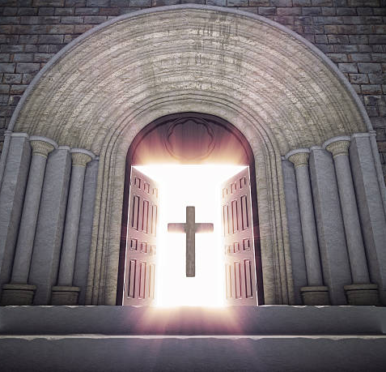
DOORS OF THE CHURCH ARE OPEN:
“Reid Temple Cares!”

