Slide 2
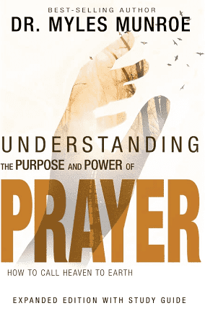
PRINCIPLES FOR PRAYER:
TWELVE ACTION STEPS TO PRAYER!
PART TWO
Dr. Mark E. Whitlock, Jr.
Pastor

Slide 3
COURSE OBJECTIVES!
PRAYER
THE WORD: Hebrews 6:13
SECURE THE PROMISES
PLEAD THE CASE
BELIEVE
GIVE THANKS
LIVE IN EXPECTATION
PRACTICE ACTIVE BELIEF
PUTTING PRAYER INTO PRACTICE
LET’S PRAY TOGETHER
OPEN THE DOORS OF THE CHURCH/OFFERING
THANK YOU!

Slide 4
THE WORD!
In this chapter, the principles that follow were developed from evaluating the prayer lives of Jesus, Abraham, Joseph, Moses, David, Ezekiel, and others in the bible. When you study these biblical figures, you see that they all used a similar pattern in prayer. Their prayers receive the attention of God and produced powerful results.
From Genesis to Revelation, we read of normal people that received the promises of God through prayer. These promises are sealed by the highest authority, God's Word.
In Hebrews 6:13 it says, “For when God made a promise to Abraham, since he had no one greater by whom to swear, he swore by himself.”
There are over 7,000 promises of God in the Bible!
God is obligated to fulfill His promises!

Slide 5
2 Corinthians 1:20 For no matter how many promises God has made, they are “Yes” in Christ. And so through him the “Amen” is spoken by us to the glory of God.
7. Principle – Secure the Promise: When you petition the Lord, take God’s promises before him, applying them to the specific request you are making. Then hold unto God promises.
God answers specific requests based on his promises. Blind Bartimaeus was healed because he asked for healing based on his legal rights. He cried out, ‘son of David” Mark 10:ii47-48). Jesus ask, “ what do you want me to do for you?” Jesus had people tell him what they wanted. The man deserved healing because he petitioned specifically through the promises. He reasoned, that every covenant promise God made to Abraham can come through Jesus!
The woman who was bent over. Jesus then set his eyes on her, put hands on her, and healed her. The bible says, “immediately she straightened up and praise god” (Luke 13:13-16).
Jesus healed her because, in the legal contract God had made with his chosen people on behalf of Abraham, he had said, “the Lord will take away from you all sickness” (Deut. 7:15).
We ask God to heal because we’re hurting, and he does because we give him evidence of his promises.
SECURE THE PROMISES!

Slide 6
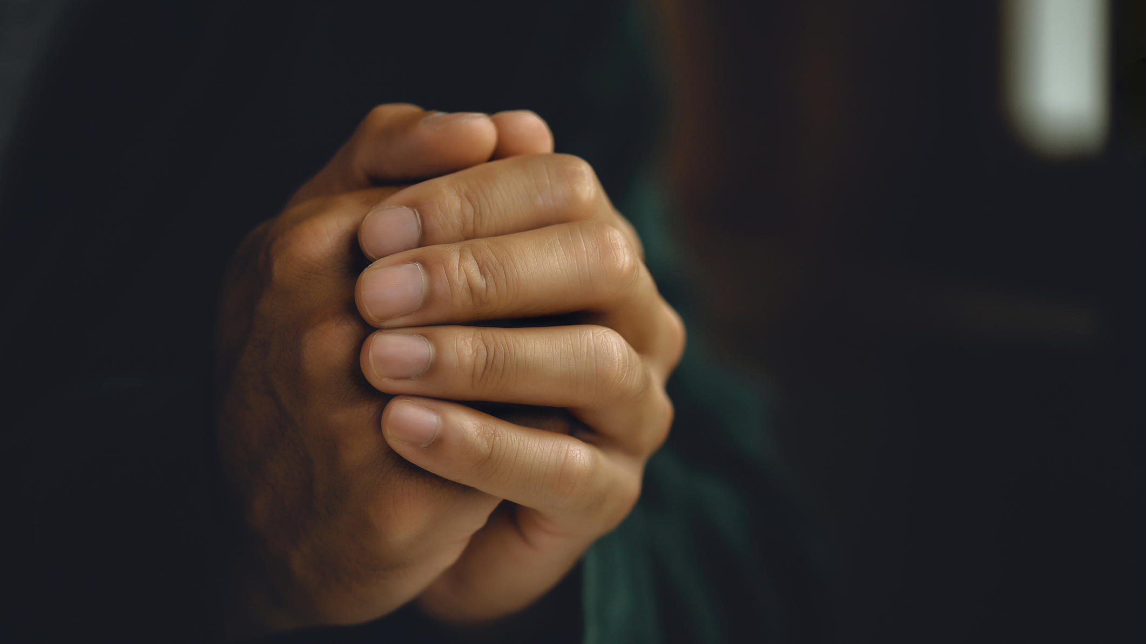
PLEAD THE CASE!
8. Principle – Plead the case: don’t beg or moan before god but pray intelligently because you rightfully deserve the answer based on God’s promises.
In Luke 18, Jesus teaches how to get a prayer through in the story of the unjust judge and widow woman. God illustrates that we are to depend on God.
He began by saying, “In a certain town there was a judge who neither feared god nor cared about men” (v. 2). “And there was a widow in that town who kept coming to him with the plea, ‘Grant me justice against my adversary’” (v. 3).
The is man grants mercy because of her nagging, not because He cared.
An answer to prayer is not because of liking you, but because of faith in His promises and righteous living; and God is holy; therefore, keeps his word.
Keep on praying!!! Faith is Believing in the promises of God!
Next, let’s look more closely at what it means to plead. Pleading the case does not mean begging to people who like or dislike you. We spend too much energy on emotions and feelings!

Slide 7
BELIEVE!
When we ask God for something according to His word, what should our attitude be concerning our request? Never give up too soon!
9. Believe: Believe right at the time you are asking that you have the answer to your request, and you will receive it. Yet, asking, in itself, doesn’t cause you to receive.
Mark 11:22 “Have faith in God,” Jesus answered. 23 “Truly[a] I tell you, if anyone says to this mountain, ‘Go, throw yourself into the sea,’ and does not doubt in their heart but believes that what they say will happen, it will be done for them. 24 Therefore I tell you, whatever you ask for in prayer, believe that you have received it, and it will be yours.
The text uses the past tense “-ed” on “received”. When you ask, believe right then and there that you have already receive it.
Daniel prayed. The same day he prayed; the answer was on the way. Daniel did not know that. (Daniel 10:10-14; 9:23) He kept praying and 21 days later the prayer was answered. We must believe that you have received what you asked for, it will be yours. (Mark 9:24; James 1:5-7)

Slide 8
After you have believed, offer thanksgiving again. There is a progression in prayer.
10. Principle- Give thanks: Thank God for what you don’t yet see because you believe it is already done.
The first thanksgiving expresses your appreciation for God’s forgiveness and mercy.
The second thanksgiving is he highest form of faith. You thank God for what you don’t see because you believe it is already done.
Don’t block your prayers. Start giving thanks and thank God until the answer manifest itself.
Hebrews 1:14 Are not all angels ministering spirits sent to serve those who will inherit salvation? Thank God for what is going to be manifested.
GIVE THANKS!
We usually give up too soon when we don’t see immediate answers to our prayers, but what will happen if we have the highest form of faith?

Slide 9
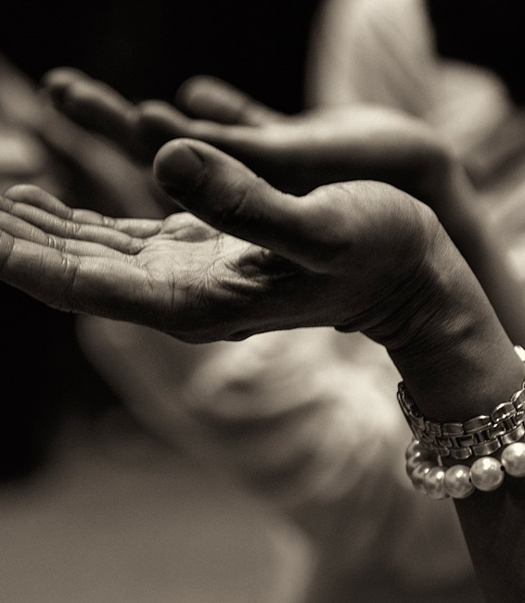
LIVE IN EXPECTATION!
11. Principle – Live in Expectation: Anticipate the answer to your prayers by preparing the way for them.
Matthew 7:7 “Ask and it will be given to you; seek and you will find; knock and the door will be opened to you. 8 For everyone who asks receives; the one who seeks finds; and to the one who knocks, the door will be opened.
Live in expectation. If you asked God to provide you can believe God heard you!
If you don’t expect, that means you don’t believe.
Ephesians 3:20 Now to him who is able to do immeasurably more than all we ask or imagine, according to his power that is at work within us.
Continuing the spirit of thanksgiving by living in expectation of the answer to your prayer. Don’t forget what you have prayed. Live in expectation of approval!

Slide 10
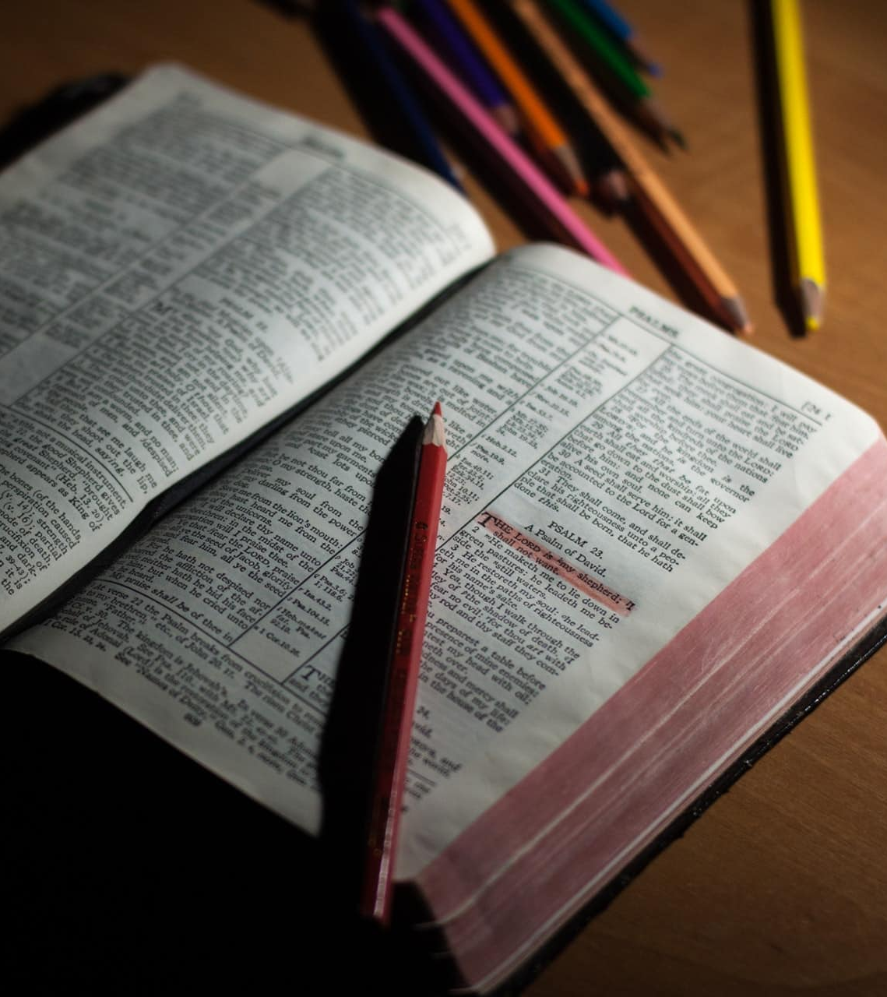
PRACTICE ACTIVE BELIEF!
What does it mean for us to actively believe?
12. Principle-Practice Active Belief: Don’t stop after you have prayed. Get up and look for what you asked for. If you seek and knock, it will come to pass.
In Luke 11:1, the disciples asked, “Lord, teach us to pray,” Jesus provided a model. He teaches to live in expectation of the answer!
Luke 11:9 “So I say to you: Ask and it will be given to you; seek and you will find; knock and the door will be opened to you.

Slide 11
PRACTICE ACTIVE BELIEF!
Jesus Is telling us, “don’t stop believing after you pray. Don’t start doubting…double down on believing.
Get up and go look for what you ask for.
Live in Expectation.
Therefore, practice active belief and continue to live before God in holiness and truth. God will bless you as ask, seek, and knock.
This is the meaning of active prayer.

Slide 12
ACTION STEPS!
This week, gradually begin incorporating the six steps into your prayers.
If you have been justifying wrongdoing in your life, agree with God that it is a sin and truly repent by turning from it and asking God to cleanse you from all unrighteousness.
Take one thing you are praying for, start living in expectation of it, and practice active belief.
According to God’s word it will happen, and plans for the answer.

Slide 13
LET’S PRAY!!

Slide 14
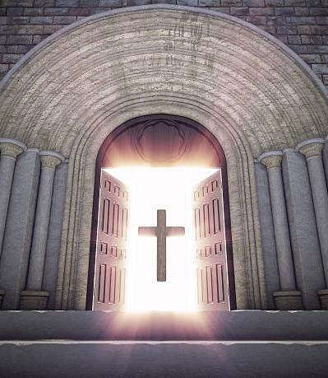
Doors of the Church are OPEN:
“REID TEMPLE CARES”

