Slide 1
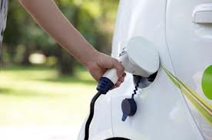
Refueling to Go Higher in God
Dr. Mark E. Whitlock, Jr.
Reid Temple AME church

Slide 2
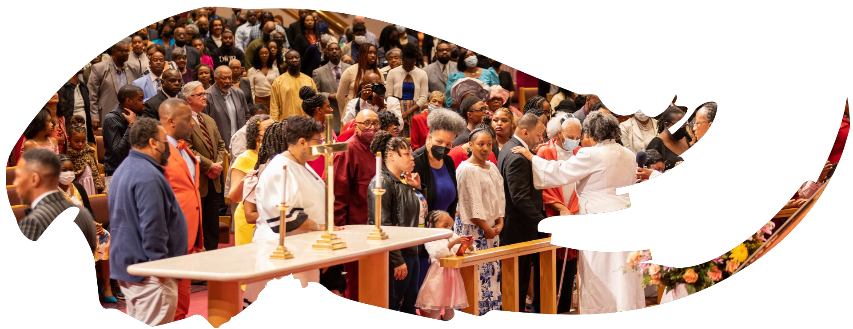
Our Core Values
Faith in GOD
Integrity, Trust and Ethical Behavior
Empowering people
Excellence and Innovation
Christ –centered Leadership

Slide 3
The Vision
Reid Temple AME Church is “Building the Beloved Community” by becoming a Bible Believing, Christ-centered, Family – Integrated, Multigenerational, Culturally aware church, spreading the gospel of Jesus Christ.

Slide 4
Our Strategic Goals
Membership Growth
Debt Free for Thee
Motivated and Skilled Staff & Volunteers
Community Commitment
New Demographic & Market Penetration

Slide 5
Overall Goals for 2023 -2024
Increase attendance to Bible Study
Increase baptisms
Increase the number of tithers
Increase the number of Disciples
Increase the number of servant leaders
Increase member and community engagement

Slide 6
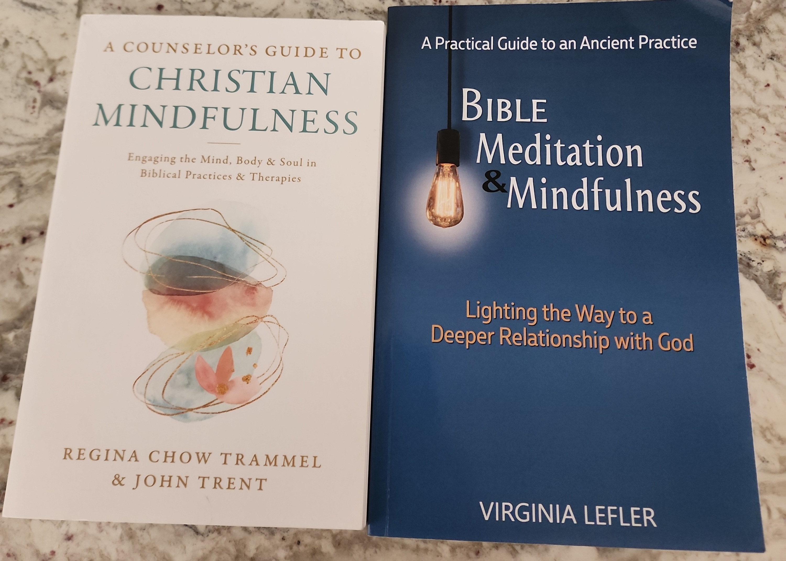

Slide 7
Refueling to Go Higher in God
Dr. Mark E. Whitlock, Jr.
Reid Temple AME church

Slide 8
Course objectives: Refueling to Go higher in god!
Prayer
Scriptures
Burnout is real
How to avoid Burnout!
Scriptures to refuel and refill
Let’s pray at the altar
Salvation and Offering
Thank you….

Slide 9
God’s Word
Ephesians 5:18 And be not drunk with wine, wherein is excess; but be filled with the Spirit; 19 Speaking to yourselves in psalms and hymns and spiritual songs, singing and making melody in your heart to the Lord; 20 Giving thanks always for all things unto God and the Father in the name of our Lord Jesus Christ;

Slide 10
Burnout is Real…
Burnout is a result of:
Over-commitment (always in motion);
Inadequate breaks and rest (continuous ministry involvement);
Idealistic standards;
Drinking and substance abuse
Lack of help and assistance;
Chronic fatigue from pushing oneself ("hitting the wall");
Guilty feelings about missing church events/activities;
Heavy job and family responsibilities/expectations;
Inability (or strong reluctance) to say no.
Addiction to pleasing people….

Slide 11
How to avoid burnout
Learn to Rest, relax, recreate, renew.
Pray for your ministry responsibilities.
Learn to say no and to set up reasonable boundaries around your involvement.
Set priorities and team up with your family in ministry activities.
Take a break from it all on a regular basis through meditation, recreation, and "sabbaticals."
Listen to your body's stress warning signals, such as headaches, backaches, insomnia, and fatigue.
Cut out the hurry and worry.

Slide 12
Holy Scriptures to Refuel!
Matthew 11:28-30 Come to me, all who labor and are heavy laden, and I will give you rest. Take my yoke upon you, and learn from me, for I am gentle and lowly in heart, and you will find rest for your souls. For my yoke is easy, and my burden is light.”
1 Corinthians 15:58 Therefore, my beloved brothers, be steadfast, immovable, always abounding in the work of the Lord, knowing that in the Lord your labor is not in vain.
2 Corinthians 4:1 Therefore, having this ministry by the mercy of God, we do not lose heart.
John 15:1-5 “I am the true vine, and my Father is the vinedresser. Every branch in me that does not bear fruit he takes away, and every branch that does bear fruit he prunes, that it may bear more fruit. Already you are clean because of the word that I have spoken to you. Abide in me, and I in you. As the branch cannot bear fruit by itself, unless it abides in the vine, neither can you, unless you abide in me. I am the vine; you are the branches. Whoever abides in me and I in him, he it is that bears much fruit, for apart from me you can do nothing.

Slide 13
Let’s pray
Come to the altar to pray for pastor, staff, ministers, ministry leaders, officers and members.

Slide 14
Questions and answers
This Photo by Unknown Author is licensed under CC BY-SA

Slide 15
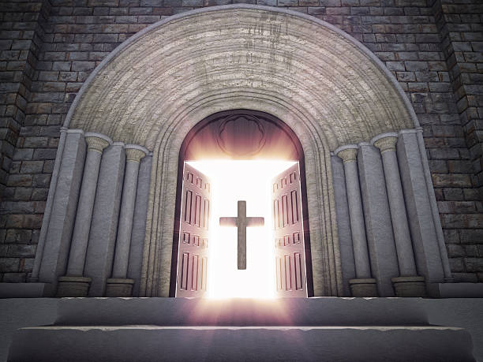
Doors of the church are open: “REID TEMPLE CARES”

