Slide 1
Building the “BELOVED COMMUNITY”
The Vision
Reid Temple AME Church is a Bible Believing, Christ-centered, Family – Integrated, Multigenerational, Culturally aware church, spreading the gospel of Jesus Christ while “Building the Beloved Community”.
Rom.8:38 For I am persuaded, that neither death, nor life, nor angels, nor principalities, nor powers, nor things present, nor things to come, Nor height, nor depth, nor any other creature, shall be able to separate us from the love of God, which is in Christ Jesus our Lord.

Slide 2
1. The Widow’s Wealth - 9/14
2. God's Will in Finances - 9-21
3. The Perils of Money- 9/28
4. Release from Financial Slavery - 10/5
5. Financial Planning - God's Way (Part 1)- 10/12
6. Financial Planning - God's Way (Part 2) - 10/26
7. God Wants You to Prosper – 11/2
8. Sharing God's Plan with the Next Generation- 11/9

Slide 3
God wants you to prosper!
Dr. Mark E. Whitlock, II
Andrea Jackson, Director of faith and finance
Reid Temple AME Church

Slide 4
Course objectives: god wants you to prosper!
Prayer
Introduction to the lesson
God’s attitude about money!
Why People want to prosper!
Andrea Jackson – Faith and Finance
Questions, comments, and answers
Thank you….

Slide 5
God’s attitude about money
1 Timothy 6:18 Command them to do good, to be rich in good deeds, and to be generous and willing to share.
Money can yield comfort and convenience and can provide resources for spreading the gospel. Accumulation of wealth means making, using, and spending money…
The love of money can ruin marriages, separate families, spoil children, and breed greed. Therefore, it is vitally important to understand God’s principles for accumulating wealth.
List five reasons why you think people accumulate money:
1. ___________________
2. ___________________
3. ___________________
4. ___________________
5. ___________________

Slide 6
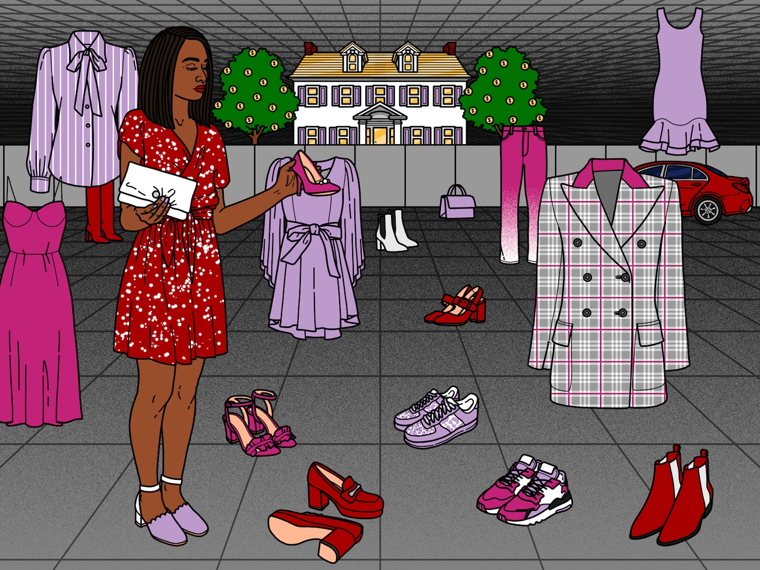
Why people want to accumulate money
Some are advised to:
Proverbs 15:22 Plans fail for lack of counsel, but with many advisers they succeed.
Why are we advised to seek counsel? __________
Proverbs 14:15 The naïve believes everything, but the sensible man consider his step?
What does the sensible person do?_____________
2. Some Accumulate out of envy:
Psalm 73:2 But as for me, my feet had almost slipped; I had nearly lost my foothold. 3 For I envied the arrogant when I saw the prosperity of the wicked.
According to the scripture, what might happen?_________

Slide 7
Why people want to accumulate money
3. Some make a game of accumulating money
Proverbs 22:11One who loves a pure heart and who speaks with grace will have the king for a friend.
Matthew 16:26 What good will it be for someone to gain the whole world, yet forfeit their soul? Or what can anyone give in exchange for their soul?
Summarize the common theme in these verses:_______________________________________________________________________________________________________________________________________________________________

Slide 8
Why people want to accumulate money
4. Some accumulate money for self-esteem
1 Timothy 6:17 command those who are rich in this present world not to be arrogant nor to put their hope in wealth, which is so uncertain, but to put their hope in God, who richly provides us with everything for our enjoyment.
What are the rich told to avoid?________________________________________
How is wealth described? _______________________________________________
Who is our only hope?__________________________________________________
Proverbs 16:18 Pride goes before destruction, a haughty spirit before a fall.
What does pride ultimately lead to? _____________________________________
Money is only a tool!!!

Slide 9
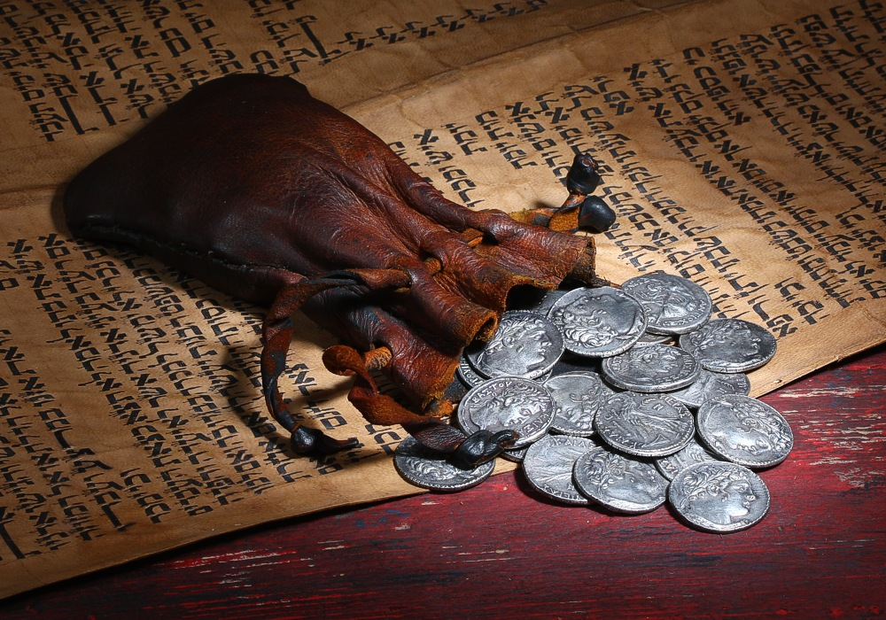
Why people want to accumulate money
5. Some accumulate money because they love money
Matthew 25:45“He will reply, ‘Truly I tell you, whatever you did not do for one of the least of these, you did not do for me.’ 46 “Then they will go away to eternal punishment, but the righteous to eternal life.”
Describe God’s warning?__________________________________
1 Timothy 6:10 For the love of money is a root of all kinds of evil. Some people, eager for money, have wandered from the faith and pierced themselves with many griefs
What is the real danger of greed?_________________________
Judas sold out Jesus for 30 shillings!

Slide 10
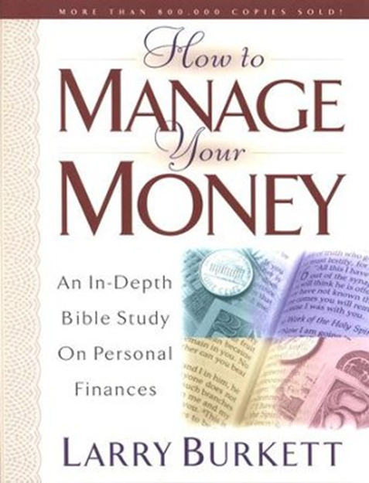
Seven reasons Why people want to accumulate money!
1. Some are advised to
2. Some accumulate out of envy
3. Some make a game of accumulating money
4. Some accumulate money for self esteem
5. Some accumulate money because they love money
6. Some accumulate money for protection
7. Some accumulate to supply spiritual gifts

Slide 11
Wealth Building Principles
Andrea Jackson
Money Coach

Slide 12
God wants us to prosper: Men Lie, Women Lie but numbers don’t lie
2,350
Estimated number of verses about money in the Bible
16 out of 38
Out of the 38 parables Jesus taught, 16 were about money
113, 190, 123
NIV displays the word money 113 times
Good News Bible displays the word money 190 times
King James Bible displays the word money 123 times

Slide 13
Myths & religious traditions
Money is the root of all evil
Jesus was poor and had nowhere to lay his head
1 Timothy 6:10 For the love of money is a root of all kinds of evil. Some people, eager for money, have wandered from the faith and pierced themselves with many griefs.
Luke 8:1-3 … ³ Joanna the wife of Chuza, the manager of Herod’s household; Susanna; and many others. These women were helping to support them out of their own means.

Slide 14
Myths & religious traditions
All preachers want is your money
When a person tithes (gives 10 percent of his or her income to God’s work) or gives extra offerings to further the cause of the gospel, God is automatically bound to meet all of that person’s financial requirements
Malachi 3: 10: Bring the whole tithe into the storehouse, that there may be food in my house. Test me in this,” says the lord almighty, “and see if I will not throw open the floodgates of heaven and pour out so much blessing that there will not be room enough to store it.
Matthew 25:23: His lord said to him, ‘well done, good and faithful servant; you have been faithful over a few things, I will make you ruler over many things. Enter into the joy of your Lord.’
3 John 2: Beloved, I pray that you may prosper in all things and be in health, just as your soul prospers.

Slide 15
Does God Wants Us to Prosper?
3 John 2: Beloved, I pray that you may prosper in all things and be in health, just as your soul prospers.
YES!

Slide 16
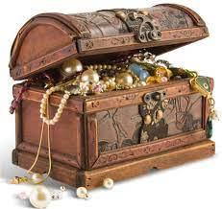
PRACTICAL WAYS TO PROSPER
Time
Talents
treasure

Slide 17
Time: 168 hours in a week

Slide 18
168 Hours in a Week
Subtract time for:
8 hours a day for work = 40
2 hours/ day Driving/running errands = 14
1 hour/day Exercising = 7
2 hours/day Family Time = 14
2 hours/day Homework/activities = 14
1 hour day Self-Care = 7
7 hours/day Sleep = 49
5 hours/week Socializing = 5
EQUALS = 150 HOURS A WEEK
Notes:
How many hours are remaining? (Select those activities that are applicable)
Winners find a way to win

Slide 19
18 Hours a Week
TO PROSPER YOUR SOUL
FELLOWSHIP
MEDITATION
DEVOTION
BIBLE STUDY
VOLUNTEER
Notes:
How many hours are remaining? (Select those activities that are applicable)
Winners find a way to win

Slide 20
Talent: what are you good at and how can that glorify god & uplift the kingdom Luke 10:2-He told them, “The harvest is plentiful, but the workers are few. Ask the Lord of the harvest, therefore, to send out workers into his harvest field.
Notes:
We don’t plan to fail, we fail to plan

Slide 21
Treasure 10% tithe
Manage the 90%

Slide 22
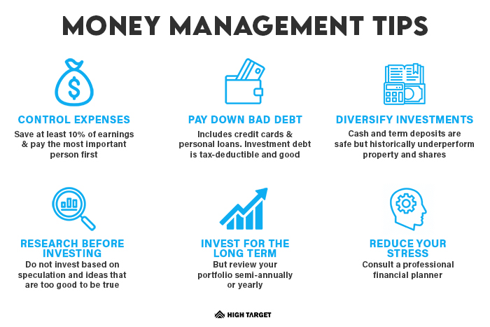

Slide 23
Stop Justifying: God only ask for 10% but ….
Store Credit Card | Interest
Macy’s | 26.99%
Target | 25.15%
Sears | 26.74%
JC Penny | 26.99%
Best Buy | 26.49%
PayPal | 25.99%
Amazon | 27.49%
Walmart | 22.90%

Slide 24
10/10/80 rule
10% Tithes
10% Personal Savings
80% Everything Else
Example:
Client’s income is $1,500 per pay
10% Tithe $150
10% Personal Savings $150
80% Everything Else $1,200

Slide 25
THE COMMITMENT
To get my financial house in order, I realize I must do
my part in order for God to do His part. I hereby make
the following commitments:
1. I commit to changing the attitude and lifestyle that keeps me in financial bondage, and I dedicate myself to becoming a good steward over what God has already entrusted to my care.
2. I commit to using faith to break the spirit of poverty, to get out of debt (surety), and to expect God to bring financial increase in my life.
I commit to establishing a surplus account by spending less than I earn and setting aside something first from each paycheck to give. Suggestion, if not immediately 10%: 10 months to the Tithe!!!
November/December = 2%
January/February = 4%
March/April = 6 %
May/June = 8%
July/August = 10%
Signature:___________________________
Please print name:

Slide 26
Why tithe?
Galatians 6:2
Bear one another’s burdens, and so fulfill the law of Christ.

Slide 28
Questions and answers
This Photo by Unknown Author is licensed under CC BY-SA

Slide 29
1. The Widow’s Wealth - 9/14
2. God's Will in Finances - 9-21
3. The Perils of Money- 9/28
4. Release from Financial Slavery - 10/5
5. Financial Planning - God's Way (Part 1)- 10/12
6. Financial Planning - God's Way (Part 2) - 10/26
7. God Wants You to Prosper – 11/2
8. Sharing God's Plan with the Next Generation- 11/9

