Slide 1
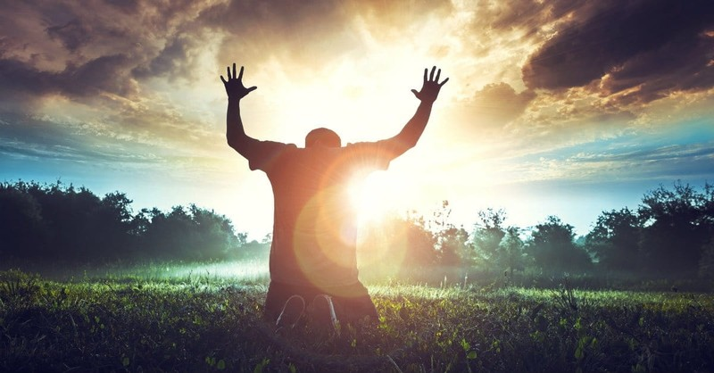
Wake Up to Dream Higher in God!
Dr. Mark E. Whitlock, Jr.
Reid Temple AME church

Slide 2
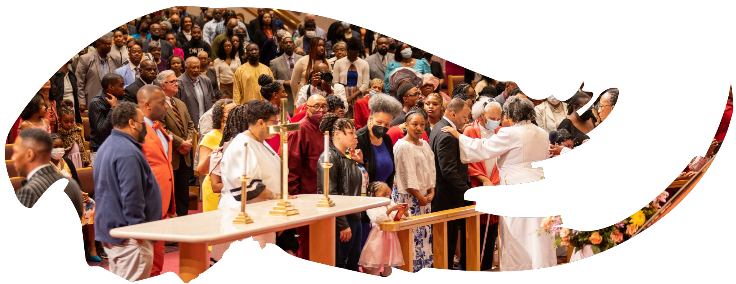
Our Core Values
Faith in GOD
Integrity, Trust and Ethical Behavior
Empowering people
Excellence and Innovation
Christ –centered Leadership

Slide 3
The Vision
Reid Temple AME Church is “Building the Beloved Community” by becoming a Bible Believing, Christ-centered, Family – Integrated, Multigenerational, Culturally aware church, spreading the gospel of Jesus Christ.

Slide 4
Our Strategic Goals
Membership Growth
Debt Free for Thee
Motivated and Skilled Staff & Volunteers
Community Commitment
New Demographic & Market Penetration

Slide 5
Overall Goals for 2023 -2024
Increase attendance to Bible Study
Increase baptisms
Increase the number of tithers
Increase the number of Disciples
Increase the number of servant leaders
Increase member and community engagement

Slide 6
WAKE UP TO DREAM HIGHER IN God!
Dr. Mark E. Whitlock, Jr.
Reid Temple AME church

Slide 7
Course objectives: Wake Up to Dream Higher in God!
Prayer
Holy Scriptures – Gen. 15:1-10
God gave Abram commands through dreams and visions.
God speaks in Dreams and visions.
ReM Sleep is better for Dreaming Higher.
Altar call
Salvation and Offering
Thank you….

Slide 8
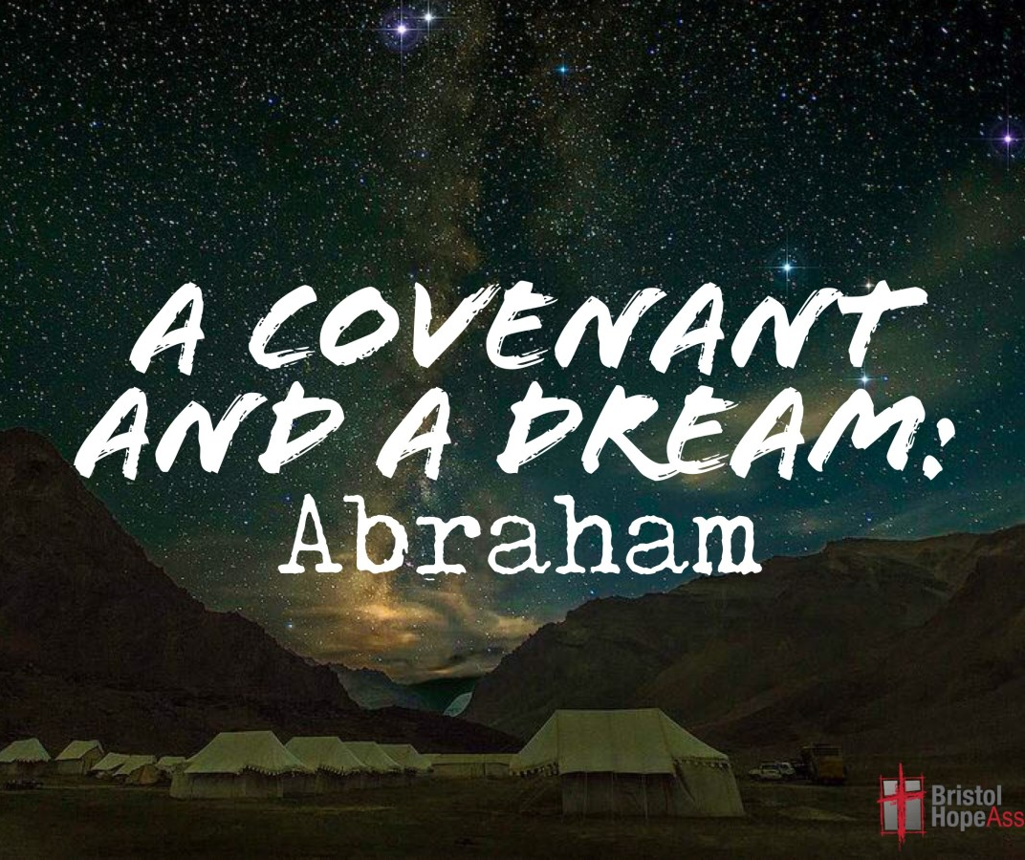
The Holy Scriptures
Gen. 15 After these things the word of the Lord came unto Abram in a vision, saying, Fear not, Abram: I am thy shield, and thy exceeding great reward. 2 And Abram said, Lord God, what wilt thou give me, seeing I go childless, and the steward of my house is this Eliezer of Damascus? 3 And Abram said, Behold, to me thou hast given no seed: and, lo, one born in my house is mine heir. 4 And, behold, the word of the Lord came unto him, saying, This shall not be thine heir; but he that shall come forth out of thine own bowels shall be thine heir. 5 And he brought him forth abroad, and said, Look now toward heaven, and tell the stars, if thou be able to number them: and he said unto him, So shall thy seed be. 6 And he believed in the Lord; and he counted it to him for righteousness. 7 And he said unto him, I am the Lord that brought thee out of Ur of the Chaldees, to give thee this land to inherit it. 8 And he said, Lord God, whereby shall I know that I shall inherit it? 9 And he said unto him, Take me an heifer of three years old, and a she goat of three years old, and a ram of three years old, and a turtledove, and a young pigeon. 10 And he took unto him all these, and divided them in the midst, and laid each piece one against another: but the birds divided he not.

Slide 9
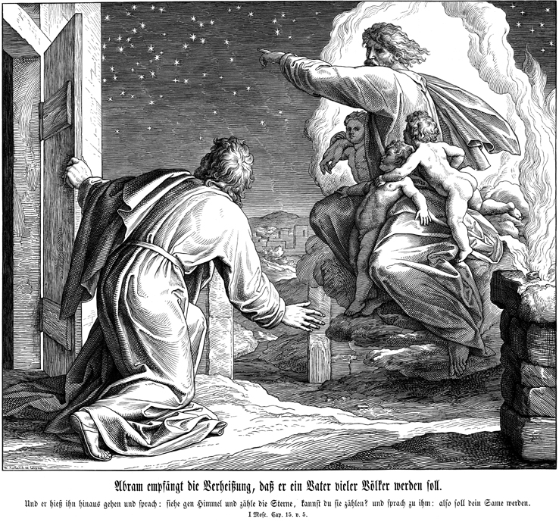
God gave Abram commands through dreams and visions.
Ur of the chaleans was the Sumerian city of UR.
Genesis 12:1-9, God's promise Abram a land, a nation, notoriety, and a blessing and curse those who curse you and all people receive a blessings through you.
Gen. 15:1 God guided Abram to have no fear, God is a shield.
Gen. 15:4, Abraham and Sarah were childless (a real source of shame in that culture), yet God promised that Abraham would have a son.
Gen. 17, God gave Abram and Sarai new names along with the covenant of circumcision and a renewed promise to give him a son through Sarai.
Gen. 22:3, God commands Abraham to sacrifice Isaac on the top of Mount Moriah.
Heb. 11:8-10, Abraham is a living example of faith and hope in the promises of God.

Slide 10
God speaks in Dreams and visions
Abimelech (Genesis 20:1-7): God sent him a dream telling him not to touch Sarah because she was Abraham’s wife.
Jacob (Genesis 28:10-17): God sent him a dream of a ladder reaching to heaven on which angels ascended and descended and that God’s promise that Abraham’s blessing would be carried on through him.
Joseph (Genesis 37:1-11): God sent him a dream that Joseph’s family would one day bow to him in respect.
Zacharias (Luke 1:5-23): God used a vision to tell Zacharias, an old priest, that he would soon have an important son.
Joseph (Matthew 1:20; 2:13):God sent an angel to him in a dream, convincing him that the pregnancy was of God and God sent two more dreams, one to tell Joseph to take his family to Egypt so Herod could not kill Jesus and another to tell him Herod was dead and that he could return home.

Slide 11
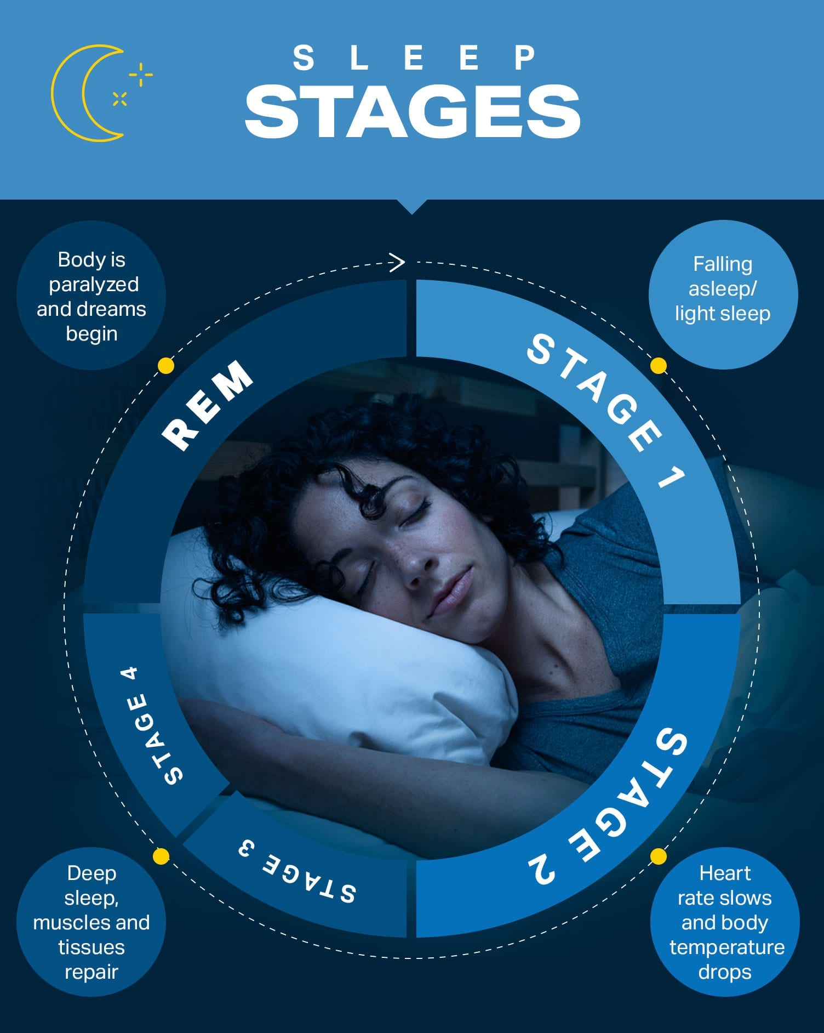
ReM Sleep is better for Dreaming Higher
Rapid eye movement sleep, also known as REM sleep, is one of the 4 stages of sleep (along with wake, light, and deep sleep) that your body cycles through on a nightly basis. The REM stage is when you get your “mentally restorative” sleep, and it is when the brain converts short-term memories from the day into long-term ones. We’ll discuss the value of REM sleep and how much is normal, then share a number of things you can do to improve it.
Meditate on God’s word before bed. ...
Hydrating properly over the course of the day (not before bed, which can disrupt sleep for trips to the bathroom)
Develop a sleep schedule . ...
Don't drink caffeine or smoke cigarettes later in the day. ...
Avoid alcoholic, marijuana, antidepressants, and sleep aids. ...
Get regular exercise . ...
Create an ideal environment for sleep. ...
Read the Bible before going to bed…
Wake Up prepared to activate the dream!!!!

Slide 12
Let’s pray
Come to the altar to pray for pastor, staff, ministers, ministry leaders, officers and members.

Slide 13
Questions and answers
This Photo by Unknown Author is licensed under CC BY-SA

Slide 14
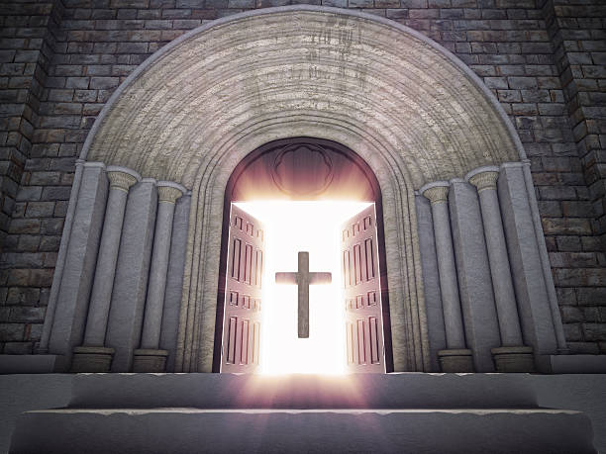
Doors of the church are open: “REID TEMPLE CARES”

